Slide 1

Analytical Study of Inventory Management and Customer Retention at XYZ Computers
Business Data Management Capstone Project
IITM Online BS Degree Program
Name: Maitri Jain | Roll Number: 23f2003837

Slide 2
Organization Background: XYZ Computers
Business: XYZ Computers, Kolkata (est. 1997)
Products: Printer supplies, cartridges, peripherals, consumables
Nature: Mid-sized IT distributor (B2B offline + B2C via Amazon)
Team: ~5 employees, sourcing from suppliers like Prodot, P.C. Forms etc.
Challenges: Inventory inefficiencies, supplier instability, online competition

Slide 3
Analyze B2B vs B2C sales, segment customers, and evaluate promotional impact.
Project Objectives
Optimize Inventory Inefficiency
Enhance Customer Retention & Competitiveness
Mitigate Supplier Volatility & Return Risks
Identify high-value SKUs, minimize dead stock, and improve turnover.
Assess supplier dependency, price fluctuations, and propose strategies for stability.
Challenges in retaining customers amidst rising online competition.

Slide 4
Data Collection
Sources (Apr 2024 – Jan 2025)
Stock Data (Inventory Ledger) → PRODUCT, QTY, UOM, RATE, AMOUNT, PRICE BRACKET
Purchase Data (Supplier Register) → DATE, PARTY, QTY, GROSS VALUE, GST_AMT, RATE
Sales Data (Debtors Ledger) → PARTY NAME, DATE, CREDIT Later split into B2B and B2C (Amazon = B2C, others = B2B)
Dataset | Key Columns | Records (approx.)
Sales | PARTY NAME, DATE, CREDIT (split B2B/B2C) | ~974
Inventory | PRODUCT, QTY, UOM, RATE, AMOUNT, PRICE BRACKET | ~417
Purchases | DATE, PARTY, QTY, GROSS VALUE, GST_AMT, RATE | ~834
Process
Primary Data: Directly collected from XYZ Computers’ internal PDF ledgers
Transformation: Main task = PDF → Excel using “Get Data from PDF” + manual formatting
Cleaning: Removed duplicates & blanks Standardized dates (MMM-YY) Unified party/SKU names Consolidated state-wise B2C into monthly totals
Prepared datasets were used for Inventory Optimization, Customer Retention, and Supplier Stability analyses.

Slide 5



Methodology & Tools
MS Excel chosen (small dataset ~1,000 rows, transparent & usable by business owner)
Optimize Inventory
Enhance Customer Retention
Mitigate Supplier Risk
ABC Classification : focus on high-value SKUs
Exponential Smoothing (Sales Forecast) : predict future demand
Inventory Turnover Ratio : identify fast vs dead stock
B2B vs B2C Sales Trend : compare channels over time
Customer Frequency Segmentation : spot repeat vs one-time buyers
Promotions Impact Analysis : measure effect of festive offers
RFM Segmentation : identify loyal vs at-risk customers
Supplier Price Variance Analysis : detect cost fluctuations
Supplier Risk Matrix : evaluate dependency & volatility

Slide 6
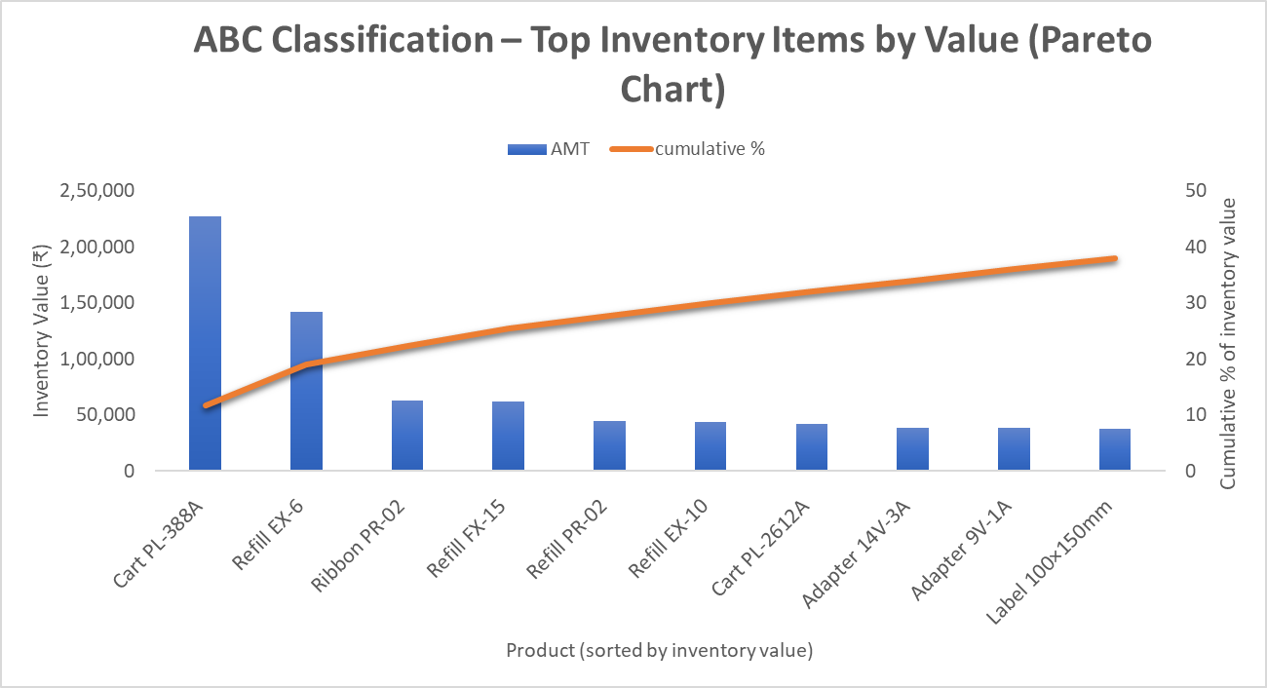
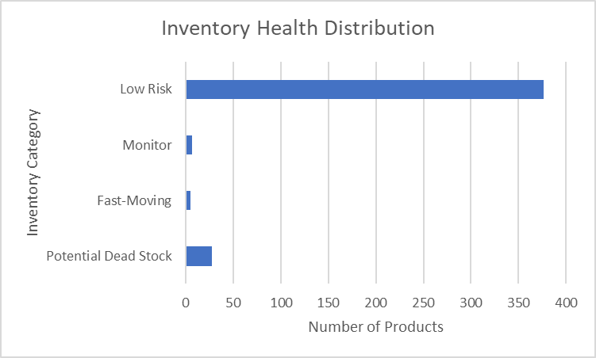
Inventory Insights:
High Concentration & ₹1.2L Dead Stock
Fig 1- ABC Classification
Fig 2- Inventory Turnover
A-class SKUs (20%) → 70% value
Dead stock: 28 items, ₹1.2L blocked
Only 5 fast-movers, rest underutilized
Forecast: ₹8.45L/month (Feb–Apr 2025)

Slide 7
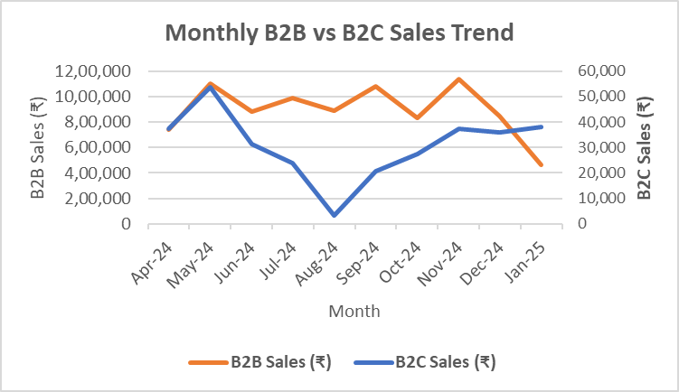
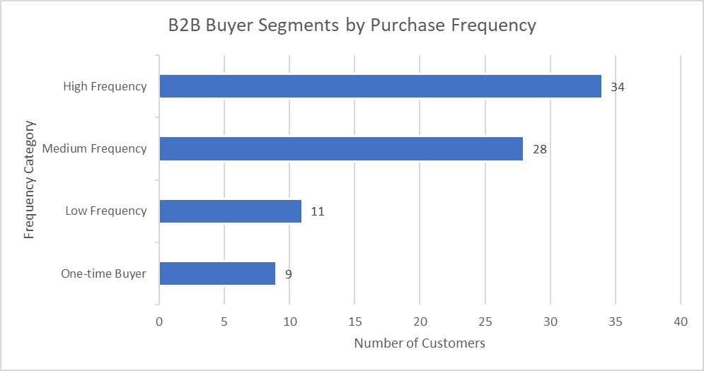
Customer Insights:
Heavy B2B Dependence, Emerging B2C Growth
Fig 3- B2B vs B2C Sales Trend
Fig 4- Customer Frequency & RFM
B2B = 80–90% revenue; Top 3 clients = ₹6L+
B2C share grew from 2% → 7.6% (Jan 2025)
Festive spike: +558% B2C in Oct–Nov (Diwali)
RFM: 3 Champions; several At Risk customers

Slide 8
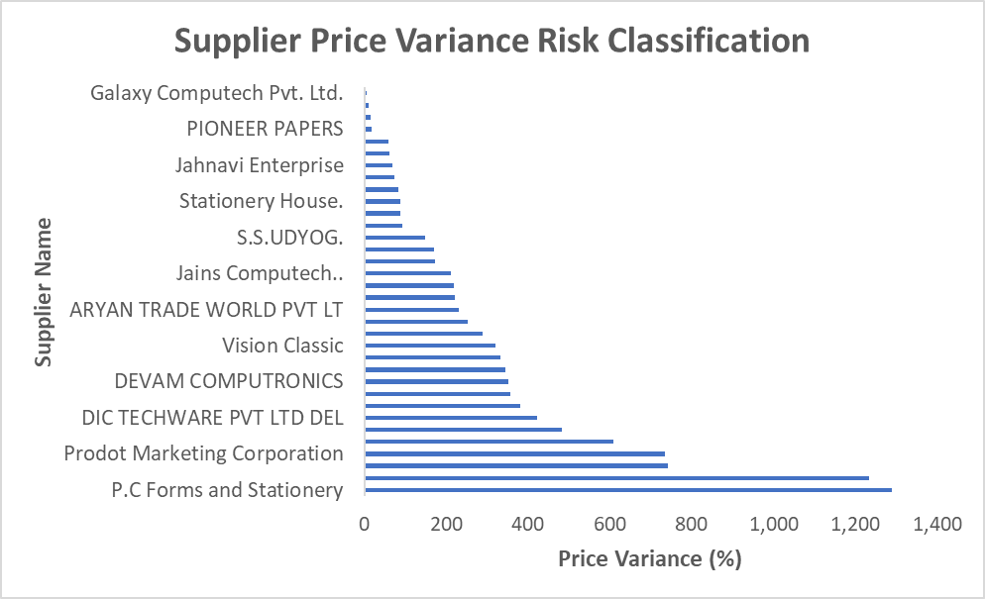
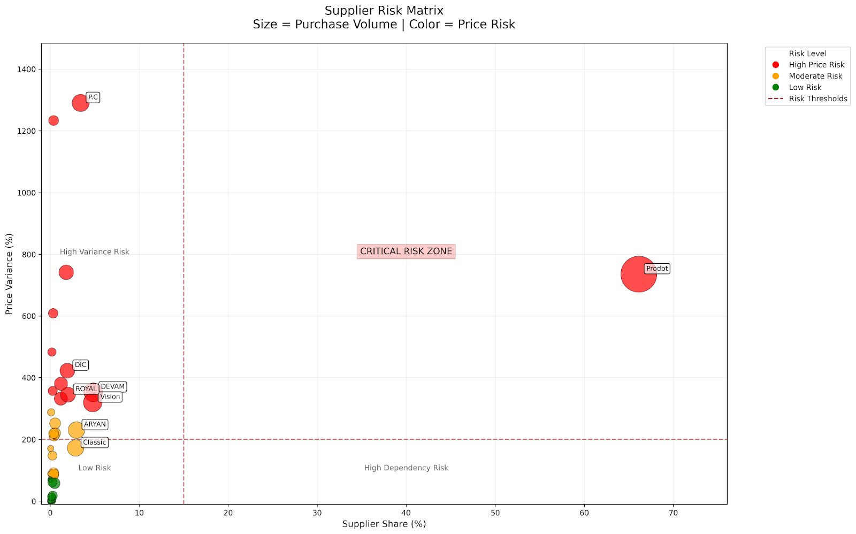
Supplier Insights:
66% Dependency & High Price Variance
Fig 5- Price Variance Analysis
Fig 6- Supplier Risk Matrix
66% procurement from Prodot (~₹1.1 Cr spend)
Price variance across suppliers: ₹735 – ₹1290
High Spend + High Variance suppliers = risk zone
Overdependence increases vulnerability

Slide 9
Interpretation & Recommendations
Inventory Management
Customer & Channel Performance
Supplier & Procurement
Dead stock (₹1.2L) → clearance or bundling offers
Focus on A-class SKUs for tighter control
Use forecast (~₹8.45L/month) for purchase planning
Reduce over-dependence on top 3 B2B clients
Retain “Champions” with loyalty discounts
Convert “At Risk” customers via targeted promotions
Scale B2C through Amazon + festive offers
Diversify to reduce 66% dependency on Prodot
Negotiate fixed-price contracts to handle volatility
Monitor supplier risk quarterly

Slide 10
Conclusion & Next Steps
Project Impact:
Identified ₹1.2L tied in dead stock
Quantified B2B dependency vs B2C growth potential
Exposed 66% supplier dependency & price variance risk
Data-driven insights → immediate actions in inventory, sales, and procurement
Next Steps:
Automate dashboards for monthly monitoring (Excel/Power BI)
Extend analysis to returns data & customer feedback
Explore supplier benchmarking for cost efficiency

