Slide 1
PROJECT 11 / BUSINESS ANALYTICS
MSME INDIA 360° ANALYSIS
Which Indian States Have the Strongest MSME Ecosystem?
A data-led view of registrations, credit support and employment.
Group Members:
Dhaval Sharma (AIDS20262001)
Khushi Shah (AIDS20262003)
Maitri Jani (AIDS20262004)
Nishant Purohit (AIDS20262007)
Riti Tripathi (AIDS20262010)
01
02
03
REGISTRATIONS
CREDIT
EMPLOYMENT
Where businesses are
How finance is distributed
Where jobs are created
SQL Server • Python / Pandas / NumPy • 36 States & UTs

Slide 2
Data & Analytical Approach
Three state-wise datasets combined into one decision-support view
01
02
03
Registrations
Credit support
Employment
Micro, small and medium enterprise counts;
total registrations and micro share.
Loan counts, sanctioned/disbursed amounts,
disbursement rate and average credit.
Male/female employment, total workforce,
female share and employment per MSME.
Workflow
1
Profile & validate
2
Standardize state
names
3
Analyze with
SQL / Python
4
Merge all 3 datasets
5
Interpret business
patterns
Validation reported: no nulls or duplicate rows; registration totals reconciled; state/UT sets matched; final merged dataset contains 36 rows.

Slide 3
Executive Summary
A 360° view of MSME registrations, credit support and employment
HIGHEST REGISTRATIONS
HIGHEST TOTAL CREDIT DISBURSED
HIGHEST MSME EMPLOYMENT
CREDIT GAP FLAG
2.21M
₹33,473 Cr
7.78M
20 / 36
Uttar Pradesh
Maharashtra
Maharashtra
55.6% under project rule
What stands out
The Central Takeaway
• MSME scale, credit and employment leadership do not always
sit with the same state.
A strong MSME ecosystem cannot be judged by
registration counts alone. The combined view helps
identify where further investigation into credit access
and job creation may be valuable.
• 20 of 36 States/UTs fall below the project’s average-credit benchmark.
• Only five States/UTs meet the project’s MSME Leader criteria.

Slide 4
MSME Registration Landscape
Where is the registered enterprise base concentrated?
Top states by total MSME registrations
#1 BY REGISTRATIONS
Uttar Pradesh
2.21 million registered MSMEs
MICRO ENTERPRISE SHARE
91.6%
Average across the 36 States/UTs
Business Interpretation
Registration scale indicates presence
not necessarily productivity or financial health.

Slide 5
Credit Support: Scale vs Reach
Total disbursement and credit per MSME answer different questions
Top states by total credit disbursed (₹ crore)
AVERAGE DISBURSEMENT RATE
86.5%
Across the dataset
HIGHEST AVERAGE CREDIT PER MSME
₹2.07 lakh
Dadra & Nagar Haveli and Daman & Diu
Credit-gap signal
20 of 36 States/UTs (55.6%) are below the average-credit threshold of ₹ 1.1 lakh.

Slide 6
MSME Employment
Total jobs, jobs per enterprise and women’s participation
Top states by total MSME employment
HIGHEST TOTAL EMPLOYMENT
7.78 million
Maharashtra
HIGHEST EMPLOYMENT / MSME
3.97
Gujarat and Maharashtra
AVG. NO. OF EMPLOYEES / MSME
2.85

Slide 7
MSME Inclusion
Women's participation in MSME employment remains relatively low
Business insight:
The MSME sector has an opportunity to improve women's participation in the workforce.
Increasing women's participation can help businesses access a wider talent pool.
Average female employment share: 25.82%.
Kerala has the highest female employment share at 36%.
Bihar the lowest at 17%.
Even the highest state-level share is below 40%.
Business opportunity: Financial institutions, government agencies, and MSME support organizations can develop targeted programs to encourage women's participation in the sector.

Slide 8
The 360° View: Different States, Different Strengths
Combining indicators reveals patterns a single ranking can miss
Dadra & Nagar Haveli and Daman & Diu
Maharashtra
₹2.07 lakh average credit per MSME
₹1.71 lakh average credit per MSME
3.42 employees per MSME
3.97 employees per MSME
What this comparison suggests
Higher average credit does not automatically correspond to higher employment per MSME.
The pattern invites further analysis; it does not establish cause and effect.
5
MSME Leaders
20
Credit Gap flags
6
Employment Gap flags

Slide 9
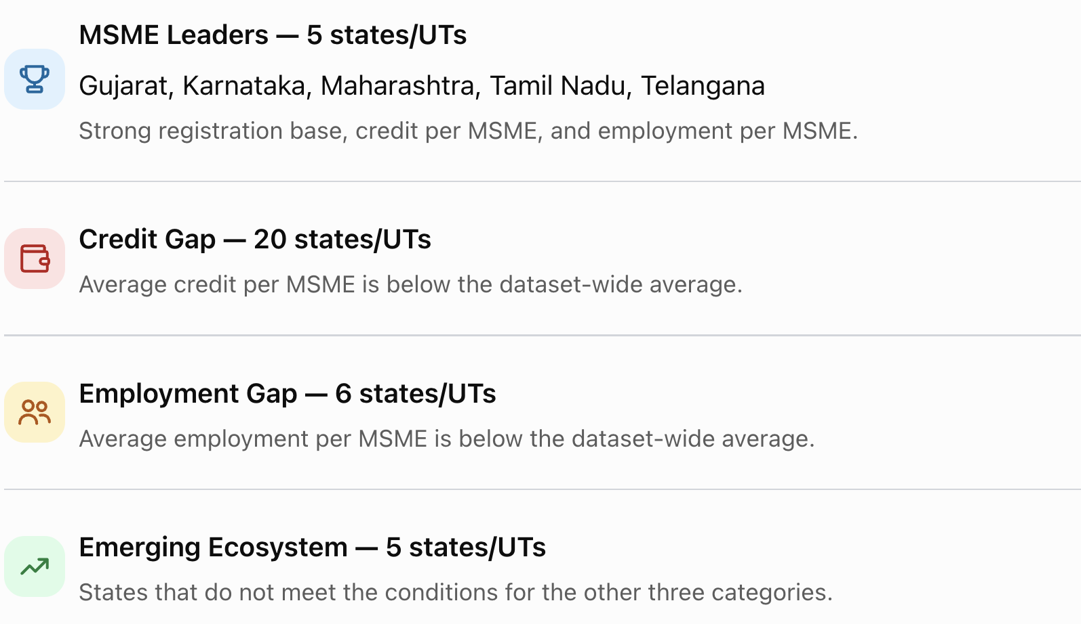
Key Insight on MSME category analysis
Combining indicators reveals patterns a single ranking can miss

Slide 10
Business Recommendations
Use the analysis to prioritize investigation—not jump to unsupported conclusions
01
Validate credit constraints
Review loan applications, rejections and unmet financing needs in states below
the average-credit benchmark.
02
Investigate job creation
Compare sector mix, enterprise size and employment trends in states flagged
for lower average employment.
03
Learn from ecosystem leaders
Study Gujarat, Karnataka, Maharashtra, Tamil Nadu and Telangana to
identify practices worth testing elsewhere.
04
Explore inclusion patterns
Investigate factors behind differences in female employment share
before designing interventions.

Slide 11
Conclusion & Next Steps
From descriptive analysis to evidence-led decisions
What we learned
Important limitations
• Uttar Pradesh leads the dataset in MSME registrations.
• Descriptive, state-level data only
• Below-average values are screening flags
• Associations do not prove causation
• More data is needed on loan demand,
industry mix and business outcomes
• Maharashtra leads total credit disbursement and total MSME employment.
• Credit and employment indicators vary across states; one ranking is not enough.
• The project’s rule-based classifications help flag states for closer investigation.
Final message: measure the ecosystem across registrations, finance and jobs—then investigate the gaps with targeted evidence.

