Slide 1
Analysis of Student participation in E-learning and academic Performance
Student: Maitriben D Shah (200510593)
Behnush Kiani (200491333)

Slide 2
Introduction
This project is based on “Relationship between Student Engagement and Performance in e-Learning Environment Using Association Rules” Research paper.
Used Apriori FUI Algorithm.

Slide 3
Motivation
Sudden shift towards online learning during Covid-19 pandemic.
Increased used of smart devices for education.
Improve performance of online or e-learning students.
To make e-learning interesting, engaging and fun.

Slide 4
Project Goals
Analyse the relationship between student engagement in online education and their academic performance.
Analyse the steps that can be taken to improve their academic performance.

Slide 5
Executive Summary
Implementation of Two-phase will result in decide whether online education make a negative or positive impact.
Key incentive is to decide which factor(feature) affect the performance of the student the most.
Online study environment is the key predictor of low engagement.

Slide 6
Approach
Use of a quantitative dataset to evaluate frequency metrics.
Creating Utility table for Two-phase with trial and error method to achieve desired outputs.
Tuned the hyper parameter(Minimum threshold) to generate best possible High Utility Itemsets.

Slide 7
Model description
Collect and pre-process the dataset.
Apply two-phase
Generate HUI for the features

Slide 8
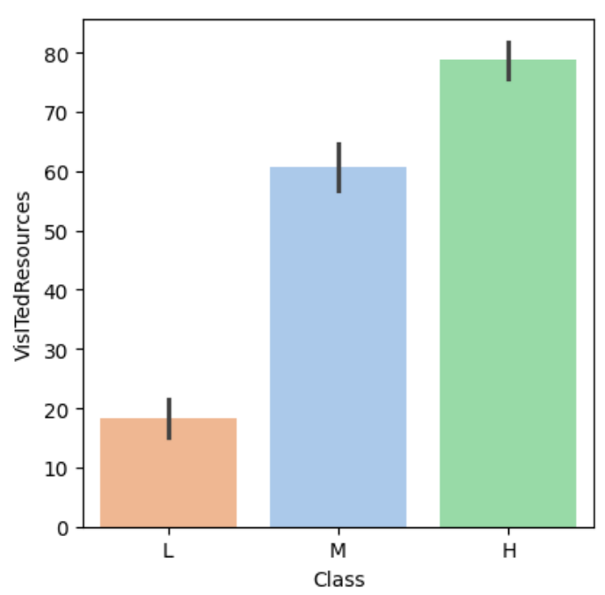
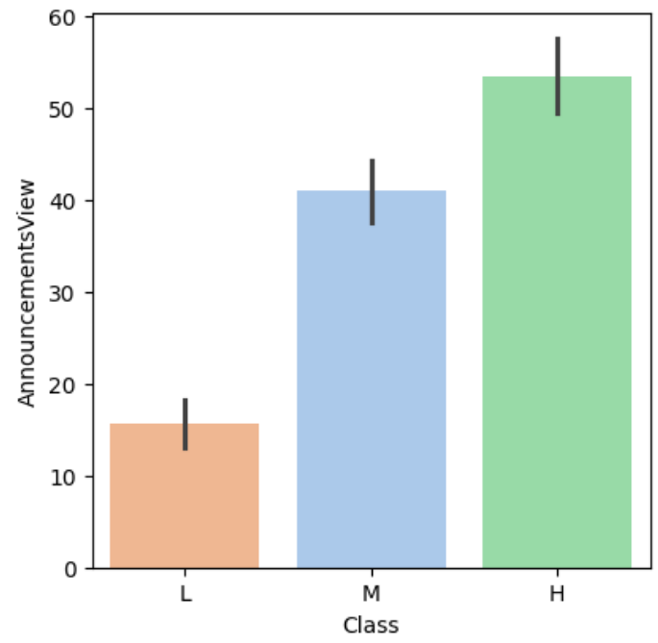
Key Points:

Slide 9
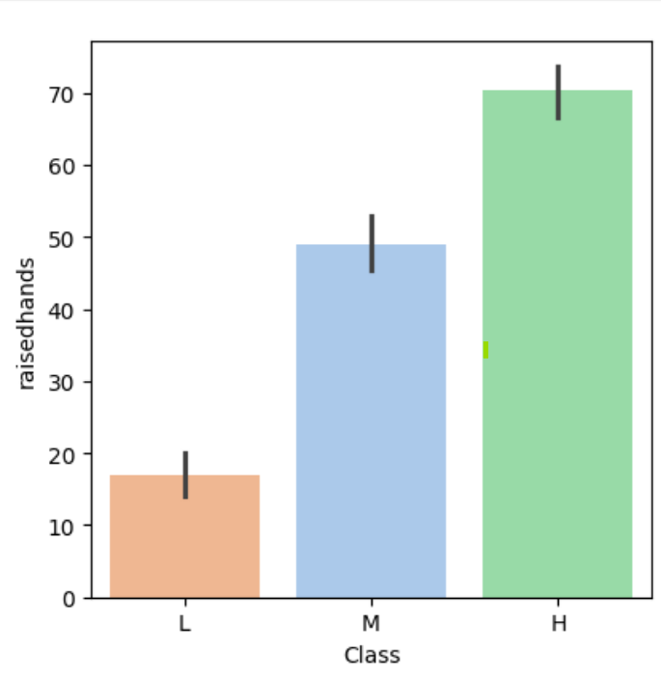
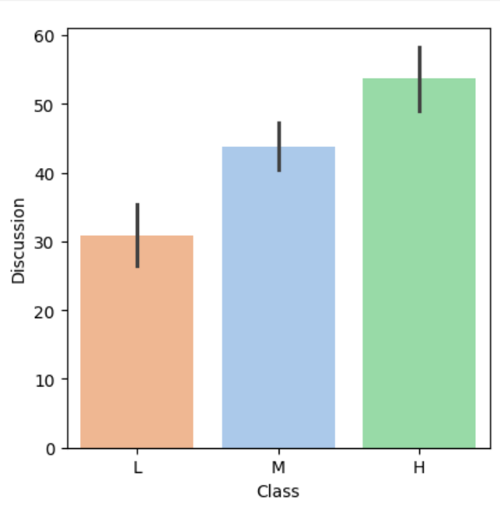
Key Points(cont.)

Slide 10
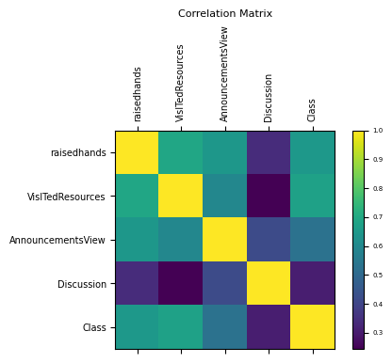
Key points(cont.)

Slide 11
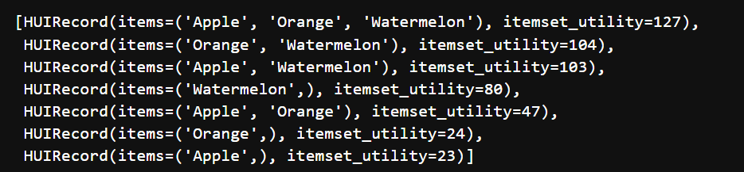
Model details(Example)
_{Tid} ^{Items} | Apple | Orange | Plum | Watermelon
T₁ | 0 | 8 | 0 | 1
T₂ | 8 | 0 | 6 | 2
T₃ | 5 | 2 | 1 | 2
T₄ | 10 | 2 | 0 | 0
T₅ | 0 | 0 | 0 | 2
T₆ | 0 | 0 | 2 | 1
Product | Price (in $/unit)
Apple | 1
Orange | 2
Plum | 3
Watermelon | 10
Utility Table
Transaction Database
TID | TU
T₁ | 26
T₂ | 46
T₃ | 32
T₄ | 14
T₅ | 20
T₆ | 16
Transaction Utility (TU)
High Utility Itemsets: MinUtil = 20

Slide 12
Software and tools Used:
Python 3.8
Libraries:
Numpy
Pandas
Matplotlib
Operator
Itemset mining(for two-phase)
Seaborn
SciPy
Sklearn

Slide 13
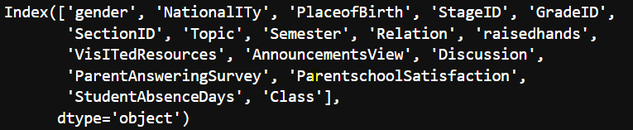
Dataset
The dataset is from: https://www.kaggle.com/datasets/aljarah/xAPI-Edu-Data
This dataset is created through Learning Management System called Kalboard 360.
The dataset consist of Data of 480 students with 16 features and one target variable called class(Final Grade).

Slide 14
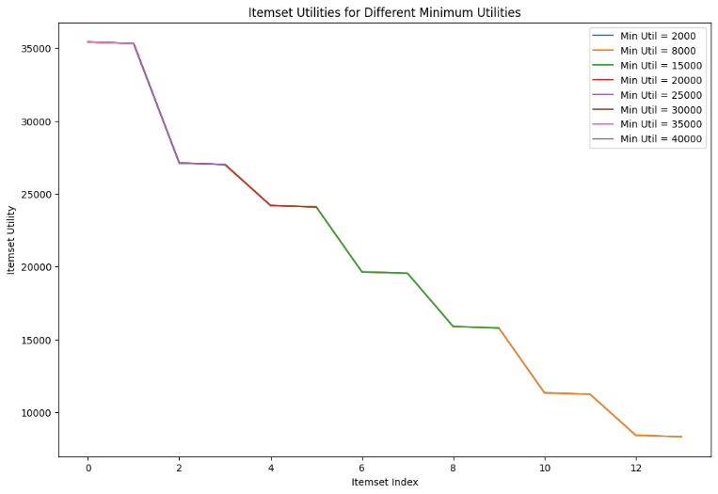
Application of Algorithm for different Minimum Utilities

Slide 15
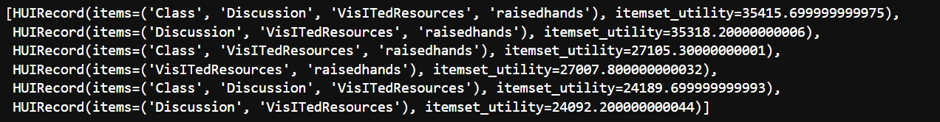
Analysis
From the graph: best minimum utility = 20000
Itemsets Class, Discussion, Visited Resources, Raised Hands has the maximum utility of just above 35K
Output

Slide 16
Findings
Positive relationship between student engagement and academic performance in online learning.
Analyse which student need help
Which activities make an impact and which does not.

Slide 17
Measures to Improve
Increase in activities can help
Different types of activities
Focusing on changing the online learning environment rather than just the academic results.

Slide 18
References
Relationship between Student Engagement and Performance in e-Learning Environment Using Association Rules
A Two-Phase Algorithm for Fast Discovery of High Utility Itemsets

Slide 19
Questions ?

