Slide 1
Specification Curves with Multiple Imputation

Slide 2
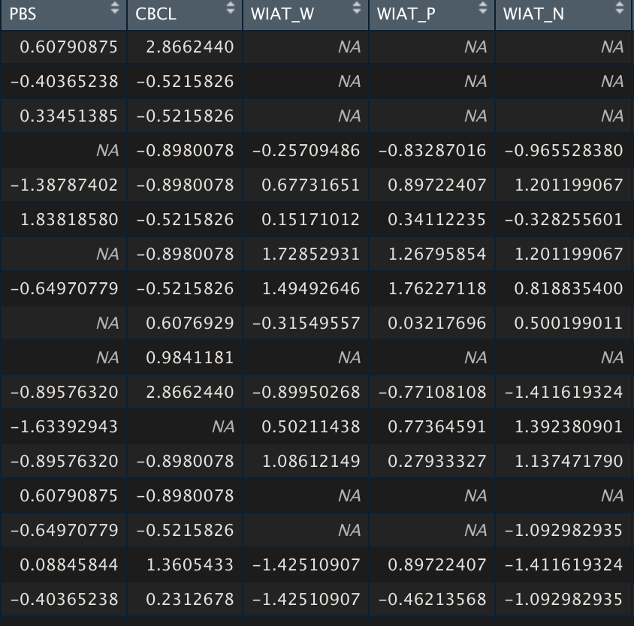
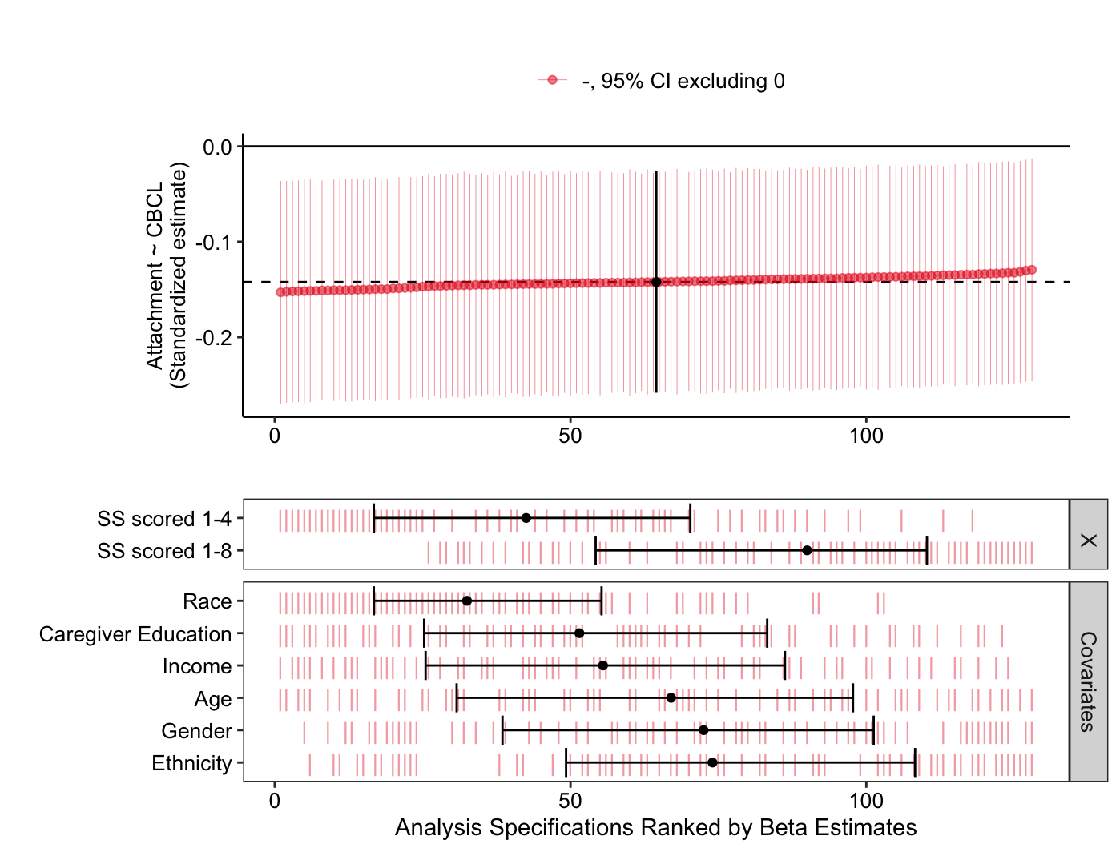
Learning Objectives
I have some missing data points. Should I use multiple imputations?
How do I actually perform multiple imputations?
Now that I have my imputed data sets, how do I analyze them?

Slide 3
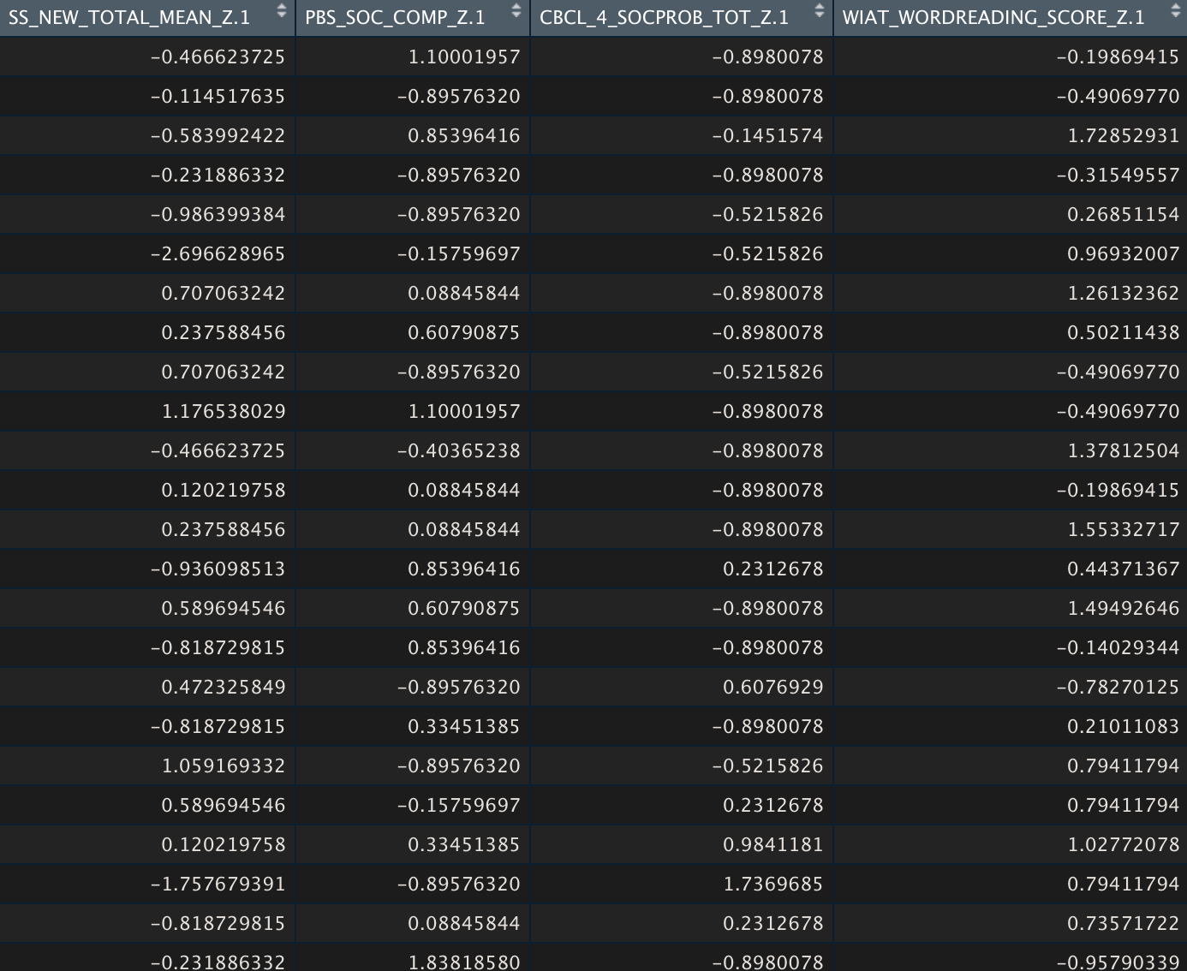
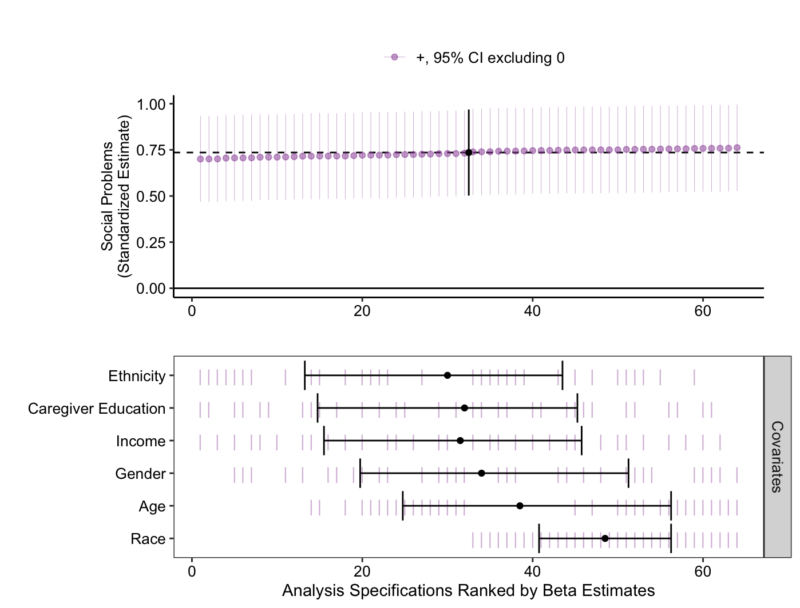
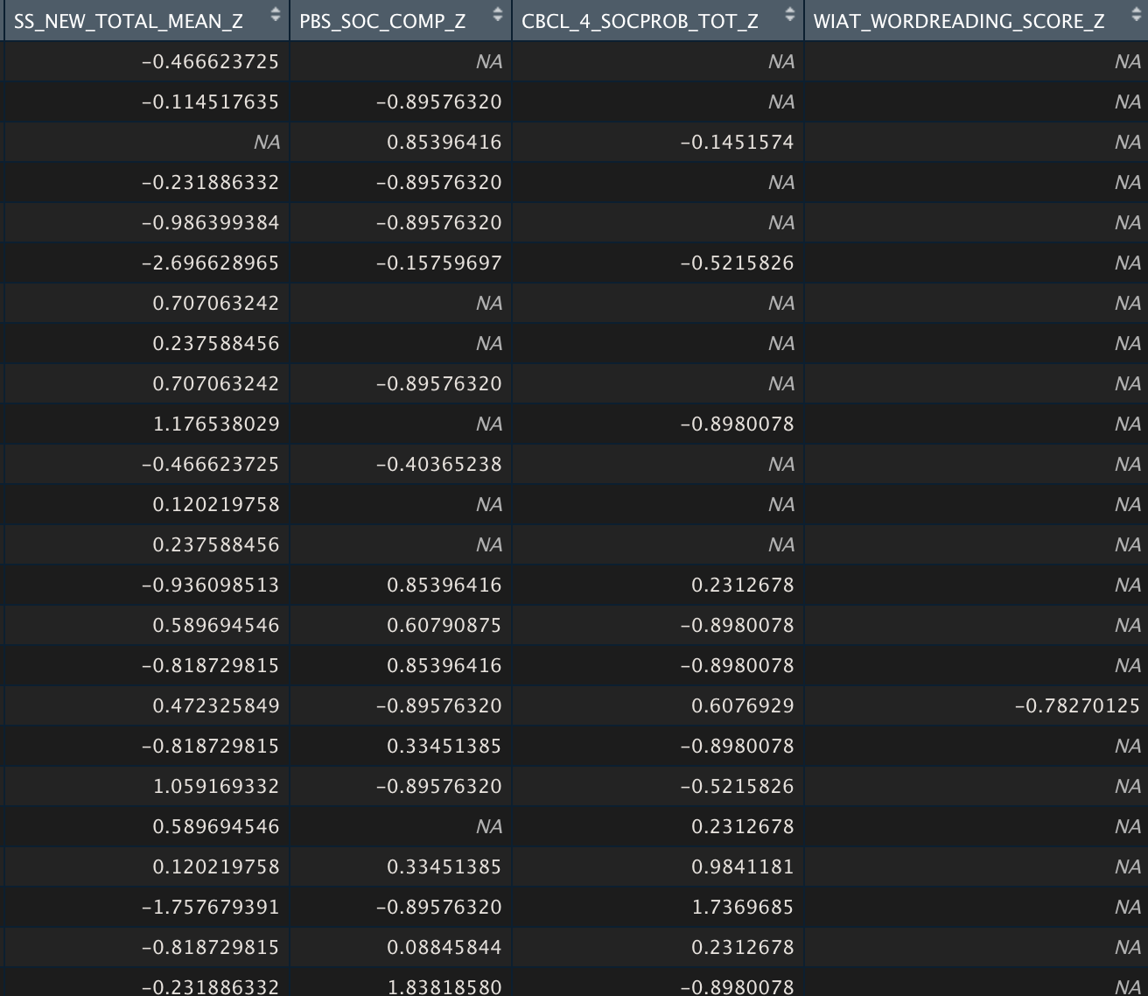

Slide 4
When to conduct multiple imputations?
How to conduct multiple imputations?
How to analyze imputed data?

Slide 5
Missing Data
How much missing data?
What type of missing data?
MCAR
MAR
MNAR
Listwise Deletion
Pairwise Deletion
FIML
Multiple Imputations
FIML
Multiple Imputations
Acknowledge the missingness
Do you want to do multiple imputations/FIML?
Getting to know your missing data
What to do about it?
Notes:
10%-40%

Slide 6
Missing Data
How much missing data?
What type of missing data?
MCAR
MAR
MNAR
Listwise Deletion
Pairwise Deletion
FIML
Multiple Imputations
FIML
Multiple Imputations
Acknowledge the missingness
Do you want to do multiple imputations/FIML?
Getting to know your missing data
What to do about it?
Notes:
10%-40%

Slide 7
Is too much of my data missing?
If more than 10% missing data, it can create bias in your results.
If more than 40% missing data, it should only be exploratory.

Slide 8
What type of missing data do I have?
Missing completely at random (MCAR)
Equal probability of any item missing.
Missing at random (MAR)
Missingness can be accounted for by other measured variables.
Missing not at random (MNAR)
We cannot account for missing values using measured variables.

Slide 9
Missing Data
How much missing data?
What type of missing data?
MCAR
MAR
MNAR
Listwise Deletion
Pairwise Deletion
FIML
Multiple Imputations
FIML
Multiple Imputations
Acknowledge the missingness
Do you want to do multiple imputations/FIML?
Getting to know your missing data
What to do about it?
Notes:
10%-40%

Slide 10
How do I deal with the missing data?
Listwise Deletion (MCAR)
Remove participants with any missing data
Pairwise Deletion (MCAR)
Remove the specific observation which is missing
Full Information Maximum Likelihood (MCAR/MAR/MNAR)
Creates one data set using values that maximizes the likelihood function
Multiple Imputation (MCAR/MAR/MNAR)
Create several plausible complete data sets

Slide 11
Why so much effort?
Reduces bias in your data set.
Increases the power of your analysis.
Really no downsides except for computational power.

Slide 12
When to conduct multiple imputations?
How to conduct multiple imputations?
How to analyze imputed data?

Slide 13
Which variables to impute?
Can demographics be imputed?
We can impute both IVs and DVs
Transform variables prior to imputations

Slide 14
What variables to use for imputations?
Whatever will be included in your analytic models need to be included in the imputation model.
Auxiliary variables
Variables not included in the analyses but used for imputations.
Related either to the construct of interest, or,
Related to the missingness
Set decision rules: r>0.4
Err on the side of more
15-25 auxiliary variables recommended
Convergence after 70 categorical or 100 continuous

Slide 15
How to conduct the imputations?
MICE package in R (Chained sequential regression imputations)
Number of imputed data sets (m)
At least as many as the percentage of missing
Fraction of missing information/m < 0.01
Make it reproducible!

Slide 16
Did I do this correctly?
Convergence
Trends in imputed data
Reasonability of imputed values
Compare imputed means to non-imputed means

Slide 17
When to conduct multiple imputations?
How to conduct multiple imputations?
How to analyze imputed data?

Slide 18
Specification Curves
Parent-child relationship
Respondent
Type of measure
Observation
Parent-report
Child report
Likert scale
Qualitative data
B
C

Slide 19
Why specification curves?
Test robustness of results
Reduces bias from researcher preferences
How different decisions influence results
Come up with ‘best practice’ methods

Slide 20
How to perform specification curve analysis?
specr package in R

Slide 21
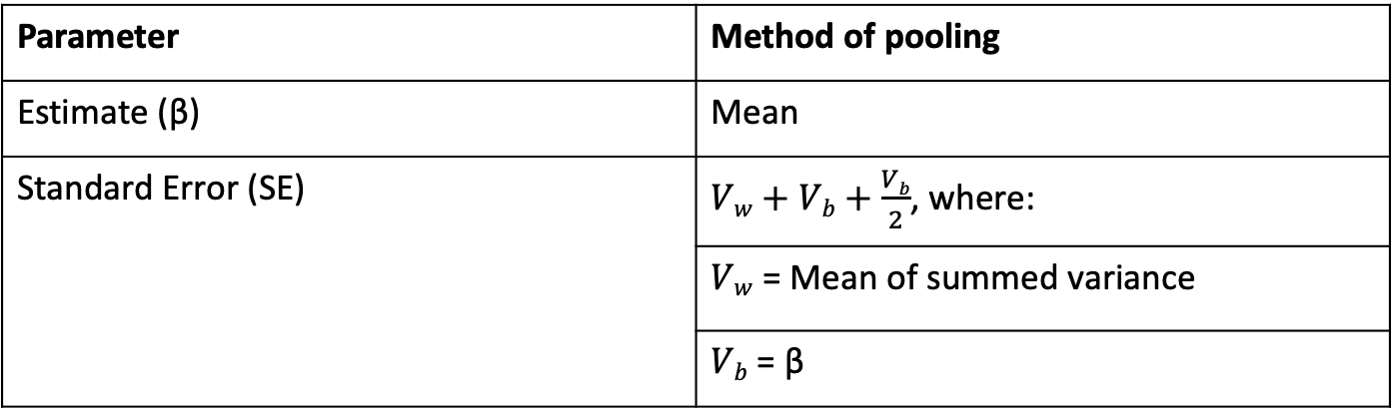
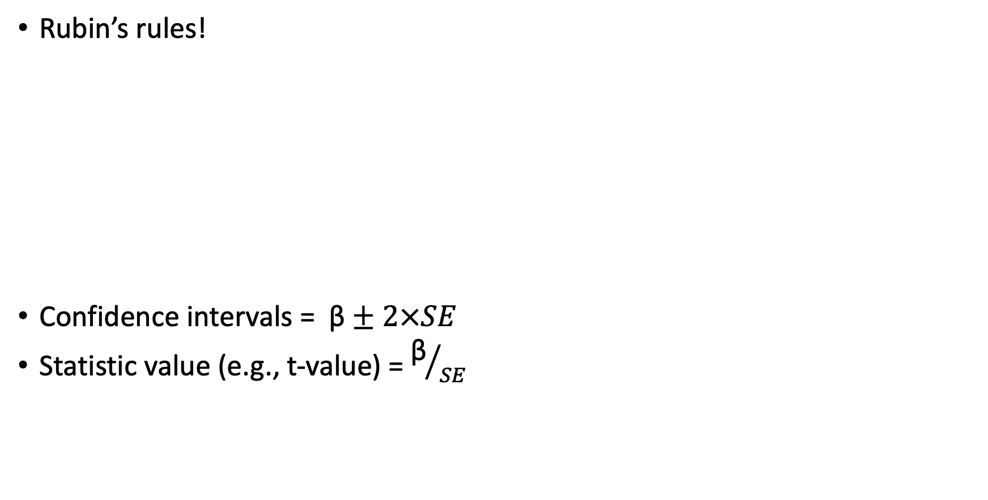
How to combine results across imputations?
Rubin’s rules!
Confidence intervals = $\text{β}±2×SE$
Statistic value (e.g., t-value) = ${\text{β}}/{SE}$
Parameter | Method of pooling
Estimate (β) | Mean
Standard Error (SE) | $Vw+Vb+\frac{Vb}{2}$, where:
 | $Vw$ = Mean of summed variance
 | $Vb$ = β

Slide 22
TL;DR
I have some missing data points. Should I use multiple imputations?
If you think your data is MAR
More than 10% missing data
How do I actually perform multiple imputations?
MICE package in R
Better to include more auxiliary variables
As many imputations as percentage of missing data
Now that I have my imputed data sets, how do I analyze them?
Analyze each separately
Combine using Rubin’s rules

Slide 23
Missing Data
How much missing data?
What type of missing data?
MCAR
MAR
MNAR
Listwise Deletion
Pairwise Deletion
FIML
Multiple Imputations
FIML
Multiple Imputations
Acknowledge the missingness
Do you want to do multiple imputations/FIML?
Which variables to impute
Auxiliary variables
Number of imputed data sets
Type of imputation
Checking results
Analyzing each data set
Combining results
Getting to know your missing data
What to do
How to impute
How to analyze imputed data
Notes:
10%-40%

Slide 24
Further Resources
Multiple imputations
https://psyarxiv.com/mdw5r/
https://www.rdocumentation.org/packages/mice/versions/3.14.0/topics/mice
Specification curve analysis
https://www.rdocumentation.org/packages/specr/versions/0.2.1
https://dcosme.github.io/specification-curves/SCA_tutorial_inferential
https://pab2163.github.io/amygdala_mpfc_multiverse/into_the_bayesian_multiverse.html
Rubin's rules
https://bookdown.org/mwheymans/bookmi/rubins-rules.html

