Slide 1
Hardware Design and Implementation of the Salsa20 Cryptosystem
PhD Course: Digital Design of Embedded Systems in
the IoT and RISC-V Open Core Era
Andrea Maioli (Politecnico di Milano, Italy)

Slide 2

Salsa20 Cryptosystem
Stream cipher
SALSA20
Encryption Decryption
Input stream
Output stream
plaintext
(ciphertext)
ciphertext
(plaintext)
Key Expansion
Key
Nonce
16 or 32 Bytes
8 Bytes

Slide 3
Encryption / Decryption

Slide 4

Salsa20 Cryptosystem – Encryption / Decryption
Salsa20 relies on a One Time Pad to encrypt/decrypt an input stream
XOR operator
Input Stream
Output Stream
Expanded Key
XOR is an involutory function
Encryption and decryption functions are the same
Low hardware resource utilization

Slide 5
Key Expansion

Slide 6
Salsa20 Cryptosystem – Key Expansion
Create a 64 Bytes matrix
Constants
Constants
Constants
Constants

Slide 7
Salsa20 Cryptosystem – Key Expansion
Create a 64 Bytes matrix
Constants
Constants
Constants
Constants

Slide 8
Salsa20 Cryptosystem – Key Expansion
Create a 64 Bytes matrix
Key
Constants
Key
Key
Key
Key
Key
Key
Key
Constants
Constants
Constants

Slide 9
Salsa20 Cryptosystem – Key Expansion
Create a 64 Bytes matrix
Constants
Key
Key
Key
Key
Constants
Constants
Key
Key
Key
Key
Constants

Slide 10
Salsa20 Cryptosystem – Key Expansion
Create a 64 Bytes matrix
Nonce
Constants
Key
Nonce
Key
Key
Key
Constants
Constants
Key
Key
Key
Key
Constants

Slide 11
Salsa20 Cryptosystem – Key Expansion
Create a 64 Bytes matrix
Constants
Key
Key
Key
Key
Constants
Nonce
Nonce
Constants
Key
Key
Key
Key
Constants

Slide 12
Salsa20 Cryptosystem – Key Expansion
Create a 64 Bytes matrix
BLOCK ID
Constants
Key
BLOCK ID
Key
Key
Block Identifier:
8 Bytes
Allows to generate unique keys
Initialized to 0
Incremented every 64 bytes of input
Key
Constants
Nonce
Nonce
Constants
Key
Key
Key
Key
Constants

Slide 13
Salsa20 Cryptosystem – Key Expansion
Create a 64 Bytes matrix
Constants
Key
Key
Key
Key
Constants
Nonce
Nonce
BLOCK ID
BLOCK ID
Constants
Key
Key
Key
Key
Constants

Slide 14
Salsa20 Cryptosystem – Key Expansion
Transform the matrix
C₁ | C₂ | C₃ | C₄ | K₁ | K₂ | K₃ | K₄
K₅ | K₆ | K₇ | K₈ | K₉ | K₁₀ | K₁₁ | K₁₂
K₁₃ | K₁₄ | K₁₅ | K₁₆ | C₅ | C₆ | C₇ | C₈
N₁ | N₂ | N₃ | N₄ | N₅ | N₆ | N₇ | N₈
B₁ | B₂ | B₃ | B₄ | B₅ | B₆ | B₇ | B₈
C₉ | C₁₀ | C₁₁ | C₁₂ | K₁₇ | K₁₈ | K₁₉ | K₂₀
K₂₁ | K₂₂ | K₂₃ | K₂₄ | K₂₅ | K₂₆ | K₂₇ | K₂₈
K₂₉ | K₃₀ | K₃₁ | K₃₂ | C₁₃ | C₁₄ | C₁₅ | C₁₆

Slide 15
Salsa20 Cryptosystem – Key Expansion
Transform the matrix – QuarterRound function
C₁ | C₂ | C₃ | C₄
K₁ | K₂ | K₃ | K₄
C₁ | C₂ | C₃ | C₄ | K₁ | K₂ | K₃ | K₄
K₅ | K₆ | K₇ | K₈ | K₉ | K₁₀ | K₁₁ | K₁₂
K₁₃ | K₁₄ | K₁₅ | K₁₆ | C₅ | C₆ | C₇ | C₈
N₁ | N₂ | N₃ | N₄ | N₅ | N₆ | N₇ | N₈
B₁ | B₂ | B₃ | B₄ | B₅ | B₆ | B₇ | B₈
C₉ | C₁₀ | C₁₁ | C₁₂ | K₁₇ | K₁₈ | K₁₉ | K₂₀
K₂₁ | K₂₂ | K₂₃ | K₂₄ | K₂₅ | K₂₆ | K₂₇ | K₂₈
K₂₉ | K₃₀ | K₃₁ | K₃₂ | C₁₃ | C₁₄ | C₁₅ | C₁₆
K₅ | K₆ | K₇ | K₈
K₉ | K₁₀ | K₁₁ | K₁₂

Slide 16
Salsa20 Cryptosystem – Key Expansion
Transform the matrix – QuarterRound function
C₁ | C₂ | C₃ | C₄
K₁ | K₂ | K₃ | K₄
K₅ | K₆ | K₇ | K₈
K₉ | K₁₀ | K₁₁ | K₁₂

Slide 17
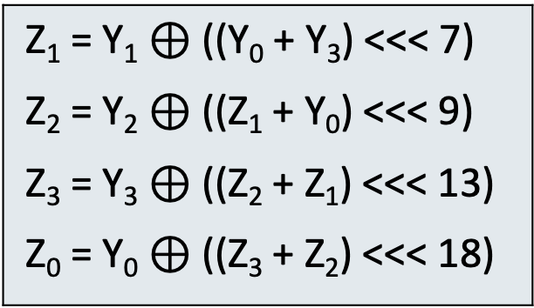
Salsa20 Cryptosystem – Key Expansion
Transform the matrix – QuarterRound function
Y₀
Z₀
Z₁ = Y₁ $⊕$ ((Y₀ + Y₃) <<< 7) Z₂ = Y₂ $⊕$ ((Z₁ + Y₀) <<< 9) Z₃ = Y₃ $⊕$ ((Z₂ + Z₁) <<< 13) Z₀ = Y₀ $⊕$ ((Z₃ + Z₂) <<< 18)
Y₁
Z₁
Y₂
Z₂
Y₃
Z₃

Slide 18
Salsa20 Cryptosystem – Key Expansion
Transform the matrix – QuarterRound function
Z₀
Z₁
Z₂
Z₃

Slide 19
Salsa20 Cryptosystem – Key Expansion
Transform the matrix – QuarterRound function
C₁ | C₂ | C₃ | C₄ | K₁ | K₂ | K₃ | K₄
K₅ | K₆ | K₇ | K₈ | K₉ | K₁₀ | K₁₁ | K₁₂
K₁₃ | K₁₄ | K₁₅ | K₁₆ | C₅ | C₆ | C₇ | C₈
N₁ | N₂ | N₃ | N₄ | N₅ | N₆ | N₇ | N₈
B₁ | B₂ | B₃ | B₄ | B₅ | B₆ | B₇ | B₈
C₉ | C₁₀ | C₁₁ | C₁₂ | K₁₇ | K₁₈ | K₁₉ | K₂₀
K₂₁ | K₂₂ | K₂₃ | K₂₄ | K₂₅ | K₂₆ | K₂₇ | K₂₈
K₂₉ | K₃₀ | K₃₁ | K₃₂ | C₁₃ | C₁₄ | C₁₅ | C₁₆
Z₀
Z₁
Z₂
Z₃

Slide 20
Salsa20 Cryptosystem – Key Expansion
Transform the matrix – RowRound function
C₁ | C₂ | C₃ | C₄ | K₁ | K₂ | K₃ | K₄
K₅ | K₆ | K₇ | K₈ | K₉ | K₁₀ | K₁₁ | K₁₂
K₁₃ | K₁₄ | K₁₅ | K₁₆ | C₅ | C₆ | C₇ | C₈
N₁ | N₂ | N₃ | N₄ | N₅ | N₆ | N₇ | N₈
B₁ | B₂ | B₃ | B₄ | B₅ | B₆ | B₇ | B₈
C₉ | C₁₀ | C₁₁ | C₁₂ | K₁₇ | K₁₈ | K₁₉ | K₂₀
K₂₁ | K₂₂ | K₂₃ | K₂₄ | K₂₅ | K₂₆ | K₂₇ | K₂₈
K₂₉ | K₃₀ | K₃₁ | K₃₂ | C₁₃ | C₁₄ | C₁₅ | C₁₆

Slide 21
Salsa20 Cryptosystem – Key Expansion
Transform the matrix – RowRound function
C₁ | C₂ | C₃ | C₄ | K₁ | K₂ | K₃ | K₄
K₅ | K₆ | K₇ | K₈ | K₉ | K₁₀ | K₁₁ | K₁₂
K₁₃ | K₁₄ | K₁₅ | K₁₆ | C₅ | C₆ | C₇ | C₈
N₁ | N₂ | N₃ | N₄ | N₅ | N₆ | N₇ | N₈
B₁ | B₂ | B₃ | B₄ | B₅ | B₆ | B₇ | B₈
C₉ | C₁₀ | C₁₁ | C₁₂ | K₁₇ | K₁₈ | K₁₉ | K₂₀
K₂₁ | K₂₂ | K₂₃ | K₂₄ | K₂₅ | K₂₆ | K₂₇ | K₂₈
K₂₉ | K₃₀ | K₃₁ | K₃₂ | C₁₃ | C₁₄ | C₁₅ | C₁₆
QuarterRound
QuarterRound
QuarterRound
QuarterRound

Slide 22
Salsa20 Cryptosystem – Key Expansion
Transform the matrix – RowRound function
Z₁ | Z₂ | Z₃ | Z₄ | Z₅ | Z₆ | Z₇ | Z₈
Z₉ | Z₁₀ | Z₁₁ | Z₁₂ | Z₁₃ | Z₁₄ | Z₁₅ | Z₁₆
Z₁₇ | Z₁₈ | Z₁₉ | Z₂₀ | Z₂₁ | Z₂₂ | Z₂₃ | Z₂₄
Z₂₅ | Z₂₆ | Z₂₇ | Z₂₈ | Z₂₉ | Z₃₀ | Z₃₁ | Z₃₂
Z₃₃ | Z₃₄ | Z₃₅ | Z₃₆ | Z₃₇ | Z₃₈ | Z₃₉ | Z₄₀
Z₄₁ | Z₄₂ | Z₄₃ | Z₄₄ | Z₄₅ | Z₄₆ | Z₄₇ | Z₄₈
Z₄₉ | Z₅₀ | Z₅₁ | Z₅₂ | Z₅₃ | Z₅₄ | Z₅₅ | Z₅₆
Z₅₇ | Z₅₈ | Z₅₉ | Z₆₀ | Z₆₁ | Z₆₂ | Z₆₃ | Z₆₄
QuarterRound
QuarterRound
QuarterRound
QuarterRound

Slide 23
Salsa20 Cryptosystem – Key Expansion
Transform the matrix – ColumnRound function
Z₁ | Z₂ | Z₃ | Z₄ | Z₅ | Z₆ | Z₇ | Z₈
Z₉ | Z₁₀ | Z₁₁ | Z₁₂ | Z₁₃ | Z₁₄ | Z₁₅ | Z₁₆
Z₁₇ | Z₁₈ | Z₁₉ | Z₂₀ | Z₂₁ | Z₂₂ | Z₂₃ | Z₂₄
Z₂₅ | Z₂₆ | Z₂₇ | Z₂₈ | Z₂₉ | Z₃₀ | Z₃₁ | Z₃₂
Z₃₃ | Z₃₄ | Z₃₅ | Z₃₆ | Z₃₇ | Z₃₈ | Z₃₉ | Z₄₀
Z₄₁ | Z₄₂ | Z₄₃ | Z₄₄ | Z₄₅ | Z₄₆ | Z₄₇ | Z₄₈
Z₄₉ | Z₅₀ | Z₅₁ | Z₅₂ | Z₅₃ | Z₅₄ | Z₅₅ | Z₅₆
Z₅₇ | Z₅₈ | Z₅₉ | Z₆₀ | Z₆₁ | Z₆₂ | Z₆₃ | Z₆₄
QuarterRound
QuarterRound
QuarterRound
QuarterRound

Slide 24
Salsa20 Cryptosystem – Key Expansion
Transform the matrix – ColumnRound function
Z₁ | Z₉ | Z₁₇ | Z₂₅ | Z₃₃ | Z₄₁ | Z₄₉ | Z₅₇
Z₂ | Z₁₀ | Z₁₈ | Z₂₆ | Z₃₄ | Z₄₂ | Z₅₀ | Z₅₈
Z₃ | Z₁₁ | Z₁₉ | Z₂₇ | Z₃₅ | Z₄₃ | Z₅₁ | Z₅₉
Z₄ | Z₁₂ | Z₂₀ | Z₂₈ | Z₃₆ | Z₄₄ | Z₅₂ | Z₆₀
Z₅ | Z₁₃ | Z₂₁ | Z₂₉ | Z₃₇ | Z₄₅ | Z₅₃ | Z₆₁
Z₆ | Z₁₄ | Z₂₂ | Z₃₀ | Z₃₈ | Z₄₆ | Z₅₄ | Z₆₂
Z₇ | Z₁₅ | Z₂₃ | Z₃₁ | Z₃₉ | Z₄₇ | Z₅₅ | Z₆₃
Z₈ | Z₁₆ | Z₂₄ | Z₃₂ | Z₄₀ | Z₄₈ | Z₅₆ | Z₆₄
QuarterRound
QuarterRound
QuarterRound
QuarterRound

Slide 25
Salsa20 Cryptosystem – Key Expansion
Transform the matrix – DoubleRound function
C₁ | C₂ | C₃ | C₄ | K₁ | K₂ | K₃ | K₄
K₅ | K₆ | K₇ | K₈ | K₉ | K₁₀ | K₁₁ | K₁₂
K₁₃ | K₁₄ | K₁₅ | K₁₆ | C₅ | C₆ | C₇ | C₈
N₁ | N₂ | N₃ | N₄ | N₅ | N₆ | N₇ | N₈
B₁ | B₂ | B₃ | B₄ | B₅ | B₆ | B₇ | B₈
C₉ | C₁₀ | C₁₁ | C₁₂ | K₁₇ | K₁₈ | K₁₉ | K₂₀
K₂₁ | K₂₂ | K₂₃ | K₂₄ | K₂₅ | K₂₆ | K₂₇ | K₂₈
K₂₉ | K₃₀ | K₃₁ | K₃₂ | C₁₃ | C₁₄ | C₁₅ | C₁₆
Z₁ | Z₉ | Z₁₇ | Z₂₅ | Z₃₃ | Z₄₁ | Z₄₉ | Z₅₇
Z₂ | Z₁₀ | Z₁₈ | Z₂₆ | Z₃₄ | Z₄₂ | Z₅₀ | Z₅₈
Z₃ | Z₁₁ | Z₁₉ | Z₂₇ | Z₃₅ | Z₄₃ | Z₅₁ | Z₅₉
Z₄ | Z₁₂ | Z₂₀ | Z₂₈ | Z₃₆ | Z₄₄ | Z₅₂ | Z₆₀
Z₅ | Z₁₃ | Z₂₁ | Z₂₉ | Z₃₇ | Z₄₅ | Z₅₃ | Z₆₁
Z₆ | Z₁₄ | Z₂₂ | Z₃₀ | Z₃₈ | Z₄₆ | Z₅₄ | Z₆₂
Z₇ | Z₁₅ | Z₂₃ | Z₃₁ | Z₃₉ | Z₄₇ | Z₅₅ | Z₆₃
Z₈ | Z₁₆ | Z₂₄ | Z₃₂ | Z₄₀ | Z₄₈ | Z₅₆ | Z₆₄
RowRound + ColumnRound

Slide 26
Salsa20 Cryptosystem – Key Expansion
Transform the matrix – DoubleRound function
C₁ | C₂ | C₃ | C₄ | K₁ | K₂ | K₃ | K₄
K₅ | K₆ | K₇ | K₈ | K₉ | K₁₀ | K₁₁ | K₁₂
K₁₃ | K₁₄ | K₁₅ | K₁₆ | C₅ | C₆ | C₇ | C₈
N₁ | N₂ | N₃ | N₄ | N₅ | N₆ | N₇ | N₈
B₁ | B₂ | B₃ | B₄ | B₅ | B₆ | B₇ | B₈
C₉ | C₁₀ | C₁₁ | C₁₂ | K₁₇ | K₁₈ | K₁₉ | K₂₀
K₂₁ | K₂₂ | K₂₃ | K₂₄ | K₂₅ | K₂₆ | K₂₇ | K₂₈
K₂₉ | K₃₀ | K₃₁ | K₃₂ | C₁₃ | C₁₄ | C₁₅ | C₁₆
Z₁ | Z₉ | Z₁₇ | Z₂₅ | Z₃₃ | Z₄₁ | Z₄₉ | Z₅₇
Z₂ | Z₁₀ | Z₁₈ | Z₂₆ | Z₃₄ | Z₄₂ | Z₅₀ | Z₅₈
Z₃ | Z₁₁ | Z₁₉ | Z₂₇ | Z₃₅ | Z₄₃ | Z₅₁ | Z₅₉
Z₄ | Z₁₂ | Z₂₀ | Z₂₈ | Z₃₆ | Z₄₄ | Z₅₂ | Z₆₀
Z₅ | Z₁₃ | Z₂₁ | Z₂₉ | Z₃₇ | Z₄₅ | Z₅₃ | Z₆₁
Z₆ | Z₁₄ | Z₂₂ | Z₃₀ | Z₃₈ | Z₄₆ | Z₅₄ | Z₆₂
Z₇ | Z₁₅ | Z₂₃ | Z₃₁ | Z₃₉ | Z₄₇ | Z₅₅ | Z₆₃
Z₈ | Z₁₆ | Z₂₄ | Z₃₂ | Z₄₀ | Z₄₈ | Z₅₆ | Z₆₄
DoubleRound

Slide 27
Salsa20 Cryptosystem – Key Expansion
Transform the matrix – DoubleRound function
DoubleRound applied n times
n = number of rounds in the Salsa version
Salsa20 -> n = 10
Salsa12 -> n = 6
Salsa8 -> n = 4

Slide 28
Salsa20 Cryptosystem – Key Expansion
Compute the expanded key
C₁ | C₂ | C₃ | C₄ | K₁ | K₂ | K₃ | K₄
K₅ | K₆ | K₇ | K₈ | K₉ | K₁₀ | K₁₁ | K₁₂
K₁₃ | K₁₄ | K₁₅ | K₁₆ | C₅ | C₆ | C₇ | C₈
N₁ | N₂ | N₃ | N₄ | N₅ | N₆ | N₇ | N₈
B₁ | B₂ | B₃ | B₄ | B₅ | B₆ | B₇ | B₈
C₉ | C₁₀ | C₁₁ | C₁₂ | K₁₇ | K₁₈ | K₁₉ | K₂₀
K₂₁ | K₂₂ | K₂₃ | K₂₄ | K₂₅ | K₂₆ | K₂₇ | K₂₈
K₂₉ | K₃₀ | K₃₁ | K₃₂ | C₁₃ | C₁₄ | C₁₅ | C₁₆
K₁ | K₂ | K₃ | K₄ | K₅ | K₆ | K₇ | K₈
K₉ | K₁₀ | K₁₁ | K₁₂ | K₁₃ | K₁₄ | K₁₅ | K₁₆
K₁₇ | K₁₈ | K₁₉ | K₂₀ | K₂₁ | K₂₂ | K₂₃ | K₂₄
K₂₅ | K₂₆ | K₂₇ | K₂₈ | K₂₉ | K₃₀ | K₃₁ | K₃₂
K₃₃ | K₃₄ | K₃₅ | K₃₆ | K₃₇ | K₃₈ | K₃₉ | K₄₀
K₄₁ | K₄₂ | K₄₃ | K₄₄ | K₄₅ | K₄₆ | K₄₇ | K₄₈
K₄₉ | K₅₀ | K₅₁ | K₅₂ | K₅₃ | K₅₄ | K₅₅ | K₅₆
K₅₇ | K₅₈ | K₅₉ | K₆₀ | K₆₁ | K₆₂ | K₆₃ | K₆₄
Z₁ | Z₉ | Z₁₇ | Z₂₅ | Z₃₃ | Z₄₁ | Z₄₉ | Z₅₇
Z₂ | Z₁₀ | Z₁₈ | Z₂₆ | Z₃₄ | Z₄₂ | Z₅₀ | Z₅₈
Z₃ | Z₁₁ | Z₁₉ | Z₂₇ | Z₃₅ | Z₄₃ | Z₅₁ | Z₅₉
Z₄ | Z₁₂ | Z₂₀ | Z₂₈ | Z₃₆ | Z₄₄ | Z₅₂ | Z₆₀
Z₅ | Z₁₃ | Z₂₁ | Z₂₉ | Z₃₇ | Z₄₅ | Z₅₃ | Z₆₁
Z₆ | Z₁₄ | Z₂₂ | Z₃₀ | Z₃₈ | Z₄₆ | Z₅₄ | Z₆₂
Z₇ | Z₁₅ | Z₂₃ | Z₃₁ | Z₃₉ | Z₄₇ | Z₅₅ | Z₆₃
Z₈ | Z₁₆ | Z₂₄ | Z₃₂ | Z₄₀ | Z₄₈ | Z₅₆ | Z₆₄

Slide 29
Salsa20 Cryptosystem – Key Expansion
Compute the expanded key
K₁ | K₂ | K₃ | K₄ | K₅ | K₆ | K₇ | K₈
K₉ | K₁₀ | K₁₁ | K₁₂ | K₁₃ | K₁₄ | K₁₅ | K₁₆
K₁₇ | K₁₈ | K₁₉ | K₂₀ | K₂₁ | K₂₂ | K₂₃ | K₂₄
K₂₅ | K₂₆ | K₂₇ | K₂₈ | K₂₉ | K₃₀ | K₃₁ | K₃₂
K₃₃ | K₃₄ | K₃₅ | K₃₆ | K₃₇ | K₃₈ | K₃₉ | K₄₀
K₄₁ | K₄₂ | K₄₃ | K₄₄ | K₄₅ | K₄₆ | K₄₇ | K₄₈
K₄₉ | K₅₀ | K₅₁ | K₅₂ | K₅₃ | K₅₄ | K₅₅ | K₅₆
K₅₇ | K₅₈ | K₅₉ | K₆₀ | K₆₁ | K₆₂ | K₆₃ | K₆₄
The 64 bytes key is valid for 64 bytes of input
After 64 bytes the block identifier is incremented and a new key is computed

Slide 30
Salsa20 Cryptosystem – Key Expansion
Compute the expanded key
K₁ | K₂ | K₃ | K₄ | K₅ | K₆ | K₇ | K₈
K₉ | K₁₀ | K₁₁ | K₁₂ | K₁₃ | K₁₄ | K₁₅ | K₁₆
K₁₇ | K₁₈ | K₁₉ | K₂₀ | K₂₁ | K₂₂ | K₂₃ | K₂₄
K₂₅ | K₂₆ | K₂₇ | K₂₈ | K₂₉ | K₃₀ | K₃₁ | K₃₂
K₃₃ | K₃₄ | K₃₅ | K₃₆ | K₃₇ | K₃₈ | K₃₉ | K₄₀
K₄₁ | K₄₂ | K₄₃ | K₄₄ | K₄₅ | K₄₆ | K₄₇ | K₄₈
K₄₉ | K₅₀ | K₅₁ | K₅₂ | K₅₃ | K₅₄ | K₅₅ | K₅₆
K₅₇ | K₅₈ | K₅₉ | K₆₀ | K₆₁ | K₆₂ | K₆₃ | K₆₄
Salsa20 is a stream cipher
Expanded key does not rely on previous encrypted or decrypted data
Key expansion requires only key, nonce, and block identifier
Main difference with respect to a block cipher
Advantages:
The key can be used in chunks
No need to wait for 64 bytes of input data
Multiple keys can be generated beforehand

Slide 31
Salsa20 Hardware Design

Slide 32

Salsa20 Cryptosystem – Design
Same logical division of the Salsa20 cryptosystem
Encryption
Decryption
The design supports multiple Salsa20 versions
Number of rounds specified during initialization
No need to resynthesize the design
Key Generator

Slide 33
Salsa20 Cryptosystem – Design
Same logical division of the Salsa20 cryptosystem
Encryption Decryption
Key Buffer
Circular buffer
Generates multiple keys in advance
Reduces key wait time
Increases throughput
Key Generator
Exploits the independence between keys

Slide 34
Design Workflow

Slide 35
Salsa20 Cryptosystem – Workflow
Three different steps
Cryptosystem initialization
Initialize the cryptosystem (n, keylength, key, nonce)
Key generation
Generate a new key
Data encryption/decryption
Encrypt/decrypt the input stream

Slide 36
Cryptosystem Initialization

Slide 37
Salsa20 Cryptosystem – Workflow
Workflow – Cryptosystem Initialization – Registers Initialization
Constraint: low number of inputs/outputs
Rounds
Keylength
Data In
Encryption
Decryption
(8 bytes)
SETUP
Address
(1 byte)
Write Enable

Slide 38
Salsa20 Cryptosystem – Workflow
Workflow – Cryptosystem Initialization – Registers Initialization
Nonce
Data In
Encryption
Decryption
Rounds
(8 bytes)
NONCE
Address
Keylength
(1 byte)
Write Enable

Slide 39
Salsa20 Cryptosystem – Workflow
Workflow – Cryptosystem Initialization – Registers Initialization
Key (8 bytes)
Data In
Encryption
Decryption
Rounds
(8 bytes)
KEY_0
Address
Keylength
(1 byte)
Nonce
Write Enable

Slide 40
Salsa20 Cryptosystem – Workflow
Workflow – Cryptosystem Initialization – Registers Initialization
Key (8 bytes)
Data In
Encryption
Decryption
Rounds
(8 bytes)
KEY_1
Address
Keylength
(1 byte)
Nonce
Write Enable
Key

Slide 41
Salsa20 Cryptosystem – Workflow
Workflow – Cryptosystem Initialization – Registers Initialization
Key (8 bytes)
Data In
Encryption
Decryption
Rounds
(8 bytes)
KEY_2
Address
Keylength
(1 byte)
Nonce
Write Enable
Key

Slide 42
Salsa20 Cryptosystem – Workflow
Workflow – Cryptosystem Initialization – Registers Initialization
Key (8 bytes)
Data In
Encryption
Decryption
Rounds
(8 bytes)
KEY_3
Address
Keylength
(1 byte)
Nonce
Write Enable
Key

Slide 43
Salsa20 Cryptosystem – Workflow
Workflow – Cryptosystem Initialization
Data In
Encryption
Decryption
Rounds
(8 bytes)
Address
Keylength
(1 byte)
Nonce
Write Enable
Init
Key

Slide 44
Salsa20 Cryptosystem – Workflow
Workflow – Cryptosystem Initialization
Registers
Data In
Encryption
Decryption
(8 bytes)
Address
(1 byte)
Write Enable
Init

Slide 45
Key Generation

Slide 46
Salsa20 Cryptosystem – Workflow
Workflow – Key Generation
Encryption
Decryption
Init
Key Buffer
Key Generator
Generate
Registers
BLKID

Slide 47
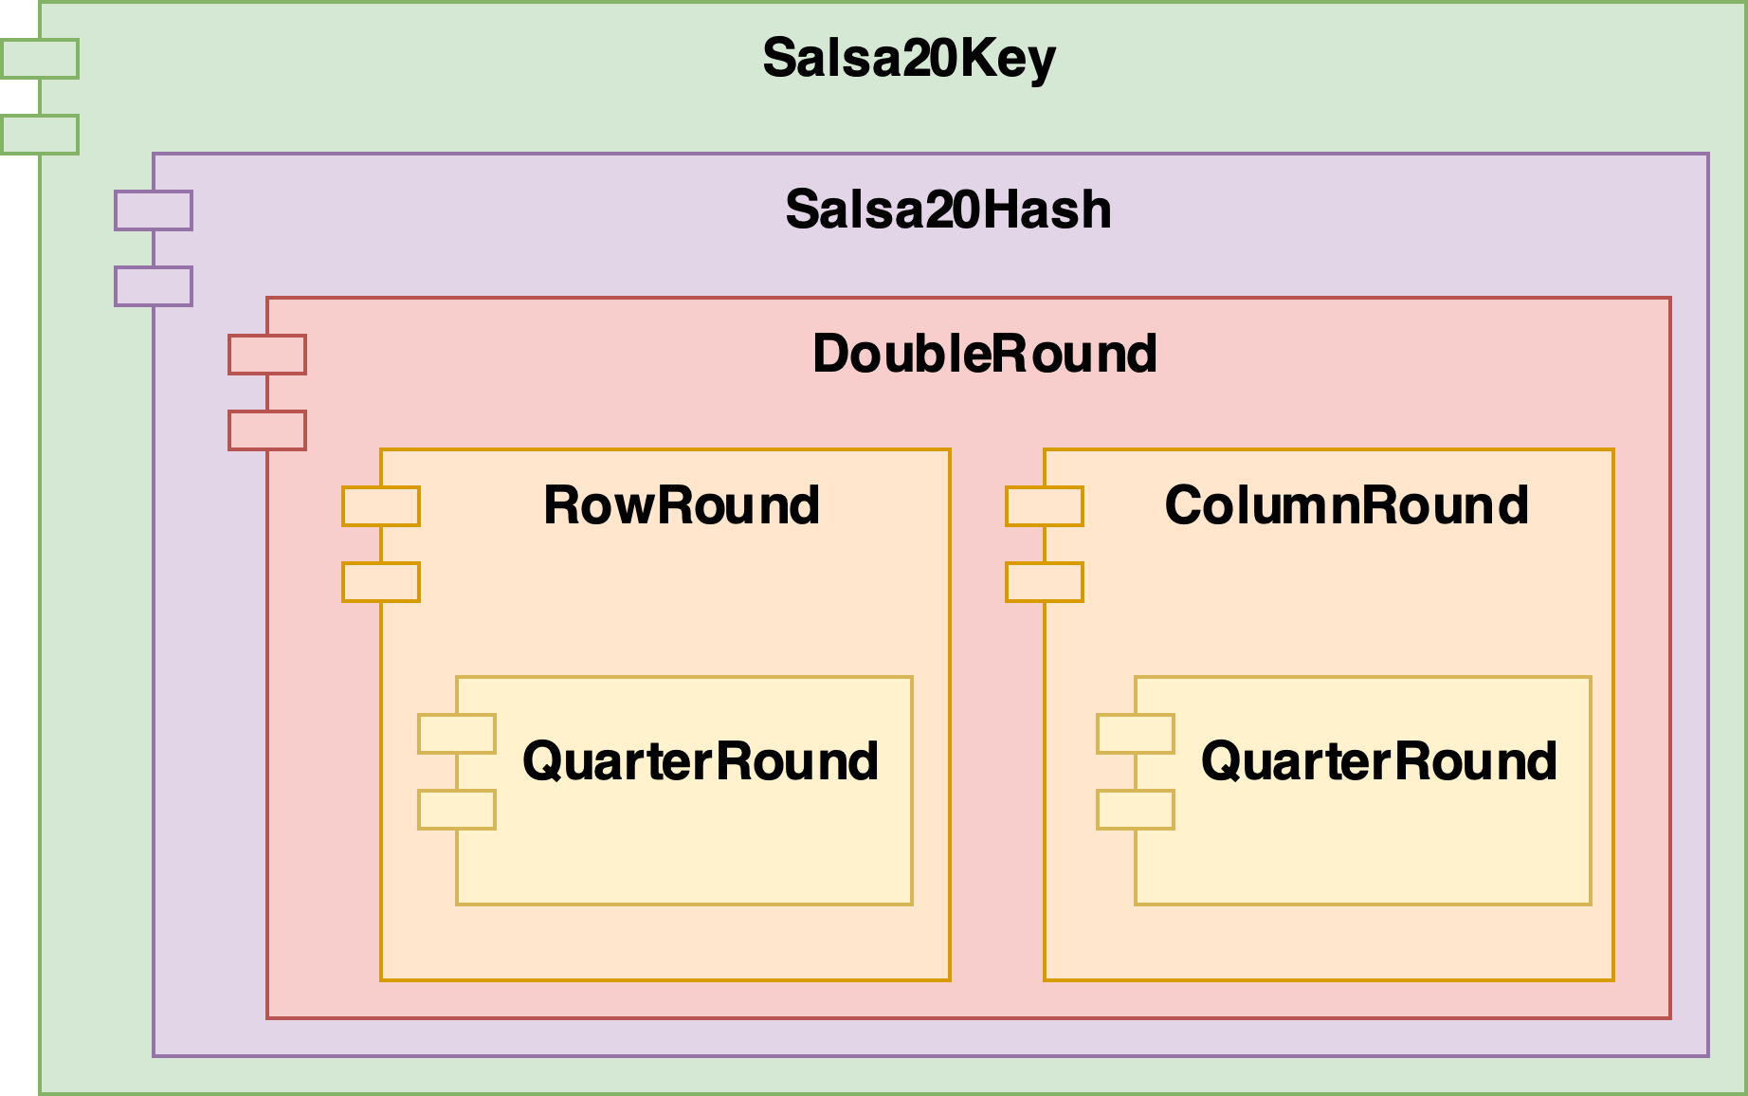
Salsa20 Cryptosystem – Key Generation Design
Design overview – Key Generation Modules
Key
Keylength
Nonce
Expanded Key
Block ID
Rounds
Salsa20Key initializes the 64 bytes matrix
Salsa20Hash uses a feedback system to transform the matrix n times
DoubleRound

Slide 48
Salsa20 Cryptosystem – Key Generation Design
Design overview – Key Generation Modules
Key
Keylength
Nonce
Expanded Key
Block ID
Rounds
Salsa20Key initializes the 64 bytes matrix
Salsa20Hash uses a feedback system to transform the matrix n times
DoubleRound
No need to re-synthesize the design to change the number of rounds
Transformations the matrix using only one DoubleRound module

Slide 49
Salsa20 Cryptosystem – Key Generation Design
Design overview – Key Generation Modules
Key
Keylength
Nonce
Expanded Key
Block ID
Rounds
The DoubleRound module transforms the matrix
Uses combinatorial logic
This is where most of the LUTs are used

Slide 50
Salsa20 Cryptosystem – Workflow
Workflow – Key Generation
Encryption
Decryption
Key Buffer
Key Generator
Key
KEY
BLKID
+1
The key is saved in a circular buffer of two keys
The block identifier is incremented

Slide 51
Salsa20 Cryptosystem – Workflow
Workflow – Key Generation
Encryption
Decryption
Key Buffer
Key Generator
Generate
KEY
BLKID
A key generation requests is sent whenever the circular buffer is not full
Every time a key is used, the record in the circular buffer is invalidated

Slide 52
Salsa20 Cryptosystem – Workflow
Workflow – Key Generation
Encryption
Decryption
Key Buffer
Key Generator
Ready
KEY
BLKID

Slide 53
Salsa20 Cryptosystem – Workflow
Workflow – Data Encryption / Decryption
Ready
Encryption
Decryption
Key Buffer
Ready
Initialized
KEYs

Slide 54
Encryption/Decryption

Slide 55
Salsa20 Cryptosystem – Workflow
Workflow – Data Encryption / Decryption
Plaintext
Data In
Encryption
Decryption
Key Buffer
(8 bytes)
Key Chunk
KEY CHUNK
KEYs
Start

Slide 56

Salsa20 Cryptosystem – Workflow
Workflow – Data Encryption / Decryption
Plaintext
Data In
Encryption
Decryption
Data Out
(8 bytes)
(8 bytes)
Start
Valid
KEY CHUNK
Ciphertext
$$⊕$$
In the same clock cycle we can provide a new input
The same workflow applies for data decryption
Plaintext

Slide 57
Design Evaluation

Slide 58
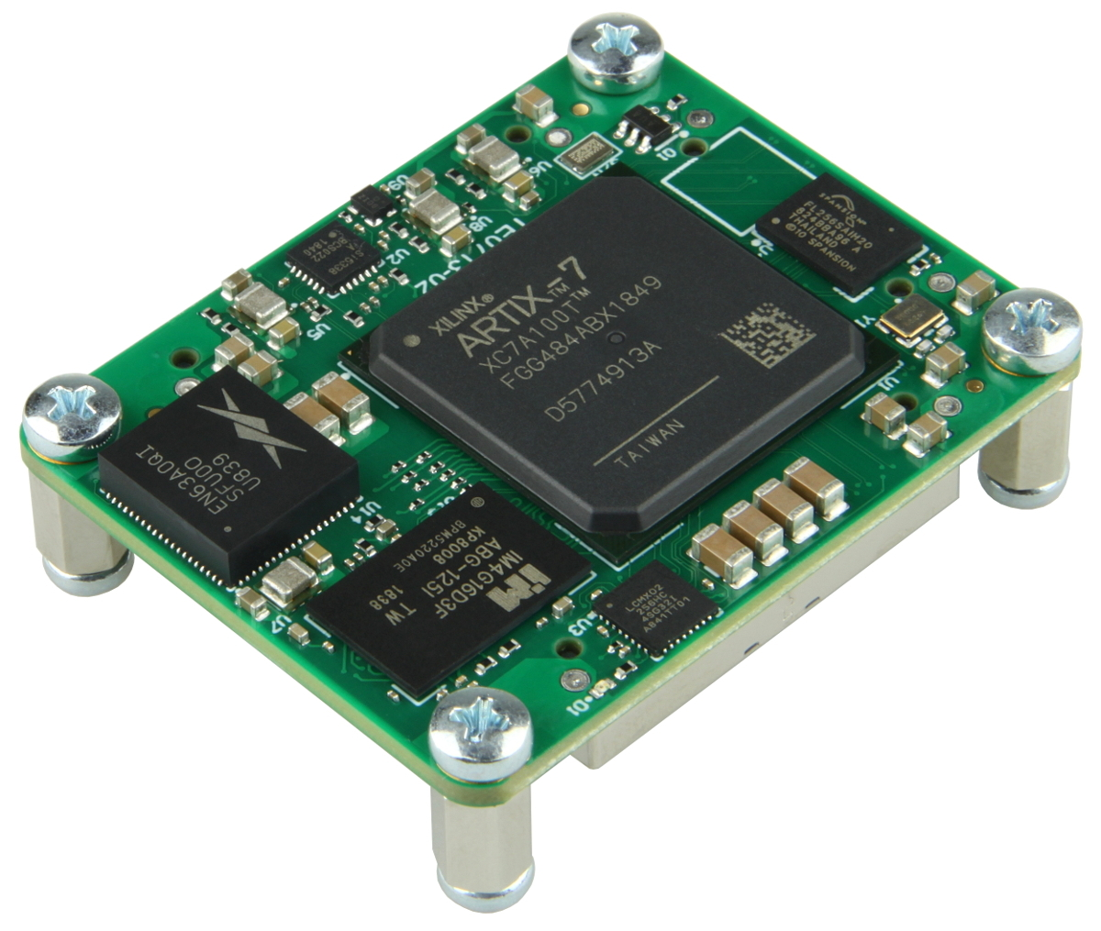
Design Evaluation - Validation
Design available at https://github.com/Maiux92/Salsa20SystemVerilog
Technical report available in the repo
Synthesized and implemented
Target platform: Xilinx Artix 7 model 7a100tcsg324-1
Validation
Data provided in Salsa20 whitepaper for Salsa20 core functionalities
Python implementation of Salsa20 for validating encryption and decryption

Slide 59
Design Evaluation – Resources Utilization
 | Synthesis | Implementation
LUTs | 2586 (4.08%) | 2582 (4.07%)
Slice Registers | 2590 (2.04%) | 2590 (2.04%)
F7 Muxes | 128 (0.40%) | 128 (0.40%)
F8 Muxes | 64 (0.40%) | 64 (0.40%)
IOB Ports | 139 (66.19%) | 139 (66.19%)
The DoubleRound module uses 82% of the LUTs (2136)
Each expanded key requires 1000 registers
Key Buffer module requires 85% of the registers (2200)
The Key Buffer module uses all the F7 and F8 muxes

Slide 60

Design Evaluation – Timing
System Timing
The DobuleRound module is responsible for the critical path
Only combinatorial logic
Minimum cock period: 23.33ns
Maximum clock frequency: 43.33MHz

Slide 61

Design Evaluation – Performance
System Performance
Initialization:
4 clock cycles with 16 bytes key
6 clock cycles with 32 bytes key
Key generator: new key every n + 2 clock cycles (n = number of rounds)
Key Buffer – first key wait cycles: n + 2 clock cycles
Key buffer – worst case: key consumed after 8 clock cycles (64 bytes of input)
Next keys wait cycles: (n + 2) - 8 clock cycles
Salsa20: 4 clock cycles
Salsa12: 0 clock cycles
Salsa8: 0 clock cycles
Encryption/decryption throughput: 8 bytes of plaintext/ciphertext per clock cycle
Without key buffer: n + 2 clock cycles
Salsa20: 12 clock cycles
Salsa12: 8 clock cycles
Salsa8: 6 clock cycles

Slide 62
Conclusion

Slide 63
Conclusion
Conclusion:
Design, synthesize, and implement the Salsa20 cryptosystem
Support various Salsa20 versions, without re-synthesizing the design
Support 16 bytes and 32 bytes keys
A feedback system limits LUTs utilization
A circular buffer increases system throughput
General evaluation of the implemented design

Slide 64
Questions?

