Slide 1
Enabling Multiple Memory Spaces in gem5 Simulations of Multi-Core Systems
PhD Course: Advances on System-on-Chip Designs
Andrea Maioli (Politecnico di Milano, Italy)
Simone Salgaro (Politecnico di Milano, Italy)

Slide 2
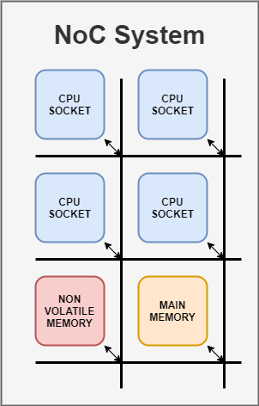
Target System Overview
Target: multi-core multi-memory space system
Multiple cores
Multiple memories divided into two memory spaces
Main memory
Additional memory
Each memory space is directly addressable
Network-on-Chip Communication

Slide 3
Motivation
Target System Motivation:
Emerging mixed-volatile platforms have two memory spaces
Main memory: usually a volatile memory (e.g. SRAM)
Additional memory: usually a Non-Volatile Memory (NVM) (e.g. FRAM, STT-RAM)
gem5 v20.1 introduces support for NVM but it lacks support for different and separated memory spaces
Exploration of emerging architectures/platforms is currently not possible

Slide 4
Enabling Support for Separated Memory Spaces

Slide 5
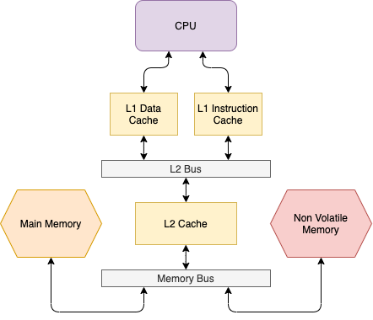
Dual Memory System
How to model a dual memory system in a single-core architecture?

Slide 6
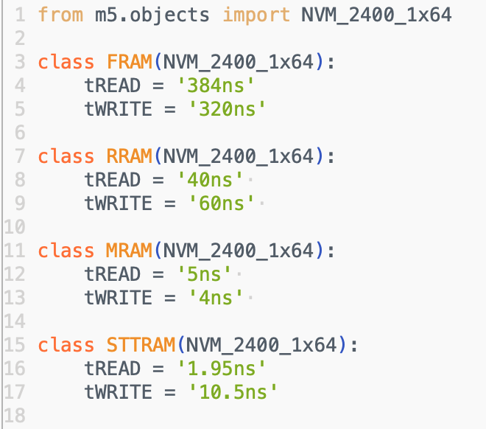
Dual Memory System – Modeling NVM
How to model a dual memory system in a single-core architecture?
ARM introduced support for NVM in gem5 v20.1
Implementing NVM is easy
We modeled FRAM, RRAM, MRAM, STT-RAM

Slide 7
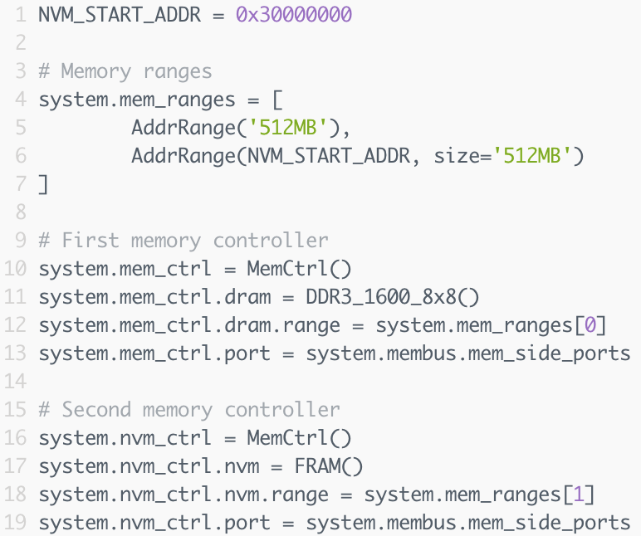

Dual Memory System – Modeling Two Memories
How to model a dual memory system in a single-core architecture?
Modeling two memories:
Specify to separated address ranges
Create two memory controllers
Connect each memory controller to the memory bus
Size: 512MB
Address range: 0x00000000
0x20000000
Size: 512MB
Address range: 0x30000000
0x50000000

Slide 8
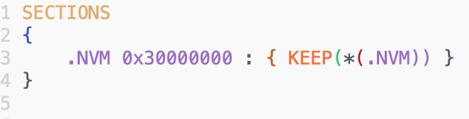
Dual Memory System – Accessing NVM
How to access the secondary memory space?
In the source code, we allocate variables onto a specific memory section using compiler's attributes
We create a custom linker script to allocate the memory section onto a specific address range
Inside source code:
Custom linker script:

Slide 9
Dual Memory System – Accessing NVM
Binary layout:
variable test address range: 0x30000000-0x30004000
Onto NVM space

Slide 10
Dual Memory System – Accessing NVM
Binary layout:
variable test address range: 0x30000000-0x30004000
Onto NVM space
Running gem5 simulation: no access to secondary memory
Size: 512MB
Address range: 0x00000000
0x20000000
Page allocation request for test (0x30000000)
Virtual address: 0x30000000
Size: 512MB
Address range: 0x30000000
0x50000000

Slide 11
Dual Memory System – Accessing NVM
Binary layout:
variable test address range: 0x30000000-0x30004000
Onto NVM space
Running gem5 simulation: no access to NVM
Size: 512MB
Address range: 0x00000000
0x20000000
Page allocation request for test (0x30000000)
Virtual address: 0x30000000
Physical address: 0x00000400
Size: 512MB
Address range: 0x30000000
0x50000000
Request redirected to the wrong memory

Slide 12
Dual Memory System – Accessing NVM
Running gem5 simulation: no access to NVM
Size: 512MB
Address range: 0x00000000
0x20000000
Page allocation request for test (0x30000000)
Virtual address: 0x30000000
Physical address: 0x00000400
Size: 512MB
Address range: 0x30000000
0x50000000
Request redirected to the wrong memory
The MMU translates each virtual address requested by the program to a physical address of the memory

Slide 13

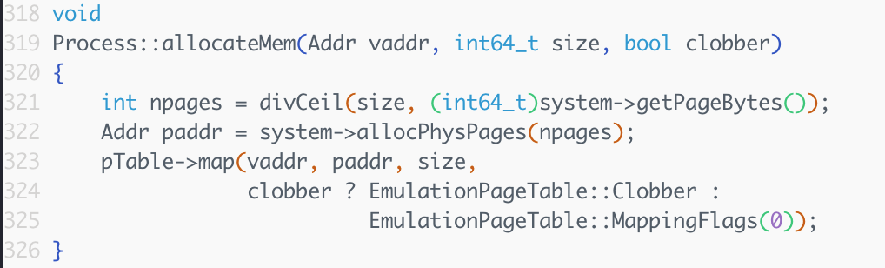
Dual Memory System – Accessing NVM
Running gem5 simulation: behind the scenes
Processes request virtual addresses, the MMU translates them to physical ones
Page allocation request for test (0x30000000)
gem5/sim/process.cc
Physical page at 0x00004000
Process lookup table now maps virtual address 0x30000000 to physical address 0x00004000
Each program request to address 0x30000000 is redirected to 0x00004000

Slide 14
Dual Memory System – Extending gem5 for Dual Memory Support
We need to redirect requests to the correct memory
We use the virtual memory address to identify the target memory
Each request with a virtual address within the rage 0x30000000-0x50000000 need to be redirected to the secondary memory
All the other requests need to be redirected to primary memory
Request to virtual address 0x30000104 redirected to 0x41040108
Request to virtual address 0x0004003A redirected to 0x1F04090A

Slide 15


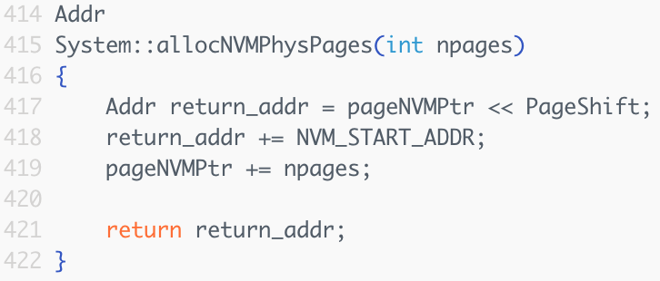


Dual Memory System – Extending gem5 for Dual Memory Support
We create and duplicate page-related variables and methods for supporting a new separated memory space
gem5/sim/system.hh
gem5/sim/system.cc

Slide 16
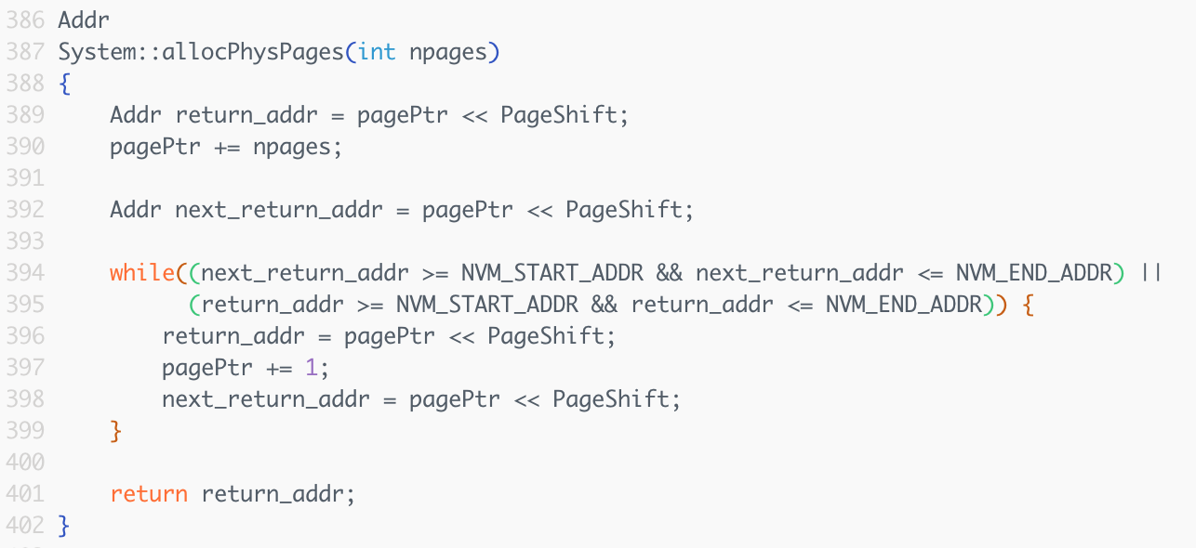
Dual Memory System – Extending gem5 for Dual Memory Support
We alter page allocation methods to ensure no collision can happen
gem5/sim/system.cc

Slide 17
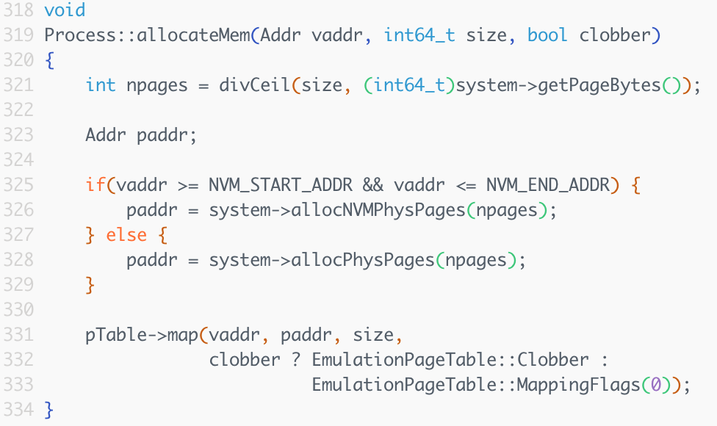
Dual Memory System – Extending gem5 for Dual Memory Support
We alter process memory allocation to now redirect the allocation request to the requested memory space
gem5/sim/process.cc

Slide 18

Dual Memory System – Extending gem5 for Dual Memory Support
Page allocation request for test (0x30000000)
gem5/sim/process.cc
Physical page at 0x30004000
Process lookup table now maps virtual address 0x30000000 to physical address 0x30004000
Request correctly redirected to the requested memory space

Slide 19
Evaluating NVM Performance

Slide 20
Evaluating NVM Performance
Evaluation Setup:
Three system configurations:
MCU-Like – Low Clock Frequency:
Clock Frequency: 16Mhz
Caches: 128B L1 Instruction cache, 128B L1 Data Cache, 512B L2 Cache (lowest possible cache sizes in gem5)
MCU-Like – High Clock Frequency:
Clock Frequency: 1Ghz
Caches: 128B L1 Instruction cache, 128B L1 Data Cache, 512B L2 Cache (lowest possible cache sizes in gem5)
Beefy MCU:
Clock Frequency: 1Ghz
Caches: 16kB L1 Instruction cache, 64kB L1 Data Cache, 256kB L2 Cache

Slide 21
Evaluating NVM Performance
Evaluation Setup:
Benchmarks (from MiBench/MiBench2 benchmarking suite)
Fast Fourier Transform (signal analysis)
Susan - Corner Recognition (image analysis)
Dijkstra algorithm (shortest path among nodes in a graph)
We consider the following memory technologies as secondary memory:
Memory Technology | Read Latency | Write Latency
SRAM | 1.23ns | 1.21ns
FRAM | 384ns | 320ns
RRAM | 40ns | 60ns
MRAM | 5ns | 4ns
STT-RAM | 1.95ns | 10.5ns

Slide 22
Evaluating NVM Performance
Evaluation Results:
We run a simulation for each system configuration and for each memory technology
Benchmark | N. Read Req. Memory 1 | N. Write Req. Memory 1 | N. Rea Req. Memory 2 | N. Write Req. Memory 2
FFT | 571'607 | 111'917 | 38'303 | 16'834
Susan | 484'384 | 3'389 | 7'669 | 7'330
Dijkstra | 3'260'480 | 754'387 | 600'194 | 95

Slide 23
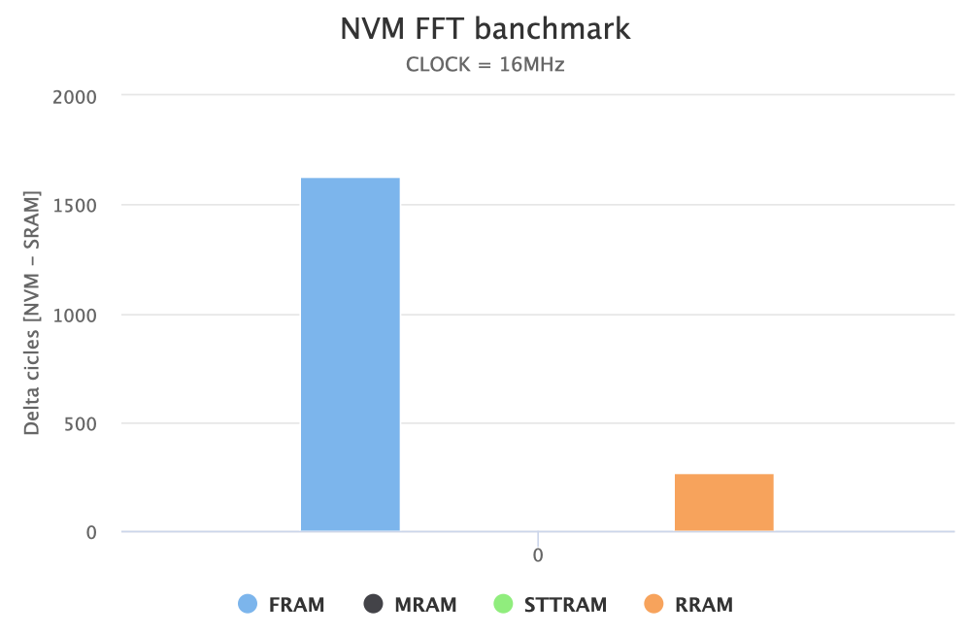
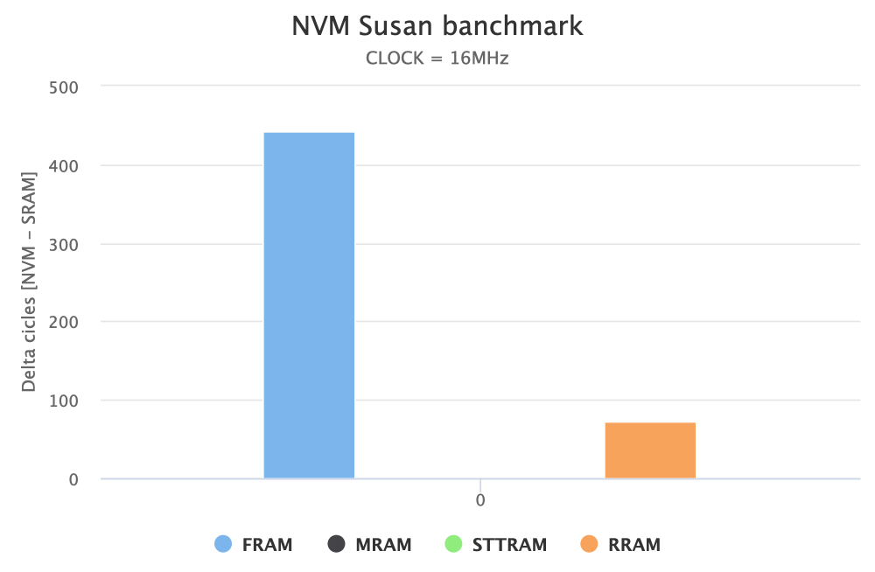
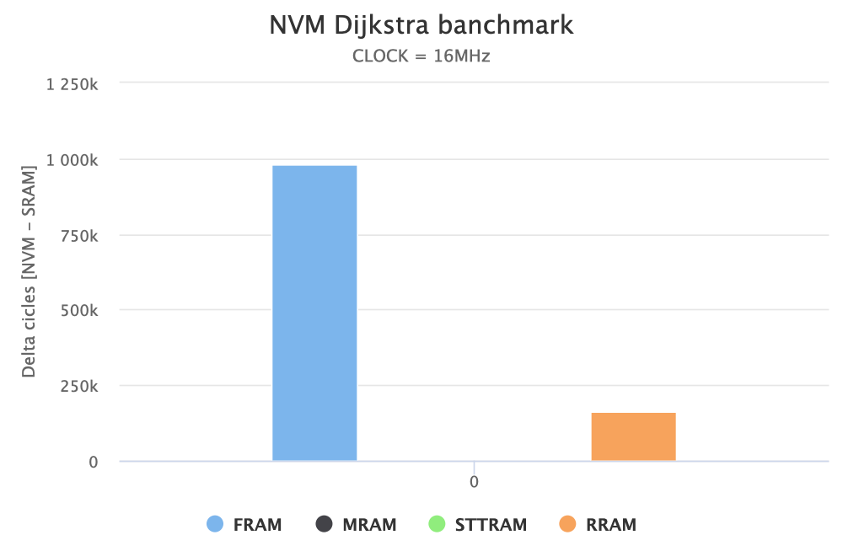
Evaluating NVM Performance
Evaluation Results – Small Cache @ 16 MHz
STTRAM and MRAM have similar performance to SRAM at a low clock frequency
The low clock frequency masks the NVM latency
FRAM has the worst performance

Slide 24
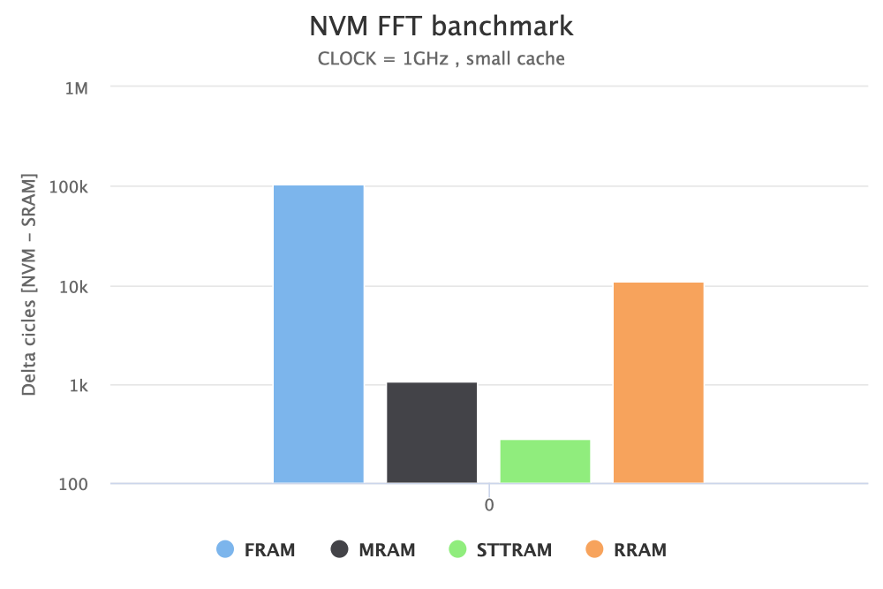
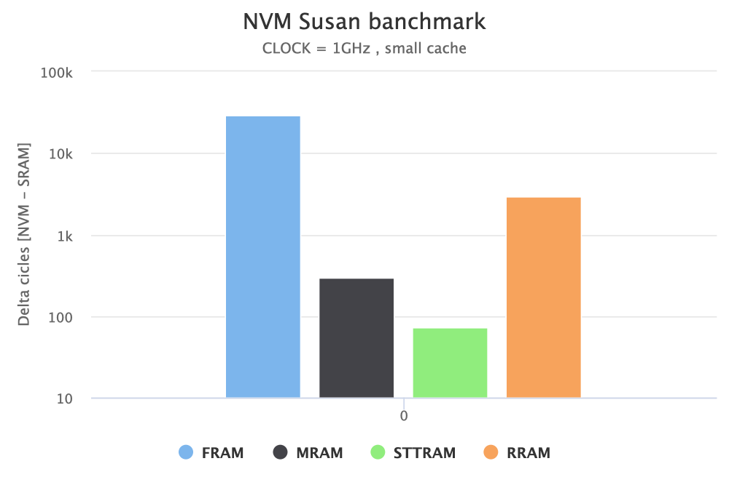
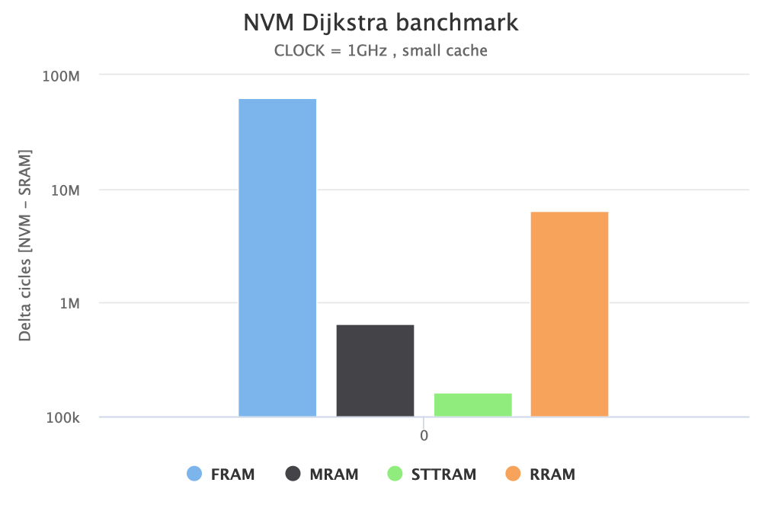
Evaluating NVM Performance
Evaluation Results – Small Cache @ 1GHz
MRAM and STTRAM no longer have comparable performance to SRAM
STTRAM has the best performance
FRAM has the worst performance

Slide 25
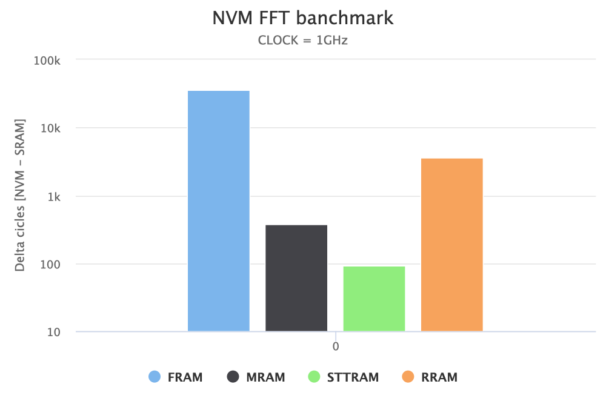
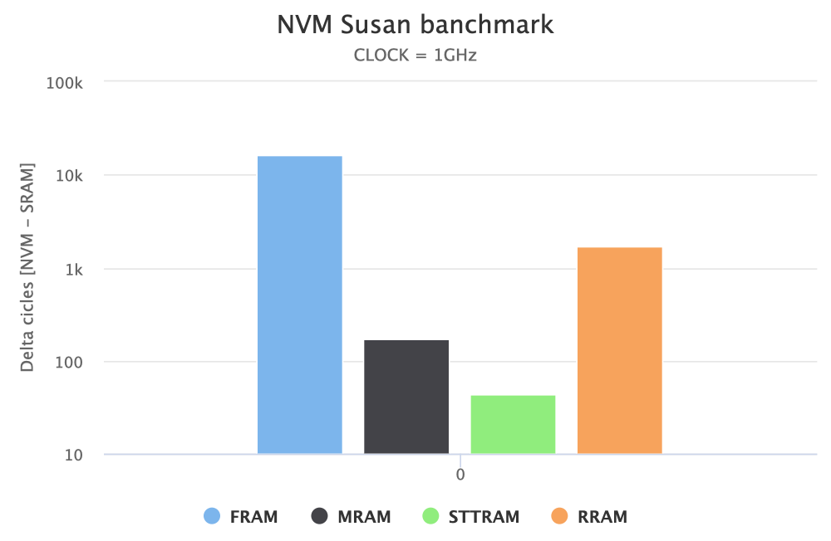
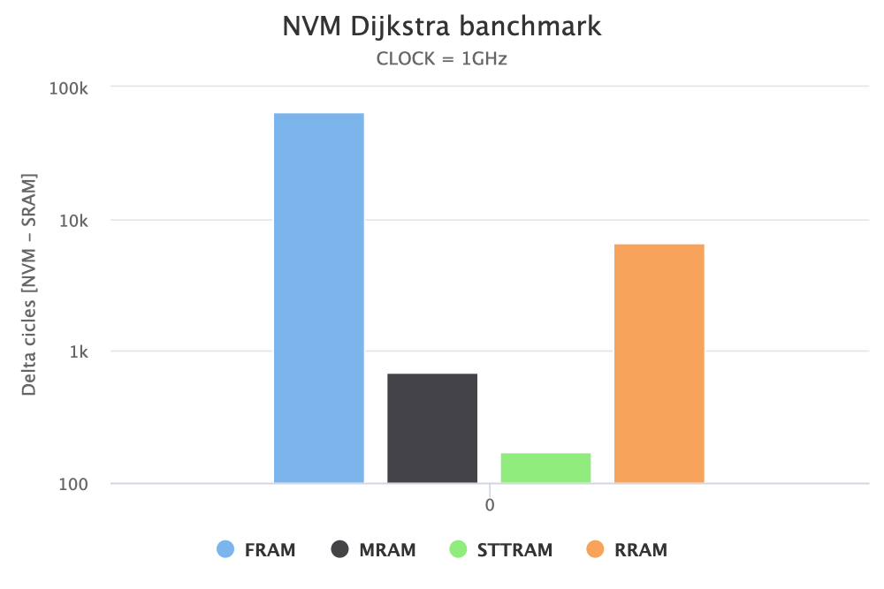
Evaluating NVM Performance
Evaluation Results – Normal Cache @ 1GHz
Increasing the cache size reduces by one order of magnitude the clock cycles overhead of NVM technologies
The performance ratio among NVM technologies does not change with respect to a smaller cache

Slide 26
Going Multi-Core with NoC Communication

Slide 27
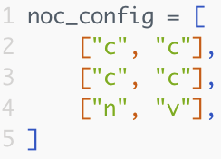
Multi-Core System Overview
NoC System
Each node of the NoC can be a CPU or a memory
We allow to easily configure the NoC components via a python list

Slide 28
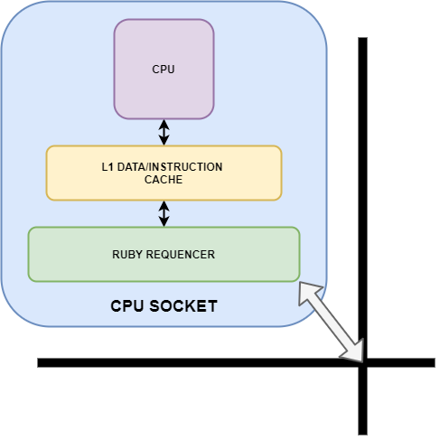
Multi-Core System Overview
NoC System
Each node of the NoC can be a CPU or a memory
We allow to easily configure the NoC components via a python list

Slide 29
Multi-Core System Overview
NoC System
A CPU socket has a private cache shared among data and instructions
A Ruby Sequencer to communicate with the NoC

Slide 30
Evaluating NoC System Performance

Slide 31
Evaluating NoC System Performance
System Setup:
We model a NoC system with:
4 CPU cores
Clock frequency: 1Ghz
Each CPU socket has 16kB of cache
512Mb of SRAM (main memory)
512Mb of Secondary Memory

Slide 32
Evaluating NoC System Performance
Evaluation Setup:
Benchmark scenarios:
4 parallel and independent executions of the Fast Fourier Transform
Dijkstra algorithm parallelized on 4 processes
Mixed analysis: 1 core runs Dijkstra algorithm, 3 cores runs a parallelized version of Susan (threads)
We consider the following memory technologies as secondary memory:
Memory Technology | Read Latency | Write Latency
SRAM | 1.23ns | 1.21ns
FRAM | 384ns | 320ns
RRAM | 40ns | 60ns
MRAM | 5ns | 4ns
STT-RAM | 1.95ns | 10.5ns

Slide 33
Evaluating NoC System Performance
Evaluation Results:
We run a simulation for each for each memory technology
Benchmark | N. Read Req. Memory 1 | N. Write Req. Memory 1 | N. Rea Req. Memory 2 | N. Write Req. Memory 2
4x FFT | 134'368 | 133'364 | 5'136 | 5'116
Dijkstra | 389'277 | 389'036 | 63'927 | 63'144
Mixed | 387'351 | 387'112 | 64'013 | 63'430

Slide 34
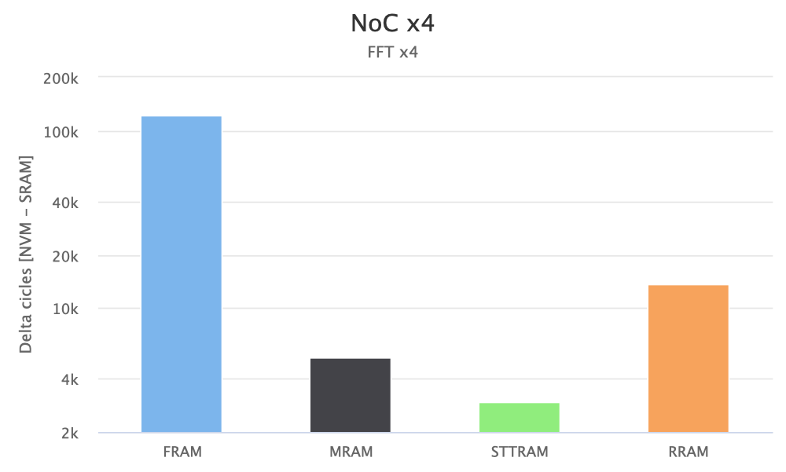
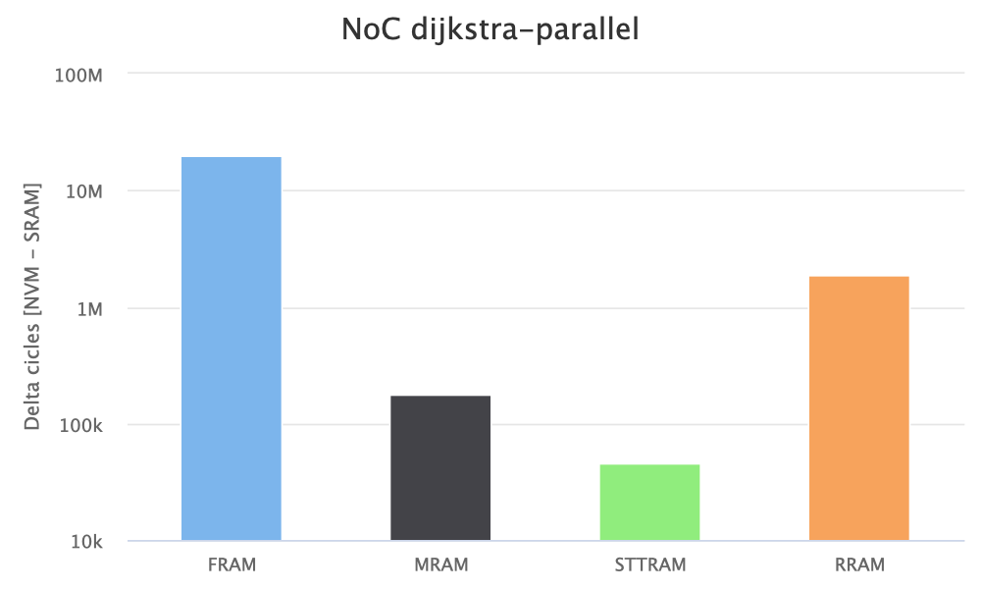
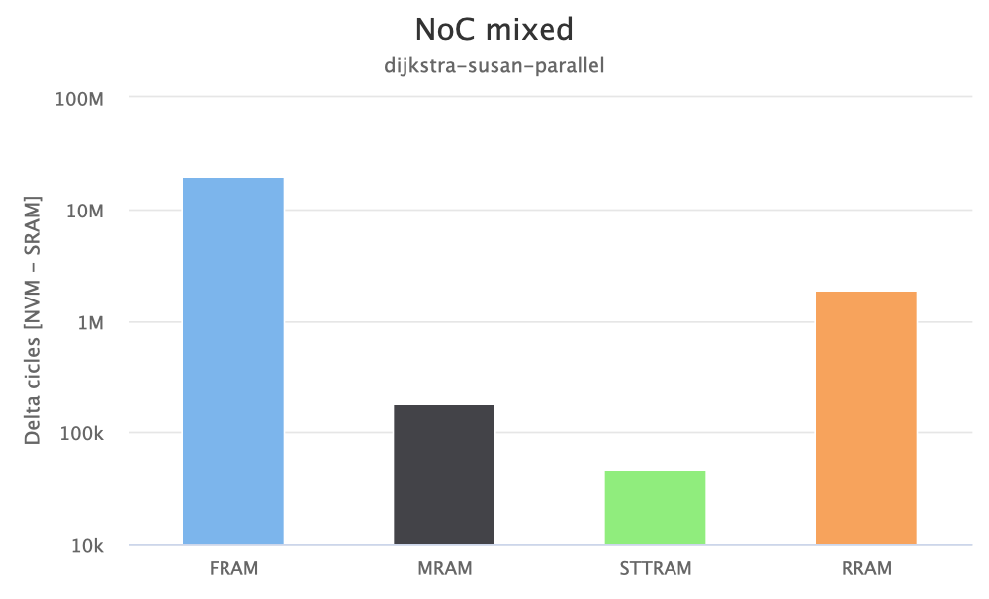
Evaluating NoC System Performance
Evaluation Results:
STTRAM has the best performance
FRAM has the worst performance

Slide 35
Conclusion

Slide 36
Conclusion
Conclusion:
We modeled four different NVM technologies inside gem5
We extended gem5 for supporting direct accesses to separated memory spaces
We modeled a NoC system that uses two separate memory spaces
We evaluated four NVM technologies across a heterogeneous set of benchmarks and system configurations

Slide 37
Questions?

