Slide 1
SyriaTel Customer Churn Prediction
SUMAIYA ABDULLahi Osman
20/02/2025

Slide 2
Business Understanding
BUSINESS UNDERSTANDING
Problem Statement
SyriaTel, a leading telecommunications company, faces a major challenge: customer churn. Customers leaving the network results in revenue loss and increased costs to acquire new users. To maintain profitability and customer loyalty, SyriaTel needs a reliable way to predict which customers are likely to churn and take proactive retention measures.
Objective
The goal of this project is to build a Classification model to predict whether customers are at risk of churning based on their call usage, account features, and service complaints. SyriaTel can then implement targeted retention strategies, such as offering discounts or improving service.

Slide 3
Data Understandingg
Dataset Source: Kaggle
Features include: State, Account length, Area code, Phone number, International plan, Voice mail plan, and more.
Target Variable: `churn` (1 = Churn, 0 = Not Churn)
Data Preprocessing & Feature Engineering
Handled missing values and outliers.
Scaled numerical features using MinmaxScaler.
Applied SMOTE to handle class imbalance.
Scaled Train and Test set Using StandardScaler
Selected important features using feature importance from XGBoost.- Created new features

Slide 4
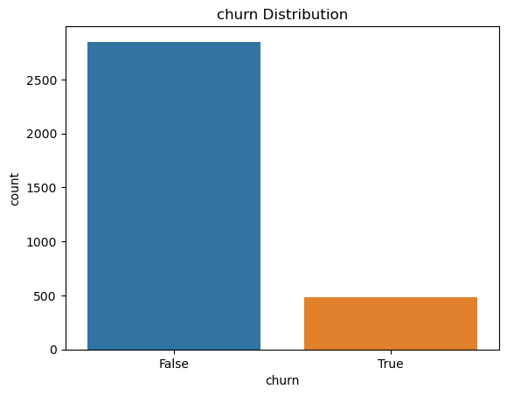
Customer Distribution: Bar chart of churn vs. non-churn customers
The dataset is imbalanced – only 14.5% of customers churn.
Why it matters: Models trained on imbalanced data may struggle to predict churn correctly because they are biased towards the majority class.
How we handle this: Techniques like SMOTE (oversampling), class weighting, or balanced metrics are used to improve model performance.

Slide 5
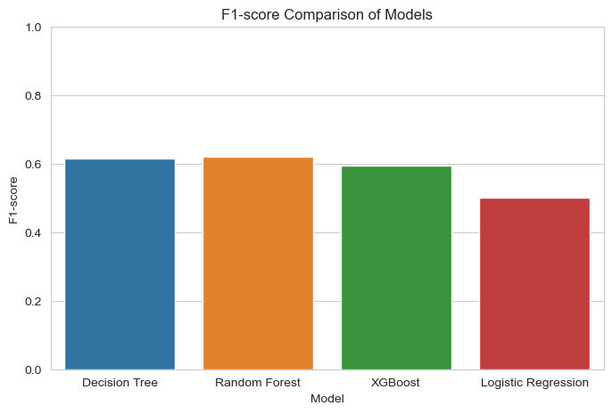
Model Performance Comparison (F1-Score)
Random Forest performs best (~0.62)
Strikes the best balance between Precision & Recall
Effectively identifies churners while minimizing false positives
Decision Tree is a close second (~0.61)
Slightly less balanced than Random Forest
XGBoost performs slightly worse (~0.60)
Despite being a strong model, hyperparameter tuning or data characteristics may have affected performance
Logistic Regression performs the worst (~0.50)
Struggles to balance Precision & Recall
High false negatives make it less suitable for this problem

Slide 6
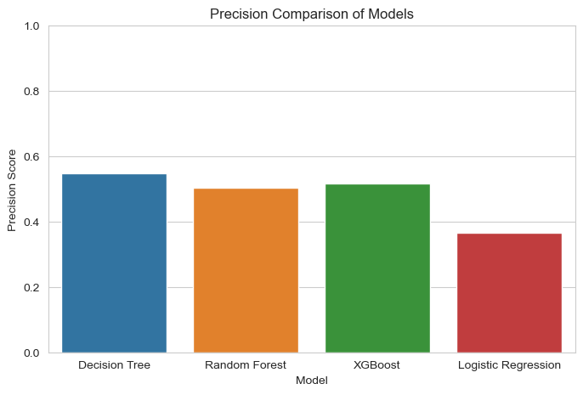
Model Performance Comparison (Precision)
Decision Tree has the highest Precision (~0.55–0.56)
More accurate when predicting churn
Fewer false positives (misclassified non-churners)
Random Forest follows closely (~0.50–0.52)
Still strong but slightly lower than Decision Tree
XGBoost has a slightly lower Precision (~0.48–0.50)
Good Recall but misclassifies some non-churners as churners
Logistic Regression has the lowest Precision (~0.35–0.37)
High false positives → wrongly predicts churn for many non-churners
Could lead to unnecessary interventions for customers

Slide 7
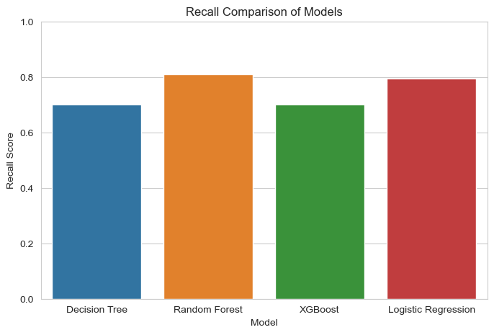
Model Performance Comparison (Recall)
Random Forest & Logistic Regression have the highest Recall (~0.80)
Best at identifying actual churners
Fewer false negatives, meaning fewer missed churners
Helps businesses detect and retain at-risk customers
Decision Tree & XGBoost have slightly lower Recall (~0.70)
Still effective but miss more actual churners
Some at-risk customers may not be flagged

Slide 8
Recommended Model – XGBoost
Model | Precision | Recall | F1-score
Decision Tree | 0.548780 | 0.703125 | 0.616438
Random Forest | 0.504854 | 0.812500 | 0.622754
XGBoost | 0.517241 | 0.703125 | 0.596026
Logistic Regression | 0.366906 | 0.796875 | 0.502463
Why Choose XGBoost?
✔ Best Balance between detecting churners (Recall) and avoiding false alarms (Precision) ✔ Consistent Performance across different validation sets ✔ More Reliable than Decision Tree & Random Forest for deployment

Slide 9
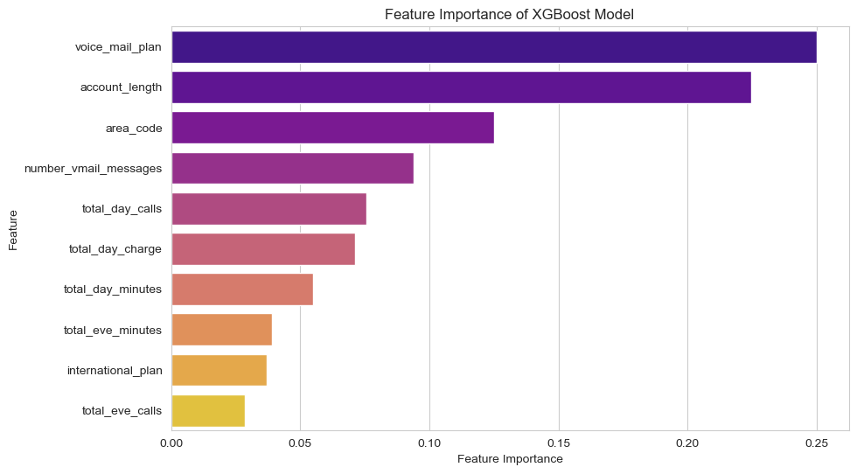
Feature Importance (from XGBoost)
Findings
Voice Mail Plan is the most important feature, highly correlated with churn. 2. Account Length is the second most influential—longer tenure impacts churn. 3. International Plan & Voicemail Messages also play a role in churn prediction. 4. Other features (area code, total charges, calls, minutes) contribute but have less impact.

Slide 10
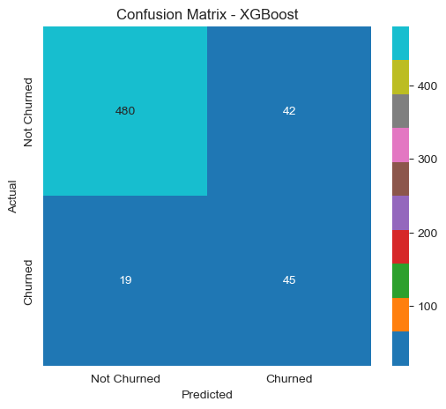
Confusion Matrix Heatmap
This heatmap visualizes the performance of the XGBoost model in predicting customer churn.
True Negatives (480): Correctly predicted non-churners.
False Positives (42): Wrongly predicted churn when the customer didn’t churn.
False Negatives (19): Missed actual churners, predicting them as non-churners.
True Positives (45): Correctly identified churners.
Key Insight: The model performs well, but some churners are misclassified as non-churners, which could impact retention efforts.

Slide 11
Conclusion & Recommendations
Key Takeaways:
XGBoost outperforms other models in churn prediction.
High churn customers tend to have month-to-month contracts and high support calls.
Business Recommendations:
Offer incentives for long-term contracts.
Improve customer support experience to reduce churn risk.
Implement targeted retention strategies for at-risk customers.

Slide 12
Next Steps
Deploy the model into a production environment.
Integrate predictive insights with CRM for proactive customer engagement.
Monitor and retrain the model periodically to maintain accuracy.

Slide 13
Q&A
Thank You!
sumaiyaabdullahiosman@gmail.com

