Slide 1
Proj 1: Netflix & More
Maiya Richardson

Slide 2
About Netflix & More
Command line interface

Slide 3
Technology used
Hadoop MapReduce
Scala 2.11 (or 2.12)
YARN(by default)
Hive
HDFS
Git + GitHub
QveenMai/NetflixAndMore (github.com)

Slide 4
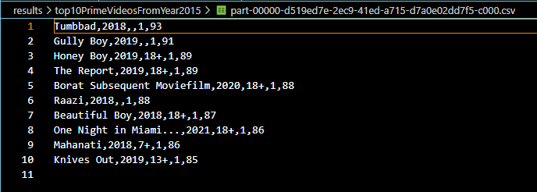
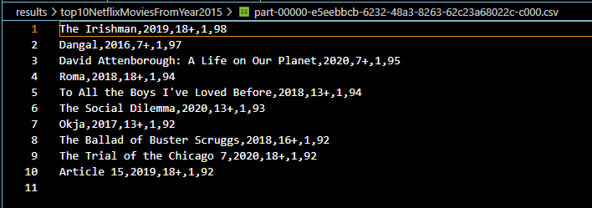
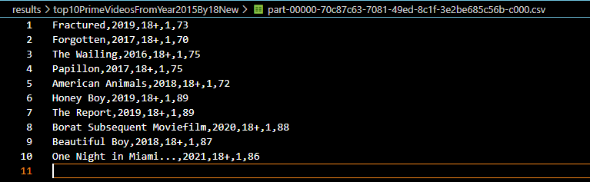
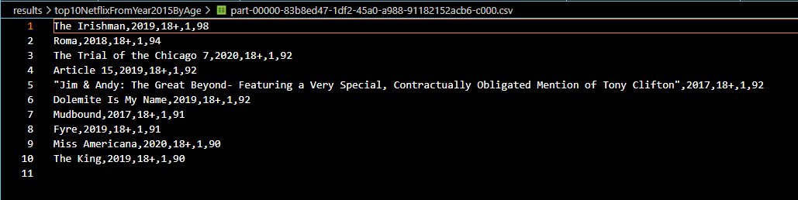
Examples from netflix & more

