Slide 1
BUSINESS INTELLIGENCE ANALYSIS
Global Superstore
Business Insights, Risks, Opportunities & Recommendations
Olorunmaiye Oluwakemi

Slide 2
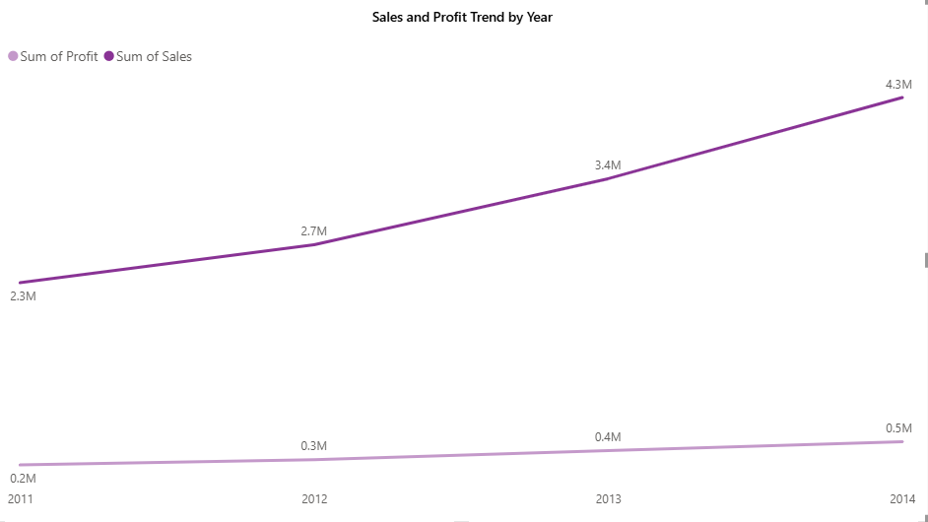
Executive Snapshot
Headline performance across the full dataset, 2011–2014
$12.64M
$1.47M
25,035
11.61%
$505
Total Sales
Total Profit
Total Orders
Profit Margin
Avg. Order Value
Sales & Profit grew every year: $2.26M / $249K (2011) → $4.30M / $504K (2014) — growth is landing on the bottom line, not just the top line.
Global Superstore — BI Analysis
Part 4 — Executive Snapshot

Slide 3
Key Business Insights
1 of 2
What is driving Sales performance
+90%
1
The strongest sales drivers are Technology, the stronger-performing regions/markets, and the growth in sales over time. Sales and profit increased consistently between 2011 and 2014. Sales increased from $2.26M to $4.30M, while profit increased from $249K to $504K, indicating that the growth in revenue was accompanied by growth in profitability.
sales growth
2011–2014
Sales volume and profitability MAY NOT move together
6.9%
2
Technology combines strong sales with the highest category margin. Technology generated $4.74M in sales and a 14.0% profit margin, while Furniture generated $4.11M in sales but only a 6.9% margin. This shows that high sales volume does not necessarily translate into stronger profitability.
Furniture
margin
Higher discount levels are associated with weaker profitability
$921K
3
Order lines discounted above approximately 20% are collectively unprofitable, while 12,544 of 51,290 order lines are loss-making, representing approximately 24.5% of order lines and a $921K negative contribution to total profit.
profit lost to
loss-making lines
Global Superstore — BI Analysis
Part 4 — Key Business Insights

Slide 4
Key Business Insights
2 of 2
Performance is heavily concentrated by market
2.0%
4
APAC is the strongest-performing market, generating $3.59M in sales and $436K in profit, with a 12.2% profit margin. EMEA, by comparison, generated $806K in sales and $44K in profit, resulting in a 5.4% margin. This indicates significant differences in sales and profitability across markets.
Southeast Asia
profit margin
Consumer is the largest revenue-generating customer segment
51%
5
The Consumer segment alone generates $6.51M in sales and $749K in profit — more than Corporate ($3.82M / $441K) and HThe Consumer segment generated $6.51M in sales and $749K in profit, compared with $3.82M in sales and $441K in profit for Corporate and $2.31M in sales and $277K in profit for Home Office. This makes Consumer the largest contributor to overall sales and profit.ome Office ($2.31M / $277K) combined. Revenue looks broad-based; profit concentration says otherwise.
of total sales from
Consumer segment
Global Superstore — BI Analysis
Part 4 — Key Business Insights

Slide 5
Business Risks
Where current performance is exposed
1
2
3
Tables is a currently loss-making
High discounting presents a profitability risk
Low-margin regional performance creates profitability risk
The Tables sub-category generated $757K in sales but a negative $64K profit, resulting in a -8.5% margin.
Profit becomes negative at higher discount levels, with order lines above approximately 20% discount collectively generating negative profit.
APAC leads market-level performance, generating $3.59M in sales and $436K in profit, with a 12.2% profit margin. EMEA generated $806K in sales and $44K in profit, resulting in a 5.4% margin.
−$64K
20%
5.4%
Tables profit
margin breakeven
discount level
EMEA profit
margin
Global Superstore — BI Analysis
Part 4 — Business Risks

Slide 6
Business Opportunities
Where the data points to upside
1
2
3
Technology carries the best margins in the portfolio
A proven high-margin market exists to copy
Develop targeted strategies for high-value customers
Increase focus on high-margin Technology products. Technology generated $4.74M in sales with a 14.0% margin, while Copiers generated $259K profit at a 17.1% margin. Management could evaluate opportunities to increase sales of high-margin Technology products.
APAC combines high sales ($3.59M) with strong margin (12.2%). Whatever's working there in pricing or discount discipline is worth testing in EMEA and Southeast Asia region.
The top five customers each generate approximately $35K-$40K in sales, significantly above the average order value. Management could explore personalised account management or loyalty initiatives to strengthen relationships with high-value customers.
17.1%
12.2%
$40K
Copiers profit
margin
APAC profit
margin
top customer
total sales
Global Superstore — BI Analysis
Part 4 — Business Opportunities

Slide 7
Business Recommendations
1 of 2
Introduce tighter controls for discounts above 20%
1
Require additional review or approval for high-discount transactions and assess whether the expected sales benefit justifies the impact on profit.
Insight 3 — Deep discounting is erasing profit
Fix or de-prioritize the Tables sub-category
2
Renegotiate supplier cost, adjust list pricing, or bundle Tables with higher-margin Furnishings so the bundle clears a positive margin.
Insight 2 & Risk 1 — Tables is the only lossmaking sub-category
Rebalance category investment toward Technology
3
Shift a portion of Furniture's marketing and floor-space budget to Technology, particularly Copiers and Phones, where margins run roughly double Furniture's.
Insight 2 & Opportunity 1 — Technology carries the best margins
Global Superstore — BI Analysis
Part 5 — Recommendations

Slide 8
Business Recommendations
2 of 2
Run a margin diagnostic on Southeast Asia and EMEA
4
Audit freight and discount practices in both regions before setting next year's growth targets — growing volume without fixing margin structure first just scales the problem.
Insight 4 & Risk 3 — weak-margin regions growing on autopilot
Launch a top-customer retention program
5
Build a loyalty or account-management track for top-decile customers, concentrated in the Consumer segment, which already outperforms Corporate and Home Office combined.
Insight 5 & Opportunity 3 — Consumer segment and top spenders
Optimize Standard Class shipping costs
6
Shipping runs 10.7% of total sales, and Standard Class carries the largest share of both sales and shipping spend — the single largest absolute cost-saving lever available.
Supporting dashboard data — Ship Mode breakdown
Global Superstore — BI Analysis
Part 5 — Recommendations

Slide 9
The Bottom Line
Growth is real and profitable — but roughly a quarter of order lines are quietly losing money. Tightening discount discipline, fixing Tables, and doubling down on Technology and top-performing markets are the fastest paths to turning current revenue into more profit.
Thank you
Prepared from the Global Superstore dataset — 51,290 order lines, 2011–2014

