Slide 1
HealthConnect Week 7
Data Analytics Testing, Refinement & End-to-End Validation
Testing evidence • Cross-track validation • Refinement • Retesting • Week 8 readiness

Slide 2
1. Week 6 → Week 7 Transition
Week 6 output tested: appointment analysis/dashboard, core KPIs and validated no-show findings shared with Data Science.
Week 7 shift: from integration and analysis to systematic testing, refinement, retesting and evidence-based validation.
Key dependency: Data Science initially used a completed-only denominator (Attended + No-Show, n=4,737), while dashboard figures used all appointments for the relevant segment.
Week 7 objective: establish a traceable Test → Finding → Action → Retest record and identify what remains before Week 8.
HealthConnect Week 7 | Data Analytics | 2

Slide 3
2. Testing Readiness — Components & Objectives
Component | What was being tested | Connected track
KPI/dashboard calculations | Core KPI accuracy and source agreement | Data Analytics
Key no-show findings | Reproducibility and segment stability | Data Analytics
DA ↔ DS figures | Methodology/denominator consistency | Data Science
31–60 lead-time finding | Whether pattern holds across appointment types | Data Science
Gender-stratified variables | Subgroup evidence requested by DS | Data Science
Dashboard interpretation | Neutral wording and usability | Data Analytics
HealthConnect Week 7 | Data Analytics | 3

Slide 4
3. Testing Record — Major Tests
Test | Expected | Actual | Status
Core KPIs | Match source | 5,000; 1,696; 48.46%; 46.28%; 5.26% | PASS
DA ↔ DS figures | Comparable under same denominator | Initial ~2–3 pp difference; denominator identified | ISSUE → RETESTED
31–60 × appointment type | Broad-based pattern | 58.1%–65.1% across all four types | PASS
Gender investigation | Identify subgroup differences for DS | Reminder/distance differences larger for female group; lead-time similar | PASS WITH CAUTION
Data quality | Structural checks pass; limitations flagged | 0 duplicates; 0 logical violations; missingness/date issue documented | PASS WITH FLAGS
Dashboard UI filters | Interactive values propagate correctly | Source-level logic checked; PBIX interaction evidence not supplied | PASS
HealthConnect Week 7 | Data Analytics | 4

Slide 5
4. KPI Validation
KPI | Source | Dashboard/reference | Status
Total appointments | 5000 | 5,000 | PASS
Unique patients | 1696 | 1,696 | PASS
No-show rate | 48.46% | 48.46% | PASS
Attendance rate | 46.28% | 46.28% | PASS
Cancellation rate | 5.26% | 5.26% | PASS
HealthConnect Week 7 | Data Analytics | 5

Slide 6
5. Analytical Validation
Finding | Result | Interpretation
Previous no-show history | 43.5% → 53.5% → 59.4% → 68.8% | Descriptive pattern retained
31–60 day lead time | 60.49% (n=2,425) | Elevated observed segment
Reminder sent vs not | 47.36% vs 51.39% | Observed difference; no causal claim
Distance ≥20 km | 57.29% (n=398) | Elevated observed segment; 90 missing values
HealthConnect Week 7 | Data Analytics | 6

Slide 7
6. Segment Validation — 31–60 Days
Appointment type | N | No-show rate
Follow-up | 697 | 65.14%
Diagnostic Test | 314 | 59.55%
Specialist Consultation | 414 | 59.18%
General Consultation | 1000 | 58.10%
Overall | 2425 | 60.49%
HealthConnect Week 7 | Data Analytics | 7

Slide 8
7. Data Science Cross-Track Validation
Measure | DA completed-only | DS recomputation | Result
Previous no-shows 0/1/2/3+ | 46.3 / 55.9 / 62.1 / 70.3% | 46.3 / 55.9 / 62.1 / 70.3% | Exact match
31–60 lead time | 63.9% | 63.9% | Exact match
Reminder sent / not | 49.9 / 54.6% | 49.9 / 54.6% | Exact match
Distance ≥20 km | 60.2% | 60.2% | Exact match
31–60 by appointment type | Broad-based | Broad-based | Conclusion consistent
HealthConnect Week 7 | Data Analytics | 8

Slide 9
8. New Cross-Track Test — Gender Investigation
Variable | Female | Male | Use for DS follow-up
Overall no-show | 51.1% | 51.5% | Baseline comparison
Previous no-shows 0→3+ | 45.7 → 57.8 → 58.1 → 69.4% | 47.2 → 53.7 → 65.9 → 73.2% | Relationship shape differs
Reminder effect | +6.7 pp | +2.3 pp | Candidate interaction
Distance effect | +14.6 pp | +5.2 pp | Candidate interaction
Lead-time effect | +24.2 pp | +25.6 pp | Similar across groups
HealthConnect Week 7 | Data Analytics | 9

Slide 10
9. Data Quality & Limitations
Check | Result | Implication
Duplicate appointment IDs | 0 | PASS
previous_no_shows > previous_appointments | 0 | PASS
Missing distance | 90 | Flag distance analysis
Missing waiting time | 60 | Flag waiting-time analysis
Date-derived lead time vs supplied field | 2,905 / 5,000 differ | Use supplied booking_lead_days; document limitation
Reason for no-show | Not present | Cannot test stated reasons
Clinic location | Not present in dataset | Cannot compare Central vs Lakeside analytically
HealthConnect Week 7 | Data Analytics | 10

Slide 11
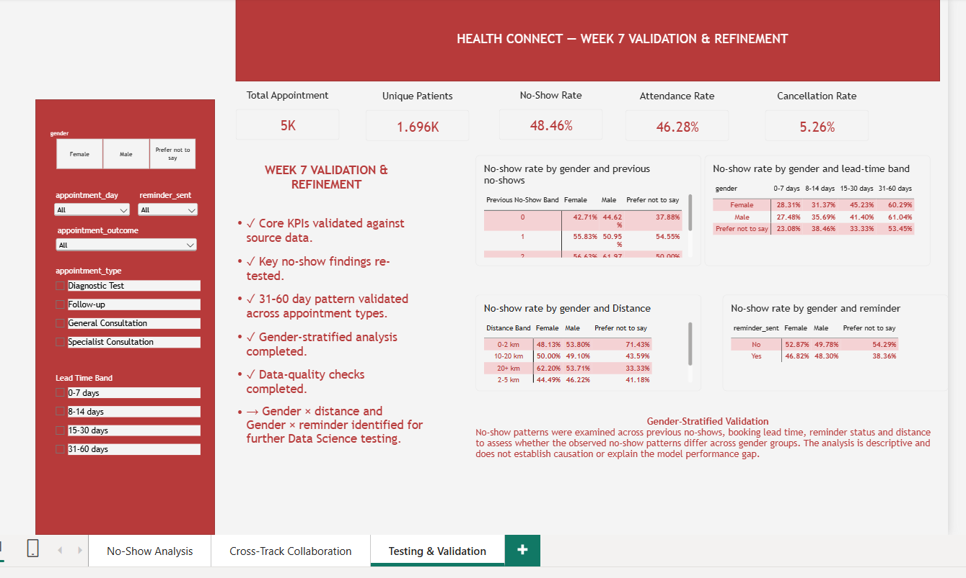
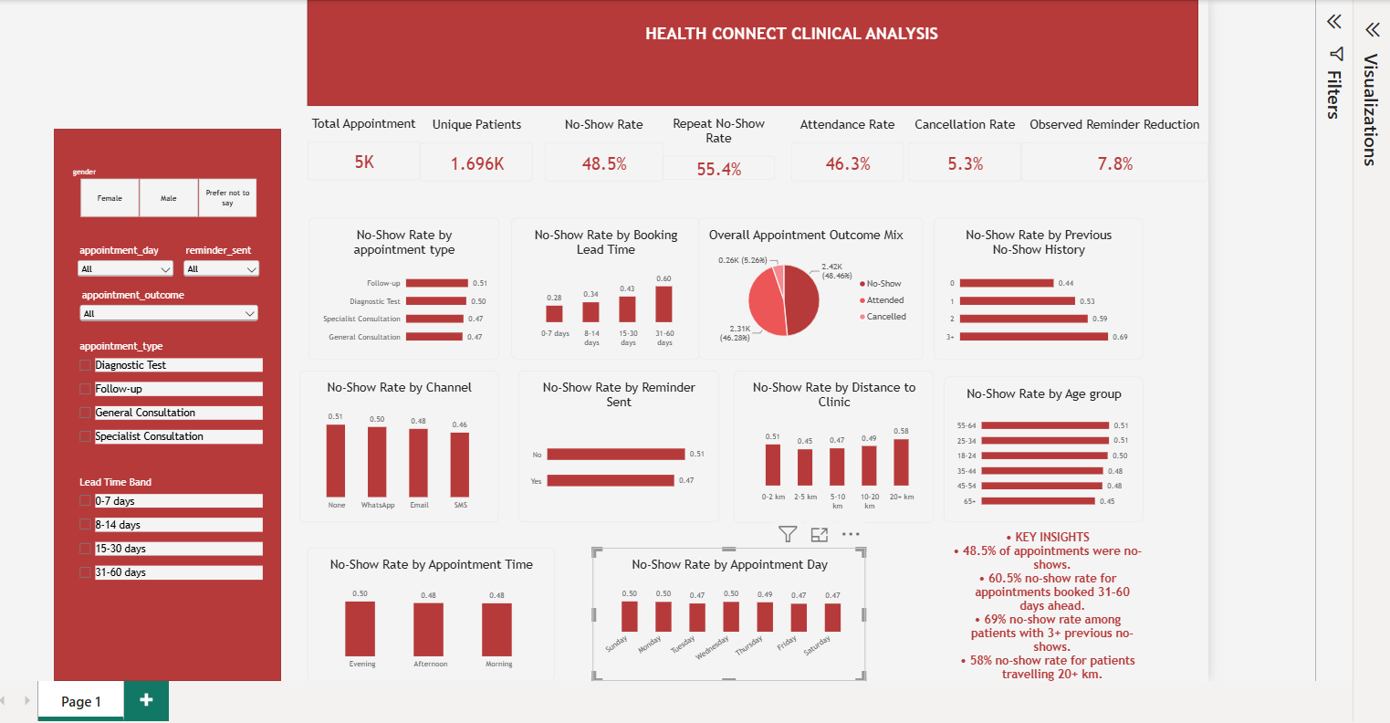
10. Dashboard Refinement & Evidence Status
Week 7 refines the existing dashboard; it does not rebuild the Week 5/6 analysis.
BEFORE STATE
Week 5 dashboard screenshot available
REFINEMENTS DEFINED
• Neutral reminder wording
• Clearer history terminology
• Validation/limitation context
• Gender evidence for DS
EVIDENCE STILL REQUIRED
Final Week 7 Power BI recording
HealthConnect Week 7 | Data Analytics | 11

Slide 12
11. Test → Finding → Action → Retest
Test | Finding | Action | Retest / status
KPI recalculation | Core KPIs matched | Retain definitions | Validated
DA ↔ DS comparison | Denominator caused initial difference | Align to completed-only comparison | Exact shared-figure match
31–60 segment | Elevated across all four types | Retain broad-based finding | Validated
Gender analysis | Reminder/distance subgroup differences | Provide targeted interaction candidates | DS model retest pending
Dashboard wording | Some metrics could be read causally | Use neutral descriptive wording | Validated in report
Filter UI | Source calculations reconcile | Capture PBIX interaction evidence | Tested
HealthConnect Week 7 | Data Analytics | 12

Slide 13
12. Assumptions, Risks & Dependencies
Area | Current status | Week 8 action
Denominator convention | Documented; DA/DS now aligned for shared comparison | Freeze shared convention
Date/lead-time consistency | Unresolved source-quality issue | Carry limitation forward
Missing distance/waiting values | Documented | Retain flags
No reason/location fields | Data limitation | Do not invent explanations; note future data needs
DS gender model test | Pending | Retest targeted interactions
HealthConnect Week 7 | Data Analytics | 13

Slide 14
13. Week 7 Project Summary
Required item | Response
1. Planned to test | KPI accuracy, dashboard/data agreement, filter/calculation logic, findings, segments, data quality and DA–DS dependency
2. Actually tested | KPIs, source-level calculations, findings, 31–60 by type, denominator reconciliation, gender analysis, data quality
3. Most important results | Core KPIs reconciled; 31–60 broad-based; DA–DS shared figures matched after denominator alignment
4. Issues | Denominator mismatch, date/lead-time inconsistency, missingness, missing reason/location
5. Improvements | Neutral wording, denominator documentation, targeted gender analysis, structured test record
6. Retesting | DA–DS and segment findings revalidated; UI tested
7–8. Collaboration | Data Science; shared figures, lead-time segment and gender analysis tested
9–10. Change & findings | Shared methodology clarified; targeted DS feature candidates provided; validated descriptive patterns retained
11–13. Challenges/decisions/limits | Source-quality issues documented; no source overwrite; no causal claims; synthetic-data limits retained
14–16. Remaining work/contribution/Week 8 | DS model retest, metric freeze; analytics testing record supports final integration
HealthConnect Week 7 | Data Analytics | 14

Slide 15
14. Week 8 Readiness — Required Before Final Integration
Freeze shared KPI definitions and denominator conventions across Data Analytics and Data Science.
Proposed Data Science follow-up: test the specific interactions gender × distance_to_clinic_km and gender × reminder_sent.
Carry forward the date/lead-time inconsistency, missing values, absent reason-for-no-show field and absent clinic-location field as documented limitations.
Use validated findings as decision-support inputs while keeping causal language out of the final solution unless further testing supports it.
HealthConnect Week 7 | Data Analytics | 15

Slide 16
15. Week 7 Conclusion
Week 7 moved the analytics work from “built and integrated” to “tested, reconciled and documented.”
CROSS-TRACK
Gender-stratified investigation
Targeted feature candidates provided to DS
Model retest remains pending
VALIDATED
Core KPIs
31–60 day pattern across appointment types
DA ↔ DS shared figures after denominator alignment
HealthConnect Week 7 | Data Analytics | 16

