Slide 1
RC8
Linked List, Template and Container

Slide 2
Outline
Linked list
Template
Container of pointers

Slide 3
Linked List

Slide 4
Linked List
What is linked list?
An ADT, which……
Stores data in series
Is mutable (not like list_t)
Is expandable – we can insert or remove data (not like array)
Slow random access (i.e. slow to read/write a[i])

Slide 5
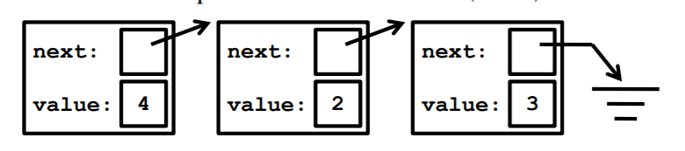
Linked List: Implementation
Firstly, we define the unit linked list - node
Stores data and address of next node in the list
Question: Can we define next as a node instead of node*?
next == NULL means we have reached end of list.
struct node {
node *next;
int value;
}

Slide 6
Linked List: Implementation
The liked list only need one (private) data member
You can also add others if needed (e.g., size).
Once we reach the first node, we can reach any node in the list
class list{
node *first;
public:
……
}

Slide 7
Linked List: Traversal
There is an example of traversal of linked list in your lecture slides
This is one reason we define first as a pointer – convenience
int IntList::getSize() {
// Effect: return # of items in this list
int count = 0; node *current = first;
while(current){
count++;
current = current->next;
}
return count;
}

Slide 8
Linked List: Member functions
bool isEmpty()
void insert(int v) // to the beginning
must use new
modify first
boundary case
int remove() // the first node
must use delete
modify first
boundary case

Slide 9
Linked List: Member functions
list()
list(const list&l)
deep copy – when data in l changes, data in this will not change
~list()
list &operator=(const list &l)
clear data & deep copy
boundary case

Slide 10
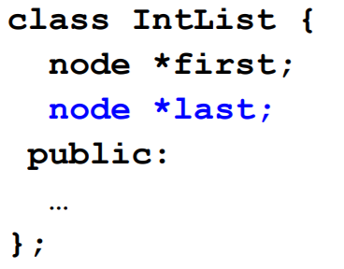
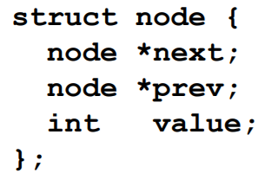
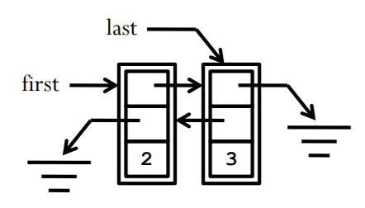
Linked List: Double ended list
Now we can insert/remove at the other end.
Which of member functions need to be modified?
However, remove from last is too slow
need to traverse from first to the “second last” node
So double linked list is needed
example from lecture slides: list (2, 3)

Slide 11
Template

Slide 12
Template
Why do we need template?
We can define class/function for different type.
Write more reusable code – polymorphism.
Example: linked list of integer and linked list of string

Slide 13
Template: How to write
Declaration: add template<class T> before declaration
Definition:
normal function:
class member function:
template<class T>
class List {
……
}
template<class T>
T max(T x, T y);
template<class T>
T max(T x, T y) {
……
}
template<class T>
T List<T>::insert(T v) {
……
}

Slide 14
Template: How to write
When use:
Create an instance of template class:
Call template function:
List<double> list1;
string a, b;
……
string c = max<string>(a, b)

Slide 15
Template: Exercise
Define a template class named CannonK with two template parameters T, U
Write its default constructor header
Write the header its copy constructor
Write its the header of its destructor
Write the header of “=“ overloading
Define a variable named airport that is a vector of CannonK with string and int

Slide 16
Container of Pointers

Slide 17
Container of Pointers
Why do we need container of pointers?
Sometimes we do not want to copy the data, especially when the data is large – sometimes we are guaranteed we do not need to copy.
Although we can easily get a container of pointers with the help of template, we do NOT write like this:
list<BigThing*> ls;
Instead, we define a templated container of pointers and write like this:
list_of_pointer<BigThing> ls;
Difference in implementation of two templated container is in the next page

Slide 18
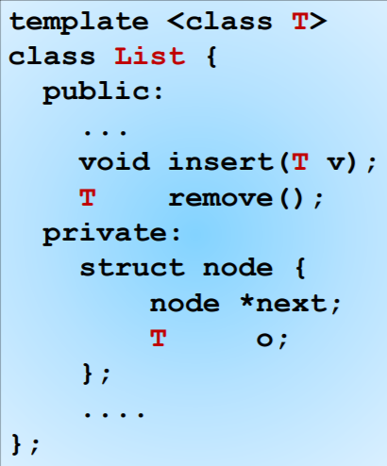
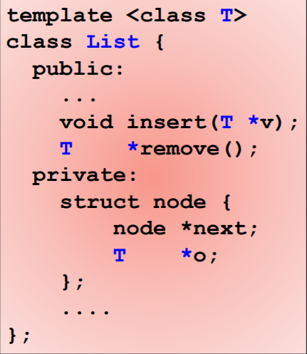
Container of Pointers

Slide 19
Container of Pointers: 1 invariant & 3 rules
At-most-once invariant: any object can be linked to at most one container at any time through pointer.
Existence: An object must be dynamically allocated before a pointer to it is inserted.
Ownership: Once a pointer to an object is inserted, that object becomes the property of the container. No one else may use or modify it in any way.
Conservation: When a pointer is removed from a container, either the pointer must be inserted into some container, or its reference must be deleted.
Go to lecture slides for example!

Slide 20
Reference
VE280-2021FA Lecture slides, Weikang Qian.
VE280-2021SU Final RC, Jiayao Wu

