Slide 1
Ve 280 Programming and Introductory Data Structures
Testing
Learning Objectives:
Understand the importance of testing
Know how to write test units

Slide 2
Testing
Given Inputs
Expected Outputs
?
=
Program under Test
Program Outputs

Slide 3
Testing It’s important!
Be skeptical.
Typically, the difference between a good and bad score on a project doesn't have much to do with your talent as a programmer. It has much more to do with your talents as a tester!
Testing is not the same as debugging
Debugging: Fixing something once you know it’s broken.
Testing: Discovering that something is broken.

Slide 4
Testing It’s important!
Some tips and truths about being a good tester:
Convince yourself that the code is broken.
Be in an adversarial frame of mind.
NEVER REST and must ALWAYS BE DILIGENT, because the code is NEVER FINISHED!
Everyone makes mistakes, and one essential nature of a mistake is that the person who made it didn't realize it was wrong – you thought it was perfect!
Notes:
Be in an adversarial frame of mind: what could be wrong?

Slide 5
Testing End-to-end vs. incremental testing
End-to-end testing is not a good idea
Errors made early tend to be pervasive and fixing them requires re-writing a large fraction of the existing program
Putting off testing until the program is "finished" increases your workload
Instead, test individual pieces of your program (such as functions) as you write them
This is incremental testing
Notes:
End-to-end testing is testing when you finish all the parts of the code. But, it has some problems
Waste of time: since many functions could potentially be wrong.
Incremental testing: for example, first make sure you read the input correctly. Then, add some functions. Then, add some more functions.

Slide 6
Incremental Testing The better type of testing
There are two advantages of incremental testing:
You are testing smaller, less complex, easier to understand units.
You just wrote the code, so you have a firm expectation of what it should do. If it's broken, it is fresh in your mind, so you can more easily fix it.
This will often require you to write extra code (the driver program) to test your program effectively. However, this is usually time well spent.

Slide 7
Five Steps in Testing
To test some piece of code (either a component or a whole piece):
Understand the specification
Identify the required behaviors
Write specific tests
Know the answers in advance
Include stress tests

Slide 8
Five Steps in Testing 1. Understand the specification
For an entire assignment, read through the specification very carefully, and make a note of everything it says you have to do – and stay away from the computer ☺
Since you have to break down the solution into (smaller) constituent parts, you must write specifications for these parts.
Sometimes your program as a whole may not work correctly, because you misunderstand the specification.

Slide 9
Five Steps in Testing 2. Identify the required behaviors
For any specification, boil the specification down to a list of things that must happen.
These are the “required behaviors” and a correct implementation must exhibit all of them.
Example: you are asked to write a command-line program called fact which takes one argument and calculates the factorial of the argument
Required behaviors
If there is no argument, output “missing argument”
If there is more than one argument, just work on the first, ignoring the remaining
If the argument is not an integer, report “non-integral value”
If it is a negative integer, report “negative integer”
If it is 0, output 1
If it is positive integer n, output n!

Slide 10
Five Steps in Testing 3. Write specific tests
For each of your required behaviors, write one or more test cases that check them.
To the extent possible, the test case should check exactly one behavior – no more!
That way, if the case fails, you know where to start looking.

Slide 11
Five Steps in Testing 3. Write specific tests
There are three classes of test cases that make sense:
Simple inputs
Boundary conditions
Nonsense
Simple cases are those that are “normal” for the problem at hand.
“Boundary” cases are at the edges of what is expected, or formed to exploit some detail of implementation.
“Nonsense” cases are those that are clearly unexpected.

Slide 12
Example: Testing Factorial Function
Simple inputs
An integer >= 1
Boundary conditions
Value 0
Nonsense
Negative values or non-integer values
Assume use cin to get the input

Slide 13

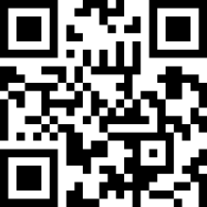
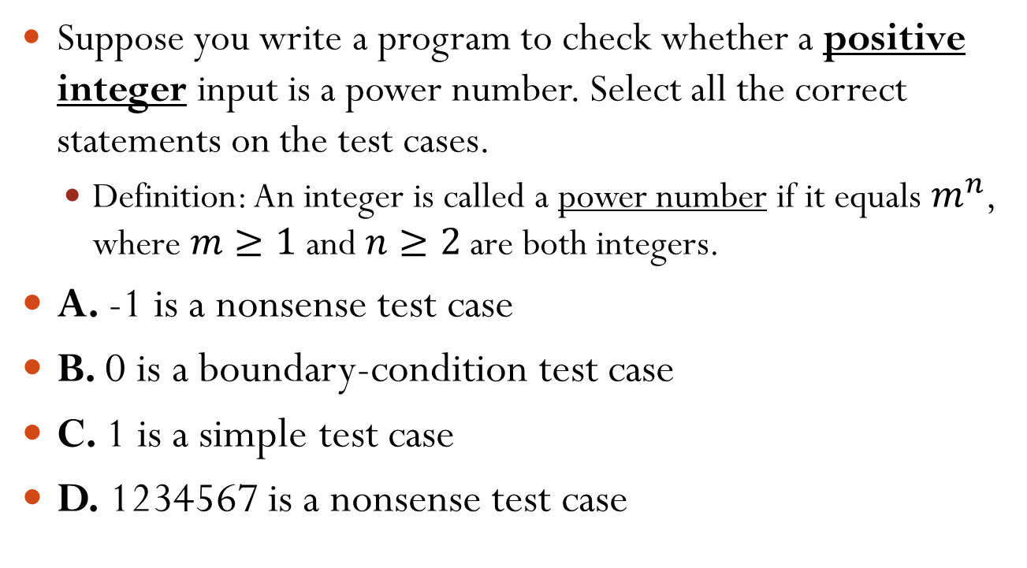
Which Statements Are Correct?
Suppose you write a program to check whether a positive integer input is a power number. Select all the correct statements on the test cases.
Definition: An integer is called a power number if it equals $m^{n}$, where $m≥1$ and $n≥2$ are both integers.
A. -1 is a nonsense test case
B. 0 is a boundary-condition test case
C. 1 is a simple test case
D. 1234567 is a nonsense test case
Notes:
Correct answers: A
Largest int: 2,147,483,647
Simple inputs: 3 & 4
Boundary conditions: 1, since it is special as 1^n =1
Nonsense: negative values, non-integer values

Slide 14
Five Steps in Testing 4. Know the answers in advance
Instead of quickly running test cases and glancing at the output:
First write down what you expect to be a correct answer.
If the result differs in any way from what you expected, try to figure out why.
It’s possible that your expectation had been wrong…or your implementation.
However, doing this ABSOLUTELY REQUIRES that you understand the specification.
If you don’t, you will create an incorrect solution that satisfies your incorrect expectation!

Slide 15
Five Steps in Testing 5. Include stress tests
Once you've tested each individual behavior, it's time to test all of them in concert.
For this, you want large and long running test cases.
They must be large, to exercise resource limits in your program.
E.g., some web applications need to be tested under a large amount of simultaneous accesses.
They must be long running, because some errors are the result of lots of little bugs that individually don't matter much, but as they cascade produces catastrophic results.
E.g., the accumulation of the round-off error
E.g., the memory leakage

Slide 16
Testing The joys of automation
As you develop test cases for some code, it pays to write other programs that automatically test the code using those test cases.
for each test case ti {
run your program on ti
compare output with expected output
}
This is important because, as the number of test cases grows (and the hour grows late) people get tired, and start to make mistakes.
Computers, however, never get tired, so take advantage of this.

Slide 17
Testing The joys of automation
Once you have your test programs, every time you change even the smallest part of your code, you can go back and test all of the behaviors. This is also referred to as regression testing.

Slide 18
General Debugging Techniques
Using cout
Using a debugger, such as GDB
Using the assert function
The assert function is a special function, defined in <cassert>, which takes a Boolean argument.
If the argument is true, assert() does nothing.
If the argument is false, assert() causes your program to stop, printing an error message to the cerr stream.
Notes:
Show demo

Slide 19
Using Assert Function
#include <cassert>
assert for the condition that should hold.
Example: In testing function int min(int a, int b), assert that the return value is the smaller one.
int smaller = min(a, b);
assert(smaller <= a && smaller <= b);
Is it perfect? If not, can you improve this?
Notes:
Improve: not just smaller, but there exists one value of a or b that is the same as the returned min.
(smaller == a && smaller <= b) || (smaller == b && smaller <= a)

Slide 20
Disable Assert
Note that things to be asserted might be expensive.
assert(very_expensive_func());
If it is, you can disable it, by compiling with the NDEBUG preprocessor variable.
There are two ways to do this:
1. Define it before including <cassert>:
#define NDEBUG // disable assert()
#include <cassert>
2. Specify it on the command line of the compiler:
g++ -DNDEBUG ...
This way, you can turn it off for "production" code, but leave it in during development and testing.
-DMARCO: Define a MARCO for you code
Same as putting “#define MARCO” in your code

Slide 21
Reference
Test-driven development and unit testing
http://alexott.net/en/cpp/CppTestingIntro.html

