Slide 1
VE280 Programming and Elementary Data Structures
Introduction

Slide 2
Instructor
Weikang Qian
Email: qianwk@sjtu.edu.cn
Phone: 3420-6765 (Ext. 4301)
Office: Room 430, JI Building
Office hour
Tuesday 7:00 – 8:00 pm
Thursday 7:00 – 8:00 pm
Or by appointment

Slide 3
Time & Physical Location
Monday 12:10-1:50 pm (odd weeks), D100 (East Upper Hall 100)
Tuesday 2:00-3:40 pm, A100 (Upper Hall 100)
Thursday 2:00-3:40 pm, A100 (Upper Hall 100)

Slide 4
Notes on Attending the Lectures
Strongly encourage to attend them onsite
If you have to attend remotely (hopefully, in very rare cases), here are the links for the online lecture:
For Monday lectures: https://vc.feishu.cn/j/802486971
For Tuesday & Thursday lectures: https://vc.feishu.cn/j/254945235

Slide 5
Textbook for Reference (Not Required)
“C++ Primer, 4th Edition,” by Stanley Lippman, Josee Lajoie, and Barbara Moo, Addison Wesley Publishing, 2005.
“Problem Solving with C++, 8th Edition,” by Walter Savitch, Addison Wesley Publishing, 2011.
“Data Structures and Algorithm Analysis,” by Clifford Shaffer. Online available: http://people.cs.vt.edu/~shaffer/Book/C++3e20120605.pdf

Slide 6
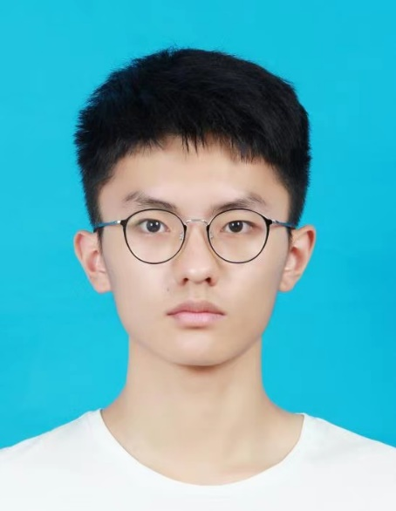
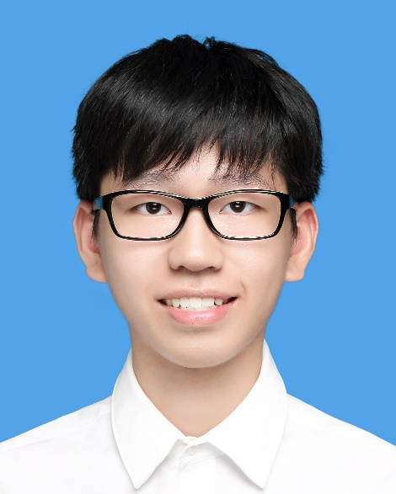
Teaching Assistants
Chen, Yunuo
Email: cyril-chenyn@sjtu.edu.cn
Ma, Pingchuan
Email: hensonma@sjtu.edu.cn

Slide 7
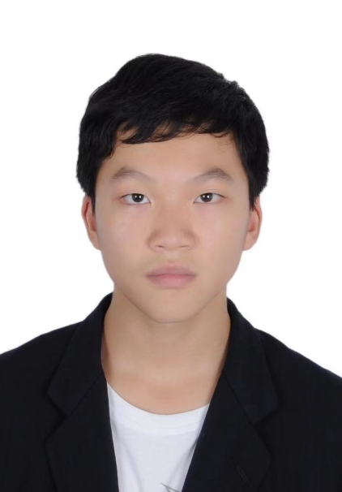
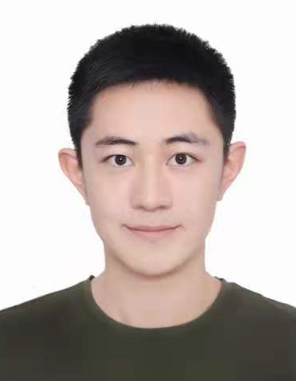
Teaching Assistants
Su, Zhenxuan
Email: sinesu@sjtu.edu.cn
Sun, Jiajun
Email: sunjiajun2007@sjtu.edu.cn

Slide 8
Grading
Composition
Class participation: 5%
(About) 5 programming projects: 50%
Midterm exam (written): 20%
Final exam (written): 25%
We will assign grades on a curve, in keeping with past grades given in this course.
Questions about the grading?
Must be mentioned to TAs or instructor within one week after receiving the item.
Notes:
Five programming projects: the first will be relatively simple, warm-up project.
If you raise the issue after the one-week deadline, we will not re-judge your assignment.

Slide 9
Class Participation
I may ask a question from time to time and randomly pick a student to answer it
If you’re there every time when I ask you, you get all participation points (That’s easy!)
Otherwise, you’ll lose some points.

Slide 10
Projects
Projects require:
Read and understand a problem specification
Design a solution (in your mind)
Implement this solution (simply and elegantly)
Convince yourself that your solution is correct
Notes:
Design a solution: in your mind. Typically, it is done hierarchically.
Implement a solution: use the programming technique you learned to realize your idea.
Convince correct: how? By testing. Right, good. Wrong, debug.

Slide 11
Projects
We will give you a few simple test cases to get started. You should design your own set of tests (very important!).
You will have chance to pre-test your program before the deadline.
We will use an online judge.
Pre-test cases are a subset of final test cases.
Grading projects will be done by a combination of testing (correctness) and reading (implementation requirement and simplicity/elegance).
Notes:
Testing is very important. Programming is not just about finishing the coding. You should make sure that your program works correctly against specifications. You should test yourself by designing various test cases. Further, you should test every specific corner.
Grading: we have a number of test cases. Part of them are those used in pretesting. If you get a few scores from pretest, then you guarantee to have those scores in the final judge.
Implementation requirement: for example, we require you to implement a function recursively, instead of iteratively.
Simplicity/elegance: e.g., code duplication?

Slide 12
Programming Environment
We require you to develop your programs on Linux operating systems using compiler g++.
C++11 standard is allowed.
Compile with the option –std=c++11
We will grade your programs in the Linux environment.
They must compile and run correctly on this operating system.
Notes:
Linux operating system: for this purpose, I will teach you a few basic things about using Linux.

Slide 13
Project Deadline
Each project will be given a due date. Your work must be turned in by 11:59 pm on the due date to be accepted for full credit.
However, we still allow you to submit your homework within 3 days after the due date, but there is a late penalty.
No work will be accepted if it is more than 3 days late!
Hours Late | Scaling Factor
(0, 24] | 80 %
(24, 48] | 60 %
(48, 72] | 40 %

Slide 14
Project Deadline
In very occasional cases, we accept deadline extension request.
Deadline extension requests will only be considered if you contact the course instructor in person. Do not contact TAs!
ONLY granted for documented medical or personal emergencies that could not have been anticipated.
NOT granted for reasons such as accidental erasure/loss of files and outside conflicting commitments.
Notes:
Outside conflicting commitment: such as scheduled interviews. Plan your time well.

Slide 15
Some Suggestions
Practice! Build demos yourself
You have the freedom. Even try something wrong on purpose
Learn from your mistakes!
Take notes on the mistakes you make. Review frequently
Start your project early!
Don’t wait until the last minute. Numerous lessons before
Hofstadter's Law: It always takes longer than you expect, even when you take into account Hofstadter's Laws
Make copies frequently in case your computer crashes.
Consequence: “computer crash” is NOT a reason for late submission!
Notes:
Numerous lessons before, even for students who are good at programming

Slide 16
Honor Code: Collaboration and Cheating
You may discuss in oral with your classmates.
But you must do all the assignments yourself.
Some behaviors that are considered as cheating:
Reading another student’s answer/code, including keeping a copy of another student’s answer/code.
Copying another student’s answer/code, in whole or in part.
Having someone else write part of your assignment.
Using test cases of another student.
Testing your code with another one’s account.
“Another student” includes a student in the current semester or in the previous semester.
Notes:
You are supposed to do it yourself. Why do you need a copy of another’s work?

Slide 17
Honor Code: Collaboration and Cheating
The previous lists of behaviors are deliberate cheating, but some unintentional actions could make you look like cheating. For example,
You use another’s computer to upload your code (in some cases like network/computer problems), but upload another’s copy.
You should be extremely careful!
If due to network/computer problem, you need to use another’s computer, double check the uploaded file.
Notes:
Yes, they do happen previously!

Slide 18
Honor Code: Collaboration and Cheating
In summary, you should be responsible for all answers/codes you submit. If you submit a copy of another student’s work (or overwrite another student’s work), it is considered cheating, no matter of the reason!

Slide 19
Honor Code: Online Attending
Online Presence and Activities
The Joint Institute imposes a “real name” policy for all online activities
Students are required to use their actual name (for Chinese students, use Pinyin) as part of their online presence
No share of the meeting ID of a given course to any person who is not enrolled in that course
Online Etiquette
Spam messages, verbal and other forms of abuse, and disturbance of the learning experience of other students are not permitted

Slide 20
Honor Code: Teaching and Learning Materials
Teaching and learning materials, such as lecture slides, assignments, your solutions, quizzes, videos etc. are copyrighted and may not be passed on to others without the permission of the course instructor.
This applies to recordings of the lectures
In particular, it is not permissible to upload videos to sharing platforms (such as Youku or YouTube) or to post lecture slides, assignment questions, project descriptions etc. on public sites such as SlideShare
If you use Github to back up your code, make your repository private

Slide 21
Consequence of Honor Code Violation
Any suspect of honor code violation will be reported to the Honor Council at JI.
For programming assignments, we will run an automated test to check for unusually similar programs. Those that are highly similar - in whole or in part - will be reported to the Honor Council at JI.
Penalty of honor code violation
Reduction of the grade for this assignment to 0, plus
Reduction of the final grade for the course by one grade point, e.g., B+ → C+, for both students involved

Slide 22
Canvas
Log into Canvas: https://umjicanvas.com
Check the class webpage on Canvas regularly for
Announcements
Slides
Grades
Course slides will be uploaded onto Canvas before each lecture.

Slide 23
Getting Help
If you have any questions, you can come to see TAs and instructor during the office hour
Better choice for questions that are not easy to solve!
You can also post it on piazza
You can help answer your fellow students’ questions
For private question, you can also write emails to us

Slide 24

Aside: Fun Quizzes!
What?
Multiple-choice questions on slides with
Non-graded and Anonymous
Feel free to answer even if you’re not sure!
How?
Scan a QR code on your smartphone
Answer
Note: Some are single-choice; some are multiple-choice
Why?
Have fun!
Allow you to check your understanding
Allow the instructor to adapt his teaching
Let’s try one!

Slide 25

Do You Like Programming?
Choose one answer:
A. I like it very much!
B. I more or less enjoy it.
C. I’m OK with it.
D. I hate it.

Slide 26
What I Assume You Know
Some basics of C++
Variables
Built-in data types, e.g., int, double, etc.
Operators, e.g., +, -, *, etc.
Flow of controls, e.g., if/else, while, for, switch/case, etc.
Functions; function declaration versus definition.
Arrays
Pointers
References
Struct

Slide 27

What Does foo(1, 2, 0) Print and Return?
double foo(int a, double b, int c){
while (c<=1) c++;
cout << (a/b);
return (a/c);
}
Choose the correct answer:
A. It prints “0.5” and returns 0.5.
B. It prints “0.5” and returns 0.
C. It prints “0.5” and returns 1.
D. It prints “0” and returns 0.
Notes:
Correct answer: B

Slide 28

Why is Programming Fun?
First is the sheer joy of making things.
Second is the pleasure of making things that are useful to other people.
Third is the fascination of fashioning complex puzzle-like objects of interlocking moving parts and watching them work in subtle cycles.
Fourth is the joy of always learning, which springs from the nonrepeating nature of the task.
Finally, there is the delight of working in such a tractable medium.
The Mythical Man-Month: Essays on Software Engineering

Slide 29
The Task of Programming
Accept some specifications of the problem. (E.g., find the shortest way to go from my home to school.)
Problem solving phase:
Design an algorithm (perhaps in pseudo-code/flow chart) that
correctly satisfies the specification.
is efficient in its usage of space and time.
Implementation phase:
Implement the algorithm correctly and efficiently
An implementation of an algorithm is correct if it behaves as the algorithm is intended for all inputs and in all situations. Correctness is never negotiable!
Efficient can mean fast, simple, and/or elegant.
Notes:
Accept some specifications of the problem. Find the shortest way to go from my home to school: this is a path-finding problem. The specification tells you that the starting point is your home and the ending point is the school. Also, not an arbitrary path, but a path in the shortest sense. Sometimes, specification may be incomplete. For this example, shortest can either refer to the time or the distance.
Problem solving phase is in your mind. When you design it, you should also think about the efficiency.

Slide 30
Problem Solving Phase
Usually, hierarchical design: decompose into sub-tasks
Example: find the shortest path from home to school
Pseudocode
void main() {
graph_t map;
node_t home, school;
path_t path;
(map, home, school) = read(filename);
path = short_path(map, home, school);
print(path);
}
Step 1: read the graph
Step 2: find the shortest path
Step 3: output the result
Notes:
Problem solving: divide and conquer. In the shortest path example, 1) read the graph, 2) find the shortest path, 3) output the result

Slide 31
Key Points of Ve280
The focus of Ve280 is on the implementation part. Some key points we will learn include
Abstraction and its realization mechanism
Techniques to increase code reuse
Techniques to efficiently use memory
Elementary data structures
Some other essential parts of C++ programming
Notes:
Previous shortest path problem gives an example of abstraction.
Techniques to increase code reuse, e.g., template, polymorphism

Slide 32
Abstraction
One important concept about programming
Provides only those details that matter
Eliminates unnecessary details and reduces complexity
You already know one realization of abstraction: function (e.g. exp(x)), which is procedural abstraction
Notes:
Eliminates unnecessary details and reduces complexity. Consequence: you only need to focus on the current thing you are implementing.

Slide 33
Abstraction
We will talk about
Basics about abstraction
Procedure abstraction (i.e., function), in more detail
Data abstraction (i.e., class)
Basics about class: constructor, destructor, etc.
Abstract base class
void main() {
graph_t map;
node_t home, school;
path_t path;
(map, home, school) = read(filename);
path = short_path(map, home, school);
print(path);
}
Data abstraction
Elegant code!
Procedure abstraction

Slide 34
Techniques to Increase Code Reuse
Function and class, which are basic ways to increase code reuse
Class inheritance and virtual function
Template and polymorphism
Template: write one thing, used for many different types
Notes:
You want to write some code once and reuse it many times. The basic ways are functions and classes. Functions are procedure. Classes are types.

Slide 35
Techniques to Efficiently Use Memory
Sometimes, the amount of memory needed to solve a problem can vary a lot
Of course, you can write your program considering the worst-case memory usage
For example, a large enough array to hold data
However, this may lead to some waste in memory use
We will learn a solution: dynamic memory management
Dynamic memory allocation and de-allocation

Slide 36
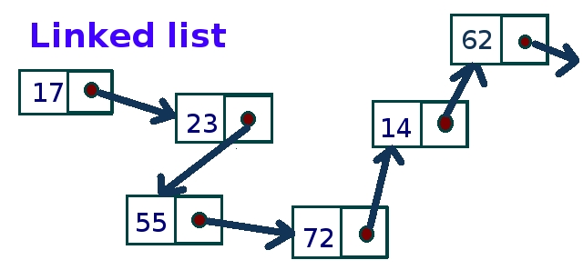
Elementary Data Structures
Data structures are concerned with the representation and manipulation of data.
All programs manipulate data.
So, all programs represent data in some way.
Example: Store a list of numbers
Array
17 | 23 | 55 | 72 | 14 | 62
Notes:
(Click)
Array: a consecutive block of memory locations
Linked list: the locations scramble over the memory, but you have some clues to track all of them, essentially, through the pointer to the next node

Slide 37
Elementary Data Structures
We will learn
Linked list
Linear list
Stack
Queue
Note: This course only shows a few elementary data structures
More data structures will be taught in a following course, Ve281 Data Structures and Algorithms

Slide 38
Other Essential Parts
Writing programs that take arguments
I/O streams, including file I/O
Error handling
Testing
Linux

Slide 39

What Are the Issues with this Code?
Choose all correct answers:
A. There is no comment.
B. The naming of variables/function is not clear.
C. The code is not indented.
D. The style is not consistent.
int f(int a, int *b, unsigned c)
{
int s = 0; int p = 1;
for(unsigned i = 0; i <= c; i++) {
s = s + b[i] * p;
p = p * a; }
return s; }
Notes:
Answer: A, B, C, D.
In our project, we will also check for your coding style. Thing like shown in this example will give you a low score.

Slide 40
Good Programming Style
Comments
// Evaluate the polynomial on x
int poly_eval(int x, int *coef, unsigned degree) {
int result = 0;
int x_power = 1;
for(unsigned i = 0; i <= degree; i++) {
result += coef[i] * x_power;
x_power *= x;
}
return result;
}
Meaningful Naming
Indentation
Consistency!

Slide 41
Relation with Other Courses
Vg101 Introduction to Computers and Programming
Very basic programming skills.
Ve280 will go in depth. To connect, we will review some basics.
Ve281 Data Structures and Algorithms
Focus on the efficiency of the algorithms.
Ve280 focuses on correctness. It will show you some very basic data structures.
Notes:
For example, one thing you probably know is cout. However, you may not know that the buffering mechanism of cout.
As we said, the efficiency is also an important concern of programming. To solve a problem, what is the most efficient algorithm? This will be talked in Ve281.

Slide 42
Questions?

