Slide 1
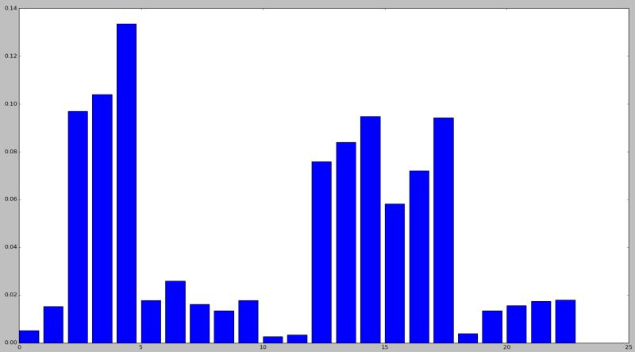
albumin","creatinine","bun","sodium","potassium","hemoglobin","bbr", "inotr
hospital duration; valvular disease; hypertension;
Albumin; creatinine; bun; sodium; potassium; hemoglobin;
bbr inotr

Slide 2
随机森林分类准确率：0.75

