Slide 1
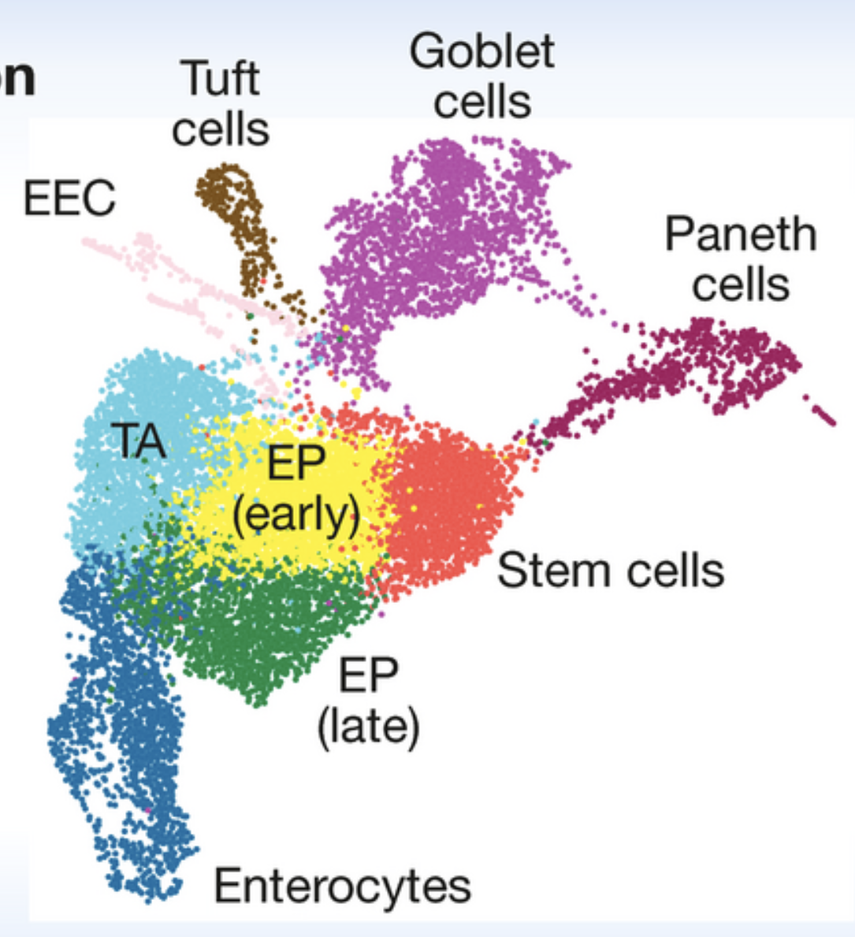
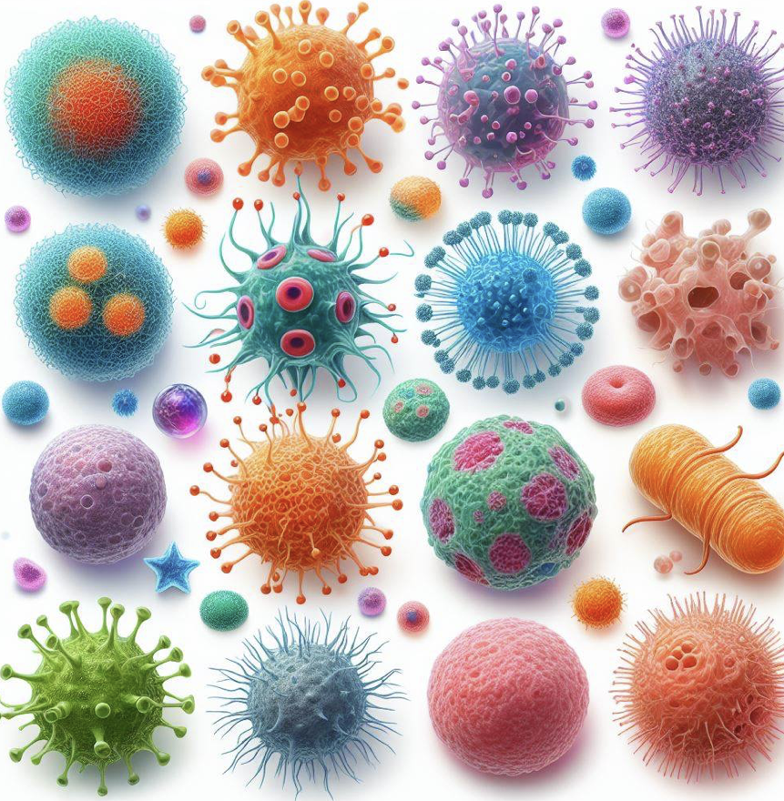
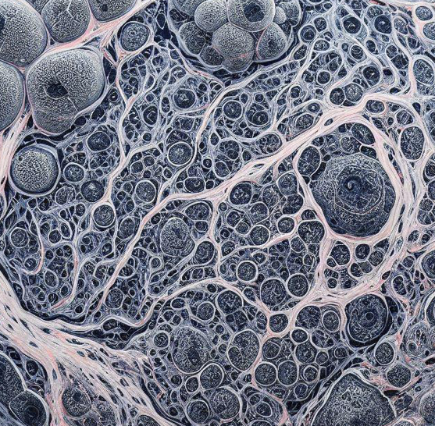
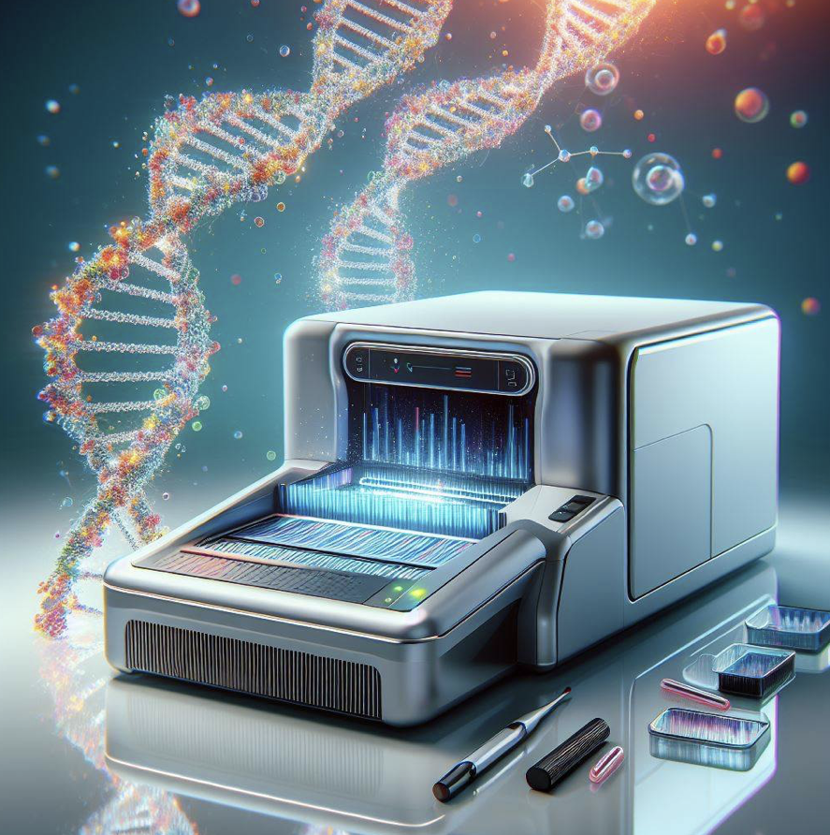
Single cell transcriptomics/
single cell RNA sequencing/
scRNAseq
Tissue
Each dot: a cell
Ind. cells
Transcriptome sequencing
Luecken & Theis 2019
Notes:
Today, we gonna talk about single cell RNAseq
Single cell RANseq stands for single cell RNA sequencing
It can also be called single cell transcriptomics or single cell transcriptome sequencing
Single cell RNAseq is a technique that has revolutionized recent biology
Basically, it is a method where we analyze the genome-wide gene expression profiles of individual cells in a hetergeneous cell population
Assume we are looking at a human tissue, it is hetergeneous and contains many different cell types
Also assume the transcriptome only contains 4 genes, which is not true, we know the transcirptome of human contains thousands of genes, here just for demonstration, we use 4 genes to represent the transcritome
Very likely, these four genes will not be expressed in the same fashion in all cell types, for example, celltype2 and celltype 5 tend to express more the green gene B, while celltype5 tend to express less the red gene A
This gene expression variability among cells can be explored using techniques such as single cell RNAseq

Slide 2
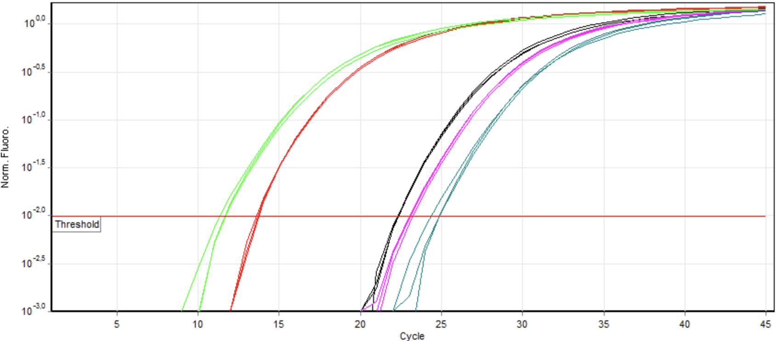
qRT-PCR
PCR
Sensitive
A small number of genes/transcripts
Notes:
Single cell RNAseq evolved gradually,
In the beginning, qRT-PCR is one of the important techniques for studying many genes at a time
It is PCR based
It is very sensitive,
But can only look at a small number of genes

Slide 3
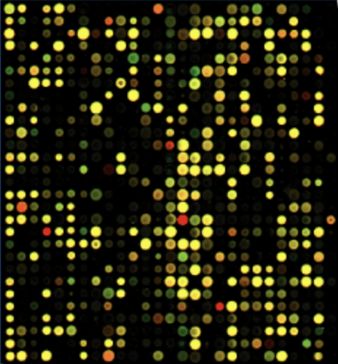
A transcriptome is the full range of messenger RNA, or mRNA, molecules expressed by an organism
microarray
Hybridization based
Genome wide survey of the transcriptome
Only profile predefined transcripts/genes on the chip
wikipedia
Notes:
Later on when microarray came in, it became one of the state of the art technique in the field,
It is hybridization based
It is able to study a large number of genes at the same time, it’s very efficient
However, it can only look at the genes that are included on the chip
Only profile predefined transcripts/genes through hybridization

Slide 4
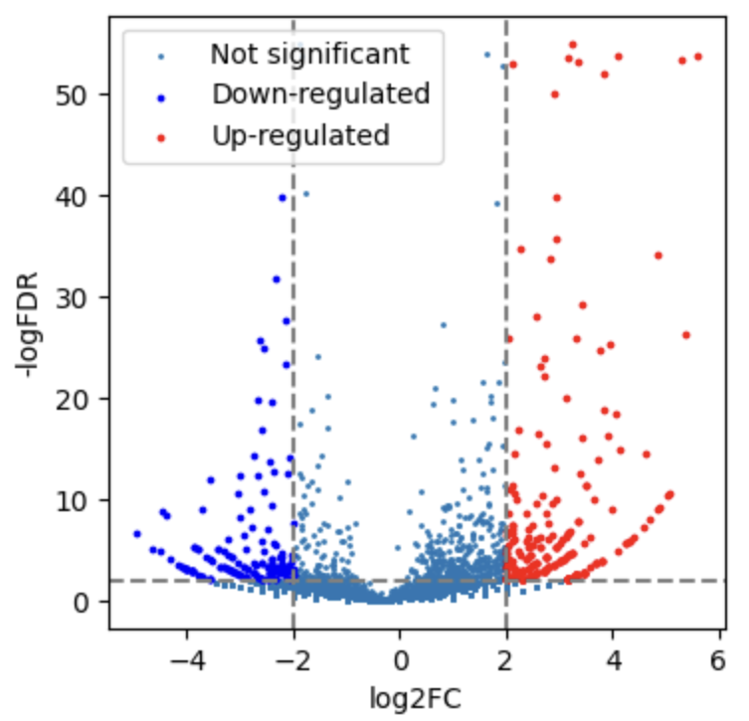
A transcriptome is the full range of messenger RNA, or mRNA, molecules expressed by an organism
Bulk RNAseq
Full sequencing of the whole transcriptome
Notes:
Which was eventually replaced by bulk RNAseq
It is a full sequencing technique of the whole transcriptome
As long as a gene is expressed, it has the possibility to be sequenced by bulk RNAseq

Slide 5
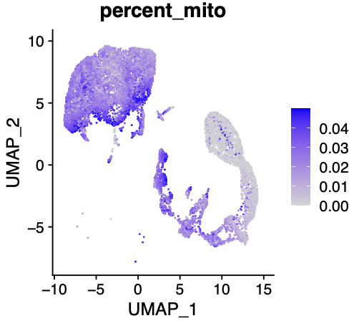
scRNAseq
Sequencing
Genome wide survey of the transcriptome
Individual cells
A transcriptome is the full range of messenger RNA, or mRNA, molecules expressed by an organism
2009
Notes:
Nowadays, single cell RNAseq is taking over from 2009,
It is sequencing based
It can measure the expression levels of a large number of genes for individual cells
and over the last decade, single cell RNAseq has been extensively used in the field of biology and neuroscience and many more

Slide 6

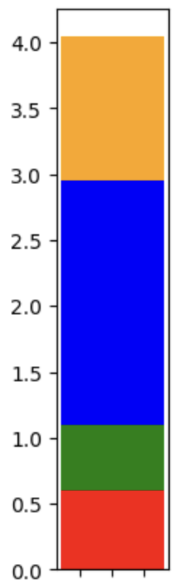
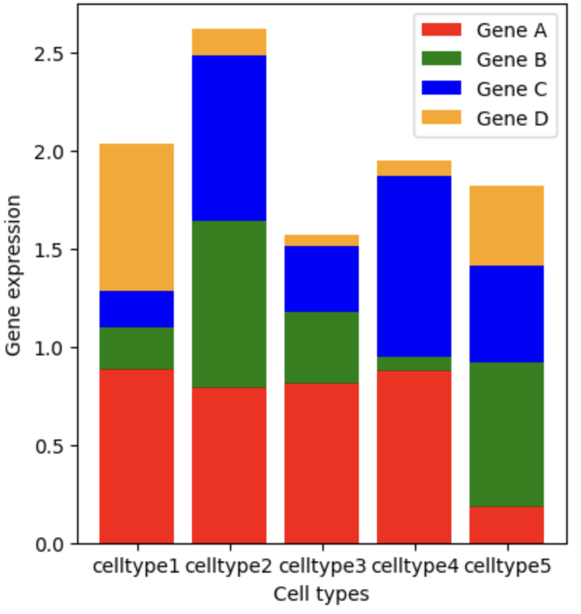
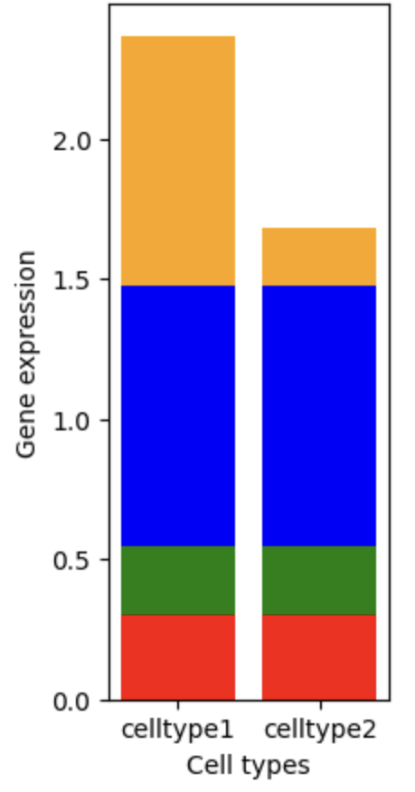
Bulk
RNAseq
Unit: sample
Sample
Tissue
Single cell
RNAseq
Unit: Ind. cells
Cell types
Notes:
Then what’s the difference between the last two techniques, the bulk and the single cell RNAseq
In bulk RNAseq, we treat each sample as a unit, crush it to extract RNA and sequence all RNAs from the same tissue together, no matter it is from cells A or B.
While in single cell RNAseq, we treat each cell as a unit, and make a survey of the transcriptome for each ind. cells, and look at the genome-wide gene expression profiles of cells of the same type, which we call it cell type.
Comparing to bulk RNAseq, scRNAseq has a higher resolution,
it can better detect gene expression changes in the sample,
and it can name which cells are responsible for those changes.
For example, if there are two celltypes within a tissue, celltype 1 and celltype2,
And there is a yellow gene that is upregulated in celltype 1, but downregulated in celltype2, this phenomenon may not be observed by bulk RNAseq,
because in bulk RNAseq, we are looking at the combined gene pression profile of both cell types together,
And the gene expression changes of these two celltypes may easily cancel each other in the mix
So it will look like we have no change at the mixture level.
However, this will not be an issue in scRNAseq.
To answer this question, we can assume we are looking at human tissue again
In bulk RNAseq, you want to take all the cells out of the tissue, crush them together, and measure the gene expression profiles of all the cells together
This approach has limitations
For example, if there are two celltypes within this tissue, celltype 1 and celltype2,
And there is a yellow gene that is upregulated in celltype 1, but downregulated in celltype2, this phenomenon will not be observed by bulk RNAseq,
because in bulk RNAseq, we are looking at the combined gene pression profile of both cell types together,
And the gene expression changes of these two celltypes will cancel each other in the mix
So it will look like we have no change at the mixture level.
However, this will not be an issue, because, in single cell RNAseq, we study the gene expression profiles of individual cells

Slide 7


Bulk
RNAseq
Unit: sample
Sample
Sample
Tissue
Single cell
RNAseq
Unit: Ind. cells
Cell types
Notes:
You can broadly understand single cell RNAseq as a fruit salad,
Where we can enjoy the individual taste of each fruit, and we know exactly which fruit we are eating
In contrast, bulk RNAseq is like fruit smoothe, in which we will only be able to tell the dominant taste of the fruits that go into the smoothe
We will not be able to understand the individual components of the smoothe.

Slide 8
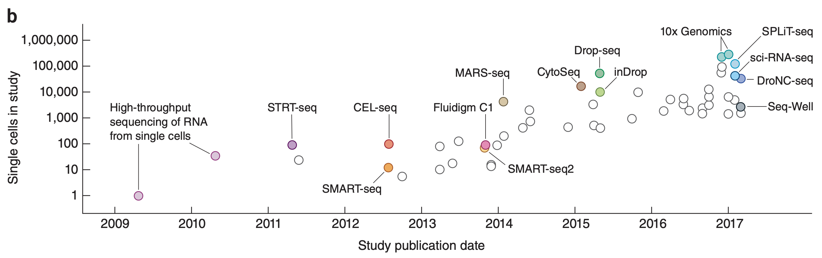
Svensson et al. 2018 Nature
Notes:
The output of single cell methods has really increased over the past decade,
back to 2009, in the first study, there was only one cell that was sequenced and that’s it,
and over the years, there is an exponential increase in the number of cells that can be processed int those studies,
each of those study represents a publication presenting new single cell methods,
and the y axis show the number of cells that have been analyzed

Slide 9
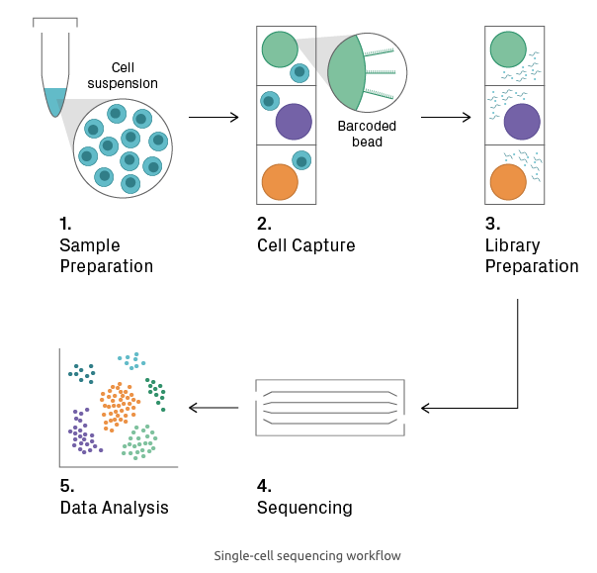
https://www.azenta.com
Notes:
Among those techniques, the basic steps of single cell sequencing usually include 1, 2, 3, 4, and 5.
1. Sample Preparation
In …, one dissociates the cells, which can be tricky for tissues with an extracellular matrix, in such situations, nuclei can be isolated instead.
Cell viability should be checked before proceeding to the next step, as a high percentage of intact and live cells is required for obtaining good data.
2. Cell Capture
The cell suspension is then loaded onto nanoliter-scale chambers, such as droplets or wells.
During or shortly after this process, a unique oligonucleotide sequence (i.e., barcode) is added to each chamber,
allowing for downstream identification of the cell. This can be accomplished with oligo-tagged beads, for example.
3. Library Preparation
Wtihin each microchamber, Cells are lysed, and library construction begins.
Within the microchamber, the cell-specific barcode is added to the target sequences;
thus, all fragments from the same cell will share a common identifier.
The barcoded fragments from all microchambers are then pooled, and the final steps of library construction (i.e., amplification and adding a sample index) are performed.
4. Sequencing
The pooled library is sequenced.
5. Data Analysis The sequencing data will then be preprocessed, filtered, and anlayzed.
1. Sample Preparation
In …, one dissociates the cells, which can be tricky for tissues with an extracellular matrix, in such situations, nuclei can be isolated instead.
Cell viability should be checked before proceeding to the next step, as a high percentage of intact and live cells is required for obtaining good data.
2. Cell Capture
The cell suspension is loaded onto a microfluidic chip or cartridge, where cells are partitioned into nanoliter-scale chambers, such as droplets or wells. The technology for cell capture differs between commercial platforms, but each employs its own set of measures to deter and/or detect loading of more than one cell per chamber (see Single-Cell Platforms section). During or shortly after cell capture, a unique oligonucleotide sequence (i.e., barcode) is added to each chamber, allowing for downstream identification of the cell. This can be accomplished with oligo-tagged beads, for example.
3. Library Preparation
Cells are lysed, and library construction begins. The enzymatic reactions that follow depend on the application (see Single-Cell Techniques section). Within the microchamber, the cell-specific barcode is added to the target sequences; thus, all fragments from the same cell will share a common identifier. The barcoded fragments from all microchambers are then pooled, and the final steps of library construction (i.e., amplification and adding a sample index) are performed.
4. Sequencing
The pooled library is sequenced on the Illumina platform.
5. Data Analysis Raw sequencing data undergoes pre-processing. Reads of low quality and those unlikely to have originated from a viable cell are thrown out. For example, reads containing a barcode with a low count and few detected genes probably represent background noise. After quality control, the data is normalized across cellular barcodes. The number of useful reads varies greatly between cells, mainly due to the low depth of sequencing per cell (i.e., sampling effects). The data is then subjected to downstream analysis, which includes feature selection, dimensionality reduction, and/or visualization². The goal here is to find biologically meaningful patterns, such as clusters in t-SNE plots that represent distinct cell types.

Slide 10
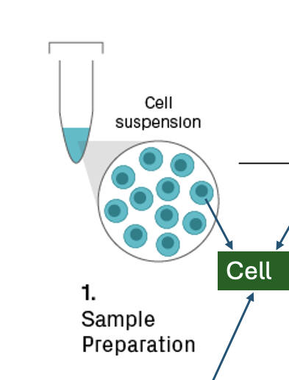
Notes:
In sample preparation, one dissociates the cells, which can be tricky for tissues with an extracellular matrix, in such situations, nuclei can be isolated instead.
Cell viability should be checked before proceeding to the next step, as a high percentage of intact and live cells is required for obtaining good data.

Slide 11
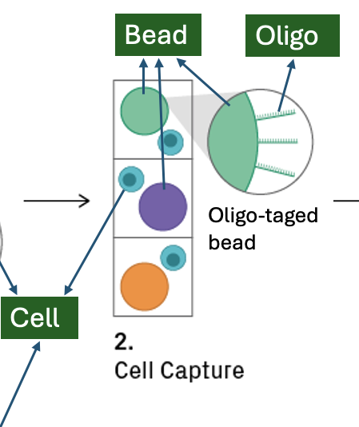
Notes:
The cell suspension is then loaded onto nanoliter-scale chambers, such as droplets or wells.
During or shortly after this process, a unique oligonucleotide sequence is added to each chamber,
This can be accomplished with oligo-tagged beads, for example.

Slide 12
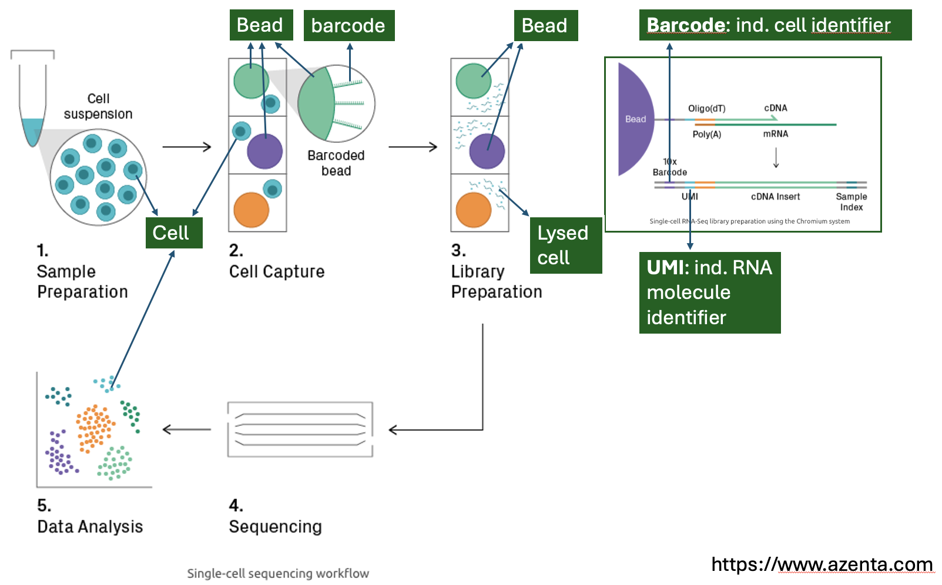
Notes:
3. Library Preparation
Wtihin each microchamber, Cells are lysed to release the RNA molecules they contain, and library construction begins.
Within the microchamber, RNA molecules are attached to oligos on the beads, there, each RNA oligo gets a cell-specific barcode,
All RNA molecules from one cell will share the same barcode, this is important, because during the last step of library preparation, the RNA molecules from all cells will be pooled together.
Apart from barcode, sometimes, each RNA molecule will also acquire a UMI sequence from the oligo,
which is unique individually, and this can be treated as an ind. RNA molecule identifier,
this is also important, because during the last steps of library preparation, the molecules will be amilplified to make many copies of each molecule, so we can have enough material to sequence.
With UMIs, we can know how many copies of each RNA molecule we have in the cell.

Slide 13
Notes:
Next, the RNA molecules will be sequenced and
the acquired sequencing data will be preprocessed, filtered, and anlayzed.

Slide 14
Svensson et al. 2018 Nature
Notes:
in the first few years of scRNAseq development, the methods mostly focused on sorting each individual cells into separate wells,
and make sequencing library within each of those wells and sequence them,
the most popular method is plate-based smart seq method

Slide 15
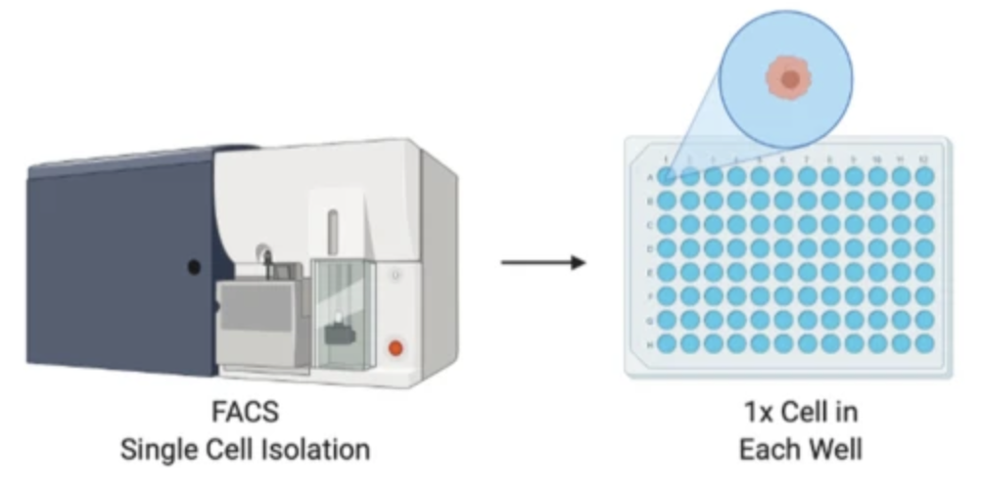
SMART-seq
Well-based
RNA full length sequencing /seq. deeper (isoform…)
Less cells
Lots of manual efforts
Flow cytometry
Probst et al. 2022 BMC genomics
Notes:
in this method, you use a cytoflowmetry method to sort the cells of interest one cell per well in a 96 well or 384 well plates,
This method sequence the full length of a RNA molecule, so it’s good if you want to detect isoforms
However, it can only sequence a few hundreds and maybe a few thousands of cells, with a lot of manual efforts and it’s very expensive.
Fluorescence-activated cell sorting (FACS) is a specialized type of flow cytometry
Flow cytometry (FC) is a technique used to detect and measure the physical and chemical characteristics of a population of cells or particles.
SMARTseq 3 has UMI, but the previous versions don’t have.
where you lyse the cell, synthesize cDNA from mRNA, fragment the cDNA, amplified them and sequence the transcriptome of each cell.
in this method, you use a cytoflowmetry method to sort the cells of interest one cell per well in a 96 well or 384 well plates, and you lyse those cells, and you do a retrotranscription reaction for library preparation, during this process, you have a oligodendrocyte dT which bind to the polyA tail of the messenger RNA, this oligodendrocyte dT has a handle on the end. During the retrotranscription process, the a DNA strand will get synthesized using the RNA as a template. In the end, a few non-templates C bases will be added, these G bases will bind to a template switching oligo, apart from the complementary G bases, the template switching oligo also has a handle. After the reotranscription reaction, you will end up with a cDNA with a PCR handle on both ends. This undergoes amplification, and you get many many copies of each cDNA, then the cDNN get broken down to many fragments, add adapters, and PCR amplification, and you end your library preparation. With this method, you will be able to sequence a few hundreds and maybe a few thousands samples, with a lot of manual efforts and it’s very expensive.

Slide 16
Svensson et al. 2018 Nature
Notes:
Later on, a few new droplet-based methods pop up in parallel with those plate-based methods. One typical such example is 10X genomics,

Slide 17
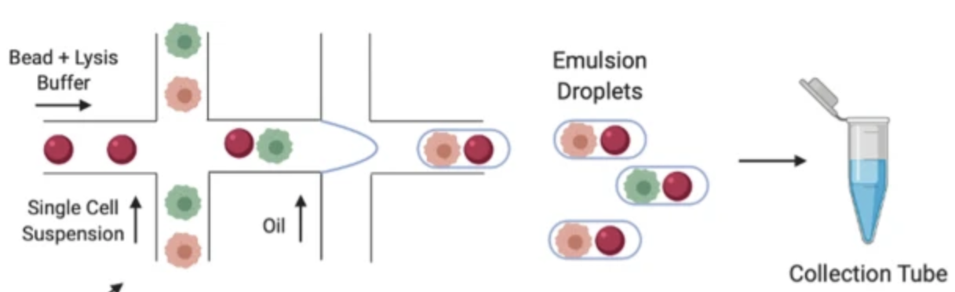
10X Genomics
Droplet-based
Only seq. 3’ end (mRNA)
Lots of missing values
A large number of cells
Cell
Oligo-taged bead
Microfluidic device
Probst et al. 2022 BMC genomics
Notes:
10X genomics, which uses a micro fluidic device,
With this device, single cells and oligo-taged beads are captured simultaneously into oil droplets,
Lyse and tag the RNA molecules with cellular barcodes and UMI within those droplets
This technique only sequence 3’end of mRNA
In 10X, we tend to do low seq depth sequencing, sequence a small proportion of the transcriptome, lots of genes that are expressed but not sequences, so we will have lots of missing values, lots of those missing values represent technical missing values, not genes that not expressed. And it has lots of missing values, which is the well known dropout problem
But it can simultaneously analyze a large number of cells, good for identifying rare cell types
in this device, beads each with a unique barcode flow in from the side,
then cells comes, they mixed together,
the oil come in to encapsulate beads and maybe cell as well into oil droplets.
You can see most of the generated oil droplets contain one bead per droplet.
Within each droplet, the cells will be lyzed, and mRNA will be bind to the unique barcodes that are attached to each beads and goes through retro transcription reaction to synthesize cDNA,
with those unique barcodes,
we will later on be able to know which RNA sequences from the same cells.
Next step, the oil droplets will be broken down, and the cDNAs from different cells will be mixed together, and theses cDNA will be amplified and used for library construction. With this method you can sequence up to 200000 cells on a single chip within one single day, so it’s very efficient.

Slide 18
What is scRNAseq
How it works
The evolution of scRNAseq
The difference between bulk RNAseq and scRNAseq
Notes:
To recap a little bit
I have talked about

Slide 21
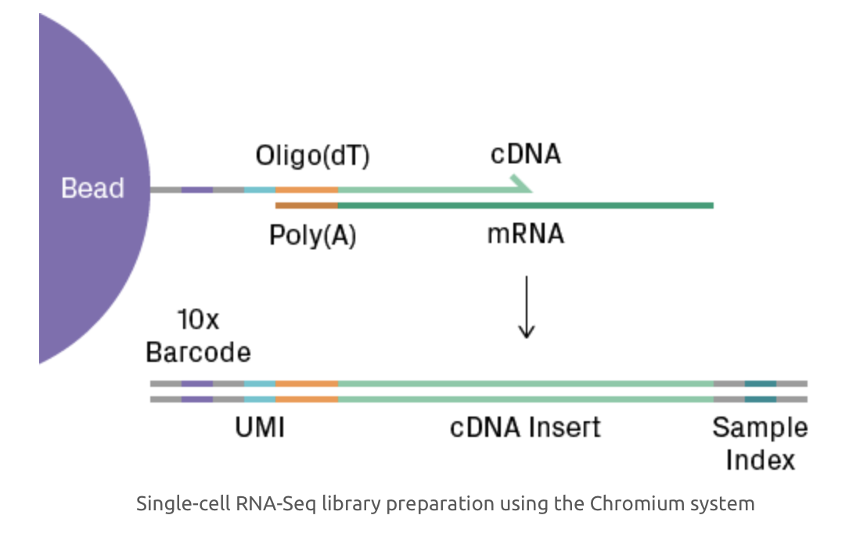
Bead
Oligo
Bead
Barcode: ind. cell identifier
Oligo-taged bead
Cell
Lysed cell
UMI: ind. RNA molecule identifier
https://www.azenta.com
Notes:
And The basic steps of single cell sequencing usually include 1, 2, 3, 4, and 5.
1. Sample Preparation
In …, one dissociates the cells, which can be tricky for tissues with an extracellular matrix, in such situations, nuclei can be isolated instead.
Cell viability should be checked before proceeding to the next step, as a high percentage of intact and live cells is required for obtaining good data.
2. Cell Capture
The cell suspension is then loaded onto nanoliter-scale chambers, such as droplets or wells.
During or shortly after this process, a unique oligonucleotide sequence (i.e., barcode) is added to each chamber,
allowing for downstream identification of the cell. This can be accomplished with oligo-tagged beads, for example.
3. Library Preparation
Wtihin each microchamber, Cells are lysed, and library construction begins.
Within the microchamber, the cell-specific barcode is added to the target sequences;
thus, all fragments from the same cell will share a common identifier.
The barcoded fragments from all microchambers are then pooled, and the final steps of library construction (i.e., amplification and adding a sample index) are performed.
4. Sequencing
The pooled library is sequenced.
5. Data Analysis The sequencing data will then be preprocessed, filtered, and anlayzed.
1. Sample Preparation
In …, one dissociates the cells, which can be tricky for tissues with an extracellular matrix, in such situations, nuclei can be isolated instead.
Cell viability should be checked before proceeding to the next step, as a high percentage of intact and live cells is required for obtaining good data.
2. Cell Capture
The cell suspension is loaded onto a microfluidic chip or cartridge, where cells are partitioned into nanoliter-scale chambers, such as droplets or wells. The technology for cell capture differs between commercial platforms, but each employs its own set of measures to deter and/or detect loading of more than one cell per chamber (see Single-Cell Platforms section). During or shortly after cell capture, a unique oligonucleotide sequence (i.e., barcode) is added to each chamber, allowing for downstream identification of the cell. This can be accomplished with oligo-tagged beads, for example.
3. Library Preparation
Cells are lysed, and library construction begins. The enzymatic reactions that follow depend on the application (see Single-Cell Techniques section). Within the microchamber, the cell-specific barcode is added to the target sequences; thus, all fragments from the same cell will share a common identifier. The barcoded fragments from all microchambers are then pooled, and the final steps of library construction (i.e., amplification and adding a sample index) are performed.
4. Sequencing
The pooled library is sequenced on the Illumina platform.
5. Data Analysis Raw sequencing data undergoes pre-processing. Reads of low quality and those unlikely to have originated from a viable cell are thrown out. For example, reads containing a barcode with a low count and few detected genes probably represent background noise. After quality control, the data is normalized across cellular barcodes. The number of useful reads varies greatly between cells, mainly due to the low depth of sequencing per cell (i.e., sampling effects). The data is then subjected to downstream analysis, which includes feature selection, dimensionality reduction, and/or visualization². The goal here is to find biologically meaningful patterns, such as clusters in t-SNE plots that represent distinct cell types.

Slide 22
Single cell transcriptomics/
single cell RNA sequencing
Tissue
Ind. cells
RNA sequencing
Celltype gene expr. profile
Notes:
Today, we gonna talk about single cell RNAseq
Single cell RNAseq is a transcriptomics technique that has revolutionized recent biology
Basically, it is a method where we analyze the gene expression profiles of individual cells in a hetergeneous cell population
Assume we are looking at a human tissue, it is hetergeneous and contains many different cell types
Also assume the transcriptome only contains 4 genes, which is not true, we know the transcirptome of human contains thousands of genes, here just for demonstration, we use 4 genes to represent the transcritome
Very likely, these four genes will not be expressed in the same fashion in all cell types, for example, celltype2 and celltype 5 tend to express more the green gene B, while celltype5 tend to express less the red gene A
This gene expression variability among cells can be explored using techniques such as single cell RNAseq

Slide 23
scRNAseq
Sequencing based
Genome wide survey of the transcriptome
Individual cells
A transcriptome is the full range of messenger RNA, or mRNA, molecules expressed by an organism
2009
Notes:
Nowadays, single cell RNAseq is taking over from 2009,
It is sequencing based
It can measure the expression levels of a large number of genes for individual cells
and over the last decade, single cell RNAseq has been extensively used in the field of biology and neuroscience and many more
1. Sample Preparation
The input for the overall workflow is a suspension of single cells. If analyzing tissue, dissociation is necessary, which can be tricky for tissues with an extracellular matrix. Depending on the application, isolated nuclei may be used as an alternative. Cell viability should be measured before proceeding to the next step, as a high percentage of intact and live cells is required for obtaining good data.
2. Cell Capture
The cell suspension is loaded onto a microfluidic chip or cartridge, where cells are partitioned into nanoliter-scale chambers, such as droplets or wells. The technology for cell capture differs between commercial platforms, but each employs its own set of measures to deter and/or detect loading of more than one cell per chamber (see Single-Cell Platforms section). During or shortly after cell capture, a unique oligonucleotide sequence (i.e., barcode) is added to each chamber, allowing for downstream identification of the cell. This can be accomplished with oligo-tagged beads, for example.
3. Library Preparation
Cells are lysed, and library construction begins. The enzymatic reactions that follow depend on the application (see Single-Cell Techniques section). Within the microchamber, the cell-specific barcode is added to the target sequences; thus, all fragments from the same cell will share a common identifier. The barcoded fragments from all microchambers are then pooled, and the final steps of library construction (i.e., amplification and adding a sample index) are performed.
4. Sequencing
The pooled library is sequenced on the Illumina platform.
5. Data Analysis Raw sequencing data undergoes pre-processing. Reads of low quality and those unlikely to have originated from a viable cell are thrown out. For example, reads containing a barcode with a low count and few detected genes probably represent background noise. After quality control, the data is normalized across cellular barcodes. The number of useful reads varies greatly between cells, mainly due to the low depth of sequencing per cell (i.e., sampling effects). The data is then subjected to downstream analysis, which includes feature selection, dimensionality reduction, and/or visualization². The goal here is to find biologically meaningful patterns, such as clusters in t-SNE plots that represent distinct cell types.

Slide 24
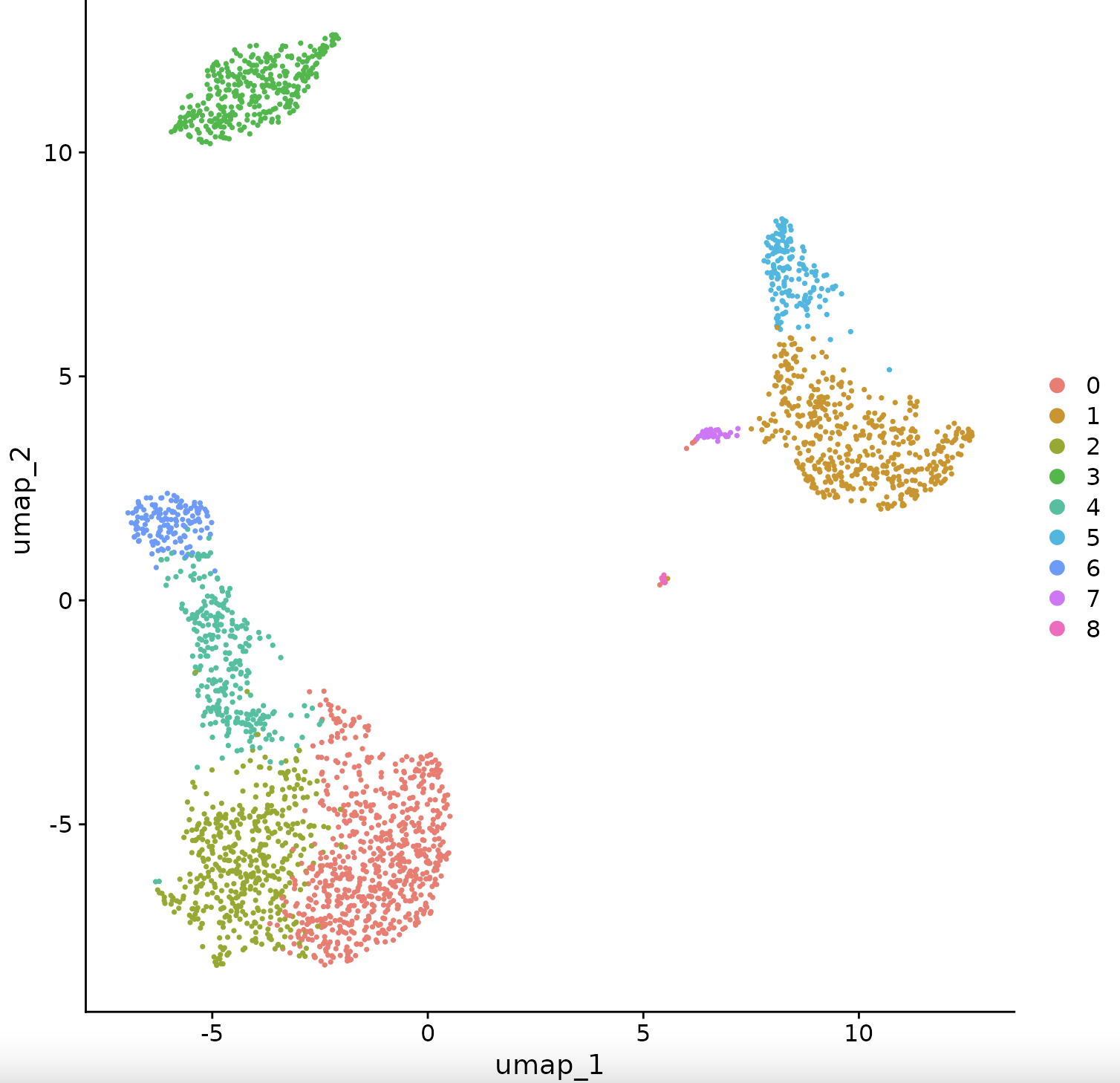
Notes:
One very cool thing is that you can identify many different cell types, this is a blood samples, in this case, many cells were processed together in parallel, each of those single cell’s transcriptome were sequenced and analyzed, you can detect up to 20000 human genes in the human genome, it’s very hard to visualize the data in a 20000 dimension, one common method is to press them down to 2 dimensions. There are many different methods, one common one is UMAP, and with this method, you end up with a plot like this, where each single dot represents a cell, those dots are clustered, and those dots that clustered close together are more similar to each other, you end up with different cell grouping that are represented on this plot, this kind of plot is useful, you see there are cell clusters, but you have no idea what they are.

Slide 25
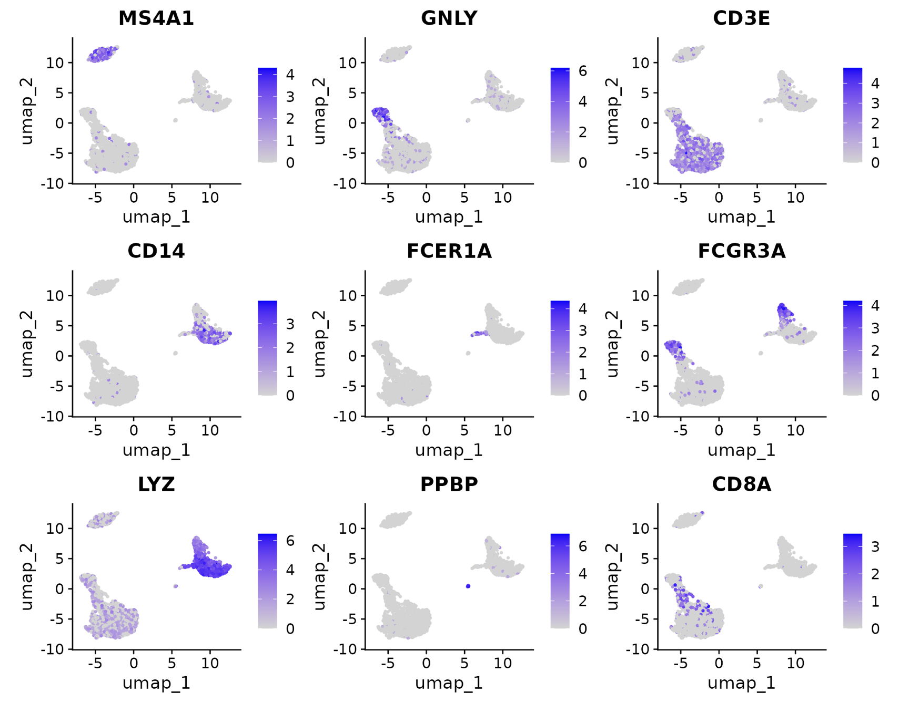
Notes:
But you can dig into using marker genes, and see which marker genes are differentially expressed between those different clusters, you can use this information to identify different clusters

Slide 26
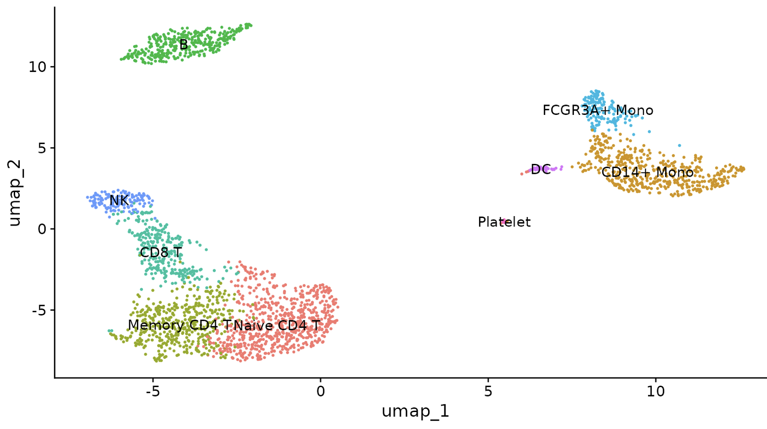
Notes:
, for instance, the blue you have B cells, red you have activated CD8 cells, you have dendritic cells in purple, NK cells in grey, this goes on and on, and you can identify different cell types, and you can identified lots of cell types by looking the transcriptimics profile within each single cluster.

Slide 27
Combinational indexing
Martin et al. 2023 Nature
Notes:
Another impressed paper that come up in 2017, for which over millions of cells got sequenced. This paper uses a method called combinational indexing, where you don’t deal with singl cell directly, instead, you do multiple rounds of barcoding and mixing, through you generate combinational barcodes that allow you to generate single cell data. The way it works is that you start with fixed cells to the left that is permeable so that regents can flow in and out. You sort a few dozen of cells into each well of those 96-well plate, you are not dealing with single cell, you still have multiple cells in each well of the plate, you undergo retrotranscription reaction with barcoded oligo dT, each of those wells, you have a different barcode oligo dT, so all the cells in the same well will have the same barcode at this step, and this depicted by the color over here, you can combined the cells from all those wells together and randomize them up, and redistribute them into wells of a 96-well plate, at this stage you take those cDNA and you do a different reaction to add a different barcode, and cells in each well will receive the same barcode. The total possible barcode combination types until this step will 96*96 that 9216 different combinations.If you do three rounds of those redistribution, you will end up with 96*96*96 that is 884736, almost one million cell barcode combinations, If you just sequence a few thousand cells you don’t have a high chance to get two cells that have the same barcodes.

Slide 28
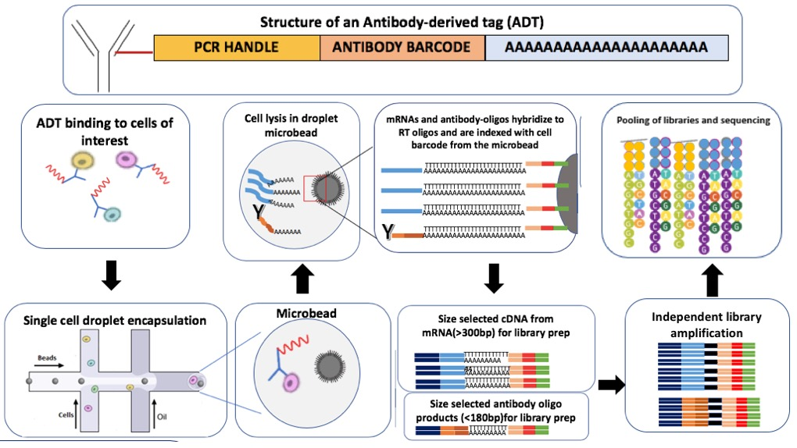
CITE-seq
Wikepedia
Notes:
So far we only use single cell platform to do RNA sequencing, but we can use the single cell platform to do some other things, such as quantifying proteins using CITE-seq. You may ask how do I quantify a protein with DNA sequencing. For CITseq, you have an antibody that will bind to proteins of interest. And this antibody is conjugated with a DNA barcode, this DNA barcode will have a PCR handle at the end, an antibody barcode will tell you which antibody you are attaching to, and a polyA tail, this polyA tail will enable the DNA barcode to be captured by sing cell RNA sequencing. You can read out this DNA barcode eventually and tell how many copies you have for each cell.

