Slide 1
Crime Scene Analysis System
By: Kagiso Maja: 221176553
Sifiso Kau: 221100291
Bonginkosi Mdakane: 221113865

Slide 2

Problem Background
Current manual methods for analyzing crime scene evidence are time-consuming, prone to human error, and vulnerable to contamination from physical handling by officers, potentially compromising investigation outcomes.

Slide 3
Solution
Automated Object Classification: Uploading and analyzing crime scene photos to accurately classify objects, reducing manual effort and potential for human error.
Route Detection: Uploading floor plans and detecting possible suspect routes, enhancing investigation efficiency and accuracy while minimizing the need for physical handling of evidence.

Slide 4

Main

Slide 5
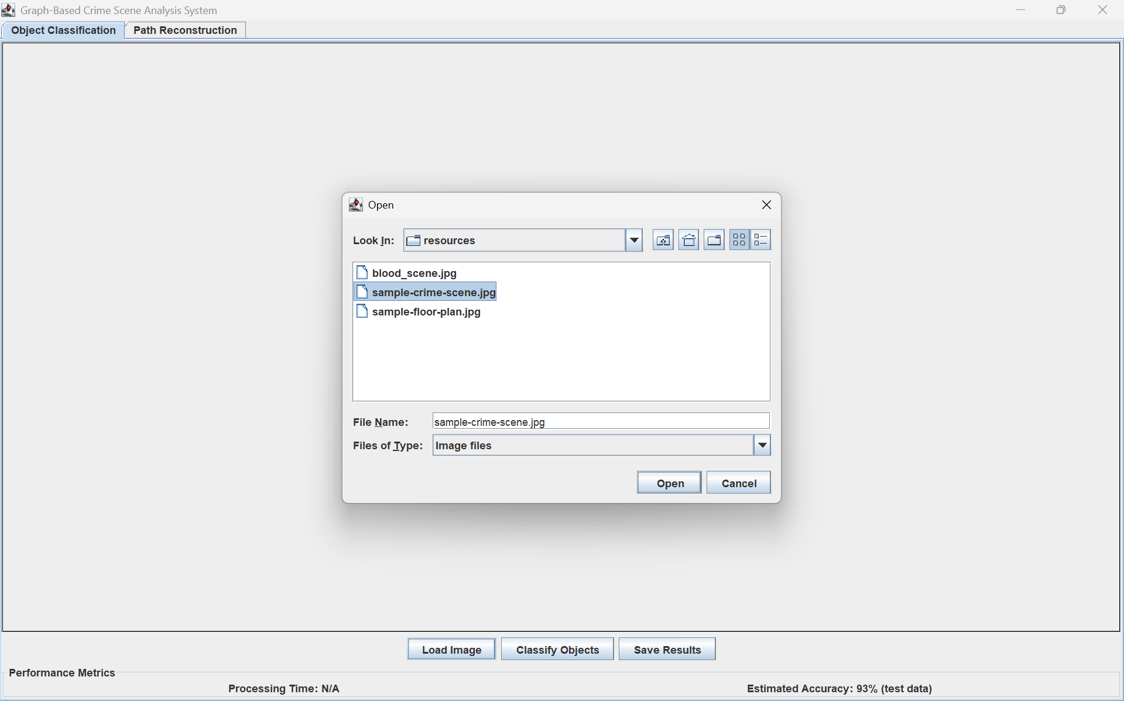
Image Selection (Object Classification)

Slide 6
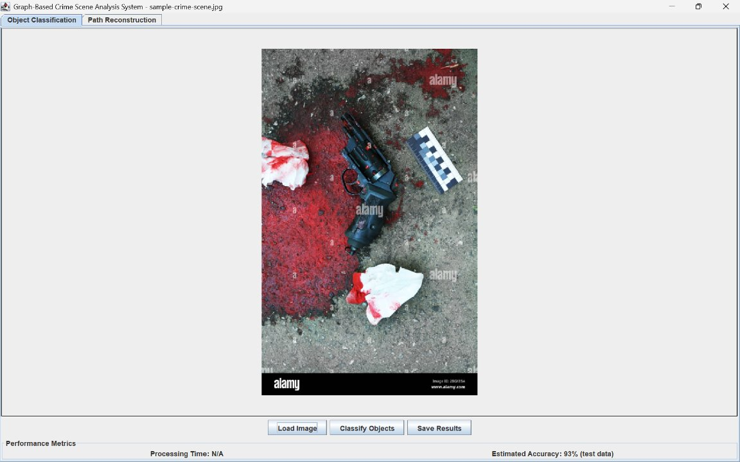
Loaded Image

Slide 7
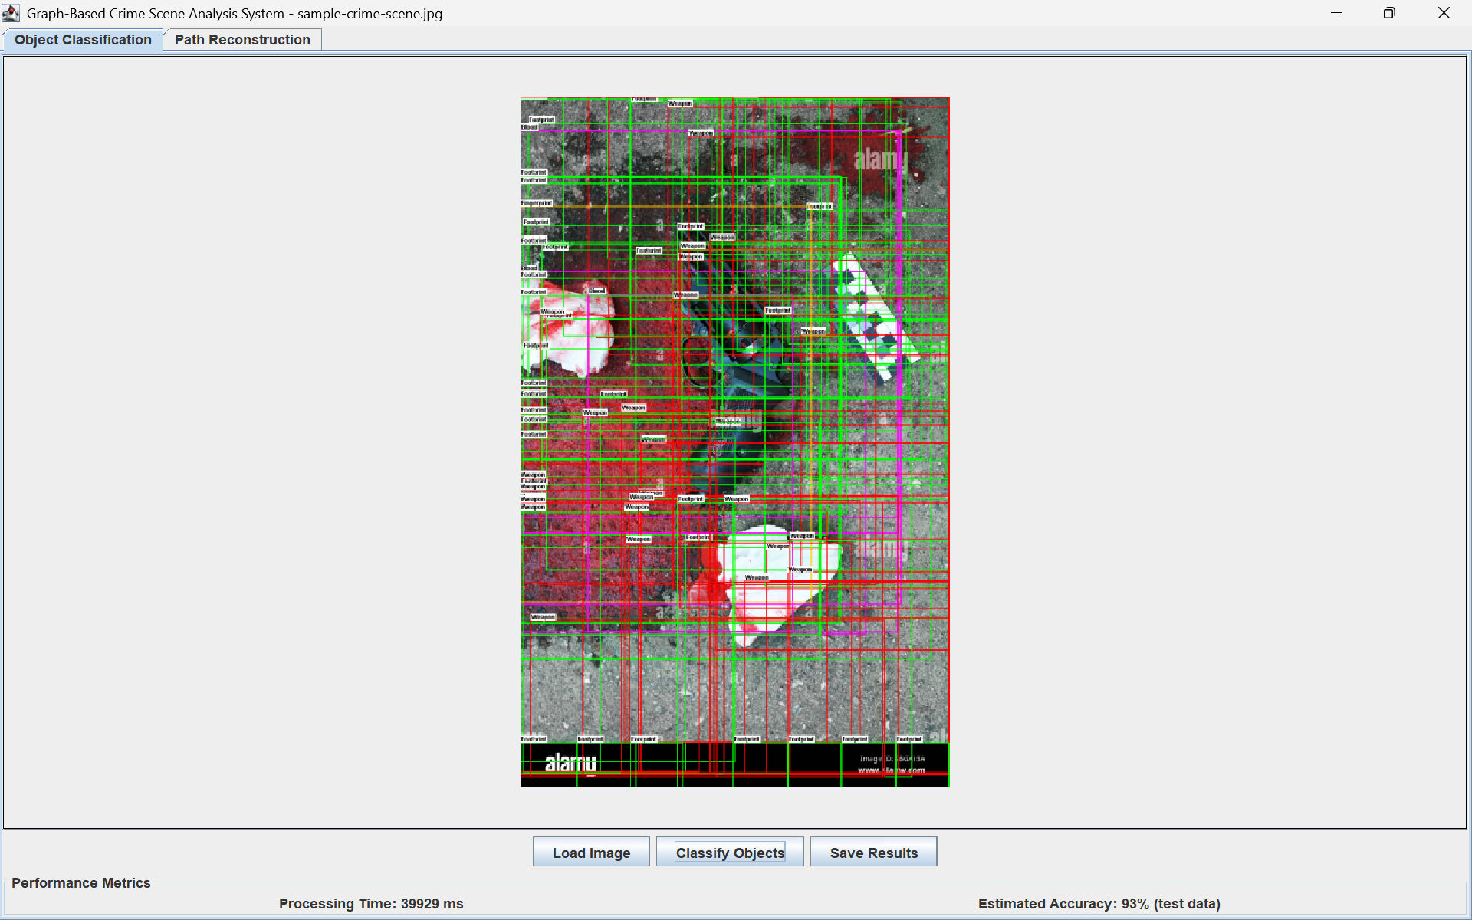
Object Classification

Slide 8
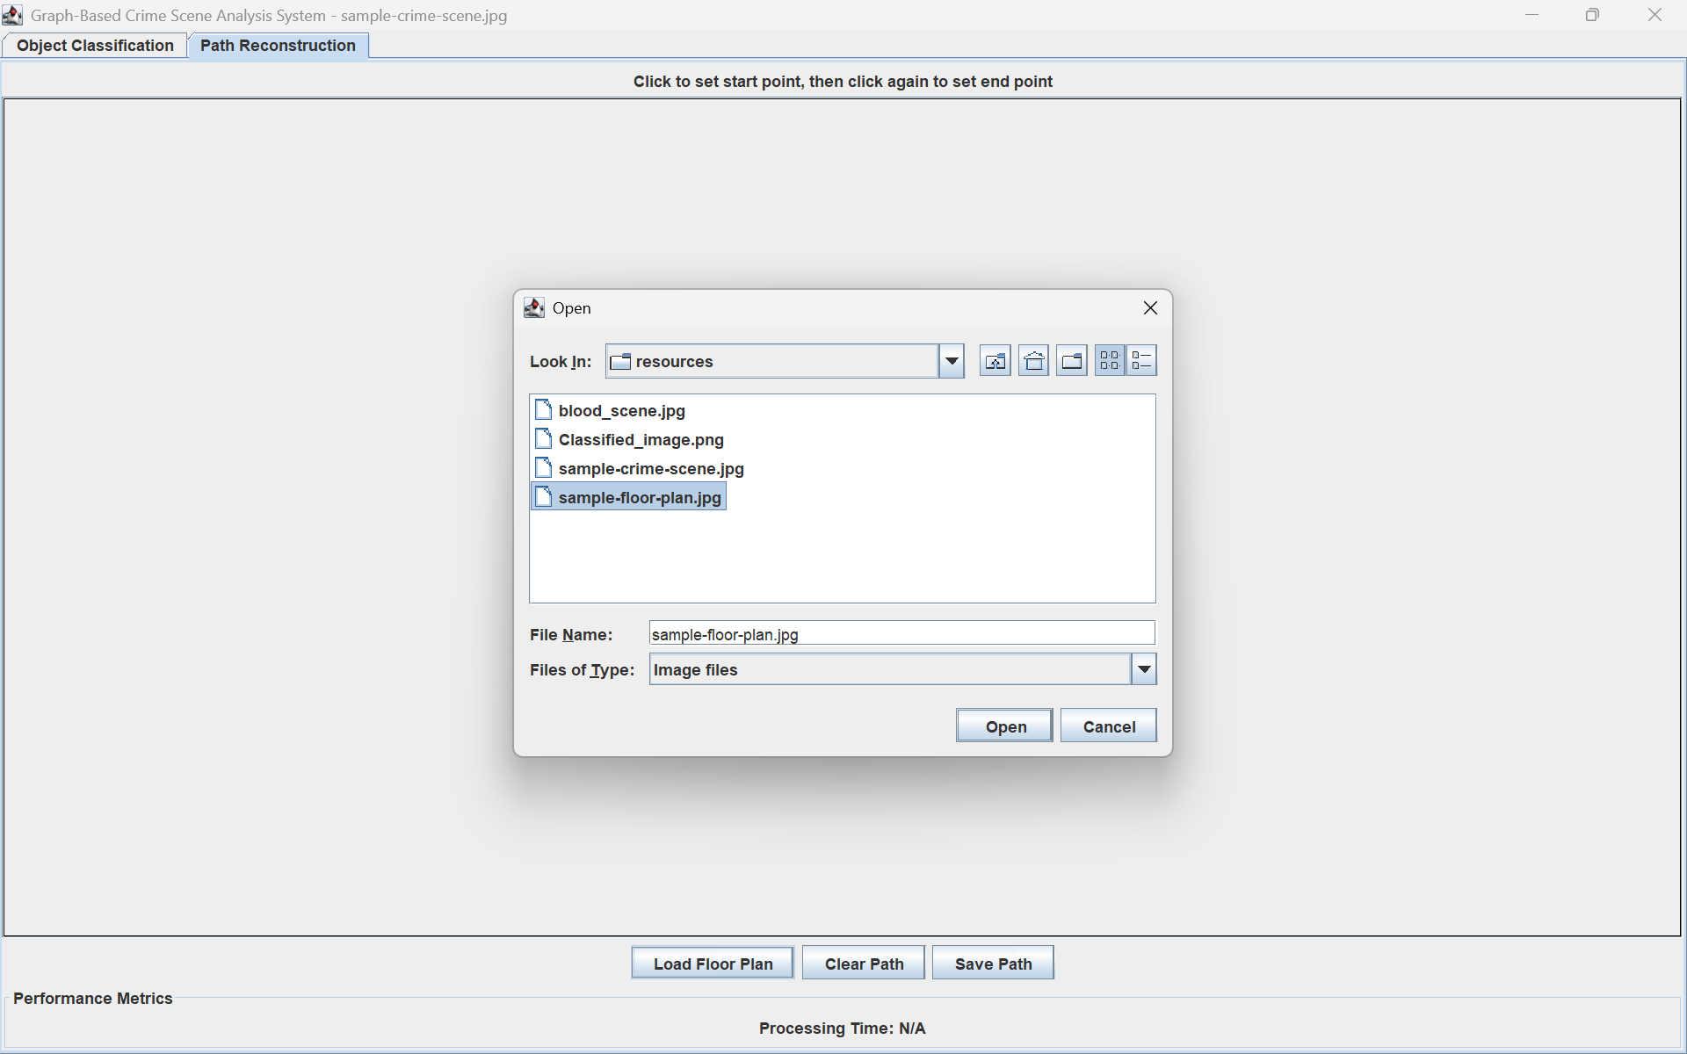
Image Selection (Path Reconstruction)

Slide 9
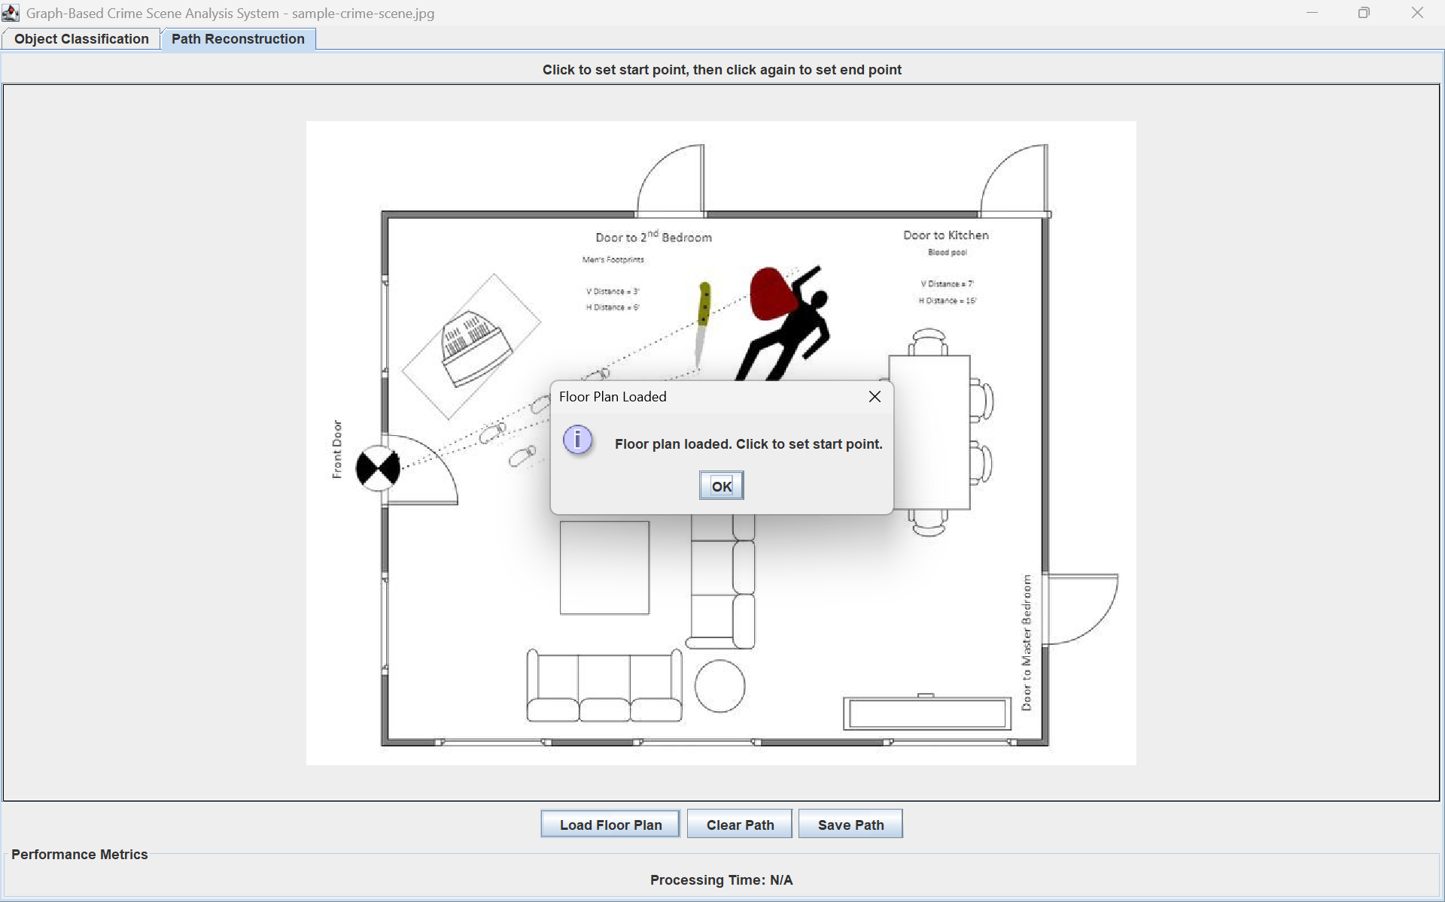

Slide 10
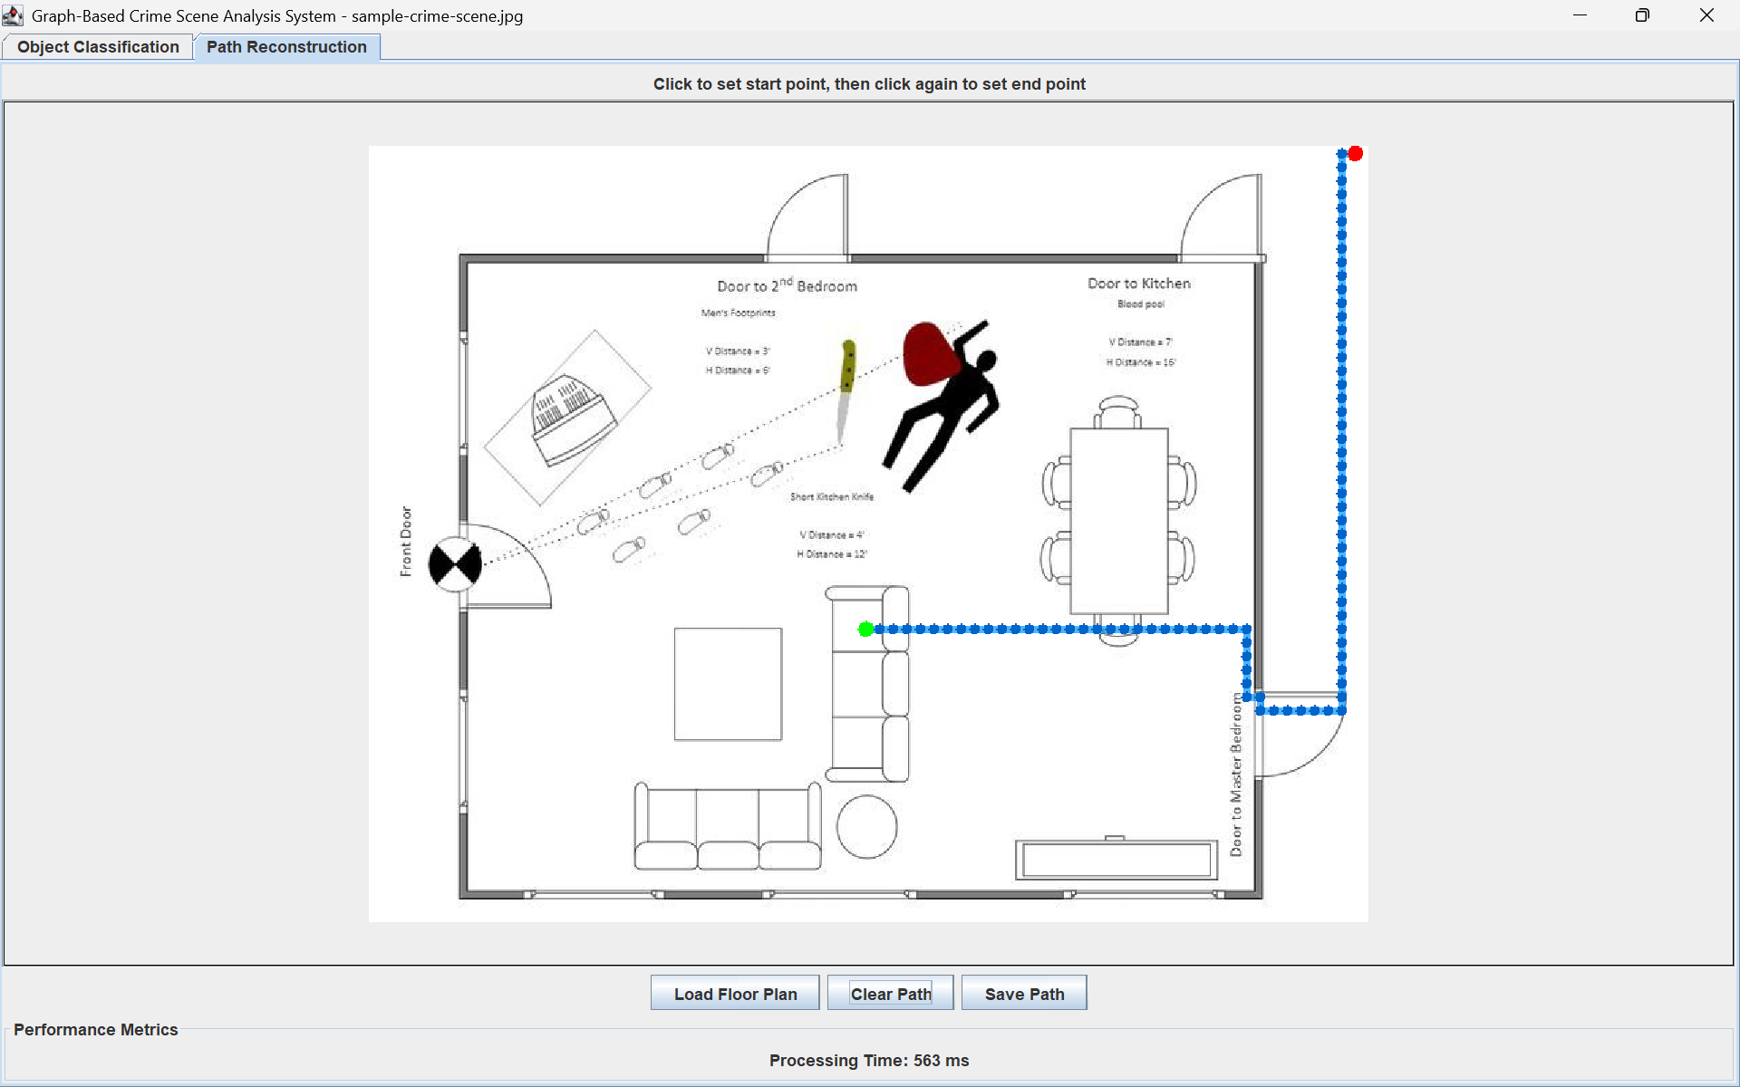
Possible Path Taken

