Slide 1
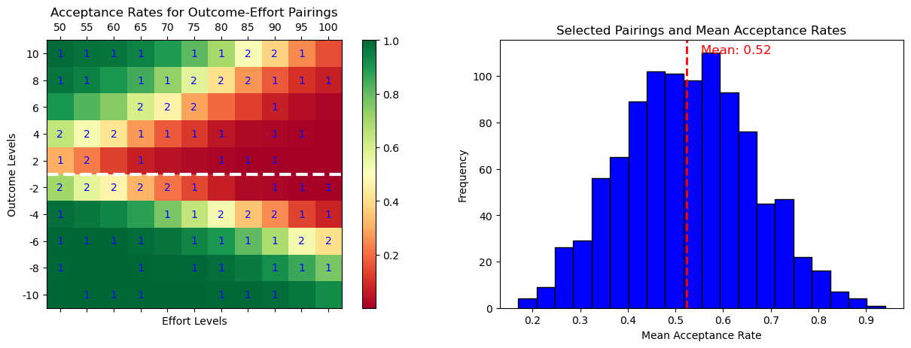
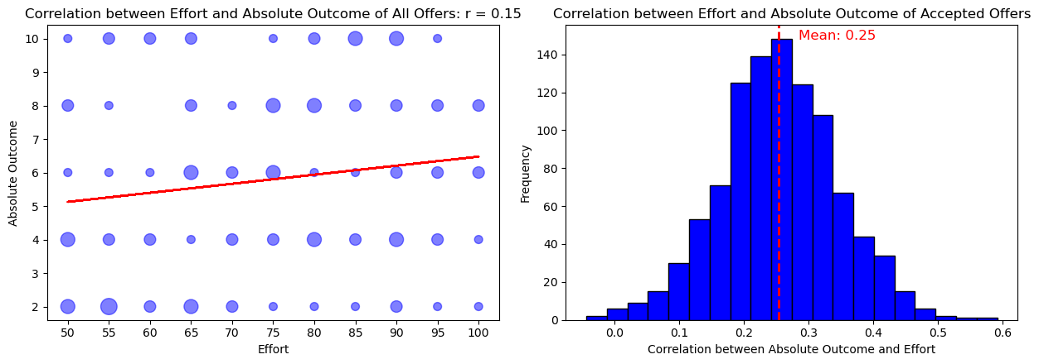
Schedule 1
Robustness for | Upper threshold | Lower threshold
alpha | +9% | -14%
lambda | +32% | -38%
k | +22% | -22%

Slide 2
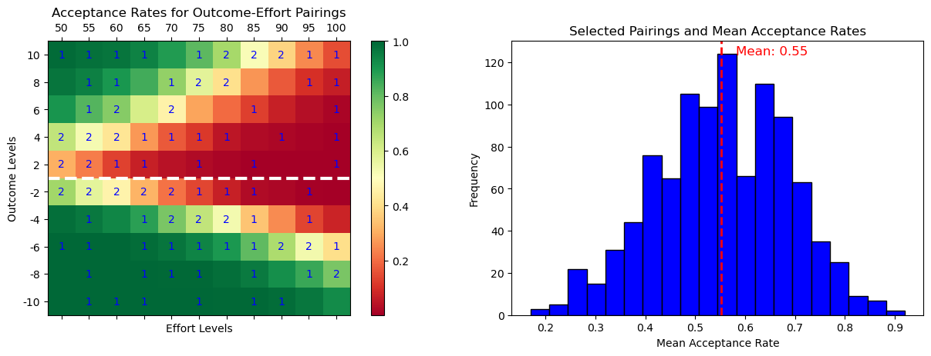
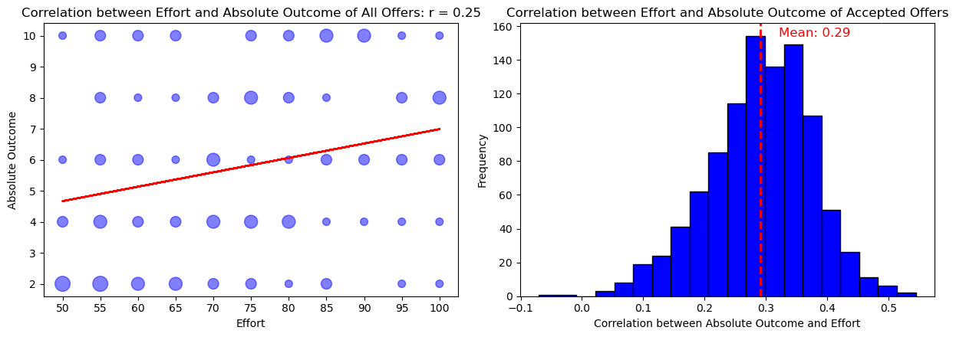
Schedule 2
Robustness for | Upper threshold | Lower threshold
alpha | +6% | -17%
lambda | +19% | -41%
k | +26% | -26%

Slide 3
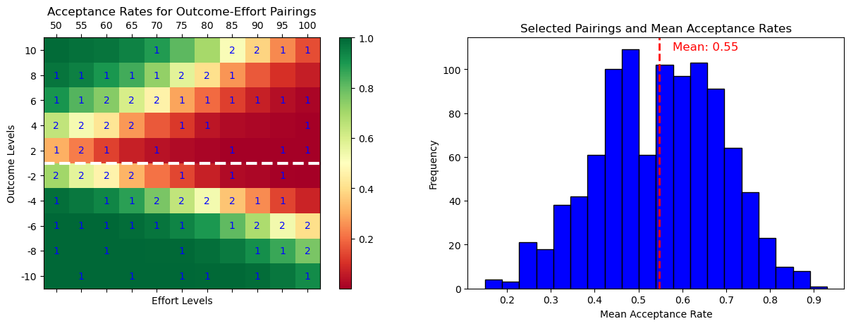
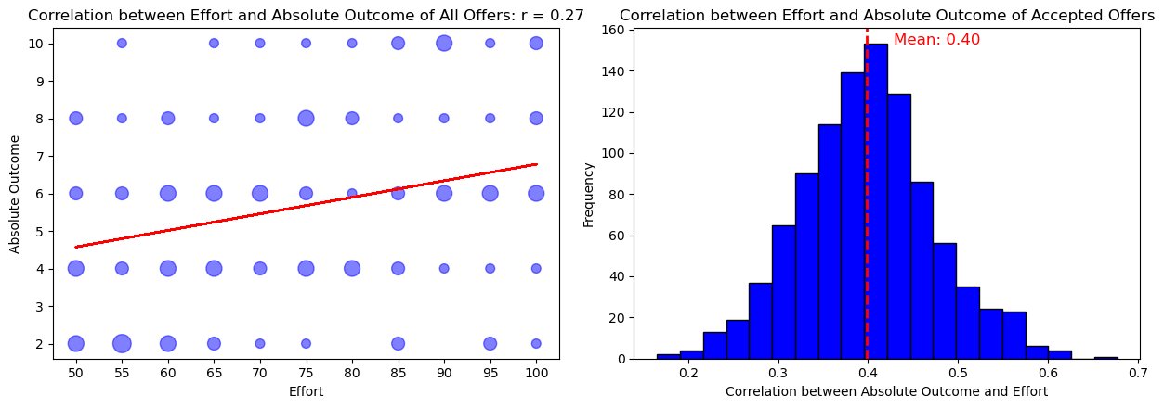
Schedule 3
Robustness for | Upper threshold | Lower threshold
alpha | +6% | -16%
lambda | +20% | -38%
k | +23% | -23%

Slide 4
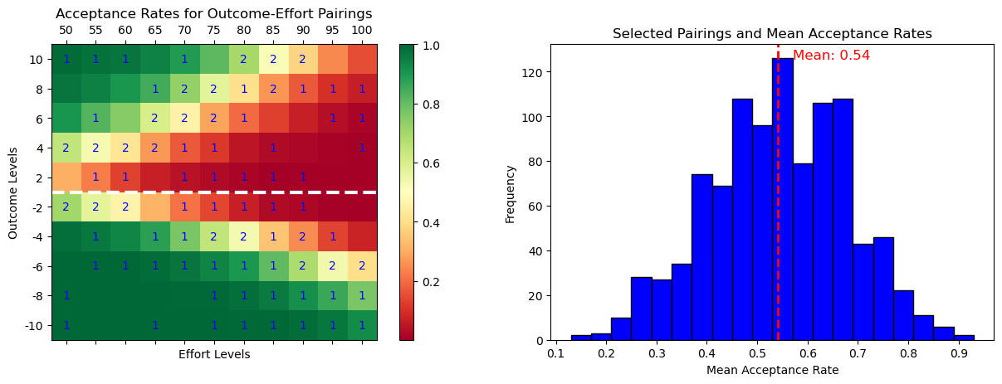
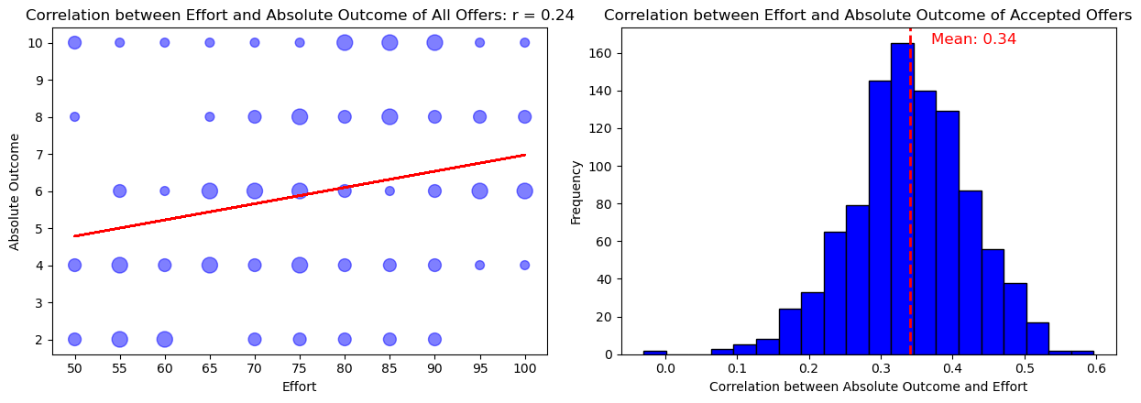
Schedule 4
Robustness for | Upper threshold | Lower threshold
alpha | +7% | -15%
lambda | +24% | -36%
k | +23% | -23%

Slide 5
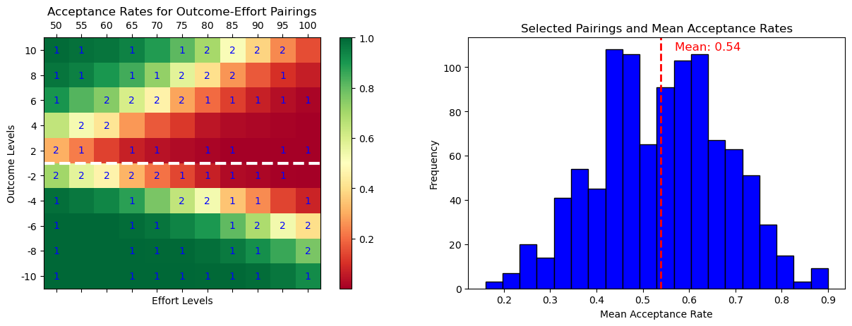
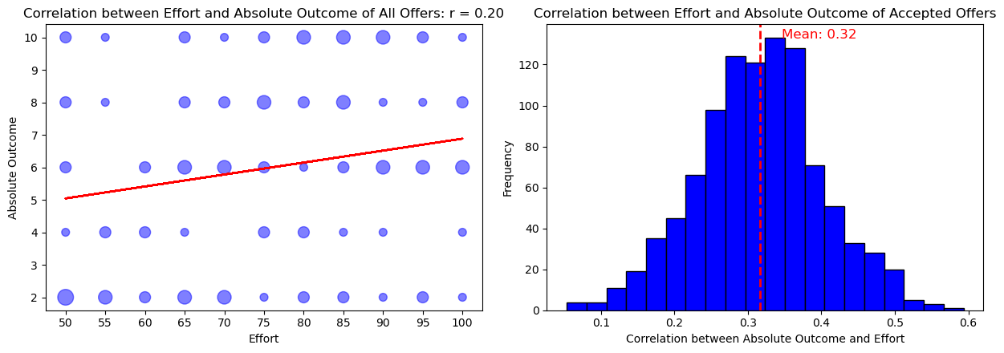
Schedule 5
Robustness for | Upper threshold | Lower threshold
alpha | +7% | -14%
lambda | +26% | -40%
k | 24x% | -24%

Slide 6
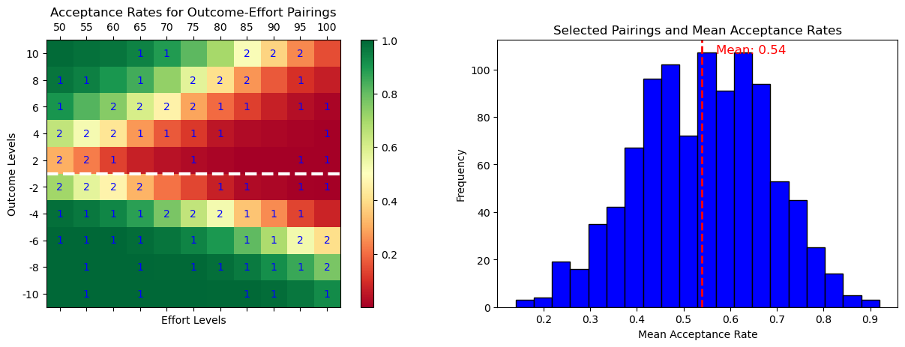
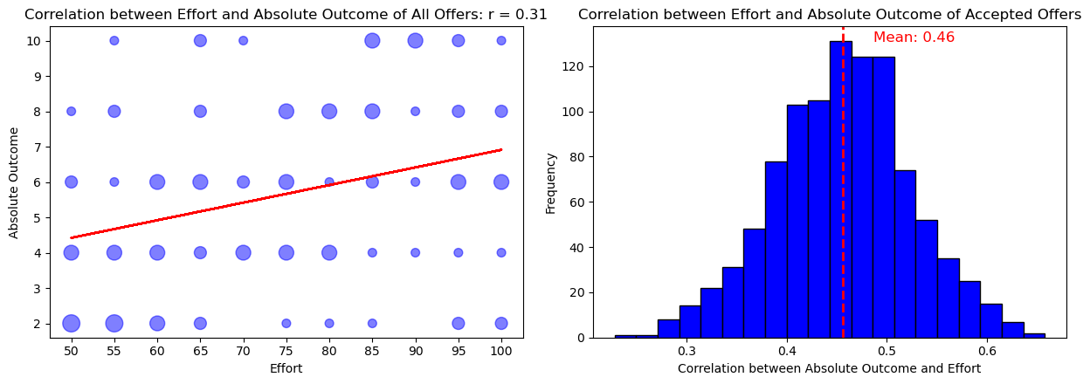
Schedule 6
Robustness for | Upper threshold | Lower threshold
alpha | +7% | -15%
lambda | +24% | -37%
k | +23% | -23%

Slide 7
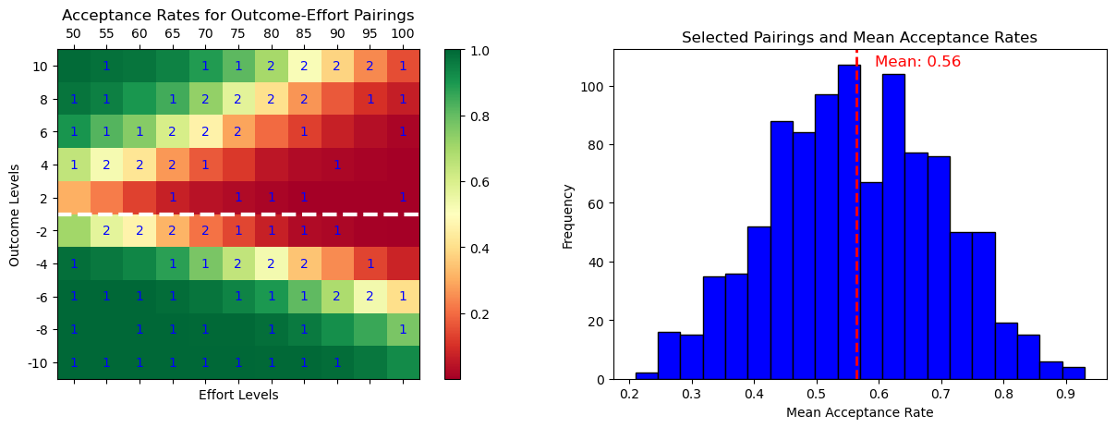
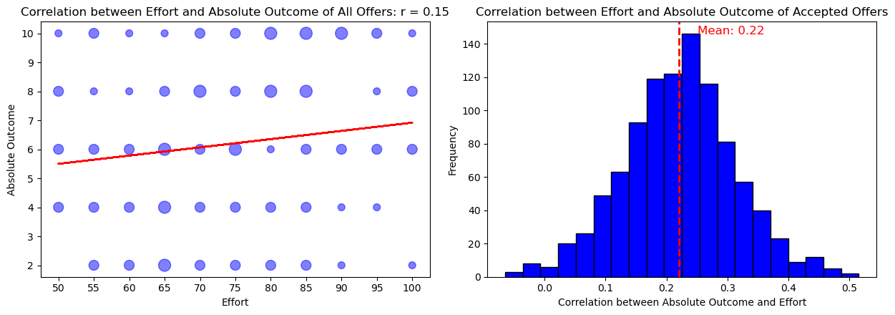
Schedule 7
Robustness for | Upper threshold | Lower threshold
alpha | +5% | -18%
lambda | +16% | -49%
k | 28x% | -28%

Slide 8
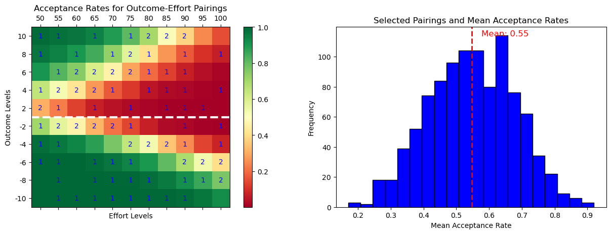
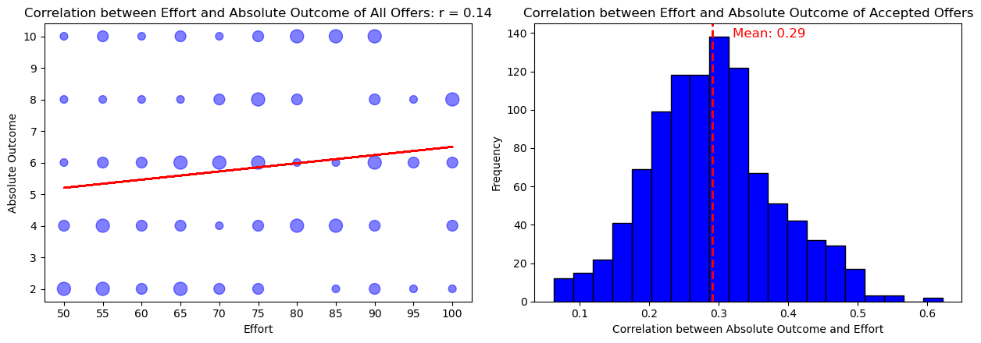
Schedule 8
Robustness for | Upper threshold | Lower threshold
alpha | +6% | -17%
lambda | +22% | -43%
k | +26% | -26%

Slide 9
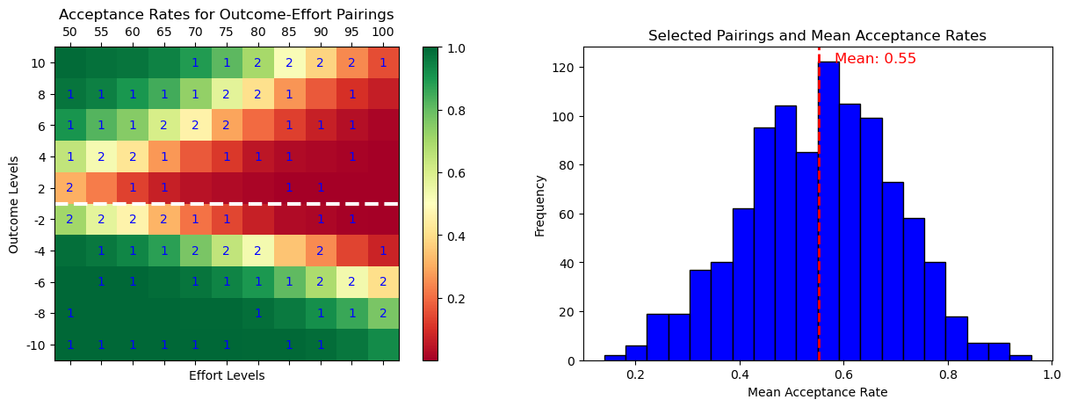
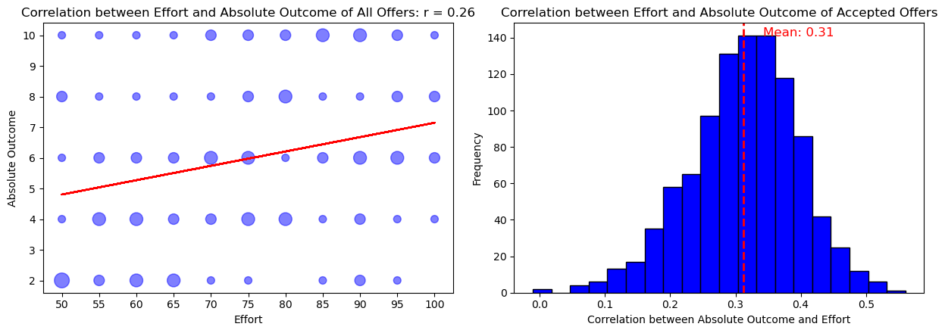
Schedule 9
Robustness for | Upper threshold | Lower threshold
alpha | +5% | -16%
lambda | +17% | -41%
k | +24% | -24%

Slide 10
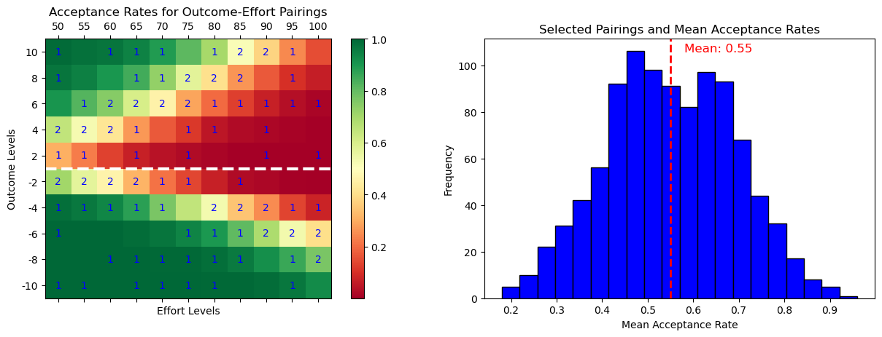
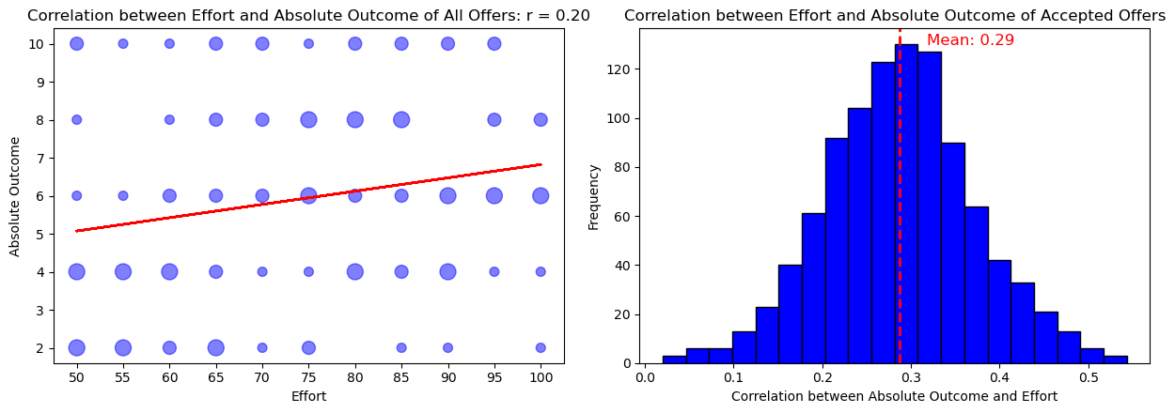
Schedule 10
Robustness for | Upper threshold | Lower threshold
alpha | +6% | -16%
lambda | +19% | -42%
k | +25% | -25%

Slide 11

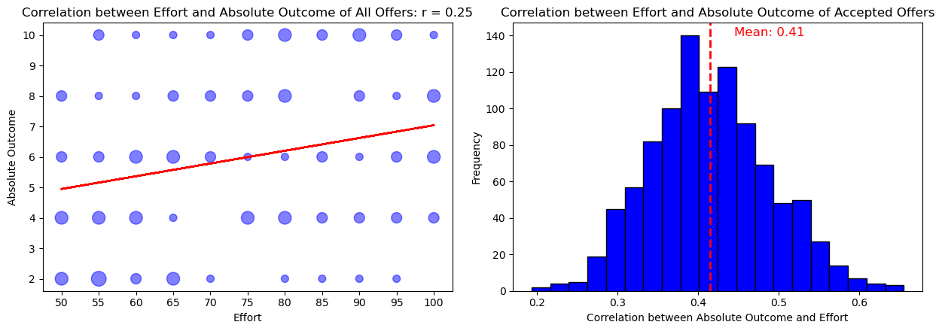
Schedule 11
Robustness for | Upper threshold | Lower threshold
alpha | +4% | -18%
lambda | +14% | -46%
k | +30% | -30%

Slide 12
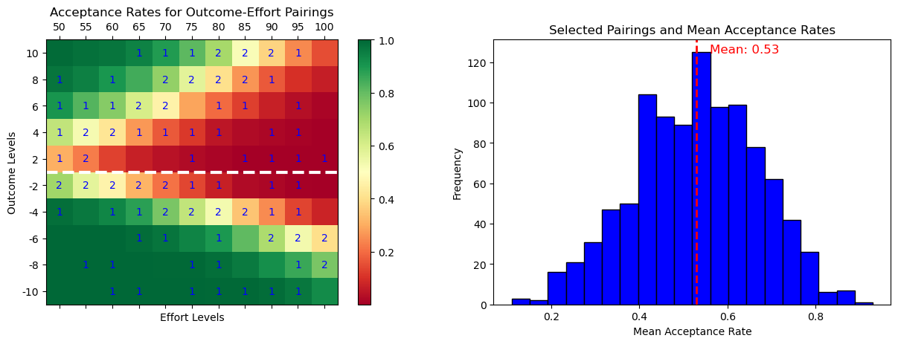
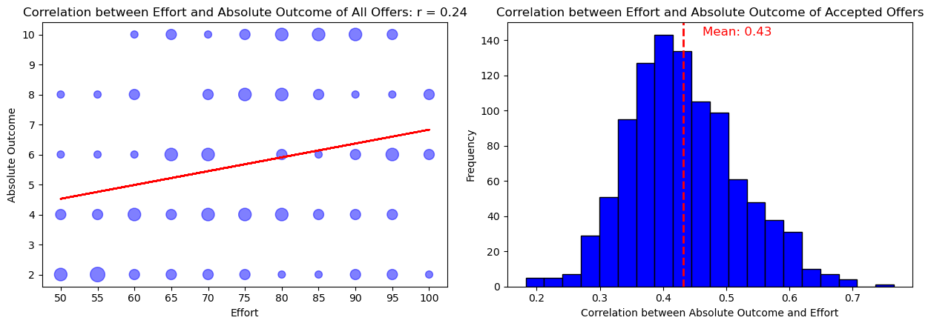
Schedule 12
Robustness for | Upper threshold | Lower threshold
alpha | +8% | -13%
lambda | +27% | -34%
k | +21% | -21%

Slide 13
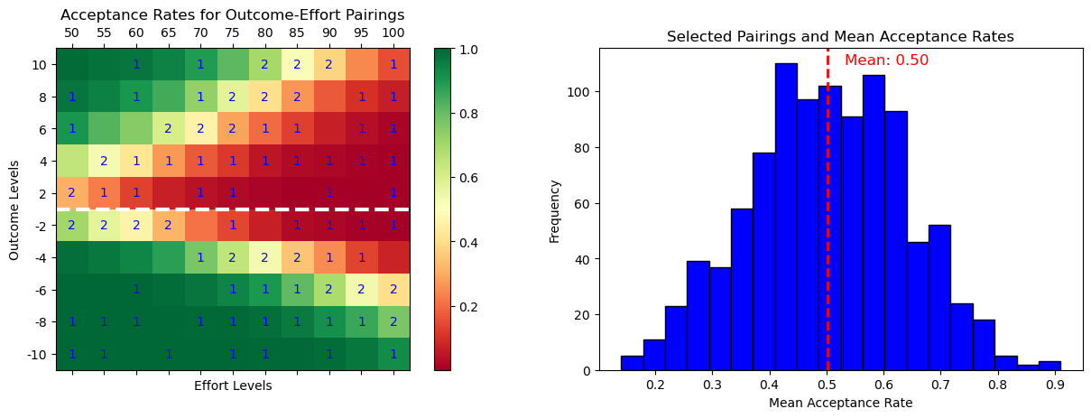
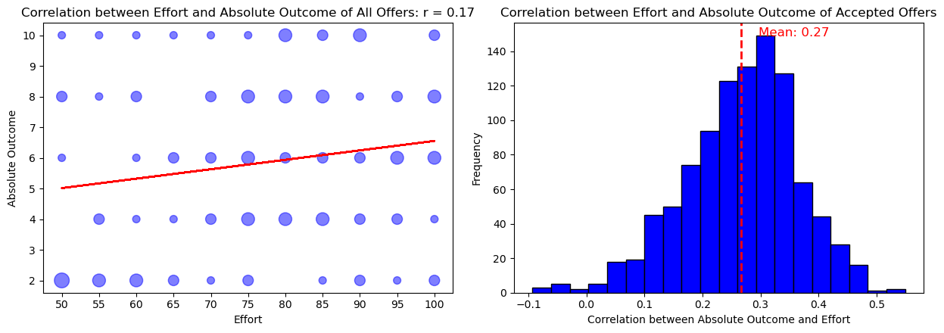
Schedule 13
Robustness for | Upper threshold | Lower threshold
alpha | +11% | -11%
lambda | +47% | -28%
k | +17% | -17%

Slide 14
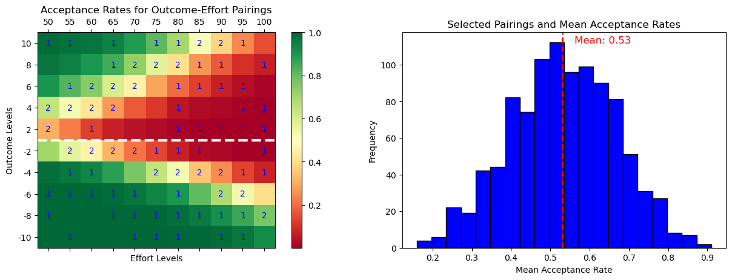
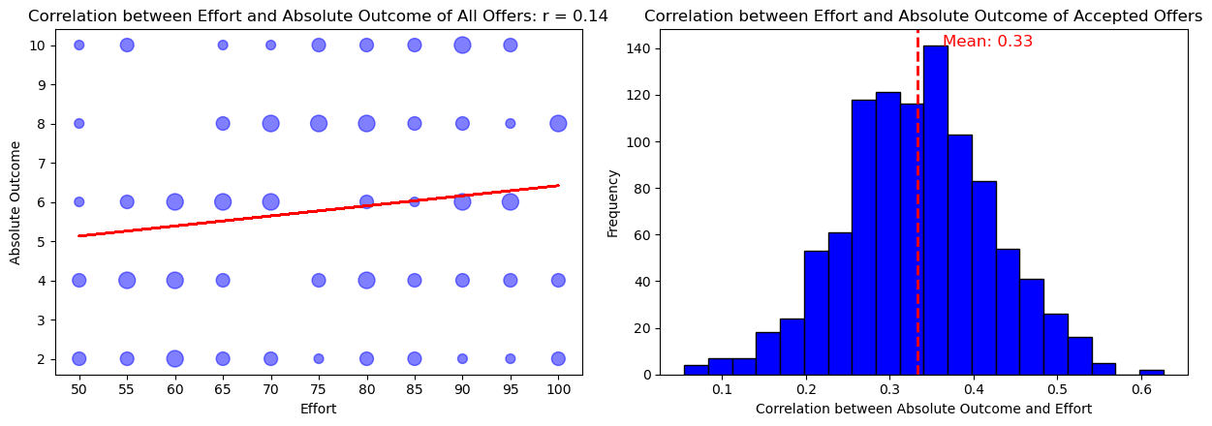
Schedule 14
Robustness for | Upper threshold | Lower threshold
alpha | +9% | -14%
lambda | +30% | -38%
k | +23% | -23%

Slide 15

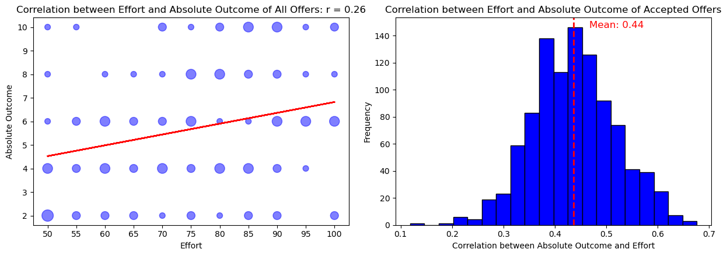
Schedule 15
Robustness for | Upper threshold | Lower threshold
alpha | +9% | -14%
lambda | +31% | -35%
k | +22% | -22%

