Slide 1
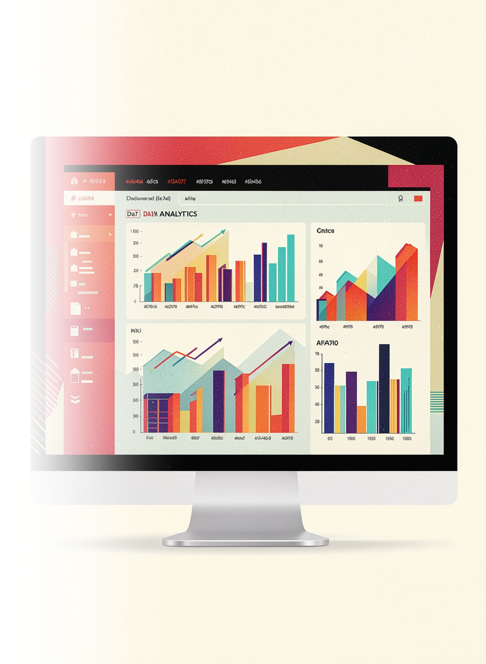
E-Commerce Customer Segmentation & RFM Analysis
Tools used: Python | SQL | Power BI
Presented by: Majaz Fatima

Slide 2
Problem Statement
The Challenge
Project Objectives
E-commerce businesses generate large amounts of transaction data. Analyzing this data can help understand customer purchasing behavior, identify valuable customers, and recognize customers who may need re-engagement.
Clean and prepare the transaction data for analysis
Analyze sales, customers, products, and purchasing patterns
Identify high-value customers and products
Perform RFM analysis to understand customer behavior
Segment customers into High Value, Loyal, At-Risk, and Dormant groups
Create a Power BI dashboard to communicate the findings

Slide 3
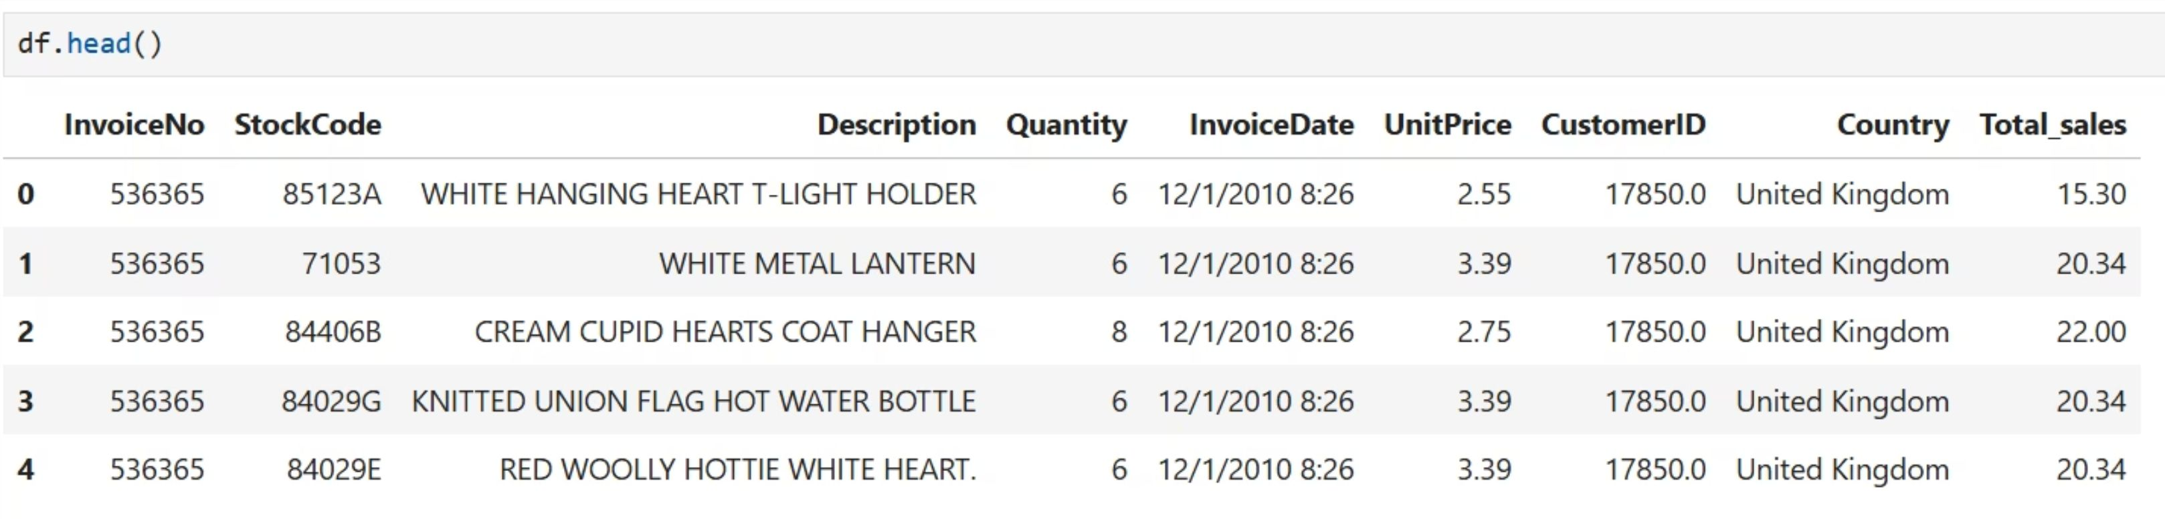
Dataset Overview
541K
13
Total Rows
Months Covered
8 columns per record
Dec 2010 – Dec 2011
Key Variables
InvoiceNo — Unique transaction number
StockCode — Product identifier
Description — Product description
Quantity — Number of items purchased
InvoiceDate — Date and time of purchase
UnitPrice — Price per unit
CustomerID — Unique customer identifier
Country — Customer location

Slide 4


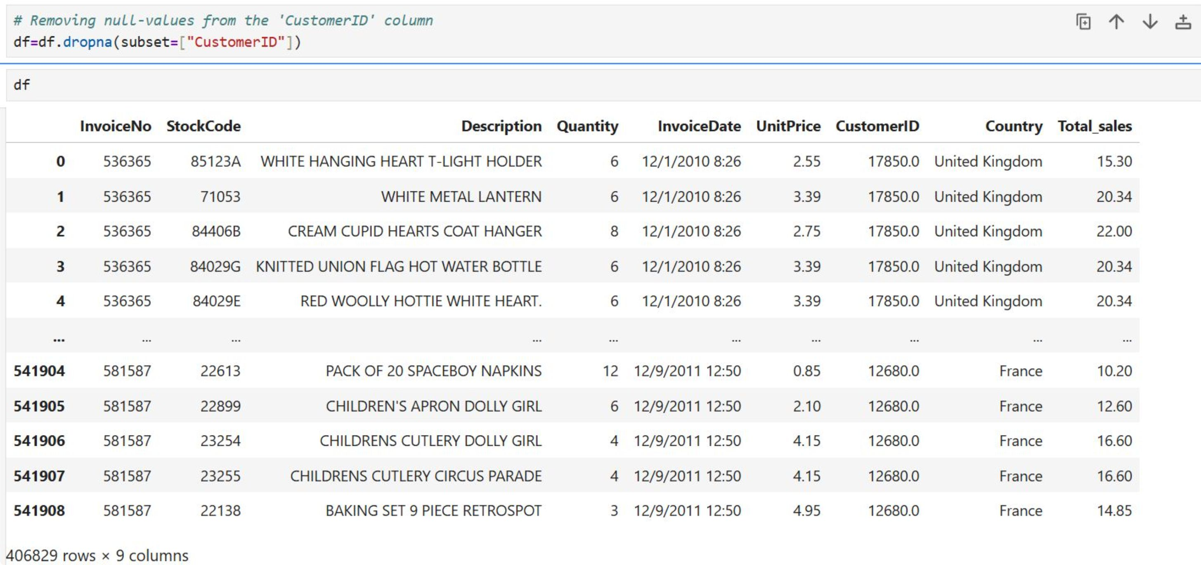
Data Cleaning & Preparation
Before analysis, the dataset was cleaned in Python to improve data quality and prepare it for customer segmentation.
Missing CustomerID
Duplicates Removed
Removed rows with missing CustomerID because customers could not be identified for segmentation.
Removed 5,525 duplicate rows to ensure data integrity.
Cancelled Orders
Non-Product StockCodes
Identified 8,872 rows with negative quantities; InvoiceNo started with "C", indicating cancellations — removed from dataset.
Removed entries such as POST, C2, M, DOT, and BANK CHARGES, which were not actual products.

Slide 5
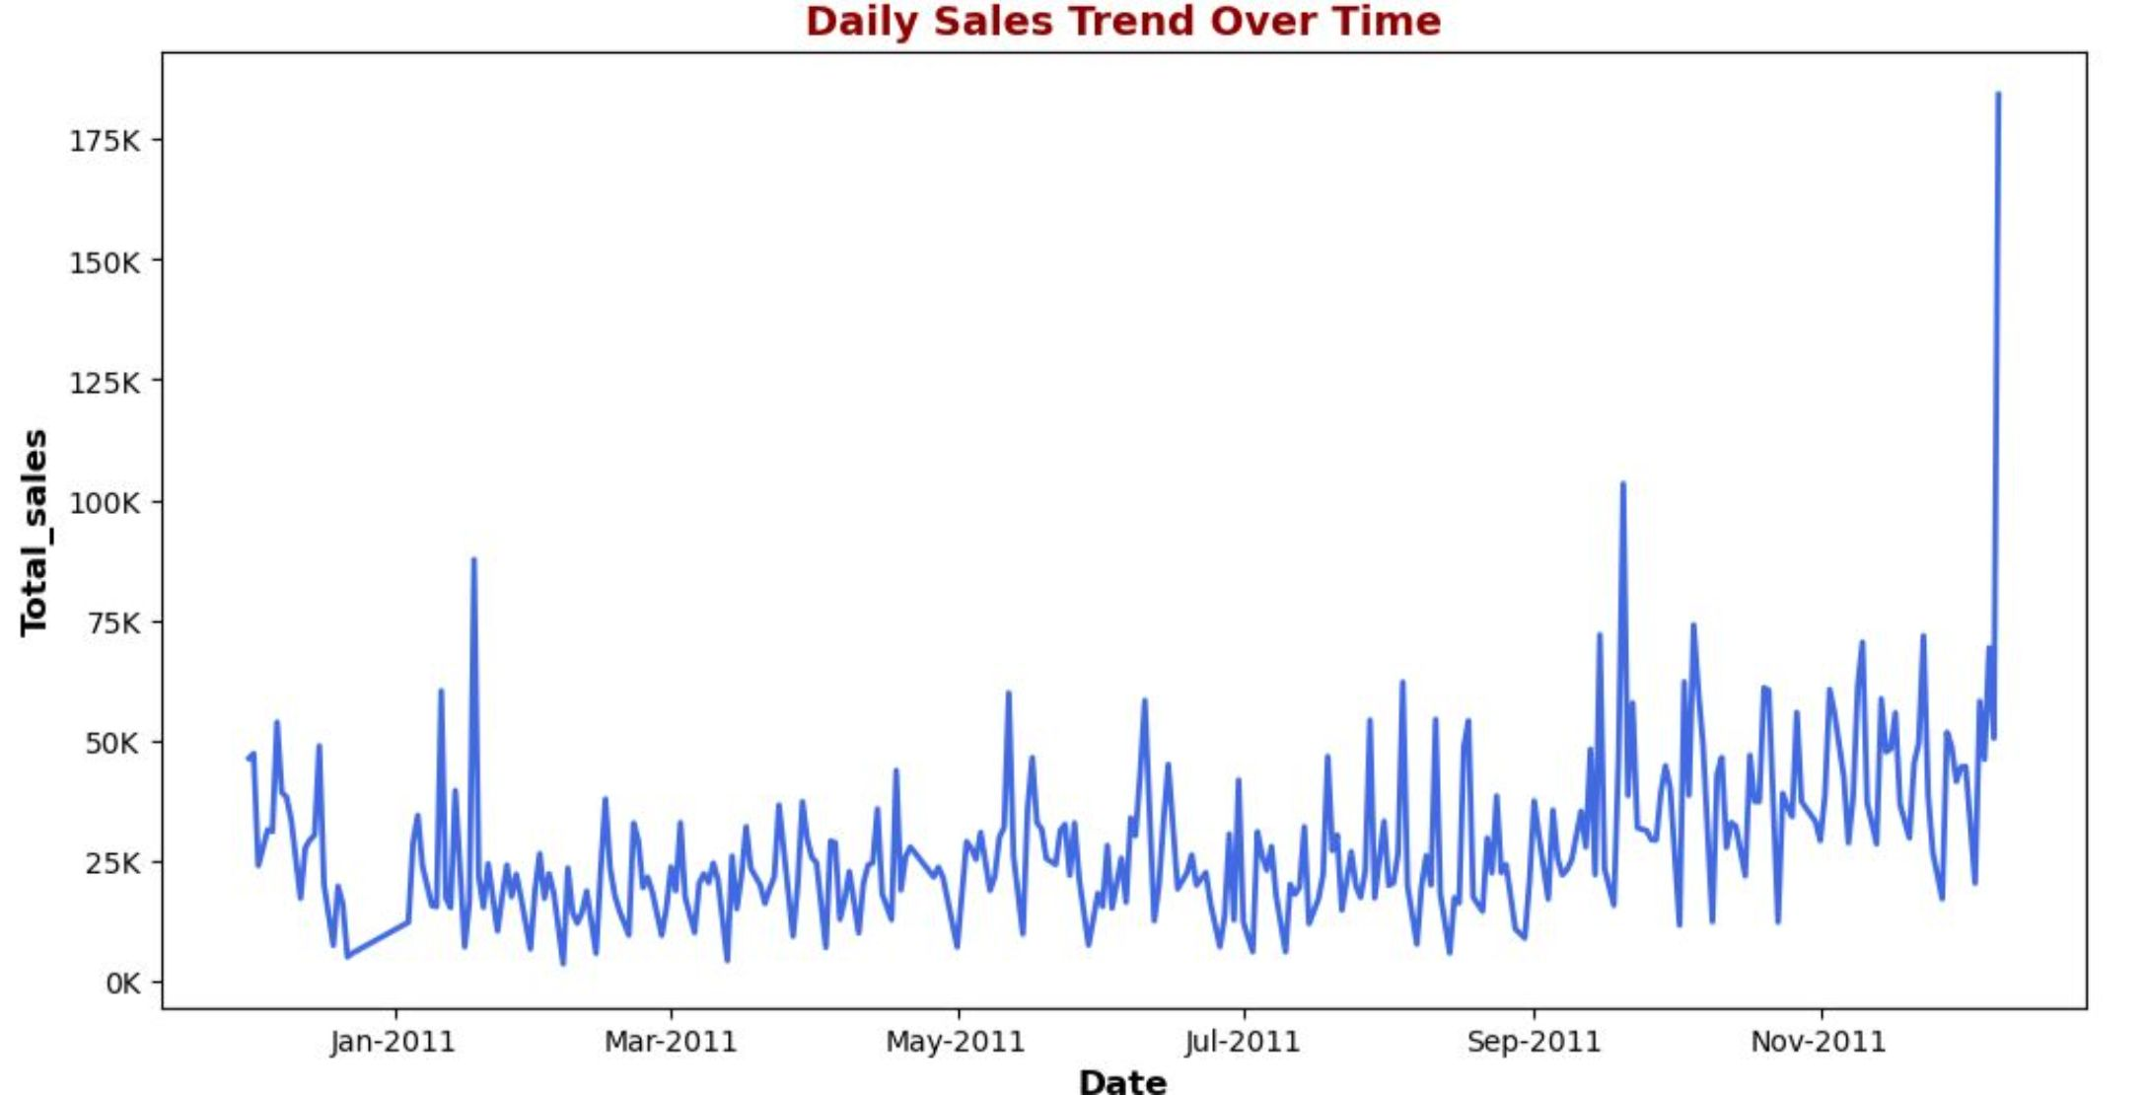
Exploratory Data Analysis (EDA)
EDA Performed in Python
Key analyses conducted to understand sales patterns, customer behavior, and product performance:
Analyzed sales trends over time
Identified top customers by total sales
Analyzed top products by revenue and quantity sold
Compared sales across countries
Analyzed monthly and day-of-week sales patterns
Investigated quantity distribution and outliers

Slide 6
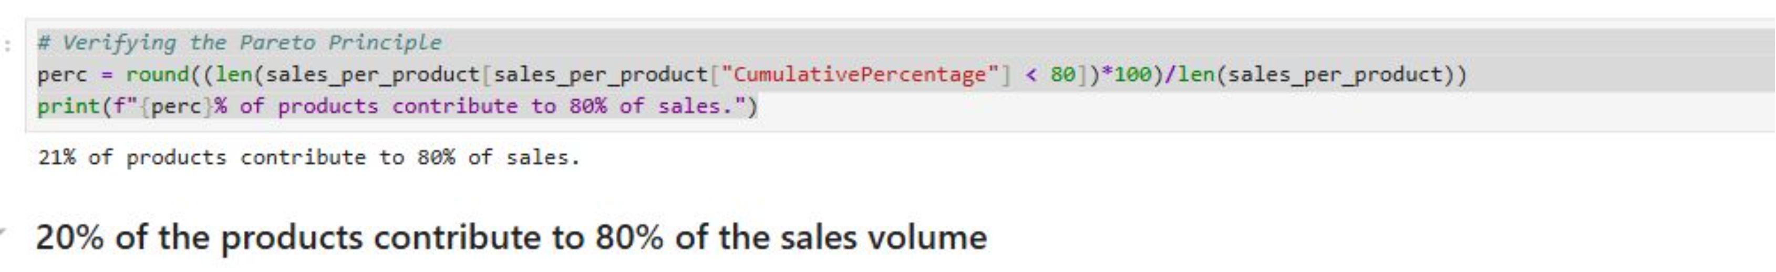
Pareto Analysis – Revenue Contribution
Pareto analysis was performed to identify the customers and products that contribute the majority of revenue.
Customer Contribution
Product Contribution
Key Takeaway
26% of customers are responsible for 80% of the revenue.
20% of products are responsible for 80% of the revenue.
A relatively small group of customers and products generates most of the business revenue.

Slide 7
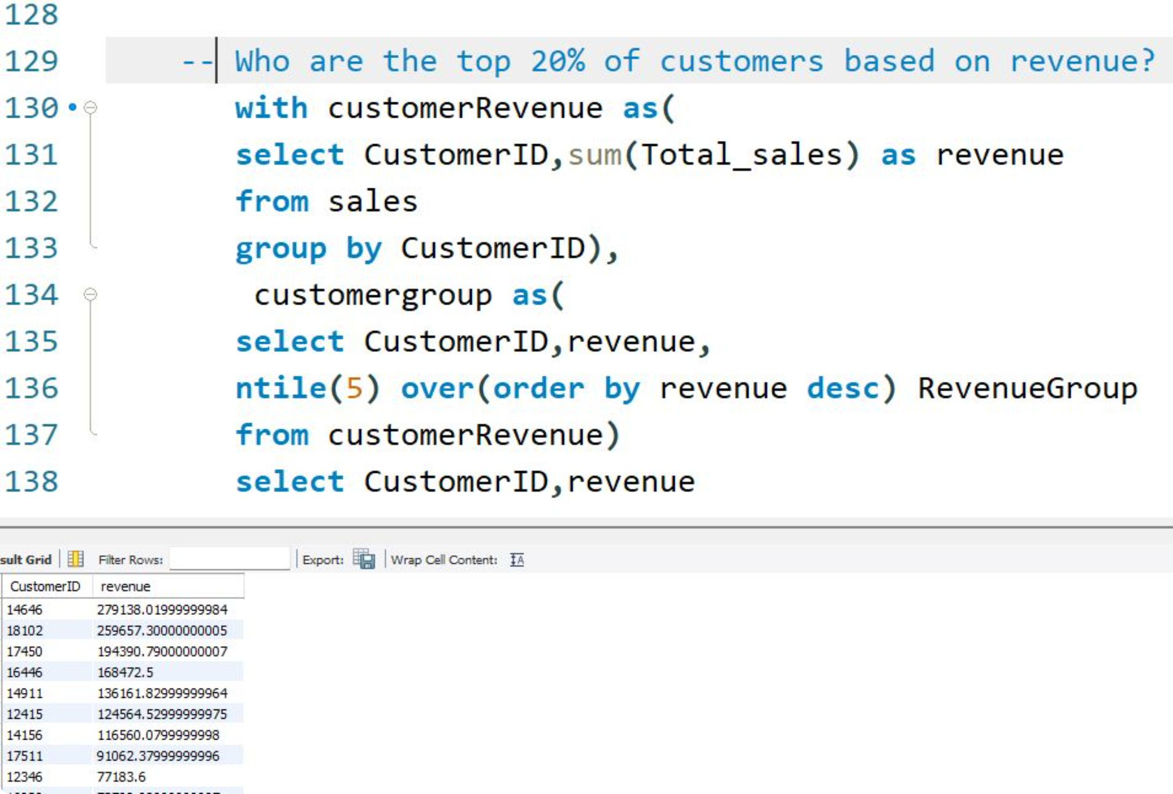
Business Analysis Using SQL
Key SQL Analyses
SQL was used to analyze customer, product, and sales performance and answer key business questions.
Identified top products by revenue and quantity sold
Analyzed revenue by country
Calculated Average Order Value (AOV)
Identified each customer's most recent purchase
Found customers with more than 5 orders
Identified customers who spent more than $1,000
Identified the top 20% of customers by revenue

Slide 8



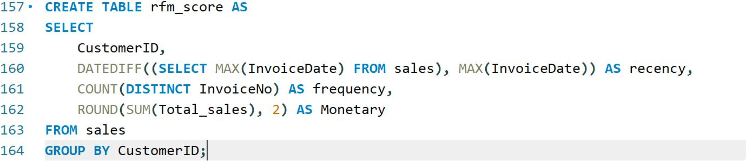
RFM Analysis & Customer Segmentation
RFM analysis was used to evaluate customers based on their purchasing behavior. Customers were scored using NTILE(5) and then classified into four segments.
Recency (R)
Frequency (F)
Monetary (M)
Days since the customer's most recent purchase
Number of unique orders made by the customer
Total amount spent by the customer

Slide 9
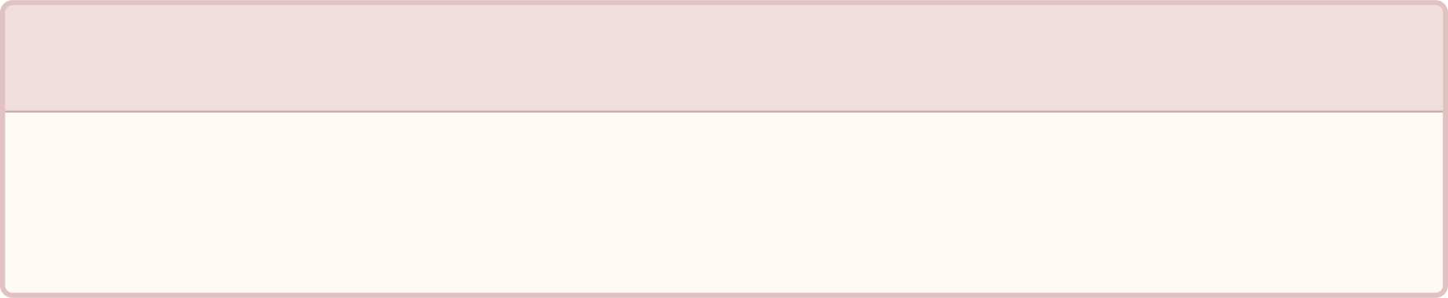
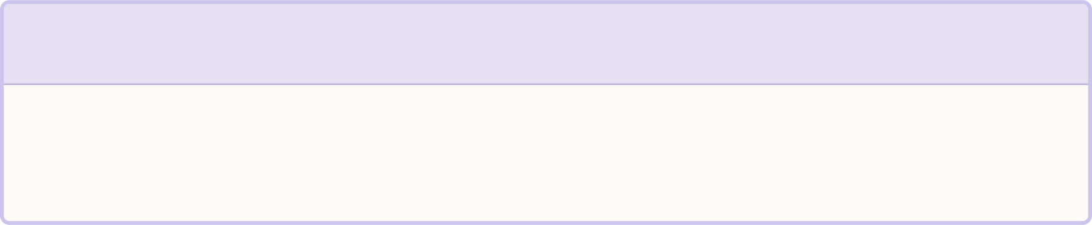


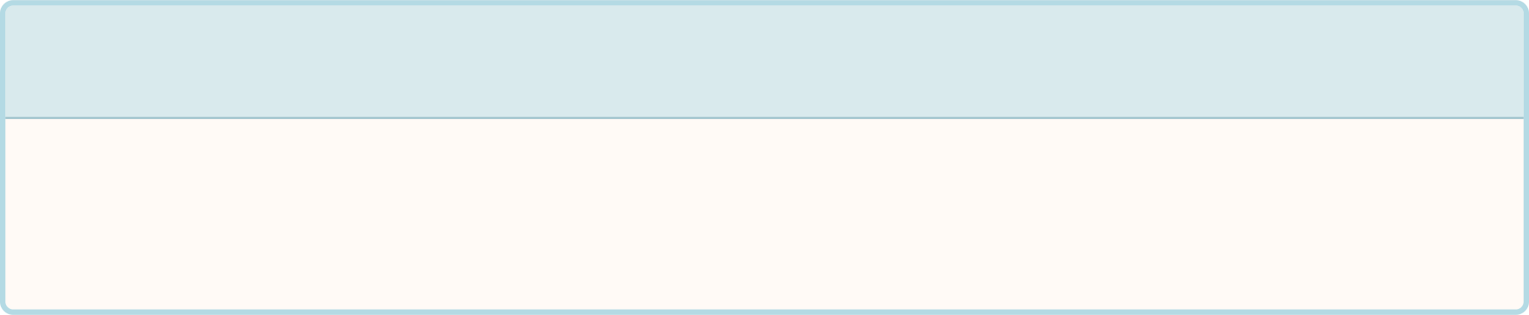


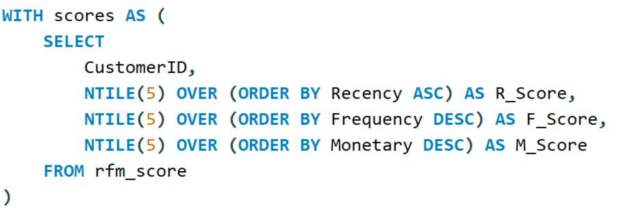
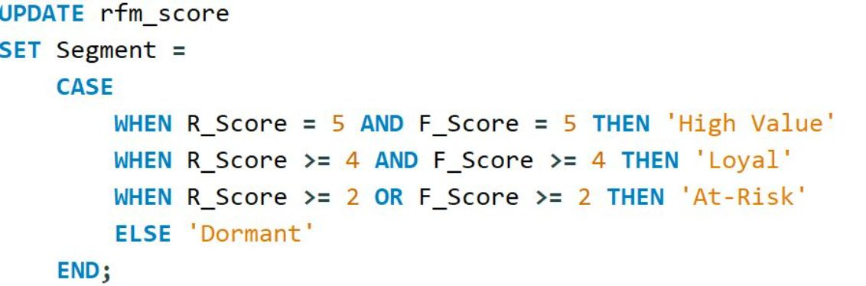
Customer Segmentation Based on RFM Scores
After calculating Recency, Frequency, and Monetary values, customers were scored and classified into four customer segments.
High Value
Loyal
Best customers with strong recent and frequent purchasing behavior
Customers who purchase recently and frequently
At-Risk
Dormant
Customers showing lower engagement and declining activity
Customers with very low recent or frequent activity

Slide 10
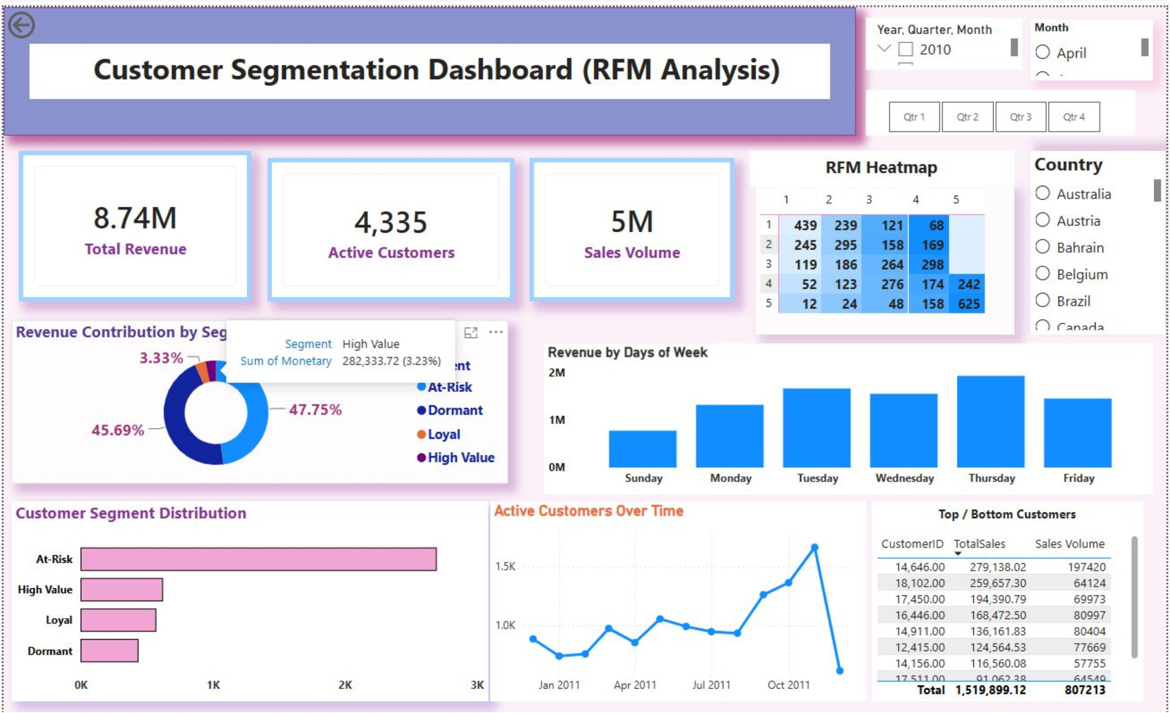



Power BI Dashboard & Key Insights
Dashboard Highlights
Business Recommendations
Monitors overall sales and customer performance
Visualizes customer segments based on RFM analysis
Tracks sales trends and customer purchasing behavior
Helps identify valuable and at-risk customers for targeted business strategies
High Value
Loyal
Reward with loyalty programs and exclusive offers
Use cross-selling and upselling opportunities
At-Risk
Dormant
Conclusion
Use personalized promotions to re-engage them
Use win-back campaigns to encourage repeat purchases
Customer behavior was analyzed using Python, SQL, and RFM analysis
Customers were segmented into High Value, Loyal, At-Risk, and Dormant
The Power BI dashboard presents key findings and supports data-driven customer strategies
Thank You

