Slide 1
Hospital Operations & Patient Safety Analytics
Impact of Bed Occupancy on Staff Responsiveness and Patient Falls
96.2%
2.61
Avg Bed Occupancy
Avg Fall Rate
2020–2024 monthly mean
Per 1,000 patient days
63.1
60
Avg Responsiveness
Monthly Records
Staff score (0–100 scale)
Jan 2020 – Dec 2024
Tools Used
Analytical Scope
Python (Pandas) · Power BI · Excel
Trend analysis, descriptive statistics, correlation analysis, and KPI dashboard development across five years of hospital operations data.

Slide 2
01 — BUSINESS CONTEXT
Business Problem & Objectives
The Challenge
Project Objectives
High bed occupancy rates may strain staff capacity — reducing responsiveness and increasing patient safety risks. Understanding these relationships is critical for hospital operations management and patient safety strategy.
1
Identify Trends
Analyze yearly and monthly trends in occupancy, unassisted fall rates, and staff responsiveness from 2020 through 2024.
Research Question
2
Quantify Correlations
How do bed occupancy levels correlate with unassisted fall rates and staff responsiveness across a five-year period?
Measure the strength and direction of relationships between the three key operational metrics using Pearson correlation coefficients.
3
Drive Recommendations
Translate analytical findings into actionable recommendations to improve patient safety and operational performance.

Slide 3



02 — DATA OVERVIEW
Dataset Overview & Methodology
Time Period
Granularity
Data Source
January 2020 – December 2024
60 monthly records of hospital-wide aggregated data
Monthly aggregated, hospital-wide scope
Each record represents one full calendar month of operations
Hospital operations case study dataset
Loaded from raw Excel format and cleaned in Python
Key Metrics Tracked
Bed Occupancy Rate (%)
Unassisted Fall Rate
Staff Responsiveness Score
Monthly percentage of occupied beds relative to total available capacity. The primary independent variable in the analysis.
Number of unassisted patient falls per 1,000 patient days. A critical patient safety outcome metric tracked month-over-month.
Composite score (0–100) measuring how quickly and effectively staff respond to patient needs. Serves as the key mediator variable in the analysis.

Slide 4

03 — DATA PREPARATION
Data Cleaning & Preparation
Tool: Python (Pandas)
Data Quality Summary
01
Check
Result
Load Raw Data
Total Records
60 months
Imported the raw Excel dataset into Python using Pandas for programmatic cleaning and transformation.
Missing Values
None
02
Data Types
Verified
Structural Cleanup
Unusual Values
1 flagged (Mar 2020)
Removed an empty/unnamed column. Verified dataset shape, data types, and field completeness.
Output Format
hospital_cleaned_data.csv
03
The March 2020 occupancy of 81% was flagged as an outlier consistent with early pandemic disruption. It was retained in the dataset with contextual annotation.
Missing Value Check
Confirmed no missing values in any of the three analysis fields — data was complete across all 60 records.
04
Feature Engineering
Created Month_Name and Year fields to enable time-series trend analysis. Renamed KPI fields for clearer interpretation.
05
Export
Exported the cleaned dataset as hospital_cleaned_data.csv for use in downstream analysis and Power BI.

Slide 5
04 — EDA
Exploratory Data Analysis
96.2%
2.61
63.1
Avg Bed Occupancy
Avg Fall Rate
Avg Responsiveness
Consistently near-capacity across the 5-year period
Unassisted falls per 1,000 patient days
Staff responsiveness score out of 100
Key Observation: March 2020 Anomaly
Distributions & Descriptive Statistics
Exploratory analysis identified an unusually low 81% occupancy in March 2020 — a significant deviation from the dataset norm. Further investigation confirmed this was an isolated pandemic-period observation.
March occupancy in subsequent years was 95%, 96%, 98%, and 94% (2021–2024), confirming that the low March average across the full dataset was heavily influenced by the single 2020 data point.
Reviewed full distributions and descriptive statistics for all three KPIs. Key observations:
Bed occupancy was highly right-clustered — the hospital operated near capacity for the vast majority of the study period
Fall rates showed moderate variability across months, with peaks aligning with high-occupancy periods
Staff responsiveness scores showed consistent underperformance relative to benchmark levels in multiple periods

Slide 6
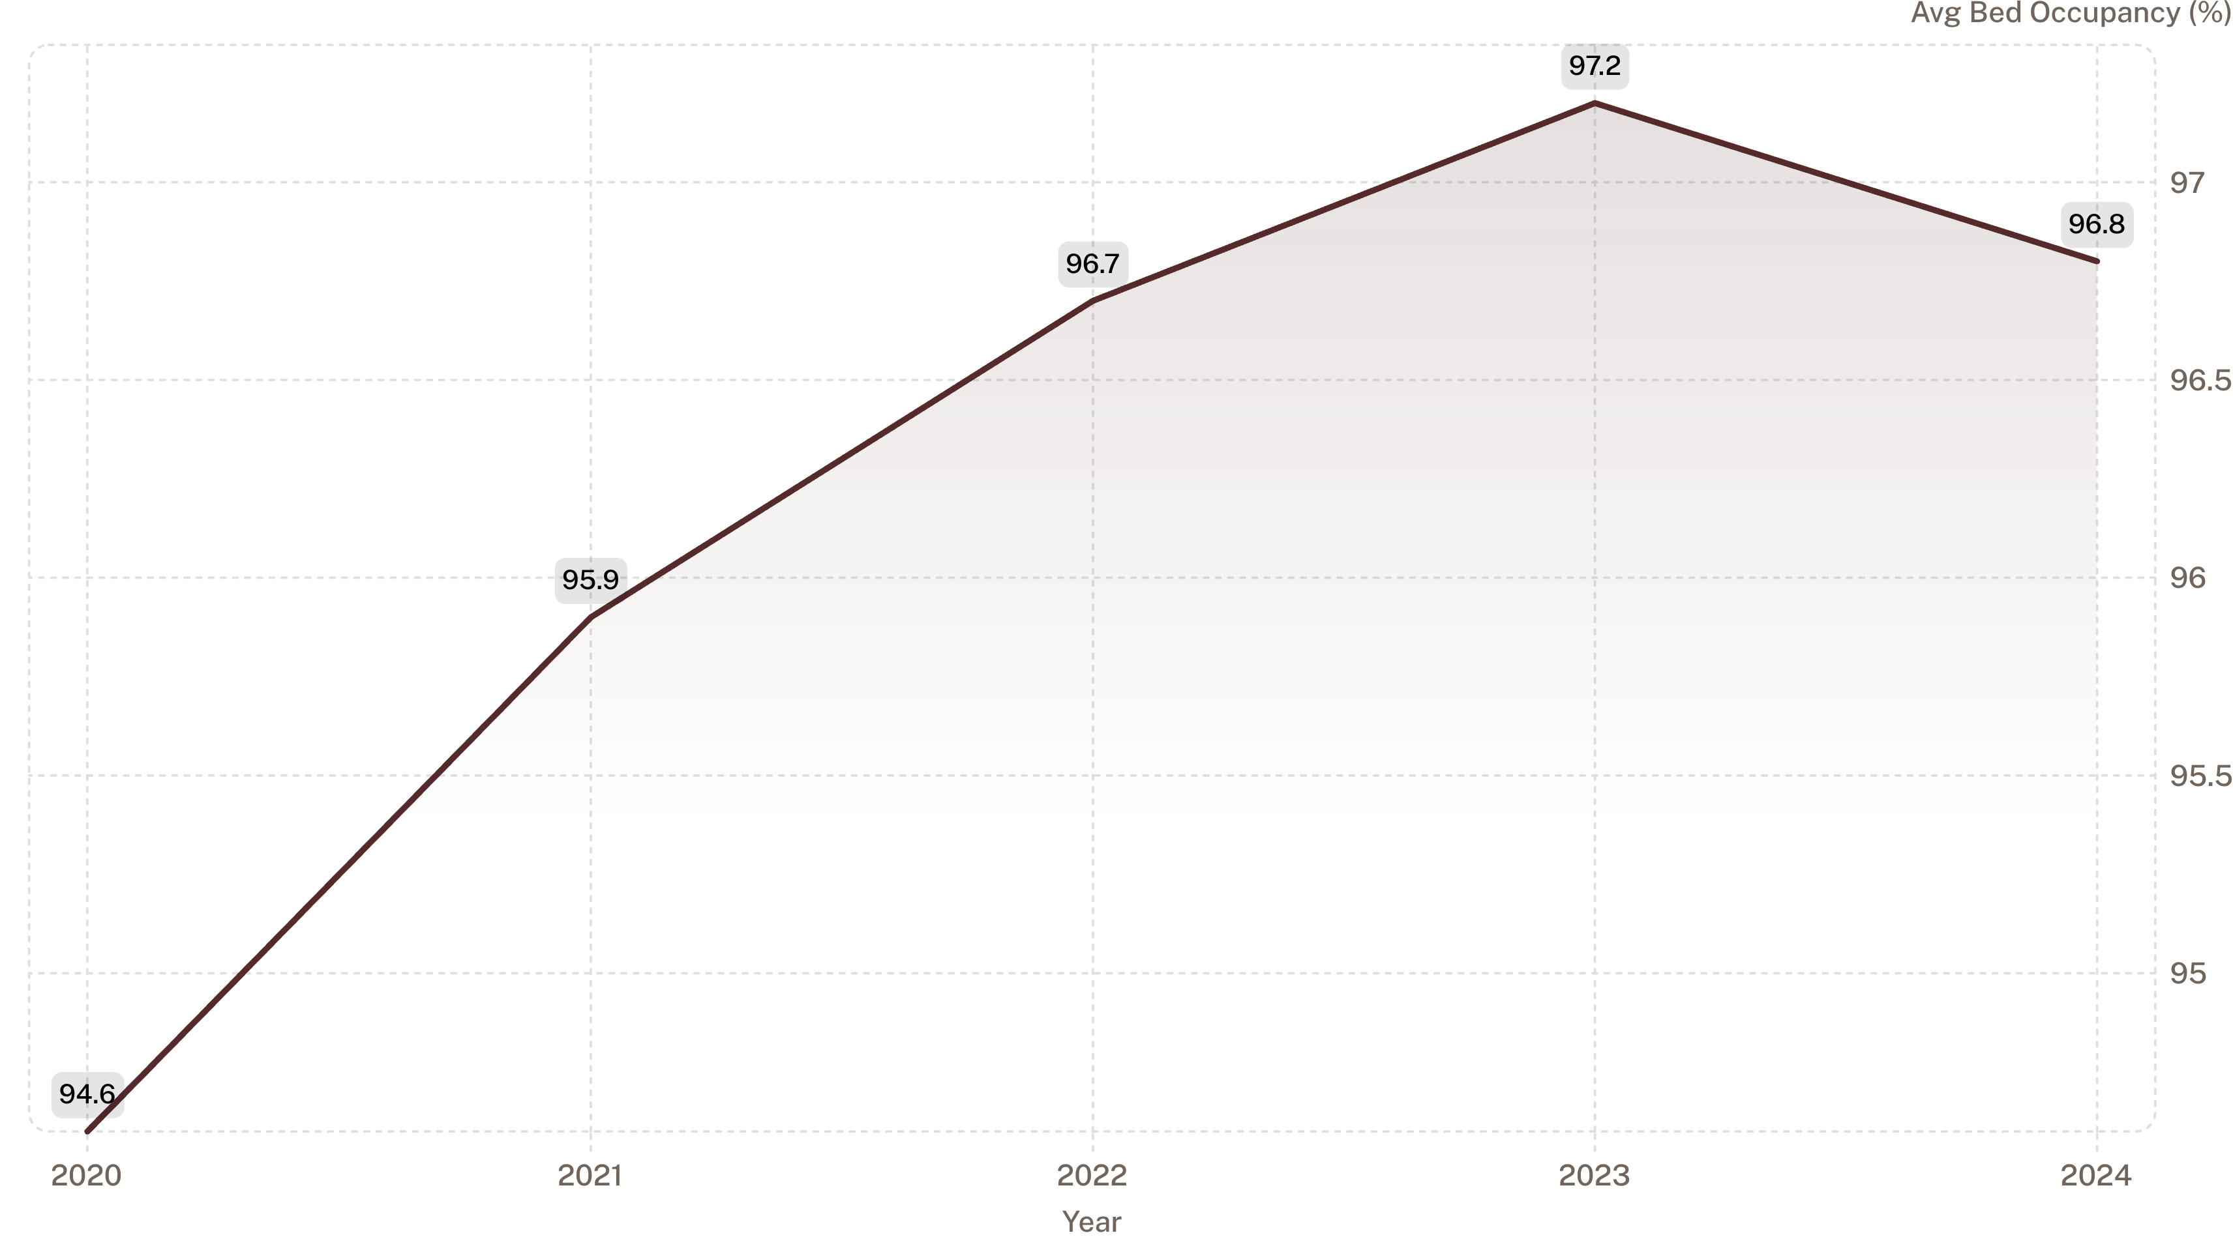
05 — TREND ANALYSIS
Bed Occupancy Trends (2020–2024)
Key Insight
Trend Narrative
Bed occupancy remained consistently high throughout the entire five-year period, never falling below 94.6% on a yearly average basis. The hospital operated at or near capacity for virtually the entire study window.
Occupancy increased steadily from 94.6% in 2020 through a peak of 97.2% in 2023 — the highest yearly average on record — before a marginal decline to 96.8% in 2024. The 2020 figure reflects the partial impact of the COVID-19 pandemic on hospital utilization patterns early in the year.

Slide 7
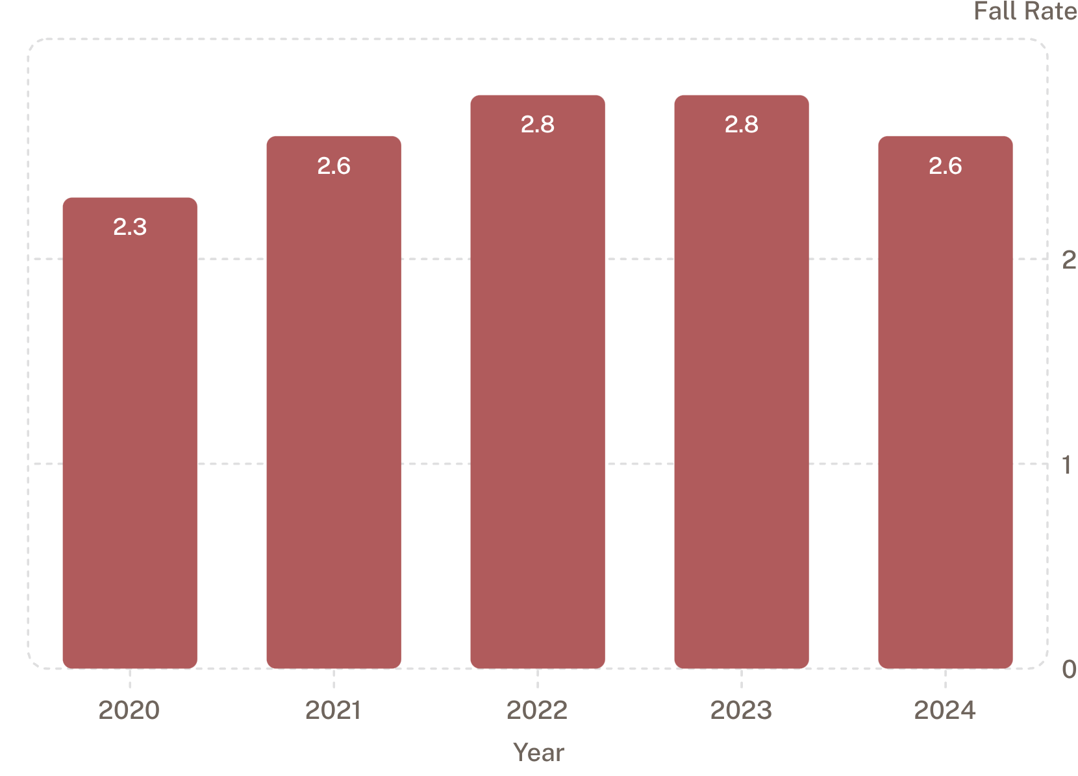



06 — TREND ANALYSIS
Fall Rate & Responsiveness Trends (2020–2024)
Unassisted Fall Rate (per 1,000 patient days)
Staff Responsiveness Performance
Average staff responsiveness across the full period: 63.1
2022 — Weakest Year
Responsiveness reached its lowest yearly performance in 2022, coinciding with peak occupancy pressure.
Post-2022 Recovery
Performance improved after 2022, consistent with the partial reduction in occupancy pressure in 2024.
Benchmark Gap
Year-specific benchmarks ranged between 65 and 66. Staff responsiveness was below benchmark in several periods, indicating a structural performance gap.
Unassisted fall rates increased from 2.3 in 2020 to a peak of 2.8 in 2022–2023, before improving to 2.6 in 2024. This pattern closely mirrors the rise and slight retreat of bed occupancy over the same period.

Slide 8




07 — CORRELATION ANALYSIS
Correlation Analysis & Key Findings
70%
37%
79%
Occupancy → Falls
Occupancy → Responsiveness
Responsiveness → Falls
r = +0.70 · Strong positive correlation
r = −0.37 · Moderate negative correlation
r = −0.79 · Strong negative correlation
Higher Occupancy → More Falls
Higher Occupancy → Lower Responsiveness
Lower Responsiveness → More Falls
A strong positive correlation (r = +0.70) between bed occupancy and unassisted fall rate was observed. As the hospital approached capacity, fall incidents increased.
The strongest relationship found: r = −0.79 between fall rate and responsiveness. Better responsiveness is strongly associated with fewer patient falls — the most actionable finding.
A moderate negative correlation (r = −0.37) indicates that as occupancy increased, staff responsiveness scores declined — consistent with capacity strain on staff resources.
Important caveat: These relationships indicate areas for further operational monitoring but do not establish causation. Additional confounding factors may influence each metric.

Slide 9

08 — ANALYTICAL FRAMEWORK
The Mediator Model: How These Metrics Connect
Bed Occupancy Rate
Percentage of occupied beds
Mediator Model
Staff Responsiveness
Responsiveness mediates occupancy effects on falls
Average response time to patient needs
Unassisted Fall Rate
Falls per 1,000 patient days
Staff responsiveness functions as a critical mediator between bed occupancy and patient falls. The strongest statistical relationship in the dataset (r = −0.79) exists between responsiveness and falls — not between occupancy and falls directly. This suggests that improving staff responsiveness, even under high-occupancy conditions, may be the most effective lever for reducing patient falls.
Strongest Signal
Operational Implication
Fall Rate ↔ Responsiveness: r = −0.79
Highest-magnitude correlation in the analysis. Responsiveness is the most actionable metric to target.
Because responsiveness partially mediates the occupancy-falls relationship, interventions that protect staff responsiveness capacity during high-occupancy periods may produce the greatest safety impact — even without reducing bed occupancy itself.

Slide 10

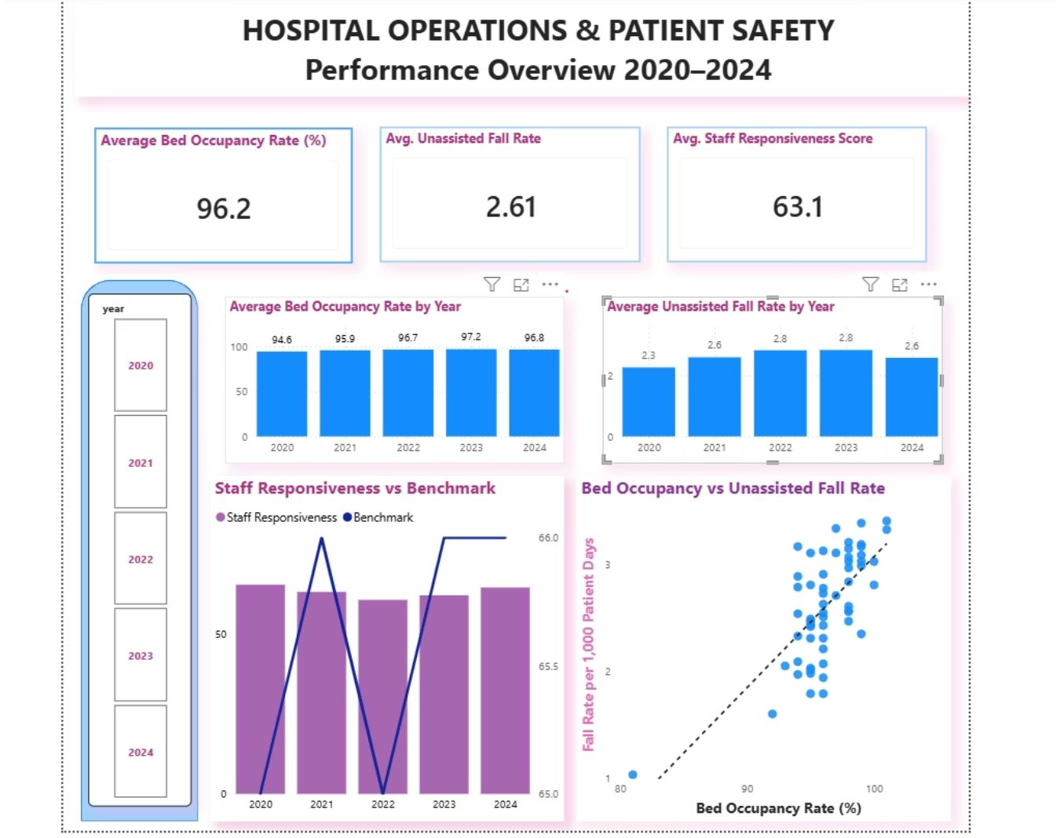



09 — RECOMMENDATIONS & CONCLUSION
Recommendations & Conclusion
Recommendations
Power BI Dashboard
Staffing & Resources
Review staffing and resource allocation protocols during periods of high bed occupancy to protect response capacity.
Fall Prevention
Strengthen patient monitoring and fall-prevention practices during higher-risk periods — particularly when occupancy exceeds 97%.
Responsiveness Monitoring
Track staff responsiveness against yearly benchmarks (65–66) and investigate periods of underperformance with structured root-cause reviews.
KPI Dashboard
Use the Power BI dashboard to monitor occupancy, fall rates, and responsiveness together in real time.
Further Analysis
Incorporate staffing levels, patient acuity, and unit-level data to better understand the drivers of patient falls beyond the three KPIs analyzed.
96.2%
r = +0.70
Avg occupancy
Occupancy → Falls
r = −0.79
Responsiveness → Falls
Conclusion: The analysis found meaningful relationships among bed occupancy, staff responsiveness, and unassisted falls. Higher occupancy was associated with higher fall rates; better staff responsiveness was associated with fewer falls — and represents the strongest operational lever for patient safety improvement.

