Slide 1
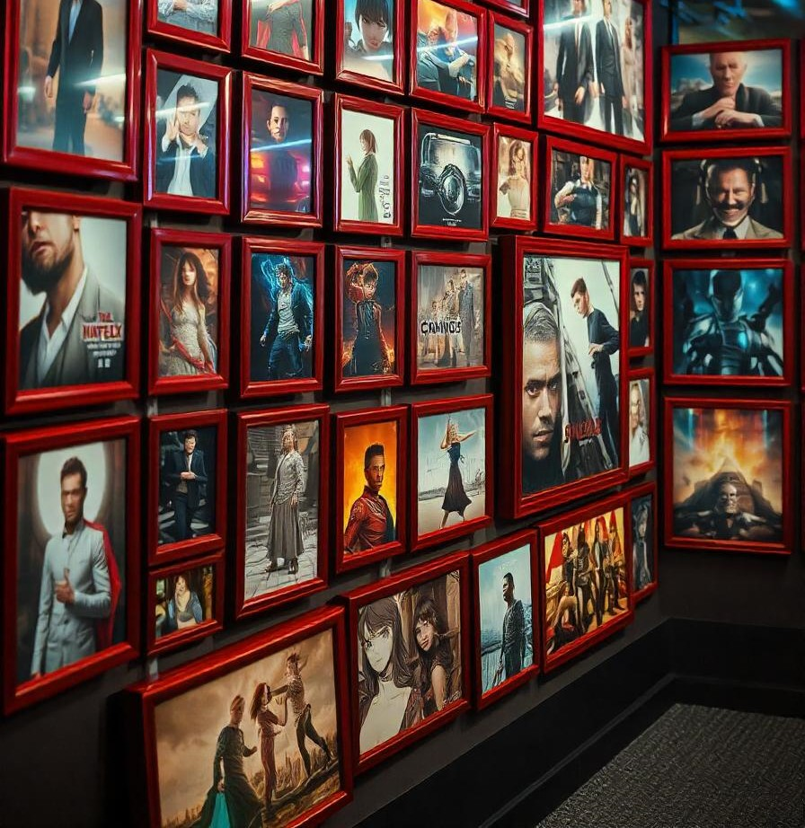
CimaNerds
Test your movie knowledge across genres, eras, and categories to see if you're a true CimaNerd!

Slide 2
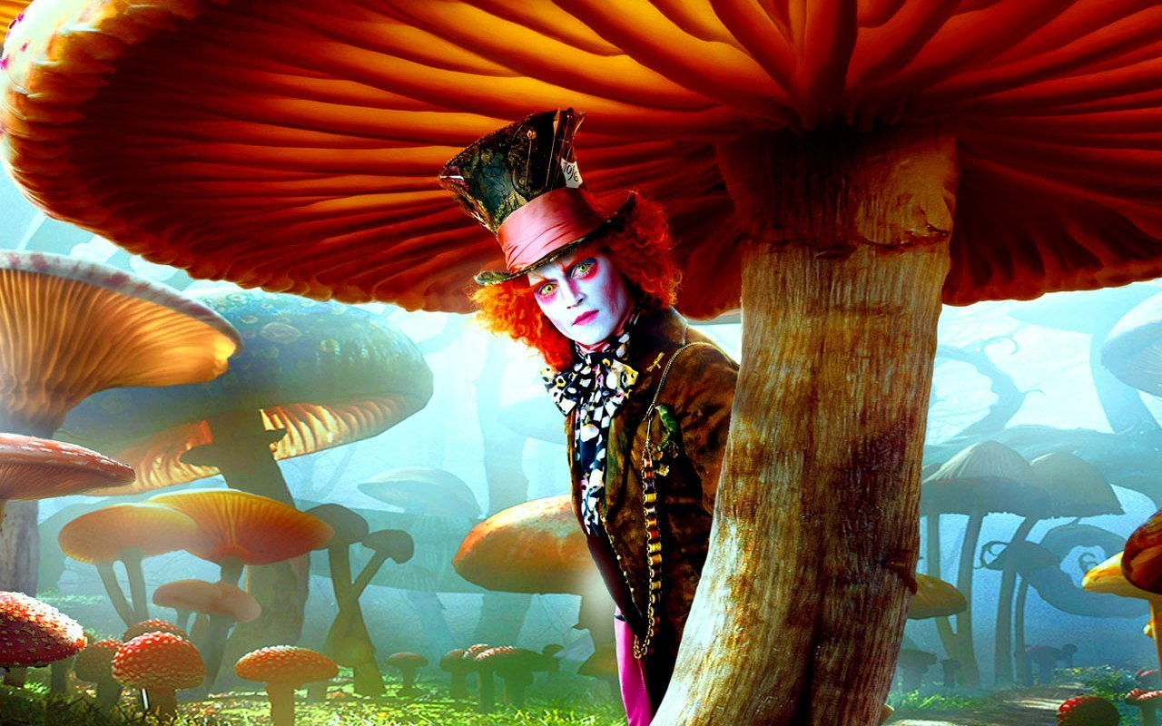
Who are the CimaNerds?
A group of people who share the same passion in the world of cima where we found our dreams come true while we watch it on the screen where we can imagine ourself and escape from the real world
PS: don’t forget to see our recommendations
“So what if I’m crazy the best people are “

Slide 3



Our Mission: Revolutionizing Online Quizzing
Engagement
1
We're committed to crafting highly engaging and interactive quizzes that captivate your attention.
Accessibility
2
We aim to make quizzing accessible to everyone, regardless of their background or knowledge level.
Innovation
3
We're constantly pushing boundaries, introducing new features and technologies to enhance the quizzing experience.

Slide 4
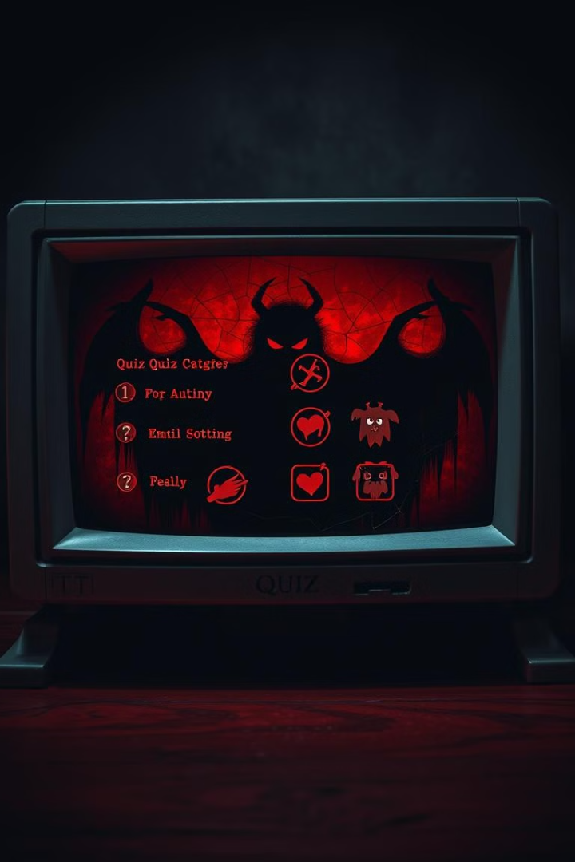
Key Features of CimaNerds
Extensive Collection
Personalized Learning
CimaNerds boasts an extensive collection of quizzes across diverse categories, ensuring something for everyone.
Our quizzes are designed to cater to your unique learning style and preferences, providing a tailored experience.
Continuous Improvement
We're constantly updating our quiz library with new and exciting content to keep you engaged and challenged.

Slide 5




Diverse Quiz Categories for All Cima Fans
Movies
Series
Test your knowledge of movies
Explore the world of series with quizzes
Anime
Delve into various aspects of Anime.

Slide 6
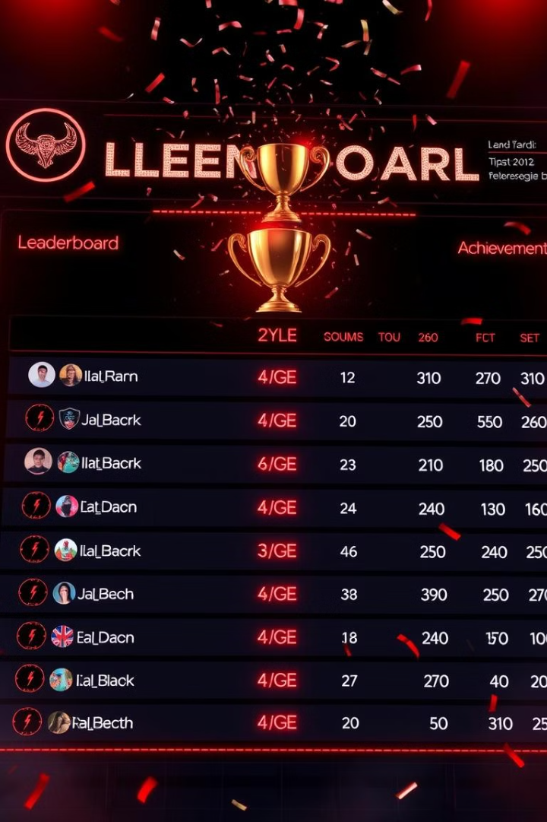
Future plans for CimaNerds
Show the scores of the best Nerds in the group …………………
Select a Nerd of the month and give him a unique nickname
Give access to all series and movies from all categories………

Slide 7

Join the CimaNerds Community: Register Today!
Join us to see how much cima expert you truly are !

Slide 8


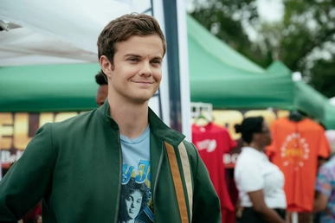
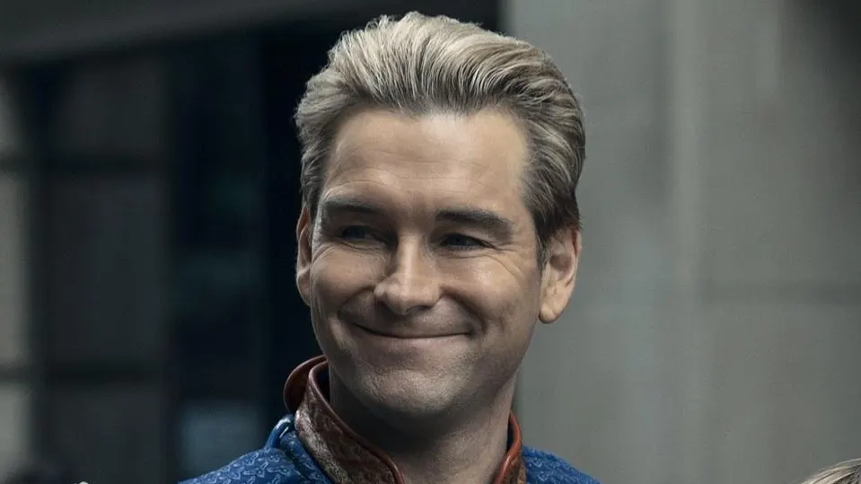
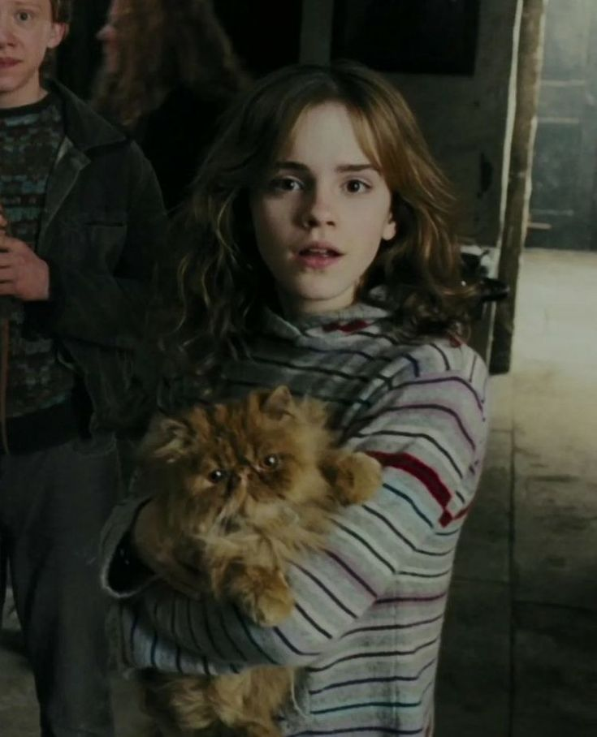
Majd Alkaseeh
Ibraheem Qunibi
Mohammad Abudeya
Ayman Aburomman
Razan Saaideh

