Slide 1

Fraud Detection Case Study
Identifying Credit Card Fraudulent Transactions
Results
Data Preprocessing
Introduction
Model
Dataset & EDA
Outline
Interview Case Study
Majd Qutaish

Slide 2





Results
Data Preprocessing
Introduction
Model
Dataset & EDA
Outline
Model Selection
&
Handling Imbalance
Dataset
&
EDA
Data Preprocessing
&
Feature Engineering
Results
&
recommendations
Introduction
&
Problem

Slide 3


1
In this project, we will investigate a fraud detection issue by using a dataset containing information about credit card transactions.
Results
Data Preprocessing
Introduction
Model
Dataset & EDA
Outline
The main objective of this case study is to develop a predictive model that can accurately identify fraudulent credit card transactions based on the provided dataset.
2

Slide 4
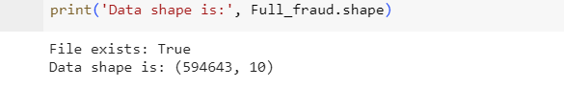
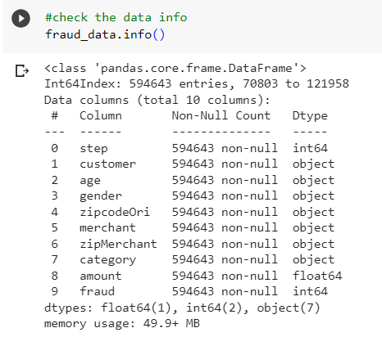
Applications:
Data Shape:
03
01
Human-computer interaction & gaming.
Robotics & industrial automation.
Drone navigation & obstacle avoidance.
Data information :
02
Results
Data Preprocessing
Introduction
Model
Dataset & EDA
Outline

Slide 5
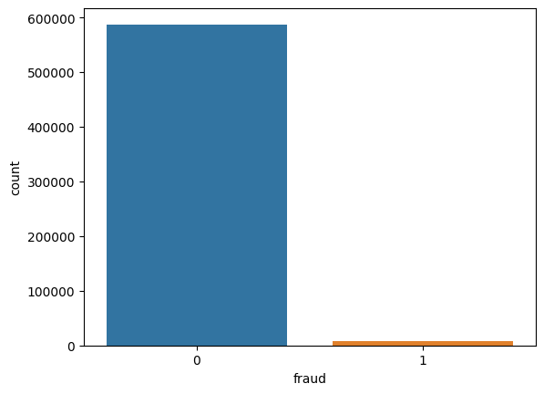
03
Exploratory Data Analysis (EDA):
Frequency distribution of Target variable :
0 : 587443
1 : 7200
Results
Data Preprocessing
Introduction
Model
Dataset & EDA
Outline

Slide 6
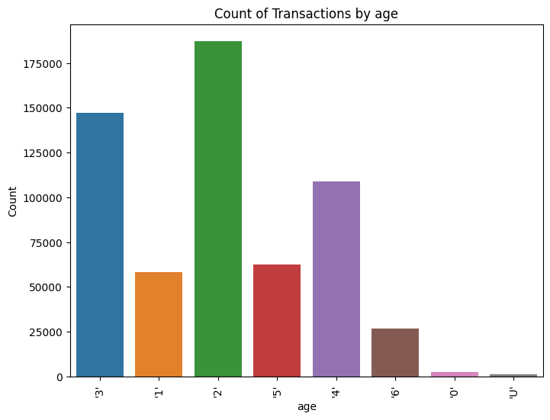
03
Exploratory Data Analysis (EDA):
Count of Transactions by Age:
Where:
0: <= 18
1: 19-25
2: 26-35
3: 36-45
4: 46-55
5: 56-65
6: > 65
U: Unknown
Results
Data Preprocessing
Introduction
Model
Dataset & EDA
Outline

Slide 7
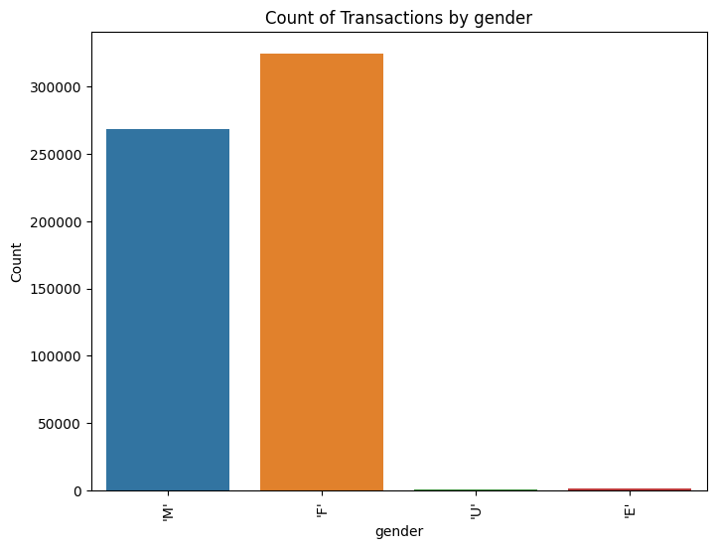
03
Exploratory Data Analysis (EDA):
Count of Transactions by gender:
Where:
E: Enterprise
F: Female
M: Male
U: Unknown
Results
Data Preprocessing
Introduction
Model
Dataset & EDA
Outline

Slide 8
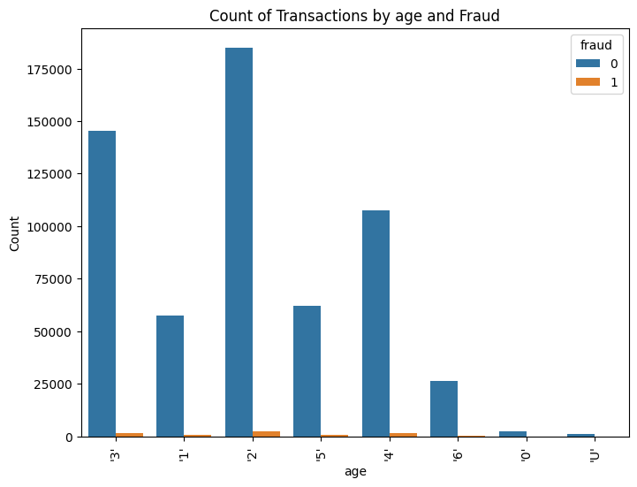
03
Exploratory Data Analysis (EDA):
Count of Transactions by age and Fraud:
Results
Data Preprocessing
Introduction
Model
Dataset & EDA
Outline

Slide 9
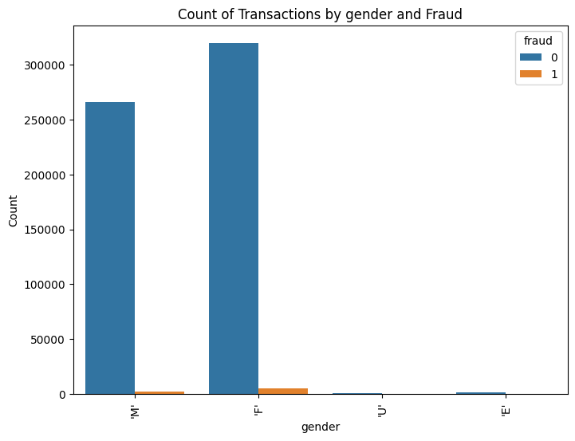
03
Exploratory Data Analysis (EDA):
Count of Transactions by gender and Fraud:
Results
Data Preprocessing
Introduction
Model
Dataset & EDA
Outline

Slide 10
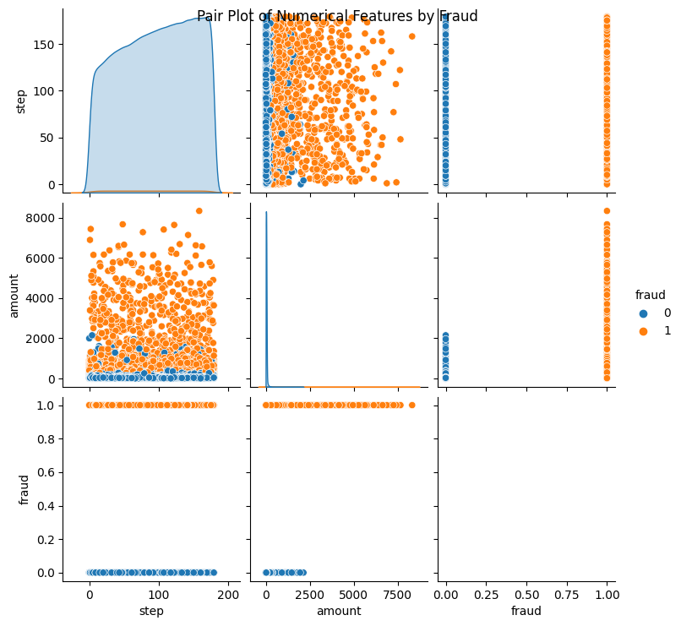
03
Exploratory Data Analysis (EDA):
Numerical features by Fraud:
Results
Data Preprocessing
Introduction
Model
Dataset & EDA
Outline

Slide 11
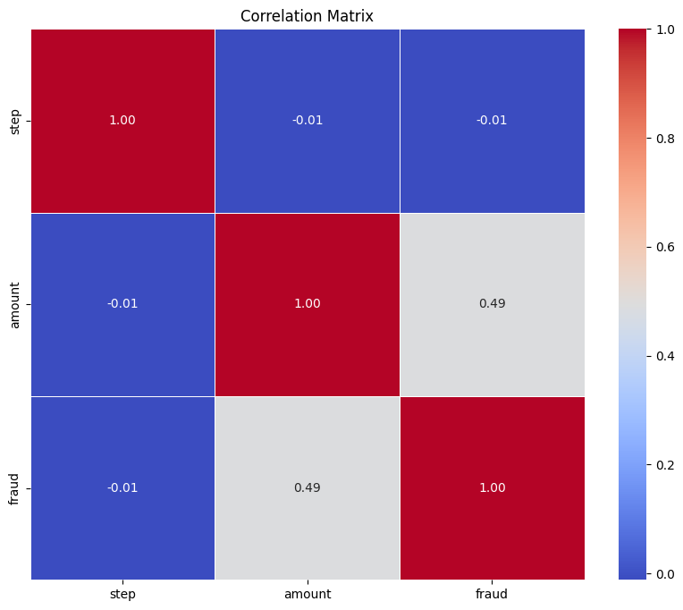
03
Exploratory Data Analysis (EDA):
Heat-Map:
Results
Data Preprocessing
Introduction
Model
Dataset & EDA
Outline

Slide 12
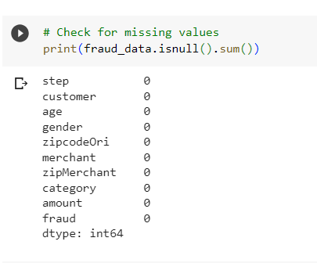
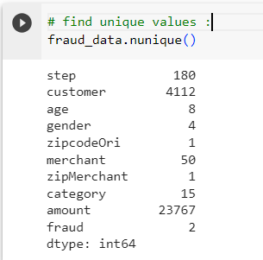
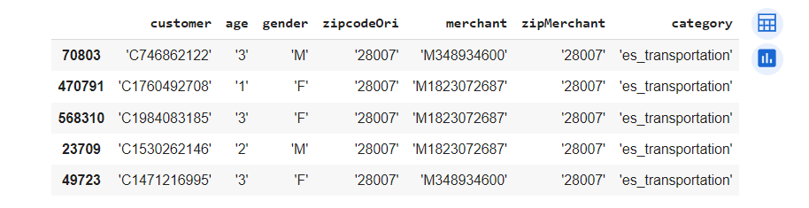
01
missing values :
- Zero missing values
03
unique values :
- Remove columns provide no useful
information for modeling or analysis
Results
Data Preprocessing
Introduction
Model
Dataset & EDA
Outline
02
categorical data:
Remove single quotes from categorical columns
Perform one-hot encoding for all categorical columns

Slide 13
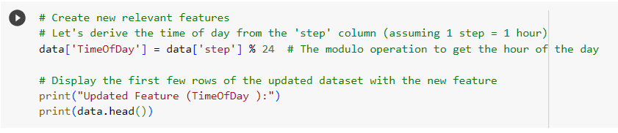
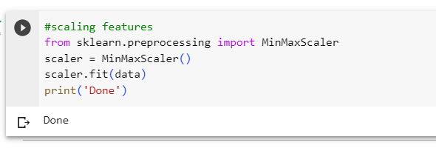
01
Add new column:
- time of day from the 'step' column
02
scaling features:
Random Forests are an ensemble learning method based on decision trees,
and they are not sensitive to the scale of features
Feature Engineering
Introduction
Results
Model
Dataset & EDA
Outline

Slide 14

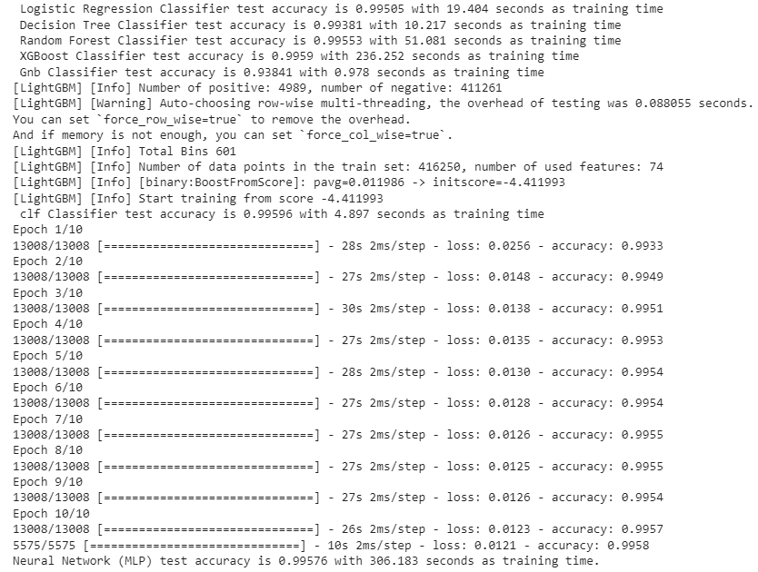
Model Selection
Results
Data Preprocessing
Introduction
Model
Model
Dataset & EDA
Outline

Slide 15
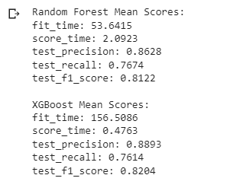
Model Selection
Both Random Forest and XGBoost are excellent choices for fraud detection, offering high accuracy and precision. The choice between them comes down to a balance between computational resources and performance optimization. If computational efficiency and ease of implementation are priorities, Random Forest may be the preferred option. However, if squeezing the last bit of performance from the model is crucial and computational resources are available, XGBoost's fine-tuning capabilities make it an attractive alternative. Ultimately, a well-informed choice between these two models can significantly impact the success of a fraud detection system.
Results
Data Preprocessing
Introduction
Model
Model
Dataset & EDA
Outline

Slide 16
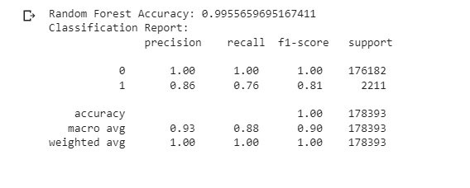
Random Forest model
Results
Data Preprocessing
Introduction
Model
Model
Dataset & EDA
Outline
Perfect Precision and Recall for Class 0 (Non-Fraudulent Transactions):
The model achieves perfect precision and recall for Class 0 (non-fraudulent transactions). While this may seem desirable, it can be a sign of overfitting.
Overfitting occurs when the model becomes too specialized in learning the training data, including its noise and fluctuations. As a result, it performs exceptionally well on the training data but may struggle to generalize to unseen data.

Slide 17
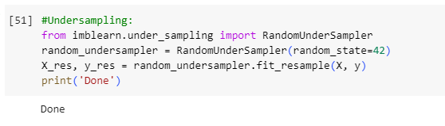
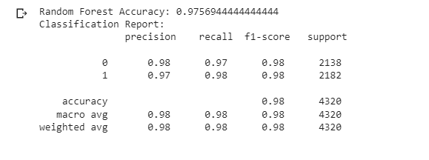
Random Forest model after under-Sampling
Handling Imbalance
Results
Data Preprocessing
Introduction
Dataset & EDA
Outline
After under-sampling the dataset to address the class imbalance, it performs very well. It achieves high accuracy, precision, recall, and F1 scores for both classes, suggesting that it effectively detects fraudulent transactions while maintaining a low false positive rate. This balanced performance is a positive outcome, and the model can be considered for use in a fraud detection system. However, it's essential to continue monitoring its performance and, if needed, further optimize hyper-parameters to ensure its effectiveness in a real-world setting.

Slide 18

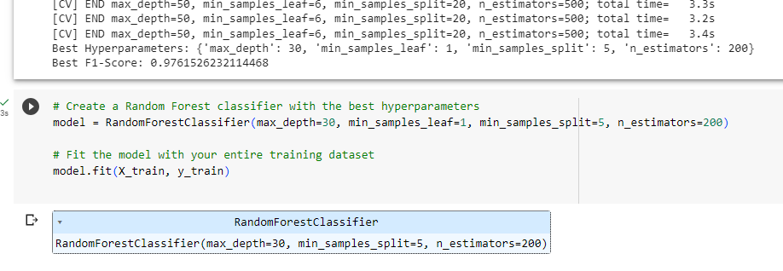
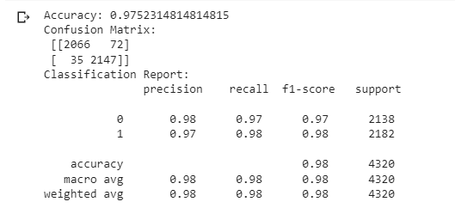
Optimize hyperparameters using GridSearchCV
The best hyperparameters obtained through grid search for the Random Forest model are as follows: {'max_depth': 30, 'min_samples_leaf': 1, 'min_samples_split': 5, 'n_estimators': 200}. These hyperparameters have been fine-tuned to optimize the model's performance on the given dataset. The grid search process aims to identify the combination of hyperparameters that yields the highest F1 score, which is a measure that balances precision and recall.
Results
Data Preprocessing
Introduction
Model
Dataset & EDA
Outline

Slide 19
Recommendations
- The Random Forest model with under sampling is a robust choice for fraud detection, providing a high level of accuracy and reliability in identifying potentially fraudulent transactions.
- The dataset exhibited a severe class imbalance, with a significantly lower number of fraudulent transactions compared to legitimate ones. To address this issue, we implemented under sampling, which helped in achieving a balanced dataset and improved the model's performance in identifying fraudulent transactions.
Data Preprocessing
Introduction
Model
Dataset & EDA
Outline
recommendations
- Removing unknown gender customers ('U' gender) improved the accuracy score from 0.97532 before removal to 0.97616 after removing them.
- Hyperparameter tuning was performed to optimize the selected model's performance. The best hyperparameters for the Random Forest model were found to be {'max_depth': 30, 'min_samples_leaf': 1, 'min_samples_split': 5, 'n_estimators': 200}, resulting in an impressive F1-score of 0.9762.

Slide 20
Outline
Thank You

