Slide 1
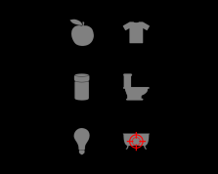

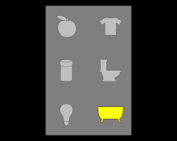
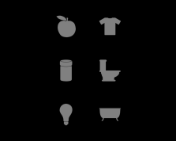
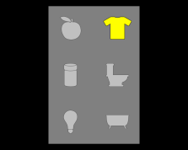
oddball stimulus (200-300 ms)
SSVEP start (500 ms)
pause (1000 ms)
cue (2000 ms)
pause (1000 ms)
oddball stimulus (200-300 ms)
oddball stimulus (200-300 ms)
cue (2000 ms)

