Slide 1
STUDIO 1 · DATABASE DESIGN
Personal Subscription Tracker
Project Proposal & Report — Group 5
Abdul Majeed Mohammed
Team Leader
Jaskaran Singh
Team Member
Priyom Roy Sammo
Team Member
Bachelor of Information Technology | Otago Polytechnic, Auckland International Campus

Slide 2
Table of Contents
1
Introduction
6
Data Dictionary
2
Use Case Diagram
7
GitHub Usage
3
User Stories
8
Challenges
4
Agile Practice
9
Conclusion
5
ER Diagram
10
Q&A
2

Slide 3
SYSTEM OVERVIEW
Introduction
Subscriptions quietly add up — Netflix, Spotify, gym, cloud storage — until a bank statement reveals the real monthly cost.
1
2
3
Track
Compare
Recommend
Log every subscription: name, category, cost, billing cycle, renewal date.
Check how often a subscription is used against what it costs.
Get a plain keep / downgrade / cancel suggestion for each one.
Goal: turn raw subscription data into one clear action the user can take.
3

Slide 4
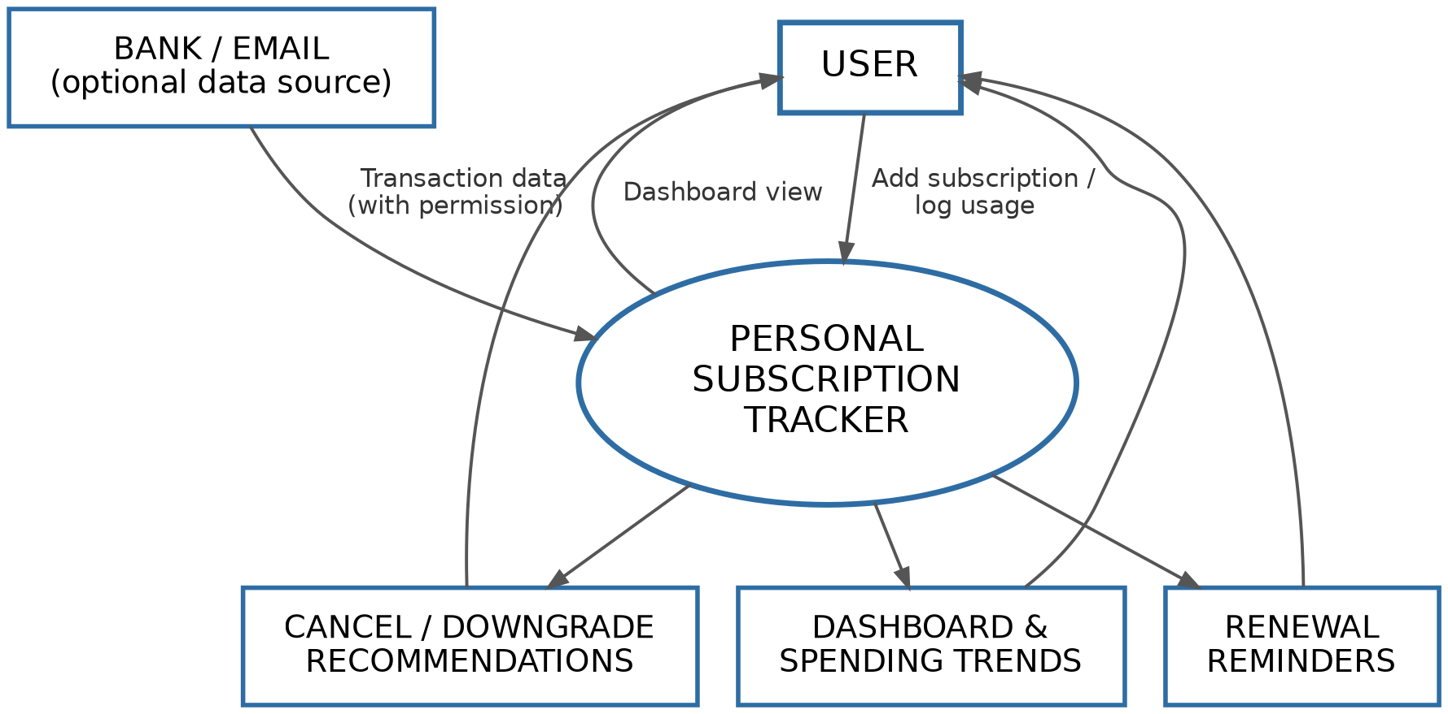
HOW THE USER INTERACTS WITH THE SYSTEM
Use Case Diagram
Core Use Cases
Register / edit / remove a subscription
View the dashboard & spend by category
Log usage of a subscription
Receive renewal & payment reminders
Receive a keep / downgrade / cancel recommendation
Optionally connect bank/email (auto-detect charges)
4

Slide 5
INDIVIDUAL CONTRIBUTION
User Stories
Abdul Majeed Mohammed
Jaskaran Singh
Priyom Roy Sammo
“As a user, I want to register a new subscription with its cost and renewal date, so nothing signs me up without my knowledge.”
“As a user, I want to log each time I use a subscription, so the system can judge real usage instead of guessing.”
“As a user, I want a keep / downgrade / cancel recommendation, so I can act on subscriptions that aren't worth their price.”
5

Slide 6
HOW WE WORKED
Agile Practice
1
Draft the proposal
Started with a 3-entity design (User, Subscription, Payment) covering the core idea.
2
Review against use cases
Walking through “log usage” and “receive a recommendation” showed they needed their own records.
3
Iterate the design
Split out Usage_Log and Recommendation as their own entities — growing the ERD from 3 to 5 entities.
4
Build & review as a group
Divided sections by strength, then reviewed and compiled each other's work into one report.
6

Slide 7
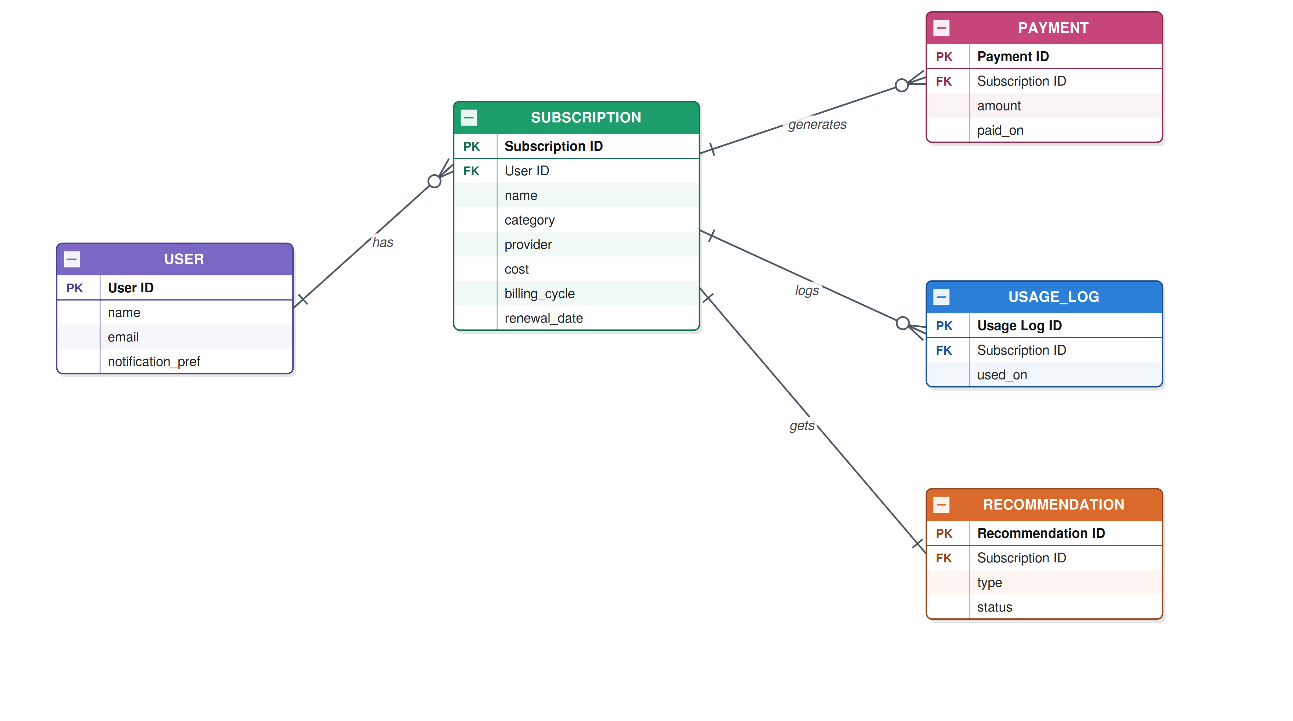
FIVE CONNECTED ENTITIES
Entity Relationship Diagram
7

Slide 8
INDIVIDUAL CONTRIBUTION
Data Dictionary
Entity | Key Fields | Purpose
User | user_id (PK) | Account: name, email, notification preference
Subscription | subscription_id (PK), user_id (FK) | Name, category, provider, cost, cycle, renewal date
Payment | payment_id (PK), subscription_id (FK) | Amount actually charged, and the date it was paid
Usage_Log | usage_id (PK), subscription_id (FK) | Timestamp each time a subscription is used
Recommendation | recommendation_id (PK), subscription_id (FK) | Keep / downgrade / cancel + accepted or dismissed
Full field-level detail (data types, constraints, examples) is in the written report.
8

Slide 9
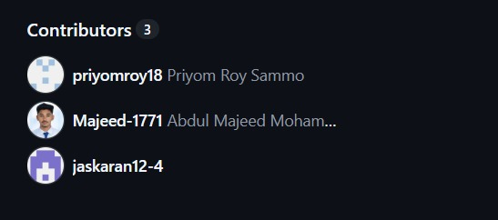
VERSION CONTROL & COLLABORATION
GitHub Usage
Repository
Contributors · 3
github.com/Majeed-1771/Studio-01
Shared repo held the schema (Subscribtion_tracker.sql), proposal, and report
Committed the CREATE TABLE statements and seed data for all five entities
Used the multi-table join query as the single source of truth for the dashboard view
priyomroy18
PR
Priyom Roy Sammo
Kept the proposal and report versioned alongside the schema so all three stayed in sync
Majeed-1771
AM
Abdul Majeed Mohammed
JS
jaskaran12-4
Jaskaran Singh
9

Slide 10
DESIGN DECISIONS WE HAD TO MAKE
Challenges
Entity count vs. scope
Normalisation vs. simplicity
Splitting Usage_Log and Recommendation out from Subscription made the ERD grow from 3 to 5 entities.
category & billing_cycle kept as plain TEXT rather than full lookup tables, to stay manageable for this stage.
SQLite's loose typing
Scoping the build
No dedicated date type — dates stored as TEXT, so formatting has to be validated by the application, not the database.
The optional bank/email auto-detect feature was cut from the schema — it depends on an external integration, not stored data.
10

Slide 11
Conclusion
The five-entity design carried through from proposal to a working SQLite schema.
Five linked entities: User, Subscription, Payment, Usage_Log, Recommendation
Seeded with sample data for 3 users and 11 related rows
One multi-table join pulls subscriptions, payments, usage, and recommendations into a single view
That join is the foundation for the dashboard, spend totals, and renewal reminders
Result: raw subscription data turned into one clear action — keep, downgrade, or cancel.
11

Slide 12
Thank You
Questions & Answers
Abdul Majeed Mohammed · Jaskaran Singh · Priyom Roy Sammo

