Slide 1
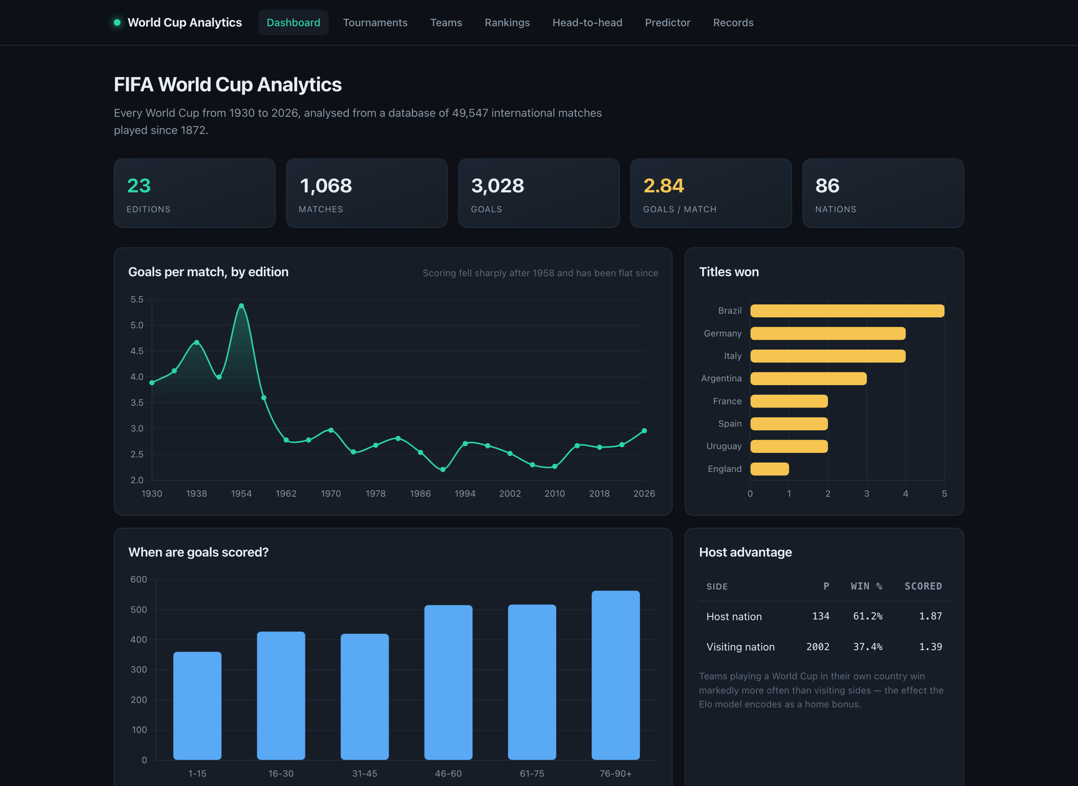
SOFTWARE ENGINEERING · PROJECT #11
World Cup
Analytics
An Elo rating engine and match predictor built over 49,547 international football matches played between 1872 and 2026.
49,547
60.1%
91
MATCHES
ACCURACY
TESTS
The dashboard: 23 World Cups, 1,068 matches, 3,028 goals
Mohammed Majeed Khan · SE23UMCS071
github.com/Majeedkhan05/world-cup-analytics
Notes:
Open with the app already running, not with this slide. One line: I built an analytics platform over 49,547 real international football matches from 1872 to 2026. It analyses every World Cup, ranks all 337 national teams using an Elo rating engine I implemented, and predicts match outcomes at 60% accuracy against a held-out test set.

Slide 2
THE BRIEF
Real data, verified before a line of code
Project #11 asked for World Cup analytics. The first decision was where the data comes from — and whether it can be trusted.
The dataset
Verified against the historical record
results.csv
49,547
✓
2018
France 4-2 Croatia
Moscow
every international match, 1872-2026
goalscorers.csv
47,914
✓
2022
Argentina 3-3 France, won on pens
Lusail
individual goals, scorer and minute
shootouts.csv
682
✓
2014
Germany 1-0 Argentina
Rio de Janeiro
penalty shootout outcomes
Top scorers match the record exactly too: Klose 16, Ronaldo 15, Muller 14, Fontaine 13, Pele 12.
Why this project, and why it is not a CRUD app
1
Real data, not seeded rows
2
A model, not just queries
3
Measured, not asserted
150 years of actual results — the analysis has something to find.
An Elo engine and a calibrated predictor, both implemented from scratch.
The model reports its own accuracy on data it never saw.
Notes:
The data is the foundation, so I checked it before building anything. I picked three finals I already knew and confirmed the archive had them right — including 2022, which was a 3-3 draw decided on penalties, so it tests that the shootout table is wired up correctly too. Source: martj42/international_results, a public archive. Credited in the README.

Slide 3
ARCHITECTURE
A layered system with one strict rule
The expensive work happens once, offline. The web tier only ever reads pre-computed results.
Raw CSV
›
ETL
›
SQLite
›
Services
›
Routes
›
Browser
3 source files
clean · derive · calibrate
9 tables + 1 view
analytics · elo · predictor
pages · JSON API
Jinja2 + Chart.js
The rule that makes it testable
Why pre-compute in the ETL
Routes contain no SQL. Services contain no HTTP. The rating engine touches neither — it is pure functions over numbers, so the most important logic can be tested with no database and no web server.
Replaying 49,547 matches takes about two seconds. Doing that per request would make every page slow; doing it once at build time makes every page instant — pages render in milliseconds.
Project structure
app/
config.py etl.py schema.sql db.py
services/ elo · predictor · analytics
routes/ pages.py api.py
templates/ static/
scripts/tune_elo.py hyper-parameter search
tests/ 91 tests
docs/ SRS · design · testing
data/raw/ the three source CSVs
Notes:
Three tiers. The ETL is offline and does the heavy lifting once. The service layer holds all the analysis. The routes only gather and render. The rule about layering is not decoration — it is what makes the project testable. Because elo.py takes numbers and returns numbers, I can test the most important logic in the project without spinning up a database or a web server. That is why 40 of my 91 tests run on a fresh checkout before the database even exists.

Slide 4
STAGE 1 · DATA PIPELINE
Extract, transform, load
One command rebuilds the entire database from raw CSV in about five seconds.
1
Extract
def clean_matches(results):
df = results.dropna(
subset=["home_score", "away_score"])
df["year"] = df["date"].str[:4].astype(int)
df["is_world_cup"] = (
df["tournament"] == WORLD_CUP).astype(int)
df = df.sort_values("date", kind="stable")
df["id"] = df.index + 1
return df
Read the three CSVs with pandas.
2
Transform
Drop unplayed fixtures, cast types, build the team dimension, derive each tournament's champion, replay 150 years through the Elo engine, calibrate and score the model.
3
Load
Sorting by date is not cosmetic — the Elo engine must replay matches in the order they were actually played.
Write every table inside a single transaction.
The bug worth talking about: who won the 1950 World Cup?
I derived each champion as "the winner of the last match played". That works for 22 of the 23 editions — but 1950 had no final. It ended in a four-team round-robin whose last two matches were on the same day, so my code crowned Sweden instead of Uruguay. The fix breaks the tie by picking the fixture between the two highest-scoring teams of the tournament, and a regression test now asserts 1950 → Uruguay.
Notes:
Run `python -m app.etl` live here. It takes five seconds and prints each stage, including the model evaluation. The 1950 bug is the best answer you can give to "what was the hardest problem". It shows you validated against reality rather than trusting your own code, and that you turned the fix into a regression test.

Slide 5
STAGE 2 · DATA MODEL
A normalised schema, and one view that pays for itself
Nine tables, plain SQL, no ORM — because in this project the queries are the analysis.
Tables
The team_matches view
teams
matches
goals
CREATE VIEW team_matches AS
SELECT id, home_team_id AS team_id,
away_team_id AS opponent_id,
home_score AS gf, away_score AS ga
FROM matches
UNION ALL -- same match, other side
SELECT id, away_team_id, home_team_id,
away_score, home_score FROM matches;
shootouts
tournaments
elo_ratings
elo_history
draw_calibration
model_metrics
matches also stores home_elo and away_elo — each side's rating as it stood before kick-off. That single design choice is what makes honest evaluation possible later.
A match is stored once, but almost every question is asked from one team's point of view.
The view writes each match twice — once per side — so "how did team X do?" collapses to a single WHERE clause. That is why the whole per-team record is one short query instead of a page of Python:
SELECT COUNT(*) AS played,
SUM(gf > ga) AS won,
SUM(gf = ga) AS drawn,
SUM(gf < ga) AS lost
FROM team_matches WHERE team_id = ?
Notes:
Why no ORM? Because in this project the queries are the analysis. An ORM would hide the most interesting code behind generated SQL, and add a dependency I would then have to explain. Why SQLite? 13 MB, single user, ships with Python, and the whole database is one file. A server would add operational cost for zero benefit. If this became multi-user with concurrent writes, Postgres would be the move. The view is the neatest trick in the schema — point at how short team_record ends up being.

Slide 6
STAGE 3 · THE MODEL
The Elo rating engine
Every nation starts at 1500. All 49,547 matches are replayed in date order, and each result nudges both ratings.
E = 1 / (1 + 10^(-(Ra + H - Rb)/400)) R' = R + K × w × m × (S - E)
E is what the ratings expected. S is what happened: 1 win, 0.5 draw, 0 loss. The rating moves by the difference between them — so a team gains points only by doing better than predicted.
Zero-sum
The 400 defines Elo
Three multipliers
Whatever the winner gains, the loser loses. Ratings never inflate.
A 400-point gap means the stronger side is expected to take ten times as many points. A unit test asserts exactly this.
K sets the learning rate; w weights a World Cup at 2.0 and a friendly at 0.7; m is sqrt(goal difference), capped.
def update_pair(r_home, r_away, hs, aws,
tournament, neutral):
adv = 0 if neutral else ELO_HOME_ADVANTAGE
E = expected_score(r_home, r_away, adv)
S = outcome(hs, aws) # 1 / 0.5 / 0
k = (ELO_K_BASE
* tournament_weight(tournament)
* margin_factor(hs, aws))
delta = k * (S - E)
return r_home + delta, r_away - delta
Why the margin is capped
A 9-0 says little more about a team's strength than a 5-0, but uncapped it would swing the rating violently. The cap keeps big wins meaningful without letting one freak result distort a rating.
Germany's rating peaks on 13 July 2014 — the day they won the World Cup.
Notes:
Draw the two formulas on the board if you can. E is what the ratings expected, S is what happened, and the rating moves by the difference. Beat a much stronger side and you gain a lot; beat a much weaker one and you gain almost nothing. The 400 is the defining constant of Elo: a 400-point gap means ten-to-one odds. I have a unit test that asserts exactly that property, rather than testing a hard-coded number. Good sanity check to mention: Germany's peak rating lands on the day of the 2014 final. Nobody told the model that was an important match — it fell out of the data.

Slide 7
STAGE 4 · PREDICTION
One rating gap into three probabilities
Elo gives a single number that blends wins and draws. Splitting it needs a draw model — so I measured one instead of assuming it.
Measured, not assumed
Observed draw rate by pre-match Elo gap (%)
30
Because every match stores the ratings that existed before kick-off, I could bucket all 49,547 matches by that gap and count the real draw rate in each bucket.
The result is on the right: evenly matched teams draw 27% of the time, badly mismatched ones under 2%. A fixed 25% would have been measurably worse.
20
10
0
0
50
100
150
200
250
300
350
400
450
500
550
600
650
700
pre-match Elo gap
The algebra
def probabilities(r_a, r_b, calib, neutral):
adv = 0 if neutral else ELO_HOME_ADVANTAGE
E = expected_score(r_a, r_b, adv)
gap = (r_a + adv) - r_b
p_draw = draw_probability(gap, calib)
p_a = E - p_draw / 2
p_b = 1 - p_a - p_draw
# clamp, then renormalise
total = p_a + p_draw + p_b
return p_a/total, p_draw/total, p_b/total
Since E = P(win) + ½ · P(draw)
P(draw) = measured rate for this gap
P(win) = E − P(draw) / 2
P(loss) = 1 − P(win) − P(draw)
At extreme gaps P(loss) can go negative, so values are clamped and renormalised — a unit test drives a 1,400-point gap through it.
Notes:
This is the question you are most likely to be asked, so have the answer ready. Elo gives one number, E, which blends wins and draws. To get three probabilities I need to know how often draws happen. Rather than assume a fixed 25%, I measured it: because I stored each team's rating as it stood before every match, I could bucket all 49,000 matches by the rating gap at kick-off and count the real draw rate in each bucket. Then, since E equals P(win) plus half of P(draw), the algebra gives me the other two. The chart is a genuine finding, not decoration: draw rate falls from 27% to under 2% as the mismatch grows.

Slide 8
STAGE 5 · RIGOUR
Tuned by search, judged on data it never saw
The two things that separate a model you can defend from a model you merely built.
Constants were searched, not guessed
A clean train / test split
scripts/tune_elo.py sweeps 96 combinations of K, home advantage and margin cap. For each one it replays the entire match history and scores it on held-out matches.
Fit
the draw model on matches before 2015 only
Score
on the 11,130 matches played since
K = 25 home = 65 margin cap = 3.0
-> best Brier of 96 combinations
Never
use a rating from after the match being predicted
My first hand-picked K produced wildly overconfident forecasts. The search fixed that.
Every prediction uses only ratings that existed before kick-off, so this is a walk-forward evaluation — not hindsight.
Accuracy on 11,130 unseen matches
0.516
11,130
This model
BRIER SCORE
TEST MATCHES
60.1%
Guessing scores 0.667. Lower is better.
Large enough not to be noise.
Home-win baseline
47.7%
Is 60% good? For three-way football outcomes, yes — professional models sit in the mid-to-high 50s. A model claiming 90% would be a model with a bug.
Notes:
These two panels are what turn a toy into something defensible. Tuning: I did not guess the constants. The script sweeps 96 combinations, replays the full history for each, and scores them on held-out matches. Be honest that the first hand-picked value was bad — it shows you validated. Evaluation: the draw model is fitted only on pre-2015 matches and scored on the 11,130 since. 60.1% against a 47.7% baseline. If asked what a Brier score is: the mean squared error of the probabilities. Say 70% and it happens, you are penalised 0.09; say 70% and it does not, 0.49. It rewards being confident AND right. Uninformed guessing is 0.667; mine is 0.516.

Slide 9
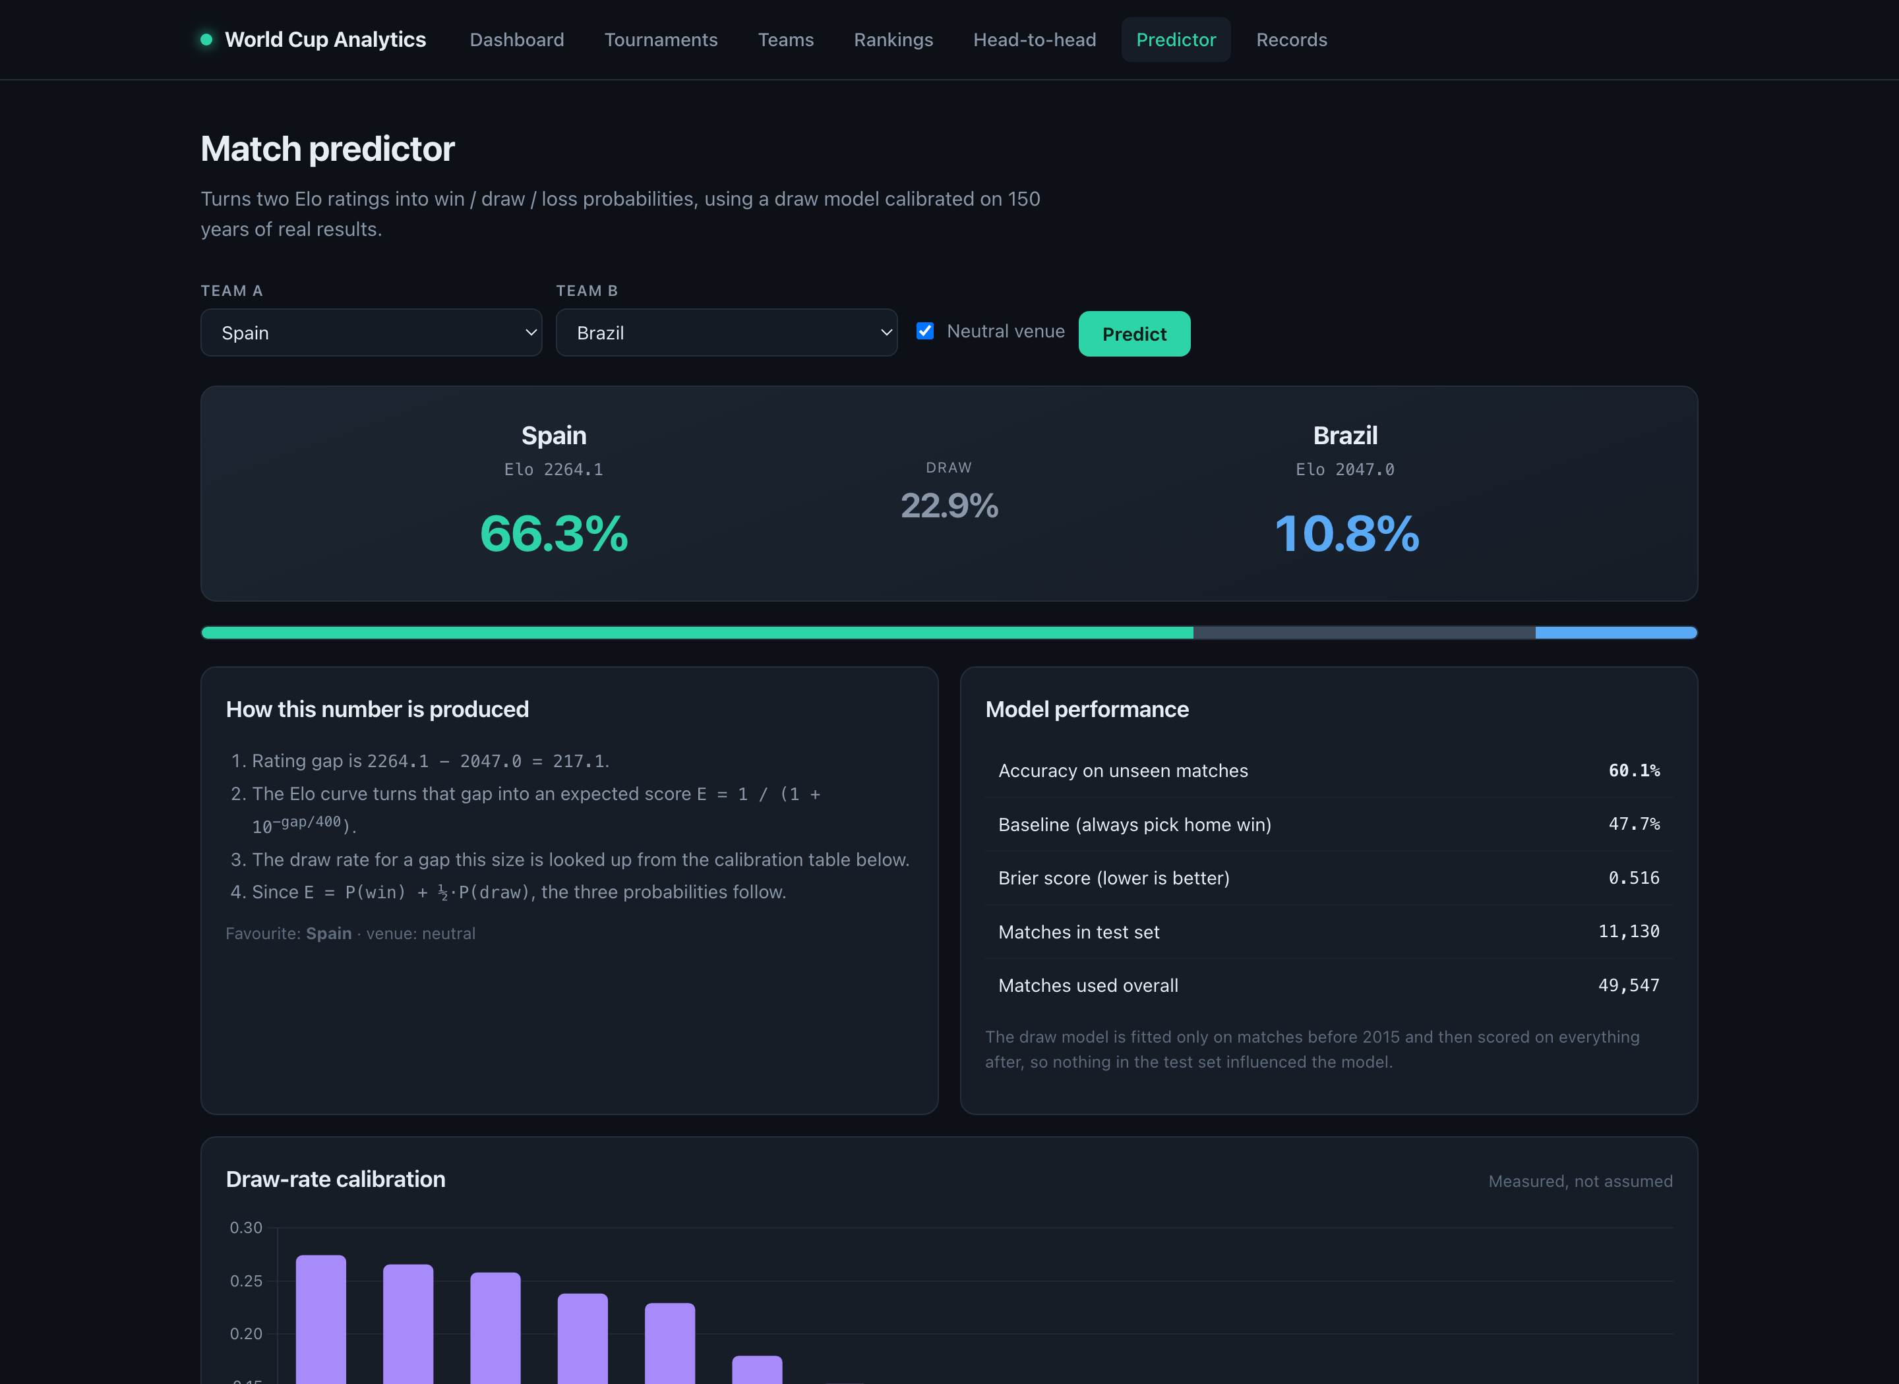
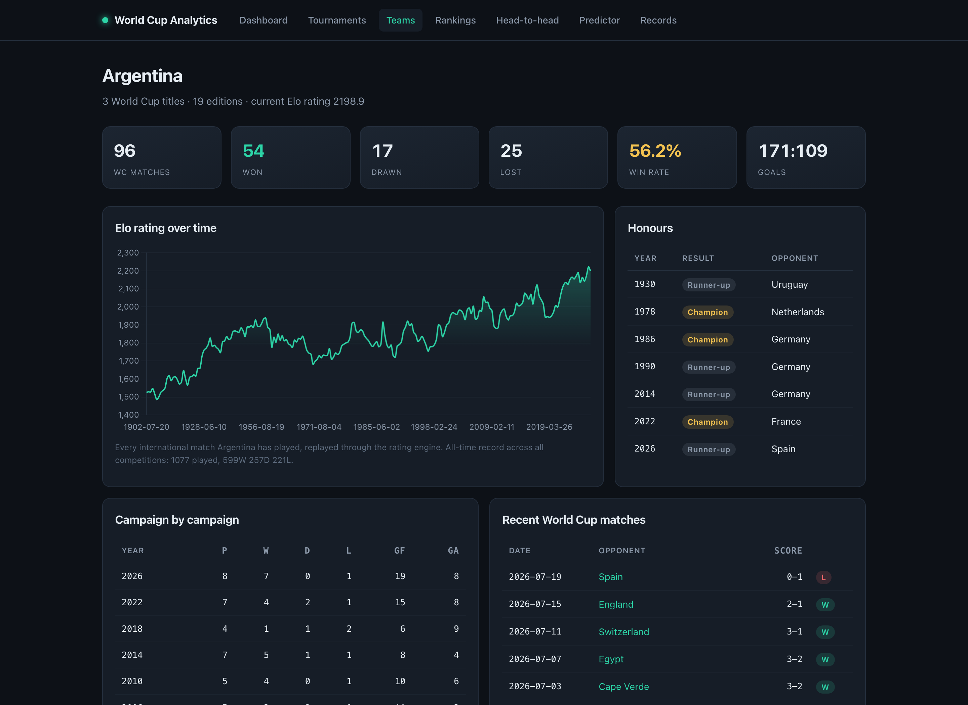
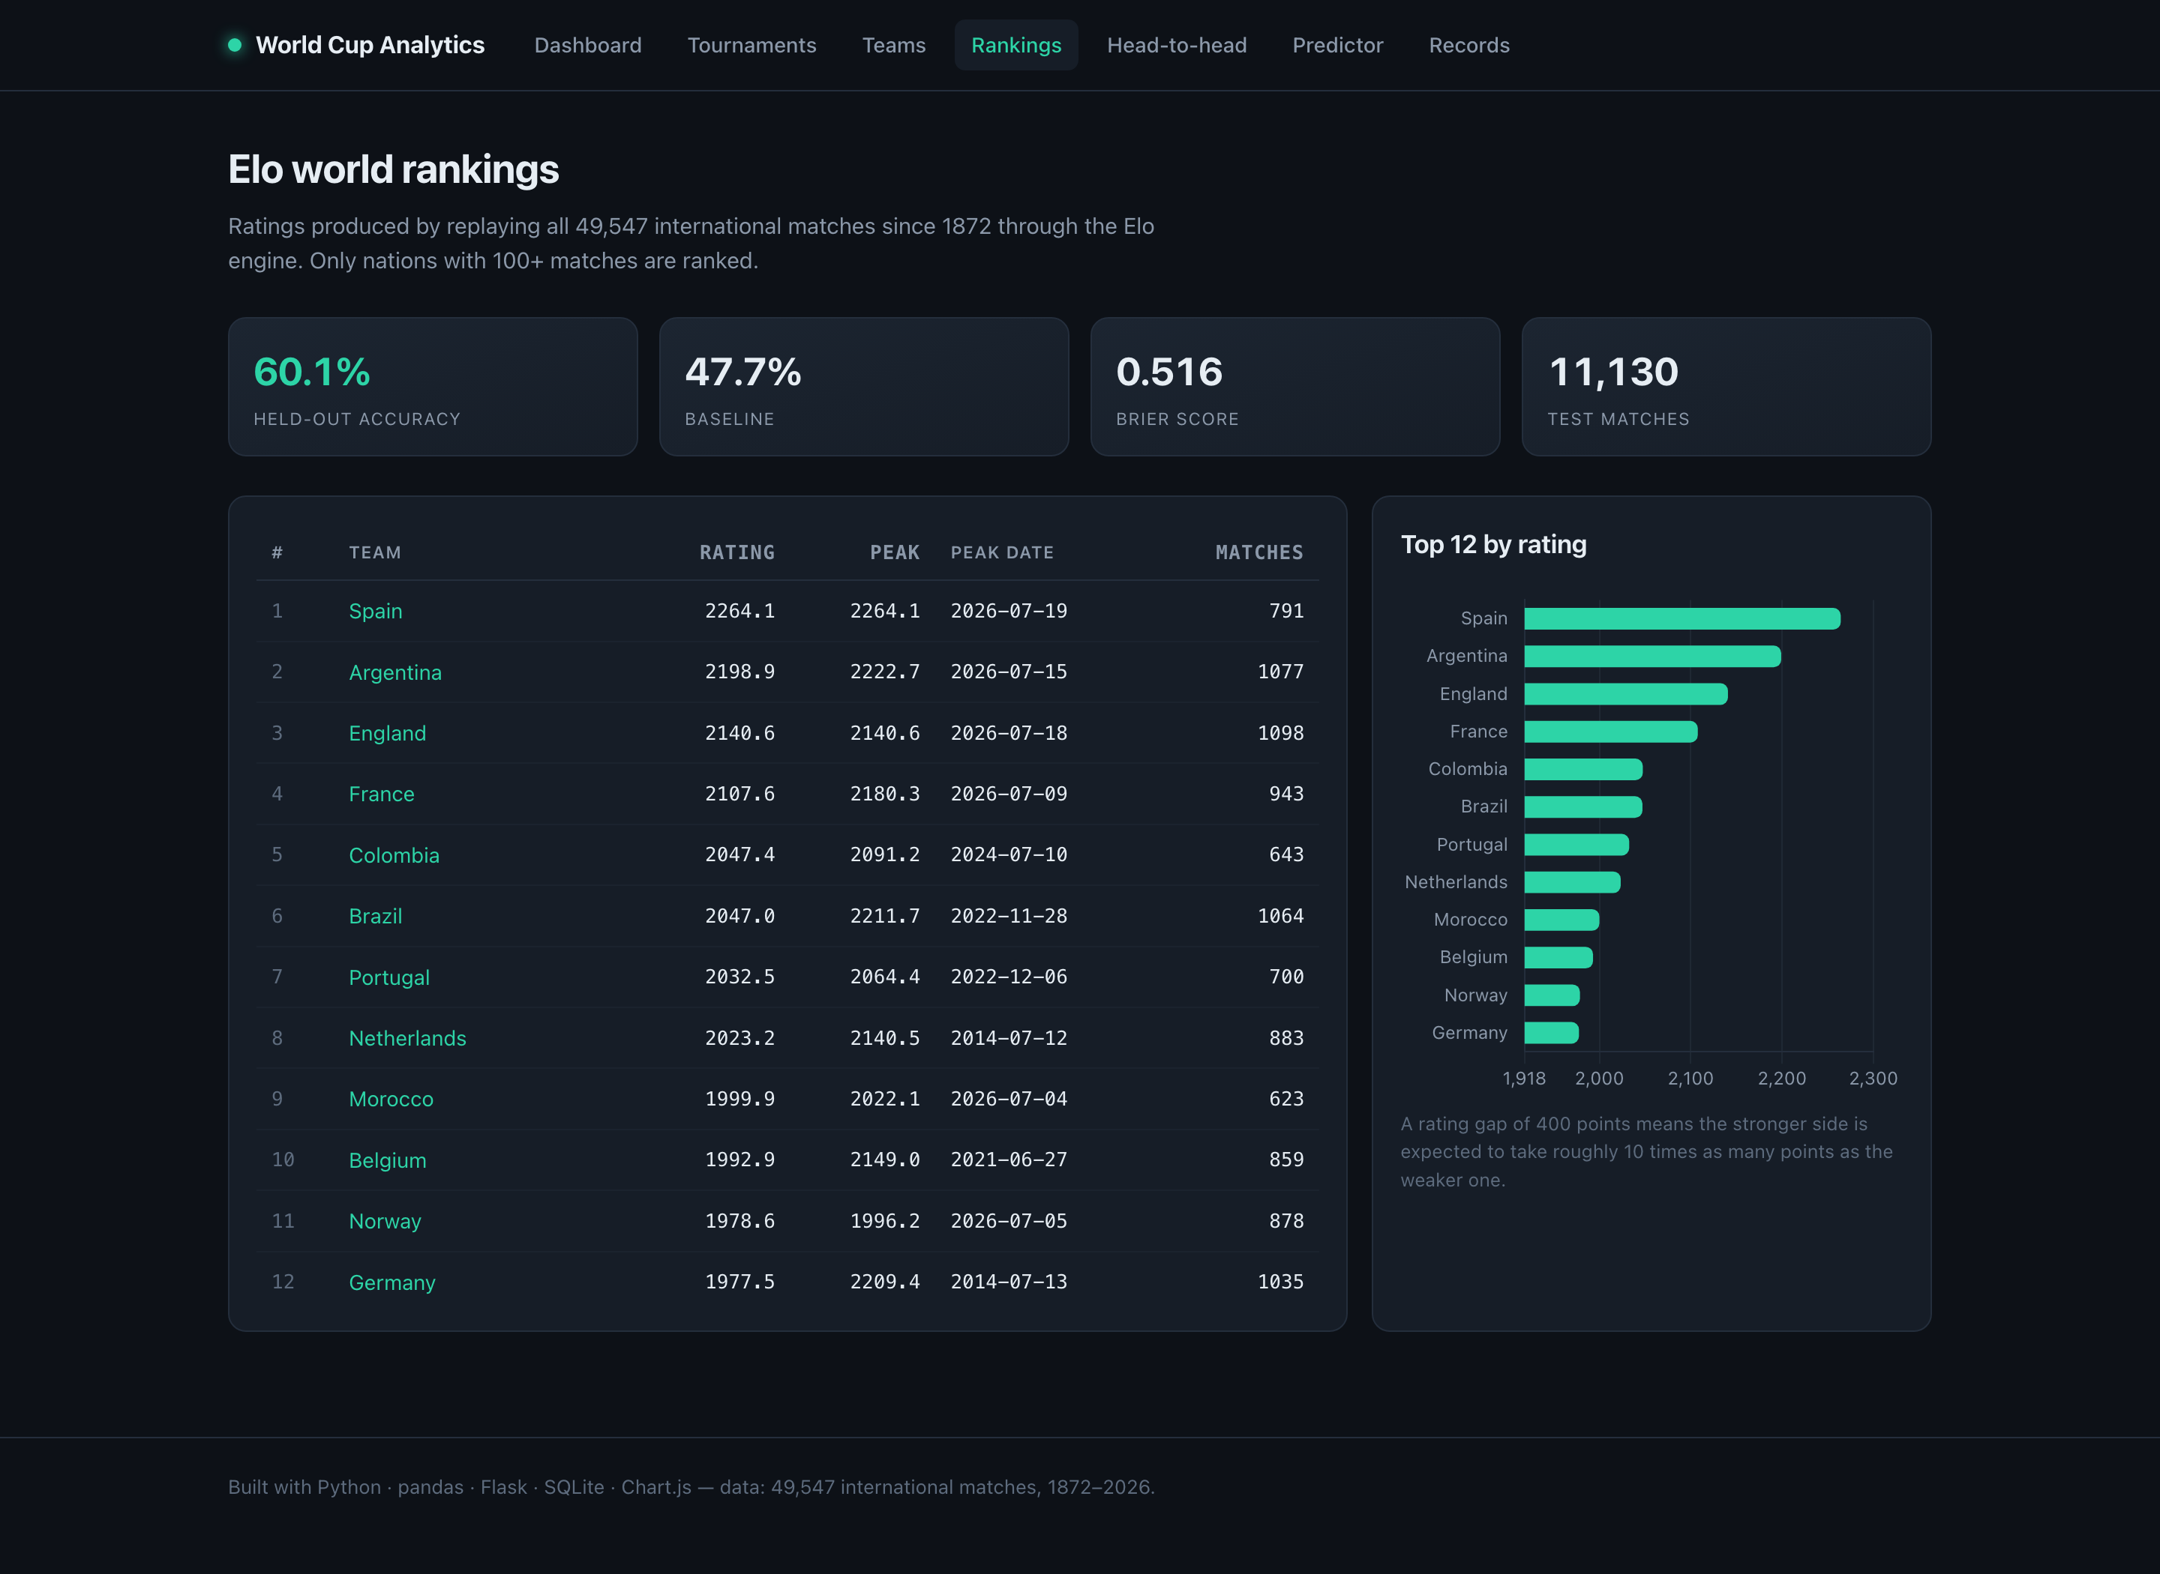
THE PRODUCT
Eight pages and a JSON API over one service layer
Server-rendered Jinja2 with Chart.js. No build step, no bundler, no frontend framework.
Team explorer — 1,077 matches replayed
Elo world rankings
Same services, two front doors
Every figure on the site is also machine-readable — 14 JSON endpoints backed by the identical service functions the pages use.
$ curl '.../api/predict?a=Spain&b=Brazil'
{"pct_a": 66.3, "pct_draw": 22.9,
"pct_b": 10.8, "favourite": "Spain"}
The predictor shows its own working — and its own accuracy
Notes:
Demo order: dashboard, then a team page (Argentina is good — peak on the day they won in 2022), then the predictor, then curl the API, then run the tests. On the predictor page, point at the 'How this number is produced' panel. Showing the model's own accuracy inside the product, rather than hiding it in a report, is a deliberate choice — anyone using it can see how much to trust it. Why server-rendered rather than React: these pages are documents, not an application. No build step means no node_modules and nothing to break in a demo.

Slide 10
QUALITY
91 tests, shaped by the fact that the core logic is pure
The Elo maths and the probability functions take numbers and return numbers — so the code most likely to be wrong is also the cheapest to test.
21
Integration
Properties, not examples
every route through Flask's test client
Rather than asserting hard-coded outputs, the tests assert the properties the model must have:
30
Data
services against the real 49,547-match database
A 400-point gap gives exactly 10:1 odds
Rating changes are always zero-sum
Both sides' expectations sum to 1
Probabilities stay valid at a 1,400-point gap
Pre-match ratings are captured before the update
40
Unit
pure functions: Elo, probabilities, ETL transforms
On a fresh checkout, before the database exists, 40 tests still pass and 51 skip with a clear message.
The test that matters most
def test_pre_match_ratings_are_recorded
_before_the_update(self):
engine = EloEngine()
engine.process(match)
assert engine.pre_match[match["id"]] == (1500, 1500)
assert engine.rating("A") > 1500
If pre-match ratings were recorded after the update instead of before, every accuracy figure in this deck would be inflated by hindsight — and nothing would look broken. One test pins that ordering in place.
Notes:
The pyramid shape is a consequence of the architecture, not an accident: because the rating engine is pure, the cheapest tests cover the riskiest code. Techniques used, if asked: equivalence partitioning on match outcomes, boundary values at bucket edges 0/49/50, property-based reasoning for symmetry and zero-sum, regression testing for the 1950 champion, negative testing for unknown teams and missing parameters. The hindsight test is worth calling out explicitly — it is the difference between an honest 60% and a meaningless one.

Slide 11
RESULTS
What the data actually says
Four findings that fell out of the analysis, each reproducible from the database.
Goals per match, by edition
5.38
5.5
1954 is the highest-scoring World Cup ever. No edition since 1962 has reached 3.0.
4.3
3.2
61.2%
Host nations win 61.2% of their matches; visiting nations win 37.4%.
2.0
1930
1954
1970
1986
2002
2018
2026
+32%
27% → 2%
The second half produces 32% more goals than the first — 1,595 against 1,207. The closing 15 minutes are the single most productive window.
Draw rate collapses as the rating gap widens. This is why the predictor needs a calibrated draw model, not a fixed 25%.
Notes:
Use the goals chart to make one point: football genuinely changed. 1954 averaged 5.38 goals a match — the highest ever. Nothing since 1962 has reached 3.0. The host advantage number is the one that justifies a design decision: 61% against 37% is exactly why the Elo model carries a home-advantage term. The data motivated the model, not the other way round. The draw-rate finding is the same story — I did not assume a draw model, the data told me what it should be.

Slide 12
HONEST CLOSE
What it does not do, and what comes next
Volunteering the limits is stronger than being caught by them.
Limitations
With more time
Elo uses only results — no squads, injuries or rest. That is the real accuracy ceiling.
West Germany and Germany stay separate, as the source records them.
The source has no match-stage labels, so group and knockout football cannot be split.
Draw calibration is global, not per-era, though draw rates have drifted since 1872.
1
Match-stage labels
separate group from knockout football
2
Era-adjusted ratings
a 2000 rating today is not a 2000 rating in 1950
3
Tournament simulator
run the bracket 10,000 times for each team's title odds
49,547
23
337
60.1%
91
~5s
MATCHES ANALYSED
WORLD CUPS
NATIONS RATED
HELD-OUT ACCURACY
TESTS PASSING
FULL REBUILD
github.com/Majeedkhan05/world-cup-analytics Python · pandas · Flask · SQLite · Chart.js · pytest
Notes:
Close by volunteering the limits — it reads as confidence, not weakness. The key line: Elo uses only results. No squad strength, no injuries, no rest days. That is precisely why 60% is the realistic ceiling and why a model claiming 90% would be a model with a bug. If asked whether the work is your own: Elo is a published rating system from chess. The implementation, the tournament weighting, the margin cap, the calibrated draw model, the hyper-parameter search and the evaluation methodology are all mine — about 200 lines across elo.py, predictor.py and tune_elo.py.

