Slide 1
SUPERSTORE
BY: MAJENGBASAN GLORY

Slide 2
ABOUT
Superstore Giant is seeking knowlege in understanding what works best for them.
They want to understand and know the product, regions, categories and customer segments they should target for more sales.

Slide 3
ANALYSIS 1
OBJECTIVE
What is the Total Sales
ANSWER
From the year 2014-2017, the total sales in superstore has been about $2.3 M, about 9.99K records were made with an average of $229.9 in sales.

Slide 4
ANALYSIS 2
OBJECTIVE
Top 5 Products by Sales
ANSWER
From ascending to descending order, the first product is GBC DocuBind TL300 Electric Binding System with a sum of $19,823.48 in sales, this is the least of the five, followed by HON 5400 Series Task Chairs for Big and Tall with a sum of $21,870.58 in sales, followed by Cisco TelePresence System EX90 Videoconferencing Unit with a sum of $22,638.48 in sales, with Fellowes PB500 Electric Punch Plastic Comb Binding Machine with Manual Bind taken second position with a sum of $27,453.38 in sales, and lastly with the product with the highest sales is Canon imageCLASS 2200 Advanced Copier, with a wooping sum of $61,599.82

Slide 5
ANALYSIS 3
OBJECTIVE
Montly Sales Trend
ANSWER
In the Year 2014-2017 it has been observed that the months: September, November and December always had the top 3 highest sales.

Slide 6
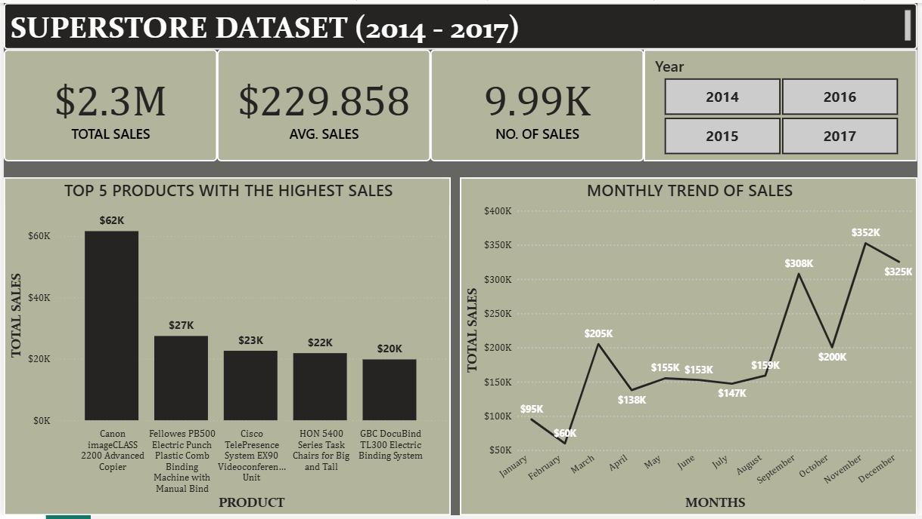
VISUAL

Slide 7
THANK YOU

