Slide 1

The Data Moat
Strategic Frameworks for Startup Disruption in an Incumbent-Dominant AI Economy
DEEP RESEARCH ANALYSIS
AI STRATEGY

Slide 2
What Is a Data Moat?
A data moat is a competitive advantage that gets stronger as a company collects, structures, and learns from more data. Over time, that data improves the product, sharpens decision-making, and makes it harder for competitors to catch up.
Why it matters
Better data leads to better models, recommendations, and customer experiences
More usage creates more data, which improves the product even further
The result is a reinforcing loop that can increase quality, speed, and defensibility
How it differs from traditional advantages
Traditional moats often come from things like brand, patents, switching costs, or scale. A data moat is different because it is built on learning velocity—the ability to turn real-world usage into continuous improvement.
Unlike a static advantage, a data moat can compound. The more unique and relevant the data, the harder it is for a new entrant to replicate the same performance, even with similar technology.
INTRODUCTORY CONCEPT
FOUNDATIONAL FRAMEWORK

Slide 3

From Economic Moats to Data Moats
Warren Buffett's economic moat — brand, scale, regulatory licenses — has evolved into the data moat: exclusive data a firm gathers to improve products in ways competitors cannot replicate.
Resource-Based View
Data Network Effects
Dynamic Capabilities
Proprietary data as a unique, inimitable strategic resource
More users → more data → better products → more users
Data acquisition, processing, and operationalization as core competencies

Slide 4


STRATEGIC FRAMEWORKS
Bessemer's "Good, Better, Best" & Progressive Delegation
Good → Better → Best Progression
Progressive Delegation: Build While You Ship
Good
1
Automate a manageable, low-risk workflow segment first
Demo-friendly feature; execution speed as moat
2
Keep humans in the loop for high-stakes decisions
Better
3
Standardize remaining manual steps for future automation
Core workflow ROI; early/weak data moat forming
Best
4
Expand as reliability is proven — creating expansion revenue
End-to-end "LLM magic"; true moat via data + multimodality
Each user interaction accumulates proprietary, workflow-specific data competitors cannot access.

Slide 5

CASE STUDY
Abridge: Healthcare Documentation AI
Medically-Tuned ASR
Specialized speech recognition for medical terminology and ambient noise — a proprietary data layer general models cannot replicate
Linked Evidence
Clinicians highlight notes to surface transcript evidence — creating a closed-loop feedback system that compounds model accuracy
Ethnographic Data Collection
Engineers "shadow" clinicians at Mayo Clinic to capture real-world data gaps and inform model development
Epic EHR Integration
Deep embedding into Epic's platform creates significant workflow switching costs — a "trust moat" alongside the technical data moat

Slide 6

CASE STUDY
EvenUp & Fieldguide: Legal and Audit AI
EvenUp — $2B Valuation, Personal Injury Law
Three-layer architecture: System of Record (structured case memory) → System of Intelligence (demand letter drafting) → System of Action (proactive recommendations).
Core asset: Settlement Repository — anonymized outcomes from 2,000+ U.S. law firms, 200,000+ cases, $10B+ in damages. Demands are 69% more likely to achieve policy limit settlements.
Fieldguide — Agentic AI OS for Audit
Multi-model routing with chain-of-thought reasoning. Testing Agent achieves 98% accuracy vs. 54% human and 90% GPT-4, operating 94% faster. Corpus: 20,000 audits across 80 engagement types. Users average 7 hours of daily active engagement.

Slide 7

Technical Implementation Patterns
Four patterns emerge consistently across successful vertical AI data moats.
Multimodal Data Integration
Closed-Loop Feedback Systems
Combine text, audio, images, and sensor data for richer, harder-to-replicate training datasets (Abridge: voice + EHR; EvenUp: PDFs + accident diagrams via reinforcement learning)
User corrections and interactions feed directly back into model improvement — turning product usage into proprietary training data that compounds over time
Domain-Specific Architecture
Modular & Adaptable Systems
Specialized technical stacks tailored to vertical requirements — not relying solely on general-purpose LLMs. Fine-tune powerful base models on proprietary workflow data
Infrastructure flexible enough to swap in better AI models as technology evolves, without discarding proprietary data and workflow integrations already accumulated
Data Moat Strength ≈ Proprietary Data Quality × Workflow Integration Depth × AI Execution Velocity × Network Effects Strength

Slide 8
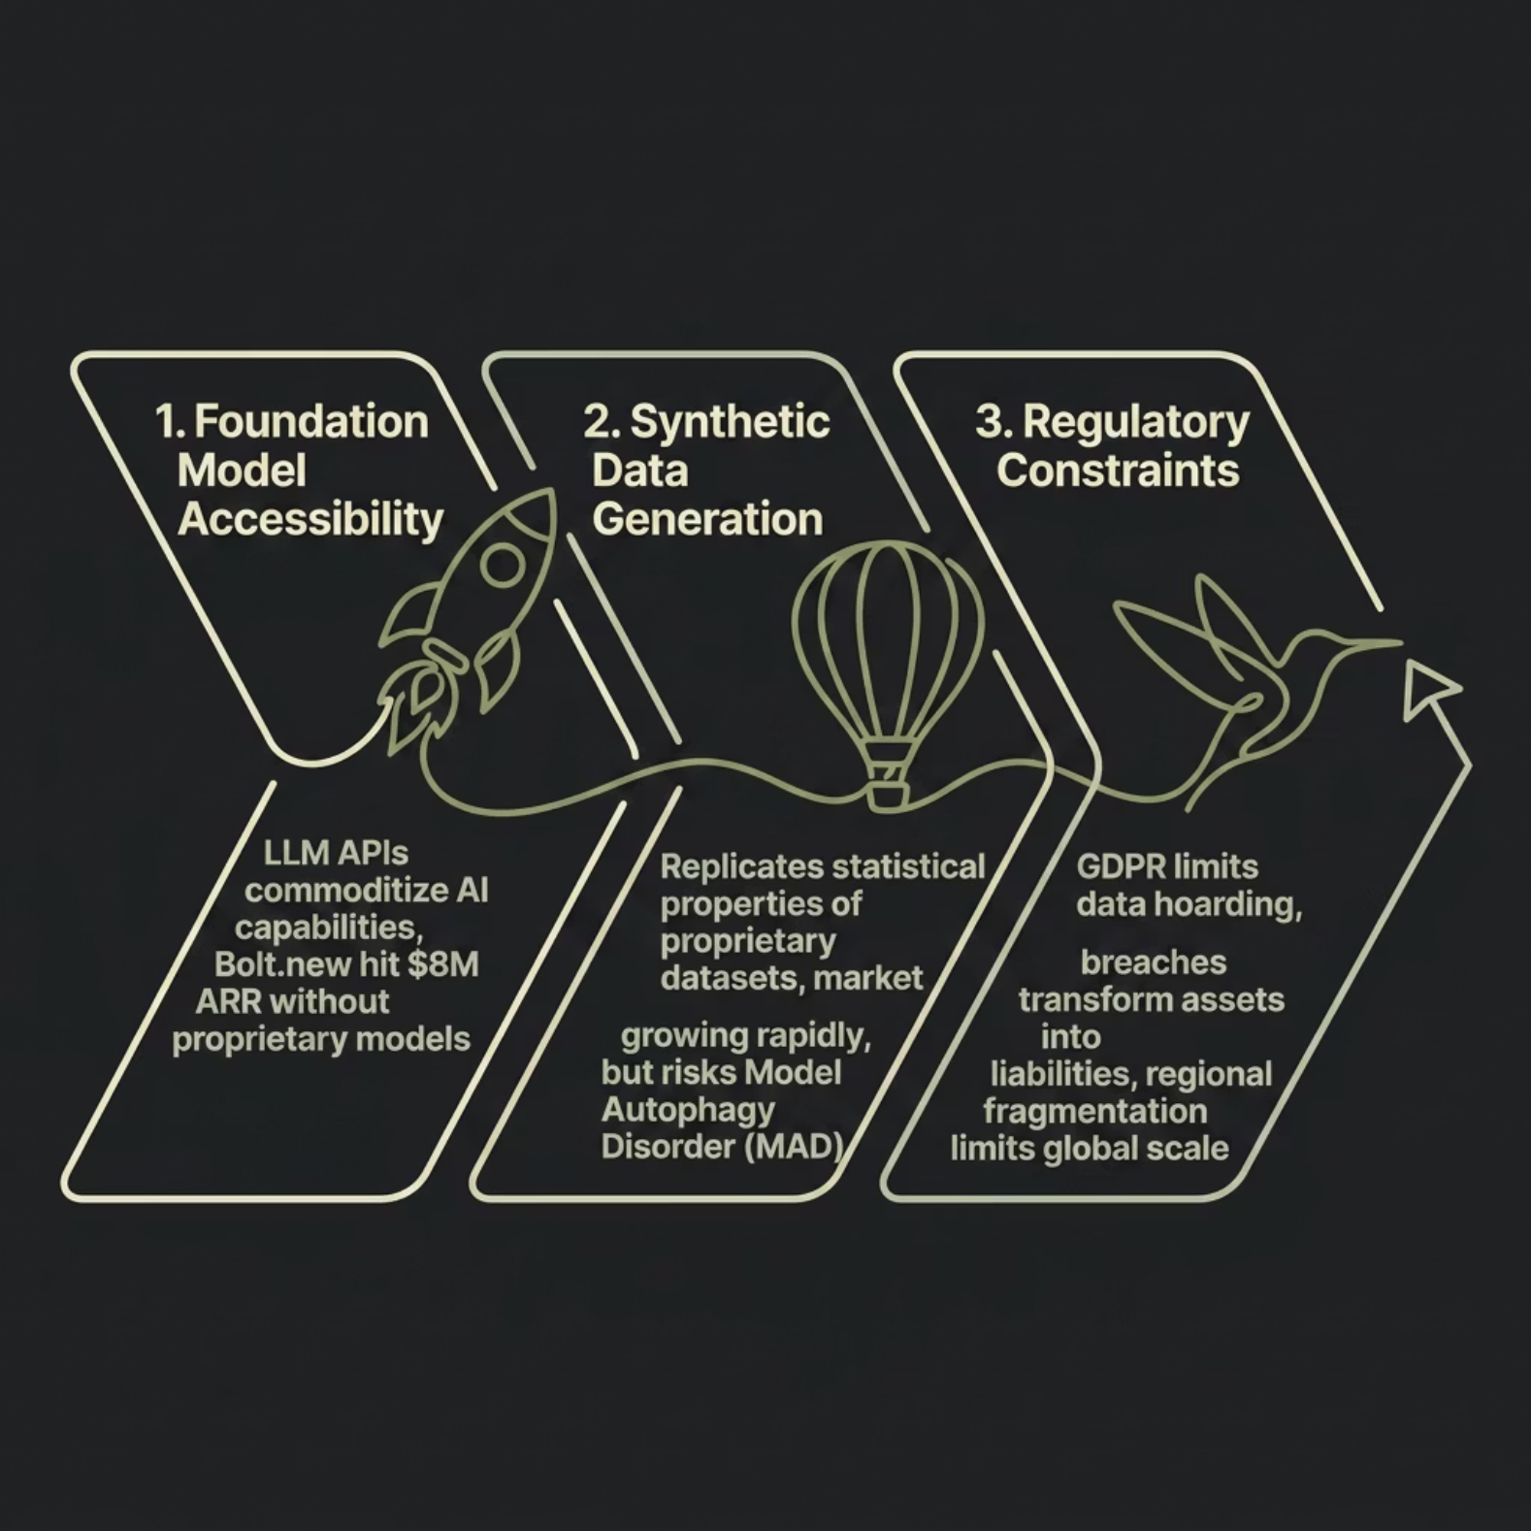


Challenges: The Democratizing Threat
Market Bifurcation Reality
Generic AI tools under $50/month suffer Gross Revenue Retention as low as 23% — catastrophic churn from lack of switching costs.
Specialized, vertically integrated AI solving complex workflows achieves GRR above 70%, proving defensibility has shifted from data ownership to deep workflow integration.
Investors now view "thin wrapper" AI startups that merely interface with LLM APIs as unfundable — structural defensibility is required.

Slide 9

Strategic Recommendations by Stage
1
Early Stage (0–18 mo)
Speed as the moat. Solve a specific, painful workflow problem. Target tertiary workflows (legal research, clinical notes) as a safer wedge. Demonstrate clear, measurable ROI fast.
2
Growth Stage (18–36 mo)
Build structural moats. Achieve 99% accuracy through edge-case engineering. Develop proprietary workflow knowledge via forward-deployed engineering. Disrupt incumbents with per-task pricing models.
3
Scaling Stage (36+ mo)
Fortify and expand. Productize data into benchmarks and premium insights. Implement stringent data governance. Drive operationalization — turn raw data into continuous production automation.

Slide 10

From Data Hoarding to Orchestration
The Old Paradigm
The Winning Paradigm
Accumulate the largest proprietary dataset. Guard it. Win through data exclusivity and scale.
Sustainable disruption comes from strategic orchestration of complementary assets:
Vulnerable to: synthetic data, foundation models, regulatory constraints, diminishing returns.
Proprietary workflows + deep integrations
Closed-loop learning systems
High AI execution velocity
Distribution and radical market trust
A culture of continuous operationalization
McKinsey: Models customized with proprietary data deliver 35–50% better performance on business-specific tasks.
The moat is not the data itself — it is the ability to operationalize it faster and deeper than anyone else.

Slide 11
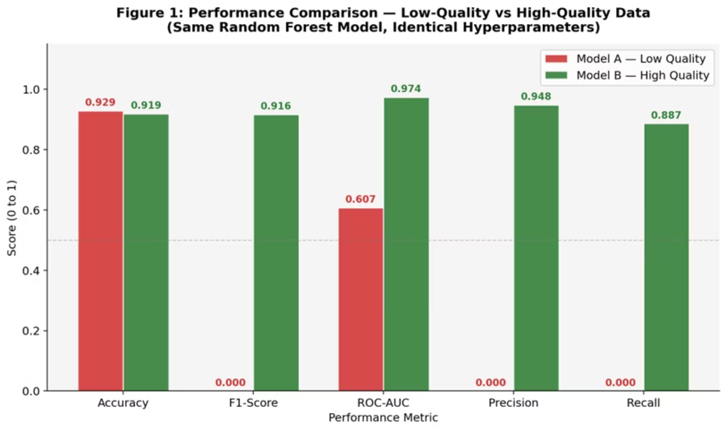
Technical Implementation for the data moat
In this technical implementation we have created two model with different dataset, the goal is to show the difference between the models created by high quality dataset and low quality dataset.
In this figure we get the comparison between two model which were created with the high quality and low quality dataset

Slide 12


