Slide 1
Table Views
Table Views are the UI View subclass behind some of the most popular apps on the App Store. They are very versatile and this is one view we must master. The name 'Table' is a little bit misleading because yes, it is a table, but a table with just one column. In fact, it might be more accurate to think of it as a list

Slide 2
Table Views: Content
First we must determine if our content is going to be dynamic or static. If we don't know how many cells we have to display until the application is running, we have to use Dynamic Prototypes to generate our cells. Since we don't know how many cells to generate beforehand, we create a prototype cell that will be used as a blueprint to create cells. On the other hand, if we know beforehand how many cells that we need, we can create Static Cells

Slide 3
Table Views: Two types
There are two main types of TableViews. Plain type is for dynamic data (when we don't know before hand how long data is going to be). Grouped type is for fixed data. One example of a Plain type is the Contacts App and an example of Grouped type is the Settings App.

Slide 4
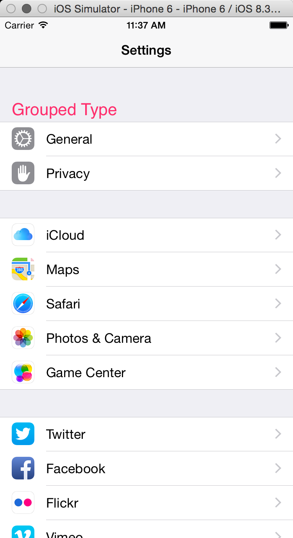
Table Views:

Slide 5
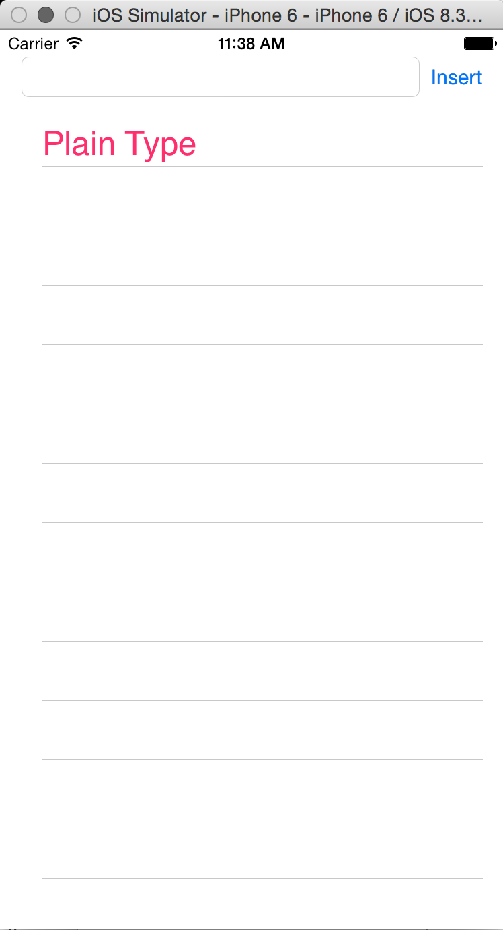
Table Views:

Slide 6
Table Views:

