Slide 1
Table Views
Are the UI View subclass behind the most popular apps on the App Store
They are very versatile and this is one view we must master
The name 'Table' is a little bit misleading because yes, it is a table
But a table with just one column
more accurate to think of it as a list

Slide 2
Table Views: Content
First we must determine if our content is going to be dynamic or static
If we don't know how many cells until running time
use Dynamic Prototypes to generate cells
Create a prototype cell that will be used as a blueprint to create cells
On the other hand
if we know beforehand how many cells
create Static Cells

Slide 3
Table Views: Two types
There are two main types of TableViews
Plain type is for dynamic data
Grouped type is for fixed data
Examples:
Plain type -> the Contacts App
Grouped type -> the Settings App

Slide 4
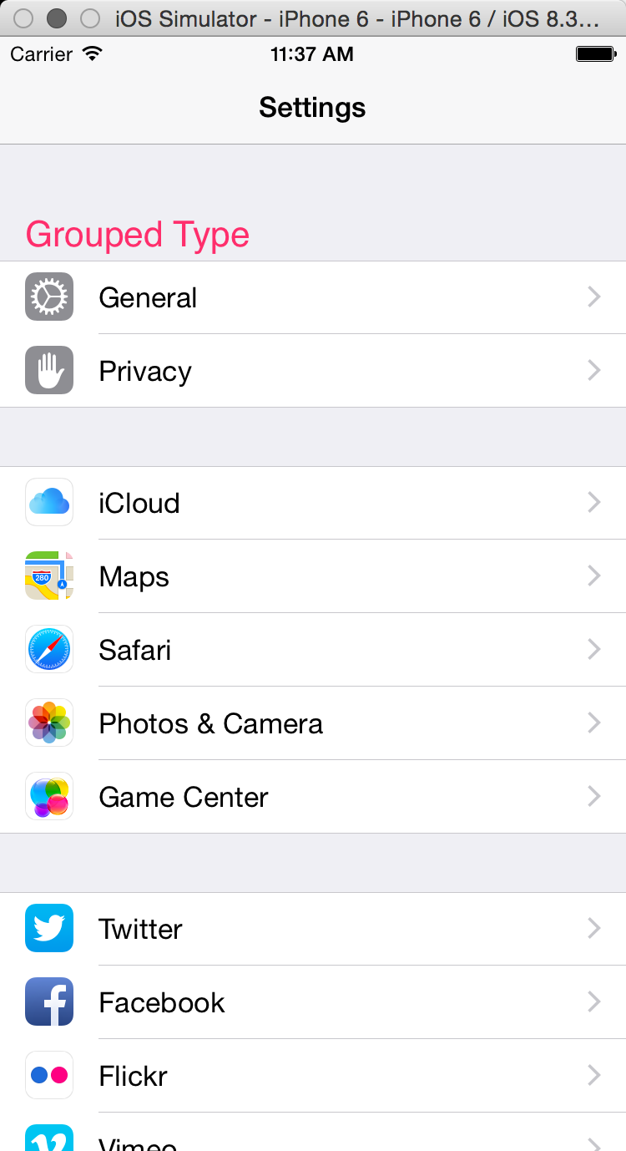
Table Views:

Slide 5
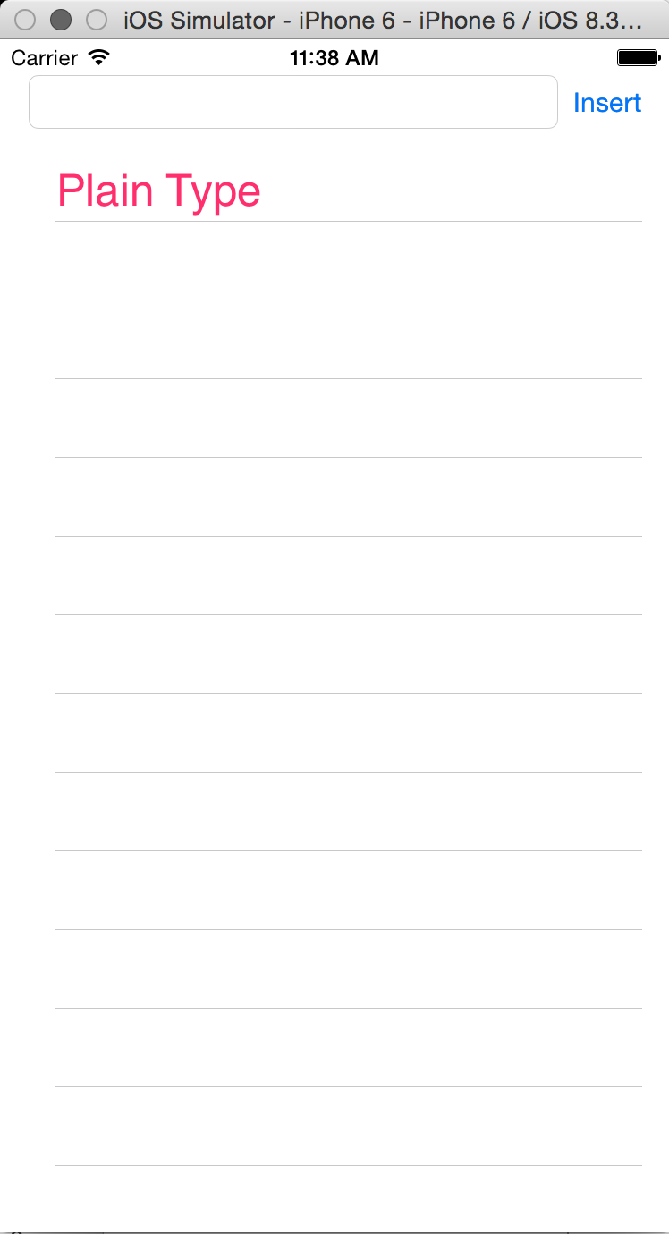
Table Views:

Slide 6
Table Views:

