Slide 1
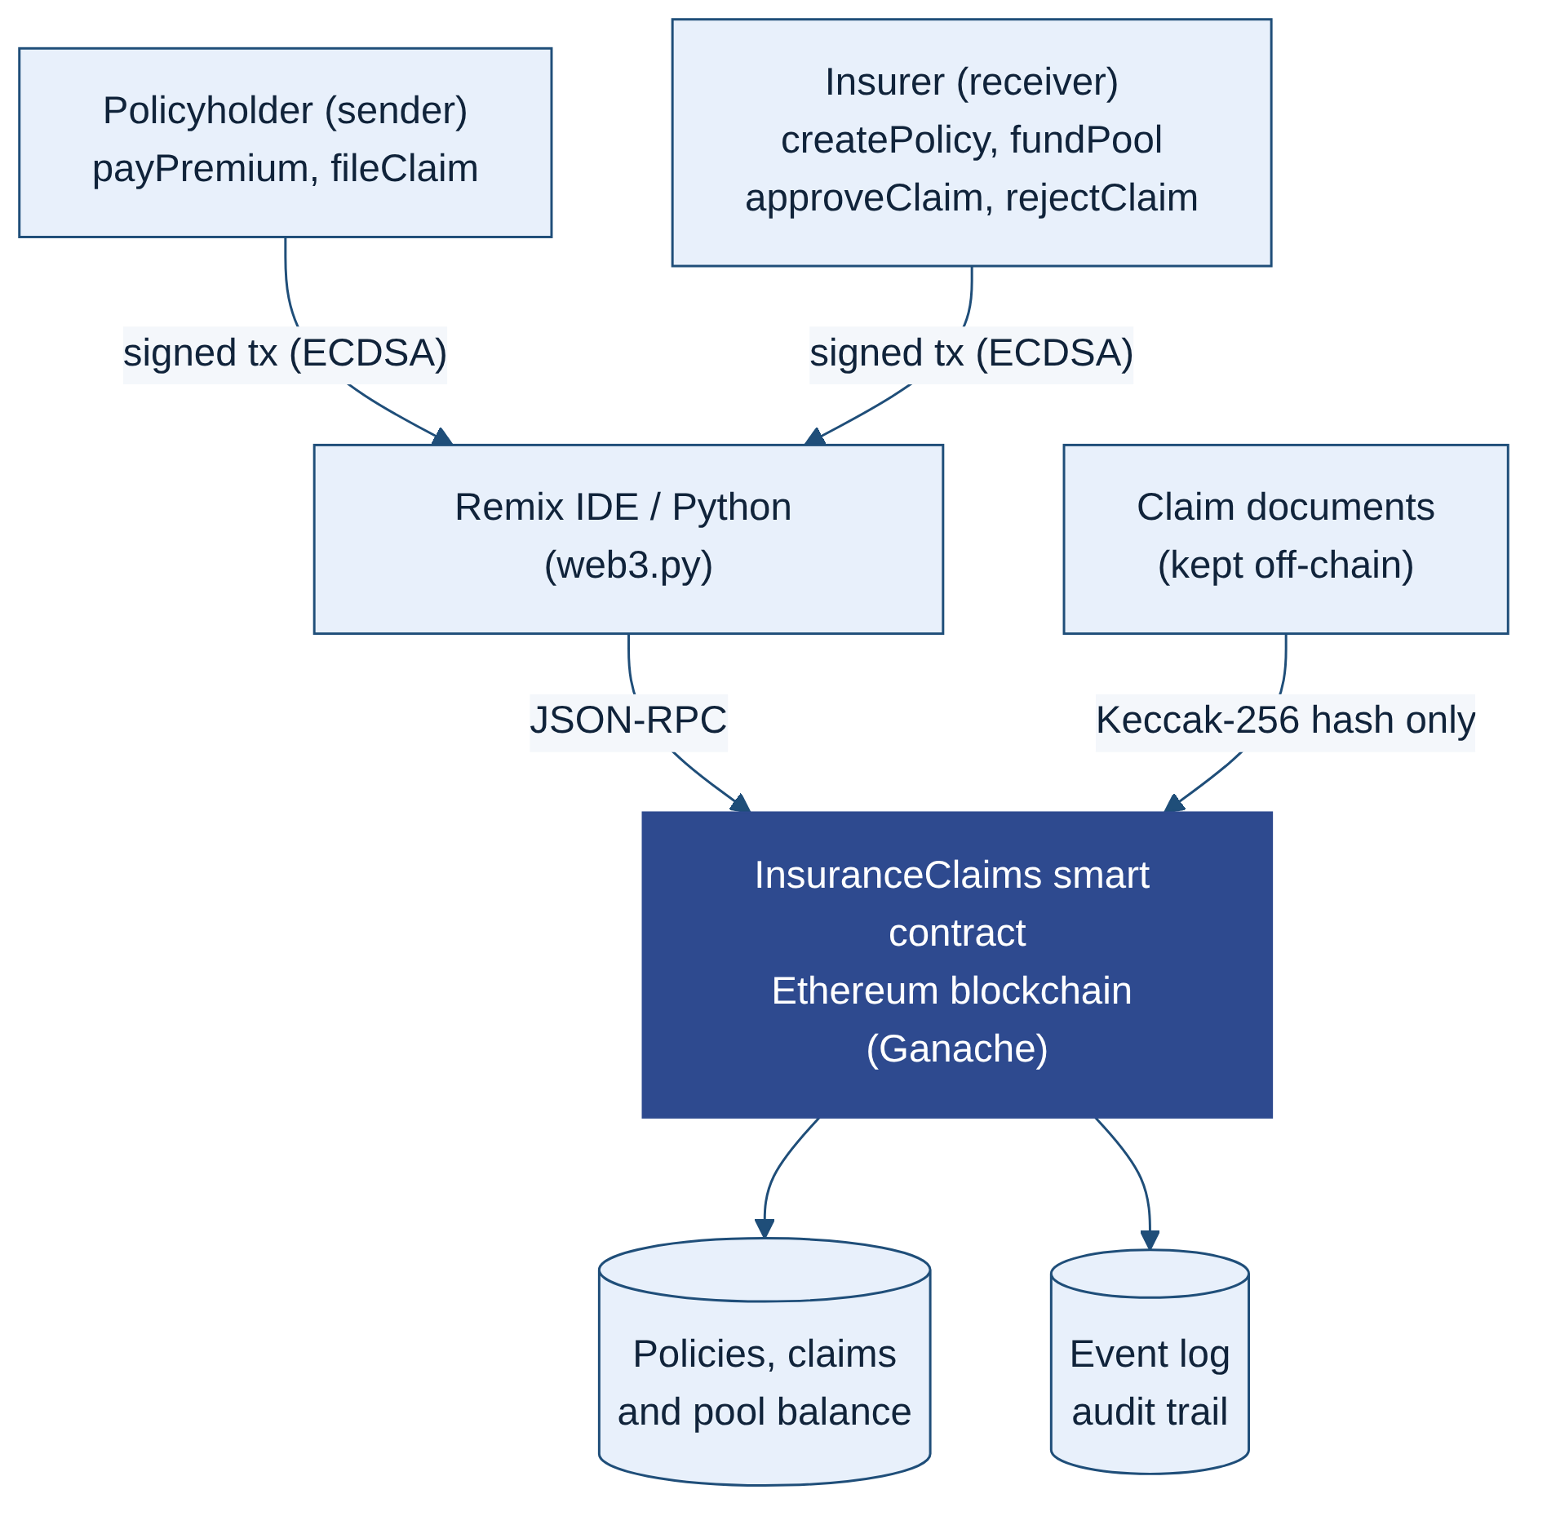
Transparent Insurance Claims on Ethereum
A Solidity smart contract linking the policyholder and the insurer
Majid Nawaz (2024473) | CCT College Dublin | Distributed Digital Transactions | github.com here
01
INTRODUCTION
Insurance runs on trust, yet claims are still slow, manual and opaque. This project proposes a decentralised application (DApp) in which a Solidity smart contract sits between the policyholder (sender) and the insurer (receiver), holds premiums and pays approved claims automatically on an Ethereum blockchain.
Goal: replace paper-based claims handling with transparent, tamper-proof rules written in code.
02
THE PROBLEM TODAY
Slow: documents are checked by hand by brokers and loss adjusters, so claims take weeks.
Opaque: policyholders cannot see how or why a decision is made.
Siloed: each insurer keeps a private database, so one loss can be claimed twice.
Alterable: central records can be edited without leaving a trace.
03
PROPOSED SOLUTION
How it works
1
The insurer issues a policy and funds the claims pool.
2
The policyholder pays the premium into the contract.
3
The policyholder files a claim with a Keccak-256 hash of the evidence.
4
The insurer approves and the contract pays out at once, or rejects it with a reason.
Figure 1: System architecture

