Slide 1


Classification with Linear Models
Losses for linear classification, logistic regression, multiclass classification
Programming and Statistical Analysis, 2025
Majid Sohrabi
National Research University Higher School of Economics
May 16, 2025

Slide 2
Can’t we just use linear regression for classification?

Slide 3
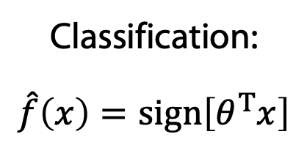

Classification with linear regression
Classification:
$$\hat{f}\left(x\right)=sign\left[θ^{T}x\right]$$
For binary classification task, assign:
$y=+1$ for positive class
$y=−1$ for negative class
Solve linear regression for $\hat{y}=θ^{T}x$ with MSE loss
Classify with $𝕀\left[\hat{y}>0\right]$
Any problems with this approach?

Slide 4
Classification with linear regression
Classification:
$$\hat{f}\left(x\right)=sign\left[θ^{T}x\right]$$
For binary classification task, assign:
$y=+1$ for positive class
$y=−1$ for negative class
Solve linear regression for $\hat{y}=θ^{T}x$ with MSE loss
Classify with $𝕀\left[\hat{y}>0\right]$
Any problems with this approach?

Slide 5

Classification with linear regression
Classification:
$$\hat{f}\left(x\right)=sign\left[θ^{T}x\right]$$
For binary classification task, assign:
$y=+1$ for positive class
$y=−1$ for negative class
Solve linear regression for $\hat{y}=θ^{T}x$ with MSE loss
Classify with $sign\left[\hat{y}\right]$
Any problems with this approach?

Slide 6
Classification with linear regression
Classification:
$$\hat{f}\left(x\right)=sign\left[θ^{T}x\right]$$
For binary classification task, assign:
$y=+1$ for positive class
$y=−1$ for negative class
Solve linear regression for $\hat{y}=θ^{T}x$ with MSE loss
Classify with $sign\left[\hat{y}\right]$
Any problems with this approach?

Slide 7




Classification with linear regression
$$y=+1$$
May face problems when classes are unbalanced or have different spread
$$x_{2}$$
Decision boundary
$$y=−1$$
$$x_{1}$$

Slide 8

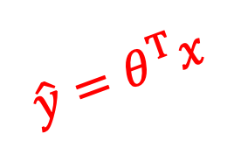


Classification with linear regression
2
MSE loss makes the model avoid high residuals
1
0
$$y$$
$$\hat{y}=θ^{T}x$$
at a price of pushing the decision boundary towards the class with higher spread
Decision boundary
–1
–2
$$x_{1}$$
$$x_{2}$$
Can we find a better loss function?

Slide 9
Classification loss functions

Slide 10


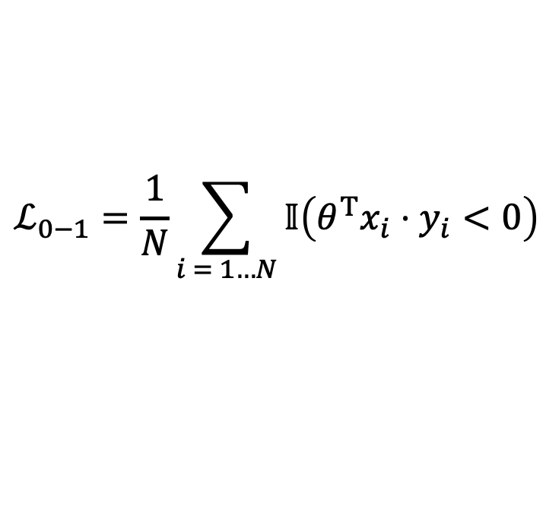
0-1 Loss
Probability of an error
$$ℒ_{0−1}=\frac{1}{N}\sum_{i = 1…N}{𝕀\left(θ^{T}x_{i}⋅y_{i}<0\right)}$$
loss
$$y_{i}∈\left\{−1, +1\right\}$$
$$θ$$

Slide 11
0-1 Loss
Probability of an error
$$ℒ_{0−1}=\frac{1}{N}\sum_{i = 1…N}{𝕀\left(θ^{T}x_{i}⋅y_{i}<0\right)}$$
loss
$$y_{i}∈\left\{−1, +1\right\}$$
$$θ$$
Can’t optimize piecewise constant function with gradient-based methods*
*other techniques exist (still quite limited)

Slide 12

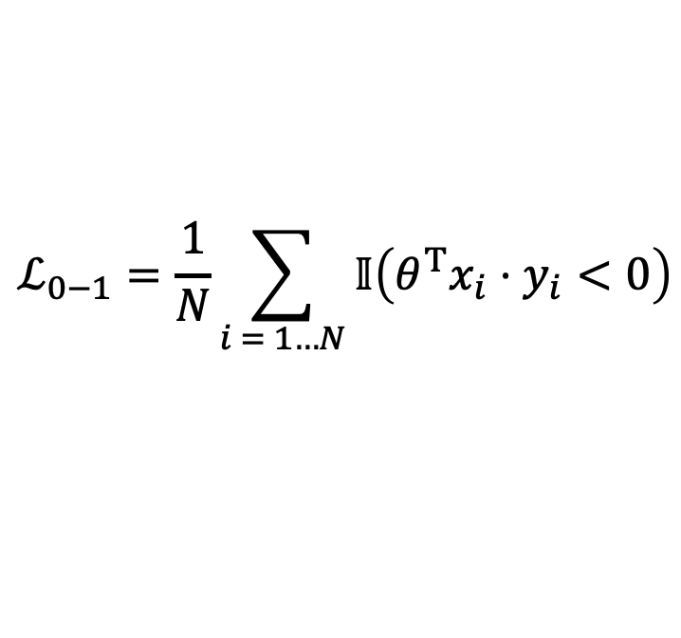

Margin
$$M=θ^{T}x⋅y$$
$$ℒ_{0−1}=\frac{1}{N}\sum_{i = 1…N}{𝕀\left(θ^{T}x_{i}⋅y_{i}<0\right)}$$
margin
$M>0$ – correct classification
$M<0$ – incorrect classification

Slide 13
Upper bounds on 0-1 loss
Instead of optimizing the 0-1 loss we can optimize a differentiable upper bound

Slide 14
Logistic Regression

Slide 15
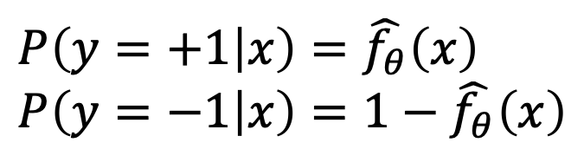
Idea
Let’s model the class probabilities
$$P\left(y=+1 | x\right)=\hat{f_{θ}}\left(x\right)$$
$$P\left(y=−1 | x\right)=1−\hat{f_{θ}}\left(x\right)$$

Slide 16
Idea
Let’s model the class probabilities
$$P\left(y=+1 | x\right)=\hat{f_{θ}}\left(x\right)$$
$$P\left(y=−1 | x\right)=1−\hat{f_{θ}}\left(x\right)$$
Fit with maximum (log) likelihood

Slide 17
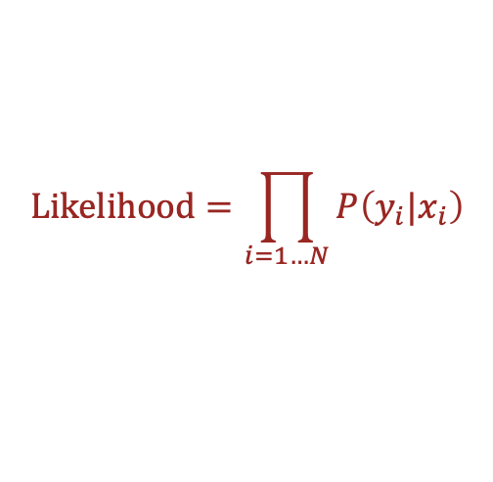
Idea
$$Likelihood=\prod_{i=1…N}{P\left(y_{i}|x_{i}\right)}$$
Let’s model the class probabilities
$$P\left(y=+1 | x\right)=\hat{f_{θ}}\left(x\right)$$
$$P\left(y=−1 | x\right)=1−\hat{f_{θ}}\left(x\right)$$
Fit with maximum (log) likelihood

Slide 18
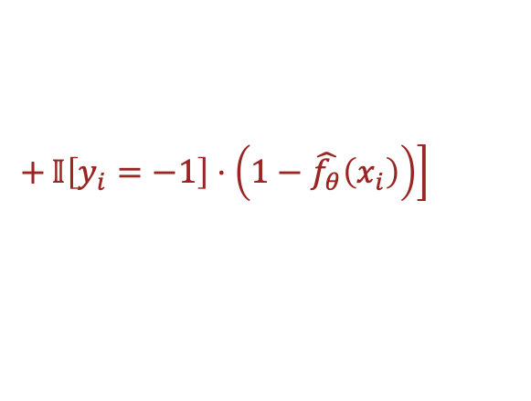
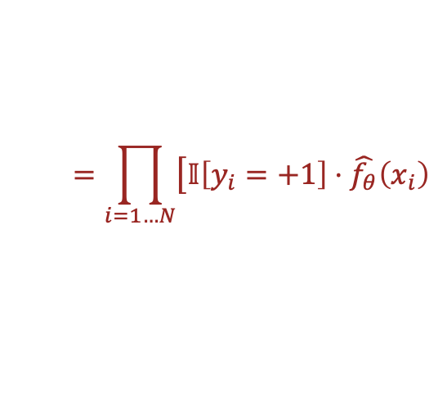
Idea
$$Likelihood=\prod_{i=1…N}{P\left(y_{i}|x_{i}\right)}$$
Let’s model the class probabilities
$$=\prod_{i=1…N}{\left[𝕀\left[y_{i}=+1\right]⋅\hat{f_{θ}}\left(x_{i}\right)\right.}$$
$$P\left(y=+1 | x\right)=\hat{f_{θ}}\left(x\right)$$
$$P\left(y=−1 | x\right)=1−\hat{f_{θ}}\left(x\right)$$
$$+\left.𝕀\left[y_{i}=−1\right]⋅\left(1−\hat{f_{θ}}\left(x_{i}\right)\right)\right]$$
Fit with maximum (log) likelihood

Slide 19
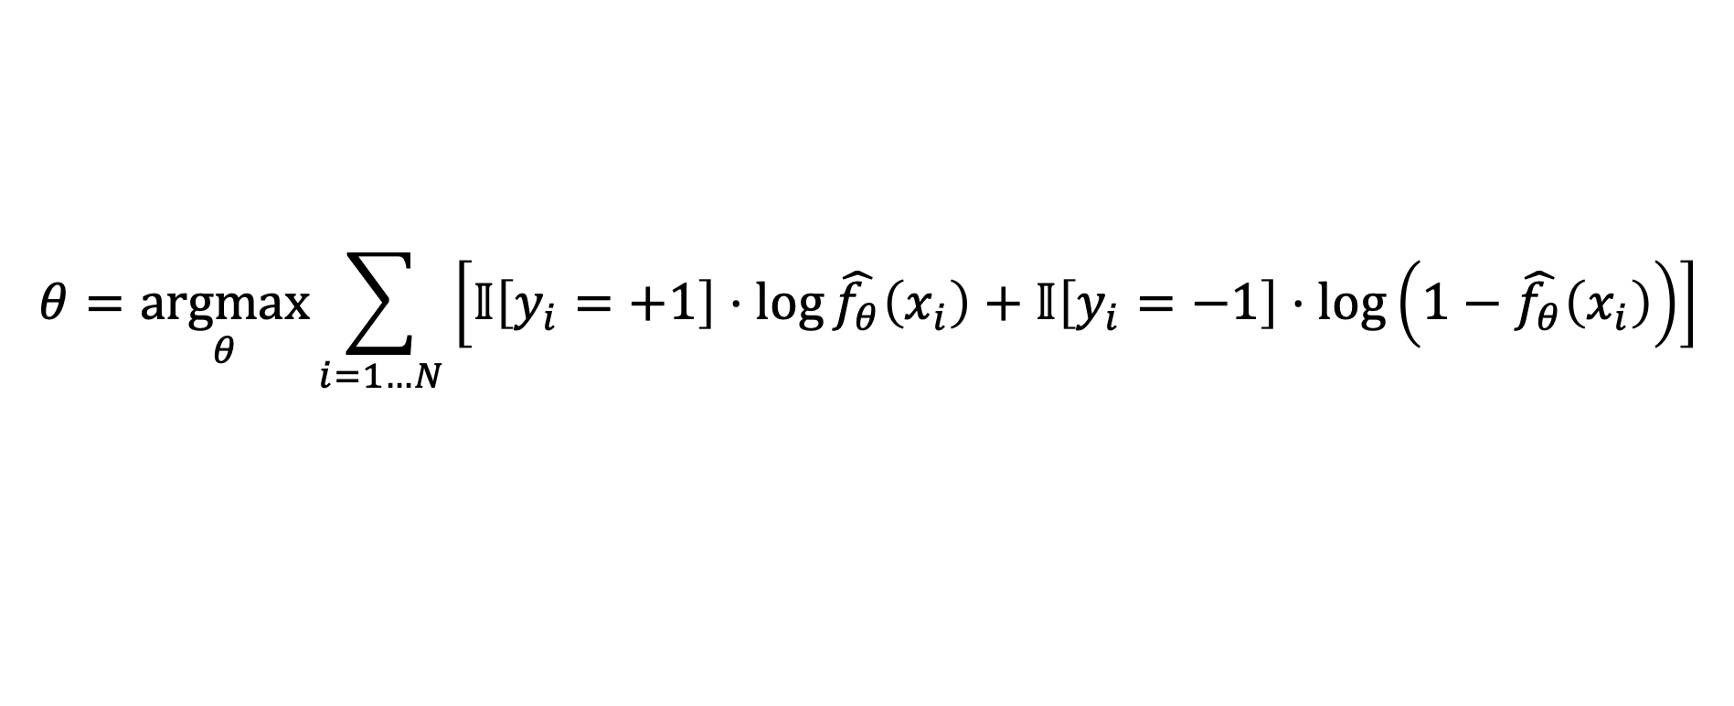
Idea
$$Likelihood=\prod_{i=1…N}{P\left(y_{i}|x_{i}\right)}$$
Let’s model the class probabilities
$$=\prod_{i=1…N}{\left[𝕀\left[y_{i}=+1\right]⋅\hat{f_{θ}}\left(x_{i}\right)\right.}$$
$$P\left(y=+1 | x\right)=\hat{f_{θ}}\left(x\right)$$
$$P\left(y=−1 | x\right)=1−\hat{f_{θ}}\left(x\right)$$
$$+\left.𝕀\left[y_{i}=−1\right]⋅\left(1−\hat{f_{θ}}\left(x_{i}\right)\right)\right]$$
Fit with maximum (log) likelihood
$$θ=\underset{θ}{argmax}{\sum_{i=1…N}{\left[𝕀\left[y_{i}=+1\right]⋅\log{\hat{f_{θ}}\left(x_{i}\right)}+𝕀\left[y_{i}=−1\right]⋅\log\left(1−\hat{f_{θ}}\left(x_{i}\right)\right)\right]}}$$

Slide 20
Idea
$$Likelihood=\prod_{i=1…N}{P\left(y_{i}|x_{i}\right)}$$
Let’s model the class probabilities
$$=\prod_{i=1…N}{\left[𝕀\left[y_{i}=+1\right]⋅\hat{f_{θ}}\left(x_{i}\right)\right.}$$
$$P\left(y=+1 | x\right)=\hat{f_{θ}}\left(x\right)$$
$$P\left(y=−1 | x\right)=1−\hat{f_{θ}}\left(x\right)$$
$$+\left.𝕀\left[y_{i}=−1\right]⋅\left(1−\hat{f_{θ}}\left(x_{i}\right)\right)\right]$$
Fit with maximum (log) likelihood
$$θ=\underset{θ}{argmax}{\sum_{i=1…N}{\left[𝕀\left[y_{i}=+1\right]⋅\log{\hat{f_{θ}}\left(x_{i}\right)}+𝕀\left[y_{i}=−1\right]⋅\log\left(1−\hat{f_{θ}}\left(x_{i}\right)\right)\right]}}$$
Predict the class with highest probability*
*more generally: find a probability threshold suitable for your problem

Slide 21
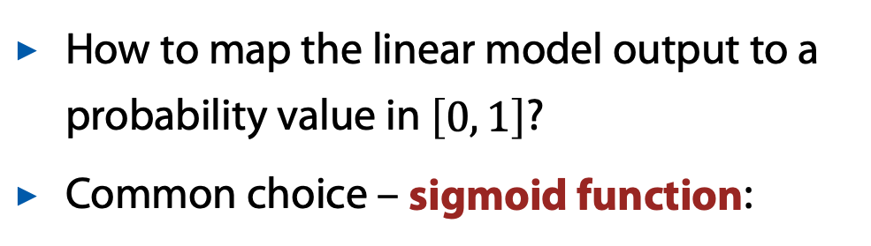
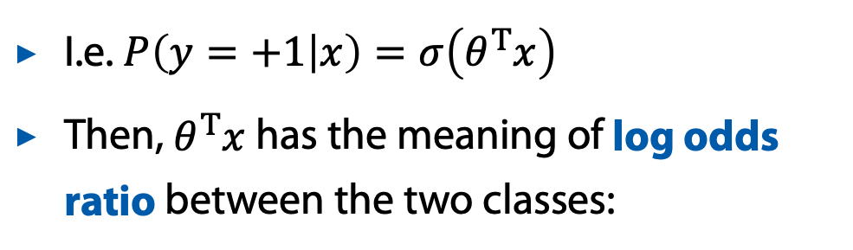
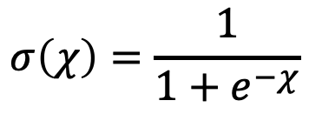
Linear probability model
How to map the linear model output to a probability value in $\left[0, 1\right]$?
Common choice – sigmoid function:
$$σ\left(χ\right)=\frac{1}{1+e^{−χ}}$$
I.e. $P\left(y=+1 | x\right)=σ\left(θ^{T}x\right)$
Then, $θ^{T}x$ has the meaning of log odds ratio between the two classes:

Slide 22


Linear probability model
How to map the linear model output to a probability value in $\left[0, 1\right]$?
Common choice – sigmoid function:
sigmoid function
$$σ\left(χ\right)=\frac{1}{1+e^{−χ}}$$
$$σ\left(χ\right)$$
I.e. $P\left(y=+1 | x\right)=σ\left(θ^{T}x\right)$
Then, $θ^{T}x$ has the meaning of log odds ratio between the two classes:
$$χ$$

Slide 23
Linear probability model
How to map the linear model output to a probability value in $\left[0, 1\right]$?
Common choice – sigmoid function:
sigmoid function
$$σ\left(χ\right)=\frac{1}{1+e^{−χ}}$$
$$σ\left(χ\right)$$
I.e. $P\left(y=+1 | x\right)=σ\left(θ^{T}x\right)$
Then, $θ^{T}x$ has the meaning of log odds ratio between the two classes:
$$χ$$

Slide 24
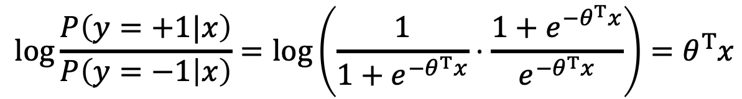
Linear probability model
How to map the linear model output to a probability value in $\left[0, 1\right]$?
Common choice – sigmoid function:
sigmoid function
$$σ\left(χ\right)=\frac{1}{1+e^{−χ}}$$
$$σ\left(χ\right)$$
I.e. $P\left(y=+1 | x\right)=σ\left(θ^{T}x\right)$
Then, $θ^{T}x$ has the meaning of log odds ratio between the two classes:
$$χ$$
$$\log{\frac{P\left(y=+1|x\right)}{P\left(y=−1 | x\right)}=\log\left(\frac{1}{1+e^{−θ^{T}x}}⋅\frac{1+e^{−θ^{T}x}}{e^{−θ^{T}x}}\right)}=θ^{T}x$$

Slide 25
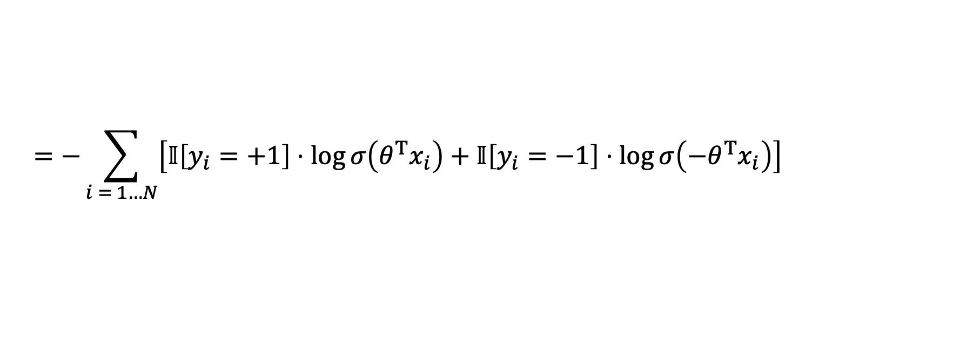
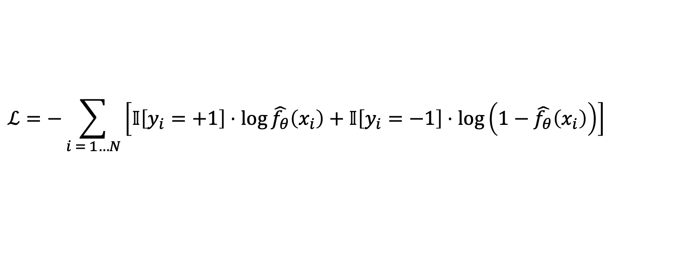
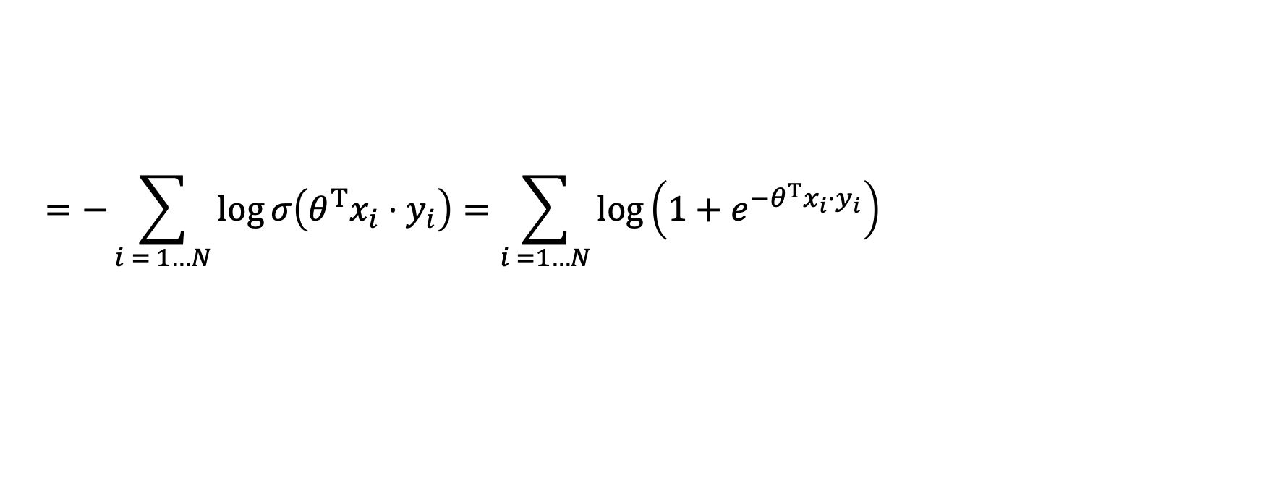
Bringing it all together
Use negative log likelihood as our loss function:
$$ℒ=−\sum_{i = 1…N}{\left[𝕀\left[y_{i}=+1\right]⋅\log{\hat{f_{θ}}\left(x_{i}\right)}+𝕀\left[y_{i}=−1\right]⋅\log\left(1−\hat{f_{θ}}\left(x_{i}\right)\right)\right]}$$
$$=−\sum_{i = 1…N}{\left[𝕀\left[y_{i}=+1\right]⋅\log{σ\left(θ^{T}x_{i}\right)}+𝕀\left[y_{i}=−1\right]⋅\log{σ\left(−θ^{T}x_{i}\right)}\right]}$$
$$=−\sum_{i = 1…N}{\log{σ\left(θ^{T}x_{i}⋅y_{i}\right)}=\sum_{i =1…N}{\log\left(1+e^{{−θ}^{T}x_{i}⋅y_{i}}\right)}}$$

Slide 26

Bringing it all together
Use negative log likelihood as our loss function:
$$ℒ=−\sum_{i = 1…N}{\left[𝕀\left[y_{i}=+1\right]⋅\log{\hat{f_{θ}}\left(x_{i}\right)}+𝕀\left[y_{i}=−1\right]⋅\log\left(1−\hat{f_{θ}}\left(x_{i}\right)\right)\right]}$$
$$1−σ\left(x\right)=σ\left(−x\right)$$
$$=−\sum_{i = 1…N}{\left[𝕀\left[y_{i}=+1\right]⋅\log{σ\left(θ^{T}x_{i}\right)}+𝕀\left[y_{i}=−1\right]⋅\log{σ\left(−θ^{T}x_{i}\right)}\right]}$$
$$=−\sum_{i = 1…N}{\log{σ\left(θ^{T}x_{i}⋅y_{i}\right)}=\sum_{i =1…N}{\log\left(1+e^{{−θ}^{T}x_{i}⋅y_{i}}\right)}}$$

Slide 27
Bringing it all together
Use negative log likelihood as our loss function:
$$ℒ=−\sum_{i = 1…N}{\left[𝕀\left[y_{i}=+1\right]⋅\log{\hat{f_{θ}}\left(x_{i}\right)}+𝕀\left[y_{i}=−1\right]⋅\log\left(1−\hat{f_{θ}}\left(x_{i}\right)\right)\right]}$$
$$1−σ\left(x\right)=σ\left(−x\right)$$
$$=−\sum_{i = 1…N}{\left[𝕀\left[y_{i}=+1\right]⋅\log{σ\left(θ^{T}x_{i}\right)}+𝕀\left[y_{i}=−1\right]⋅\log{σ\left(−θ^{T}x_{i}\right)}\right]}$$
$$=−\sum_{i = 1…N}{\log{σ\left(θ^{T}x_{i}⋅y_{i}\right)}=\sum_{i =1…N}{\log\left(1+e^{{−θ}^{T}x_{i}⋅y_{i}}\right)}}$$

Slide 28
Bringing it all together
Use negative log likelihood as our loss function:
$$ℒ=−\sum_{i = 1…N}{\left[𝕀\left[y_{i}=+1\right]⋅\log{\hat{f_{θ}}\left(x_{i}\right)}+𝕀\left[y_{i}=−1\right]⋅\log\left(1−\hat{f_{θ}}\left(x_{i}\right)\right)\right]}$$
$$1−σ\left(x\right)=σ\left(−x\right)$$
$$=−\sum_{i = 1…N}{\left[𝕀\left[y_{i}=+1\right]⋅\log{σ\left(θ^{T}x_{i}\right)}+𝕀\left[y_{i}=−1\right]⋅\log{σ\left(−θ^{T}x_{i}\right)}\right]}$$
$$=−\sum_{i = 1…N}{\log{σ\left(θ^{T}x_{i}⋅y_{i}\right)}=\sum_{i =1…N}{\log\left(1+e^{{−θ}^{T}x_{i}⋅y_{i}}\right)}}$$

Slide 29
Bringing it all together
Use negative log likelihood as our loss function:
$$ℒ=−\sum_{i = 1…N}{\left[𝕀\left[y_{i}=+1\right]⋅\log{\hat{f_{θ}}\left(x_{i}\right)}+𝕀\left[y_{i}=−1\right]⋅\log\left(1−\hat{f_{θ}}\left(x_{i}\right)\right)\right]}$$
$$1−σ\left(x\right)=σ\left(−x\right)$$
$$=−\sum_{i = 1…N}{\left[𝕀\left[y_{i}=+1\right]⋅\log{σ\left(θ^{T}x_{i}\right)}+𝕀\left[y_{i}=−1\right]⋅\log{σ\left(−θ^{T}x_{i}\right)}\right]}$$
$$=−\sum_{i = 1…N}{\log{σ\left(θ^{T}x_{i}⋅y_{i}\right)}=\sum_{i =1…N}{\log\left(1+e^{{−θ}^{T}x_{i}⋅y_{i}}\right)}}$$
This can be optimized numerically

Slide 30
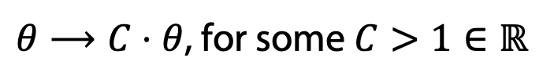
Example
Now the boundary is at the right place
Note: when classes are linearly separable for any correct decision boundary
$θ⟶C⋅θ$, for some $C>1∈ℝ$
$$x_{2}$$
keeps the boundary at the same place, yet improves the loss
$$x_{1}$$

Slide 31
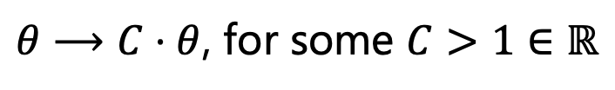
Example
Now the boundary is at the right place
Note: when classes are linearly separable for any correct decision boundary
$θ⟶C⋅θ$, for some $C>1∈ℝ$
$$x_{2}$$
keeps the boundary at the same place, yet improves the loss
$$x_{1}$$

Slide 32
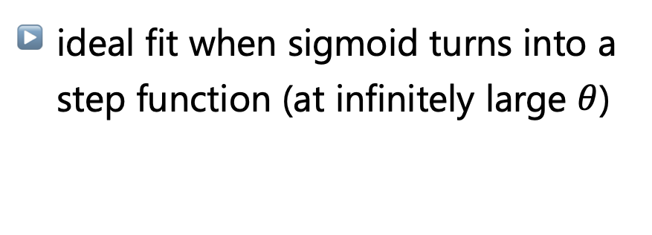
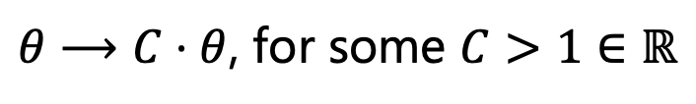
Example
Now the boundary is at the right place
Note: when classes are linearly separable for any correct decision boundary
$θ⟶C⋅θ$, for some $C>1∈ℝ$
$$x_{2}$$
keeps the boundary at the same place, yet improves the loss
ideal fit when sigmoid turns into a step function (at infinitely large $θ$)
$$x_{1}$$

Slide 33
Example
When classes overlap the loss has a finite minimum
Predicted class probability changes smoothly
$$x_{2}$$
$$x_{1}$$

Slide 34
Multiclass Logistic Regression

Slide 35


Multinomial Logistic Regression
Similarly to the binary case, we’ll model the class probabilities
Let’s model unnormalized class probabilities like this:
Note: now we have $K$ parameter vectors
$$\tilde{P}\left(y=k | x\right)=\exp{θ_{k}^{T}x}$$

Slide 36
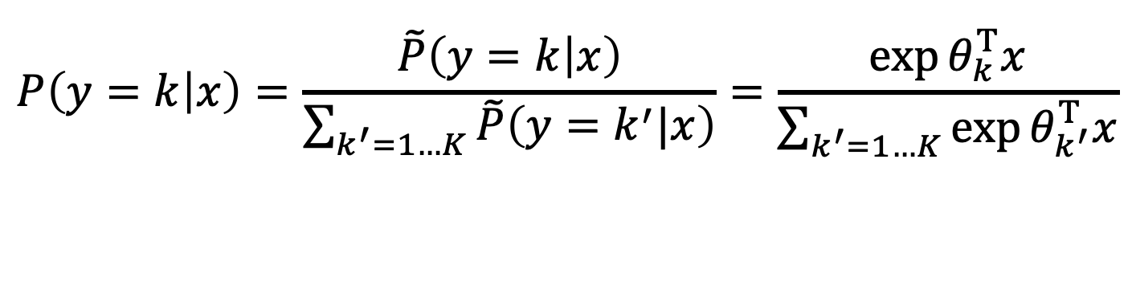
Multinomial Logistic Regression
Similarly to the binary case, we’ll model the class probabilities
Let’s model unnormalized class probabilities like this:
Note: now we have $K$ parameter vectors
$$\tilde{P}\left(y=k | x\right)=\exp{θ_{k}^{T}x}$$
Then, the normalized probabilities are:
$$P\left(y=k | x\right)=\frac{\tilde{P}\left(y=k | x\right)}{\sum_{k^{′}=1…K}{\tilde{P}\left(y=k^{′}|x\right)}}=\frac{\exp{θ_{k}^{T}x}}{\sum_{k^{′}=1…K}{\exp{θ_{k^{′}}^{T}x}}}$$
This function is called softmax and is commonly used in neural networks

Slide 37

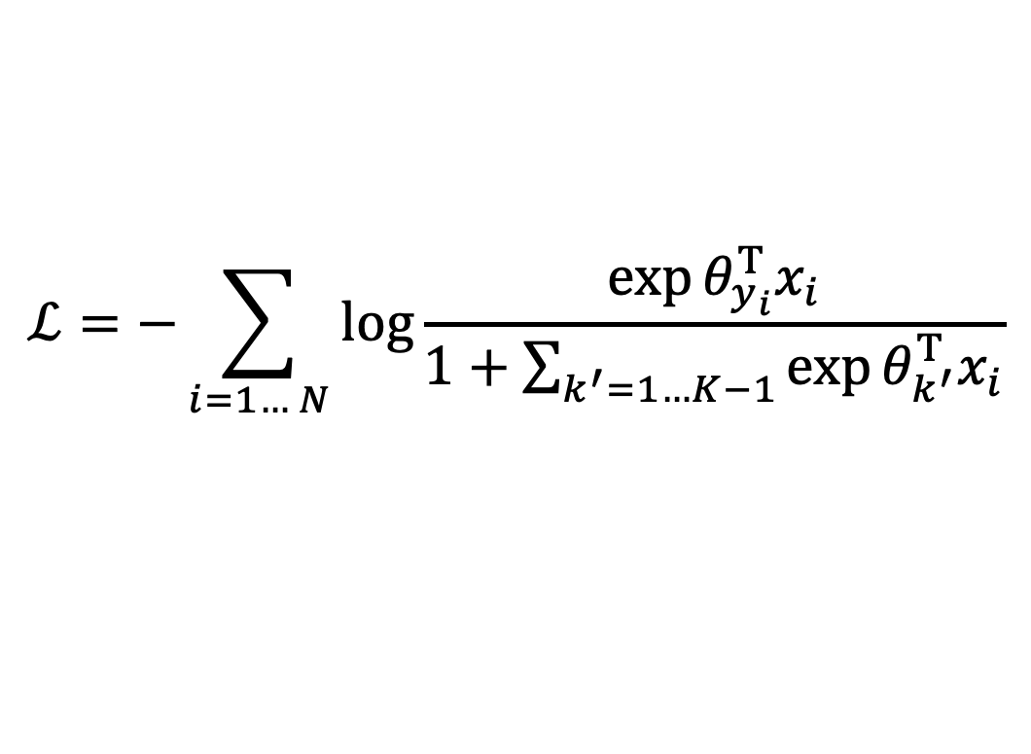
Multinomial Logistic Regression
Plugging everything into the negative log likelihood we get our loss function:
$$ℒ=−\sum_{i=1… N}{\log{\frac{\exp{θ_{y_{i}}^{T}x_{i}}}{1+\sum_{k^{′}=1…K−1}{\exp{θ_{k^{′}}^{T}x_{i}}}}}}$$
$$\left(θ_{K}=0\right)$$
Again, this can be optimized numerically

Slide 38
Multiclass classification: general approach

Slide 39
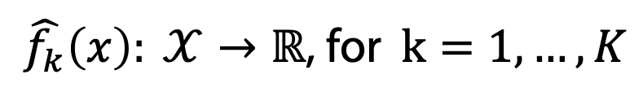
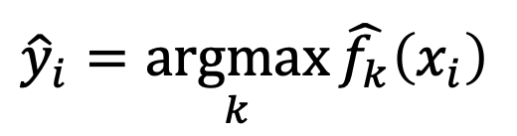
General idea
For a problem with $K$ classes introduce $K$ predictors:
$\hat{f_{k}}\left(x\right): 𝒳→ℝ$, for $k=1,…,K$
each of which outputs a corresponding class score.
Predict the class with the highest score:
$${\hat{y}}_{i}=\underset{k}{argmax}{\hat{f_{k}}\left(x_{i}\right)}$$

Slide 40
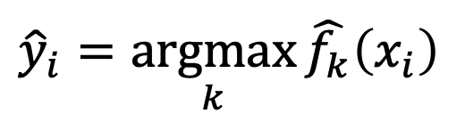

Example: binary → multiclass
Any binary linear classification model can be converted to multiclass with one-vs-rest strategy
For each class $k$ train a binary model $\hat{f_{k}}\left(x\right)=θ_{(k)}^{T}x$ separating the given class from all others, ${\hat{y}}_{\left(k\right)}^{1−vs−rest}=𝕀\left[\hat{f_{k}}\left(x\right)>0\right]$
Use the outputs of $\hat{f_{k}}$ as class scores for multiclass classification:
$${\hat{y}}_{i}=\underset{k}{argmax}{\hat{f_{k}}\left(x_{i}\right)}$$

Slide 41

Example: binary → multiclass
Any binary linear classification model can be converted to multiclass with one-vs-rest strategy
For each class $k$ train a binary model $\hat{f_{k}}\left(x\right)=θ_{(k)}^{T}x$ separating the given class from all others, ${\hat{y}}_{\left(k\right)}^{1−vs−rest}=sign\left[\hat{f_{k}}\left(x\right)\right]$
Use the outputs of $\hat{f_{k}}$ as class scores for multiclass classification:
$${\hat{y}}_{i}=\underset{k}{argmax}{\hat{f_{k}}\left(x_{i}\right)}$$

Slide 42
Example: binary → multiclass
Any binary linear classification model can be converted to multiclass with one-vs-rest strategy
For each class $k$ train a binary model $\hat{f_{k}}\left(x\right)=θ_{(k)}^{T}x$ separating the given class from all others, ${\hat{y}}_{\left(k\right)}^{1−vs−rest}=sign\left[\hat{f_{k}}\left(x\right)\right]$
Use the outputs of $\hat{f_{k}}$ as class scores for multiclass classification:
$${\hat{y}}_{i}=\underset{k}{argmax}{\hat{f_{k}}\left(x_{i}\right)}$$

Slide 43
Example
Consider the following 3 class problem

Slide 44
Example
“Class-1 VS rest” binary classifier

Slide 45
Example
“Class-2 VS rest” binary classifier

Slide 46
Example
“Class-3 VS rest” binary classifier

Slide 47
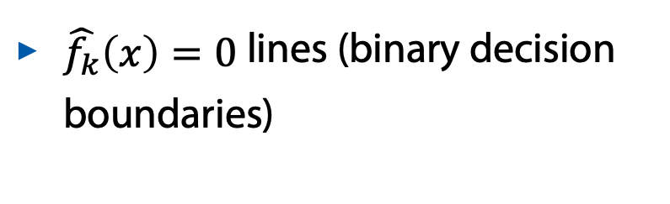
Example
$\hat{f_{k}}\left(x\right)=0$ lines (binary decision boundaries)

Slide 48
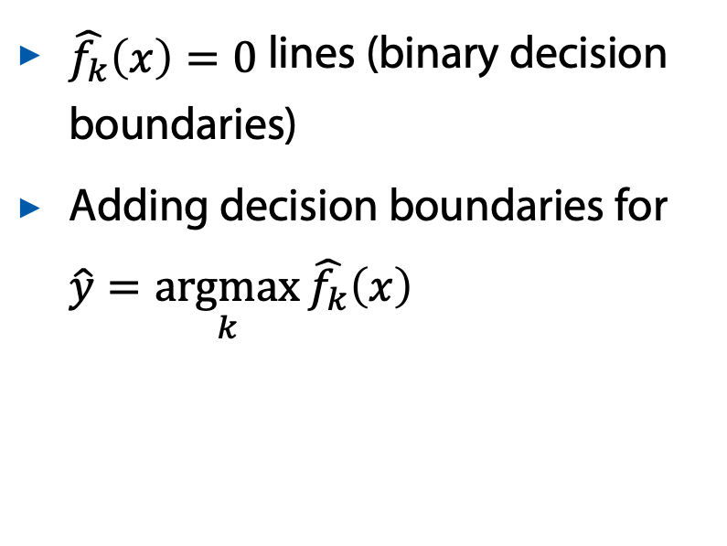
Example
$\hat{f_{k}}\left(x\right)=0$ lines (binary decision boundaries)
Adding decision boundaries for $\hat{y}=\underset{k}{argmax}{\hat{f_{k}}\left(x\right)}$

Slide 49
Example
$\hat{f_{k}}\left(x\right)=0$ lines (binary decision boundaries)
Adding decision boundaries for $\hat{y}=\underset{k}{argmax}{\hat{f_{k}}\left(x\right)}$

Slide 50
Summary
Classification with linear regression and MSE loss may provide biased results
0-1 loss function is better, but is hard to optimize directly
Various differentiable upper bounds on 0-1 loss may be used instead
Logistic Regression combines such an upper bound with a probabilistic model using the sigmoid function
Generalizing sigmoid function to a multiclass case yields softmax function
Any binary linear classifier can be adapted to multiclass with the one-vs-rest strategy
Food for thought: how can you mitigate the biased probability problems when using one-vs-rest strategy (as discussed on the previous slide)?

Slide 51


Thank you!
Majid Sohrabi
msohrabi@hse.ru

