Slide 1
Xad preselection project showcase
How to optimize a simple mathematical problem for maximum performance with SIMD and std::thread

Slide 2
Today I am presenting to you my solution to a problem for a school hackathon
This was my solution project for the xad preselection, which I am very proud of the performance it did achieve

Slide 3
Well what was the problem
Create a Matrix class for representing a M*N matrix that consist of double elements
Create a MatrixView class that represent a rectangular view of a matrix
The MatrixView class can’t store matrix data
Casting a MatrixView to a Matrix must create a matrix
Create a function frobenius_norm that calculate the frobenius norm of a Matrix
Optimize the performance of the solution
well today I will present to you the optimization part

Slide 4
What was the solution for optimization
But there was another bottleneck in the code, copying the data from a MatrixView to a Matrix was very slow
The sulution for this was simple:
The use of memcpy to copy data from MatrixView to Matrix as it uses the full width of the cpu
The use of std::thread to multithread the data copy
For the actual calculation:
The use of FMA and AVX SIMD intrinsics to accelerate the dot product part of the frobenius_norm function.
The use of std::thread to multithread the frobenius_norm function

Slide 5
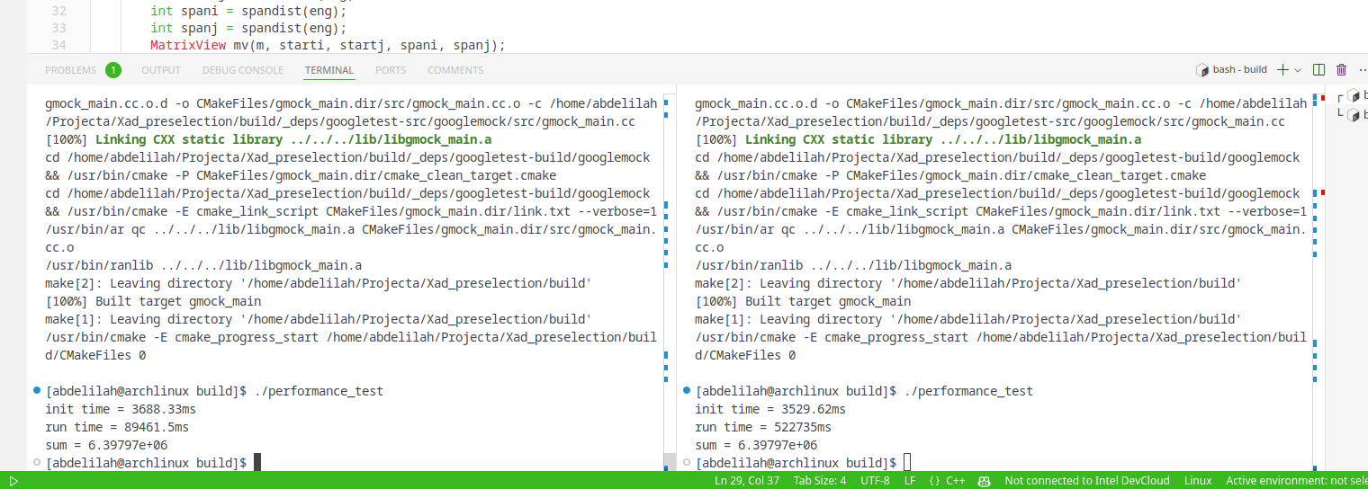
The resulting performance
optimized
89,461 microseconds
Unoptimized
522,735 microseconds
That is 484% more performance

Slide 6
Finally, Thank you for following this showcase.
Links:
Project repo: https://github.com/MajidAbdelilah/Xad_preselection
My github: https://github.com/MajidAbdelilah/

