Slide 1
Design of Engineering Controls
Majid Tooranisama, Taraneh Khaleghi
Professor: Randall Kozak
April 12, 2019

Slide 2
Proposal and Description
An Airplane System Controls and Radar Control
Not a touch screen
Regular size of the computer screen 17”
Camera, Call center, and Map
Environment Control
Air & Pressure & Gas Controls
Direction, Latitude, and Traffic Controls

Slide 3
Ergonomic
Safety
Comfort
Threats to privacy
Legal liabilities
Human lives
Any mistake of eye strain or fatigue decision cause a catastrophic plane crash

Slide 4
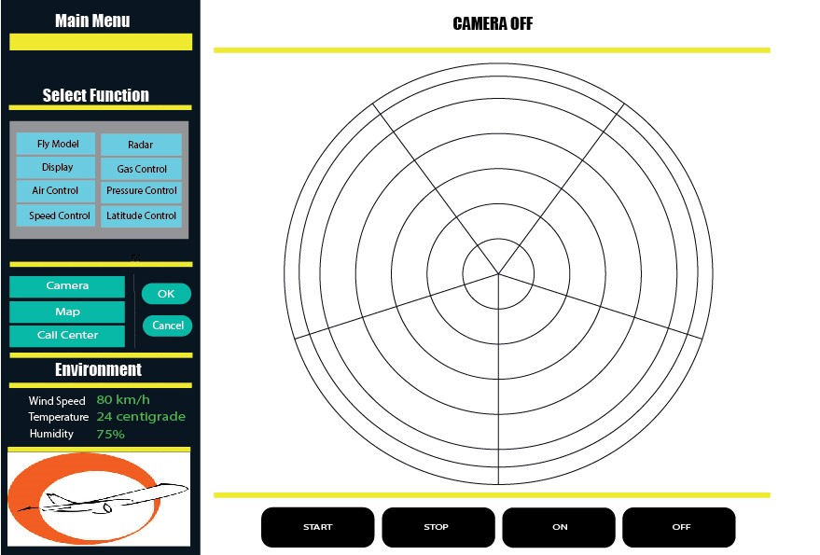
Main Screen

Slide 5
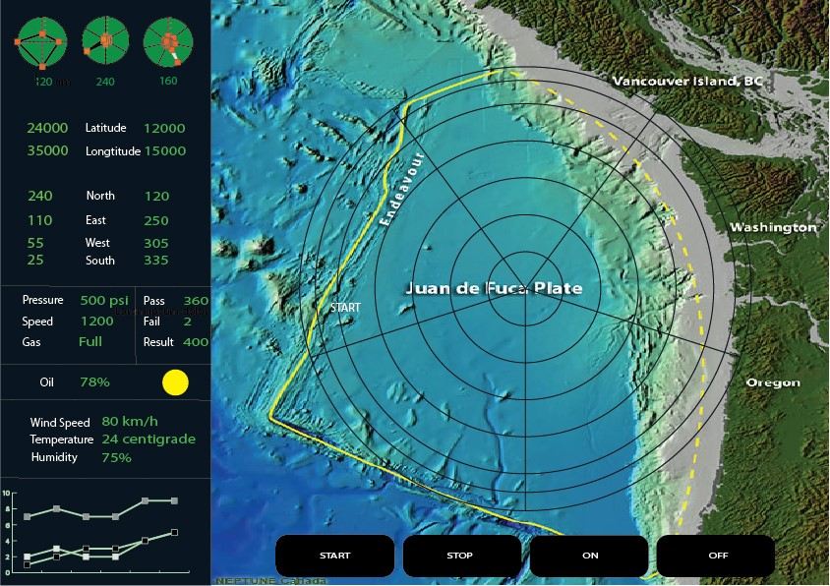
Readouts

Slide 6
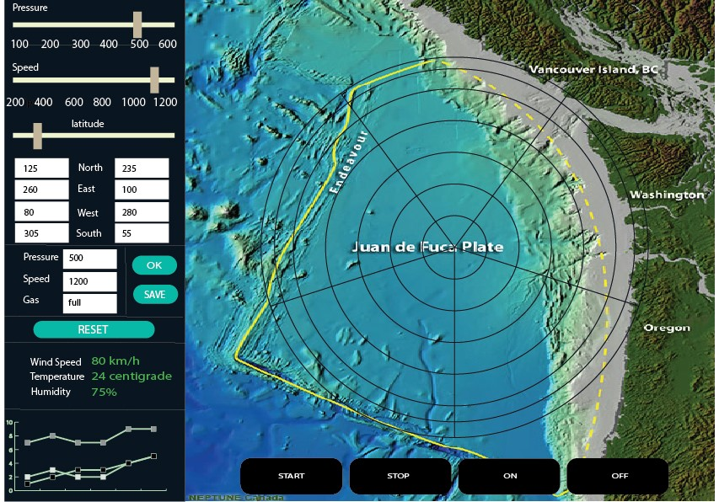
Input Controls

Slide 7
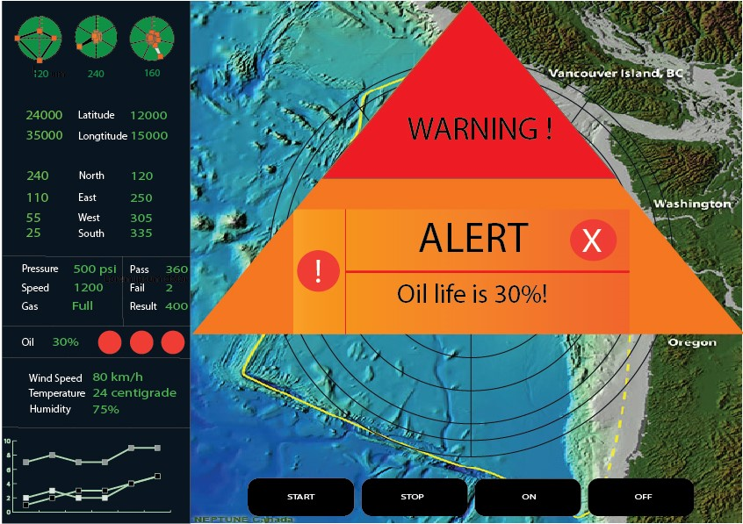
Warning Box Popup

Slide 8
Thank you

