Slide 1
Farm in Your Hand Mobile App
Group names: Majid & Taraneh

Slide 2
Description: We have developed an idea for farmer market online app with a name of “Farm in Your Hand”. This app provides opportunities for farmers in our area to sell their products through online marketing.

Slide 3
Feature List:
Chat
Food category
Delivery options
Schedule the time of preparation the order
Share with friends
Movies
Live camera on farms
Payment option

Slide 4
Business Model
getting a percentage of sales or commission from farmers and food companies, and making money from Ads.

Slide 5
Future goals
Making cheaper Ads available for small local farmers
adding more features according to the needs of customers and farmers
such as movies and live camera for watching the farms online.

Slide 6
Personas
Name | John
Age | 43
Occupation (if applicable) | Factory’s owner (farm products)
Location: | Elmira, Ontario
Interest Level in the App’s Field | Casual, Neophyte, Entertainment, Connoisseur, , Amateur, Professional
Demographics | professional, management, craftsperson, stay-at-home parent, student, income level: 100k-150k annually
Computer Skills | Casual (browser, email, texting, etc.) Expert business software user IT Professional Software professional
Motivations and goals with respect to the field (of the app) | Motivations: sell more Farm’s products to people without intermediaries Goals: To expand business and finding more customers
Frustrations with respect to the field | Cost of indoor delivery
Projected interest in the app | Increasing annual sales

Slide 7
Personas
Name | Steve
Age | 35
Occupation (if applicable) | Farmer
Location: | St.Jacobs, Ontario
Interest Level in the App’s Field | Casual, Neophyte, Entertainment, Professional, Amateur, Connoisseur
Demographics | professional, management, craftsperson, stay-at-home parent, student, income level: 50k-80k annually
Computer Skills | Casual (browser, email, texting etc.) Expert business software user IT Professional Software professional
Motivations and goals with respect to the field (of the app) | Motivations: sell the farmer’s products to people directly Goals: gain more income by selling more farmer’s products
Frustrations with respect to the field | Cost of indoor delivery, working with app included upload the information of products
Projected interest in the app | Introduce the products

Slide 8
Personas
Name | Rose
Age | 48
Occupation (if applicable) | nurse
Location: | Kitchener, Ontario
Interest Level in the App’s Field | Casual, Neophyte, Entertainment, Professional, Amateur, Connoisseur
Demographics | professional, management, craftsperson, stay-at-home parent, student, income level: 60k-80k annually
Computer Skills | Casual (browser, email, texting, etc.) Expert business software user IT Professional Software professional
Motivations and goals with respect to the field (of the app) | Motivations: shopping healthy and organic products with spending less time Goals: To have organic food in daily meal
Frustrations with respect to the field | Finding products through category section or search box
Projected interest in the app | Information section about each product

Slide 9
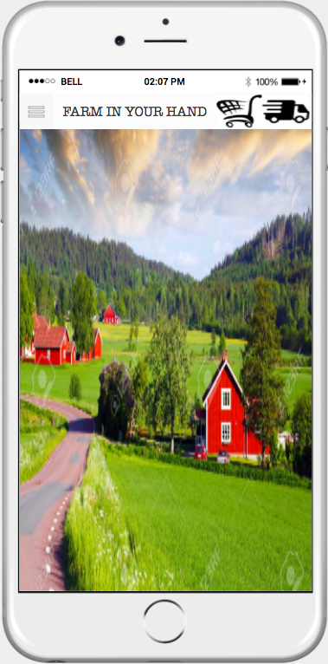
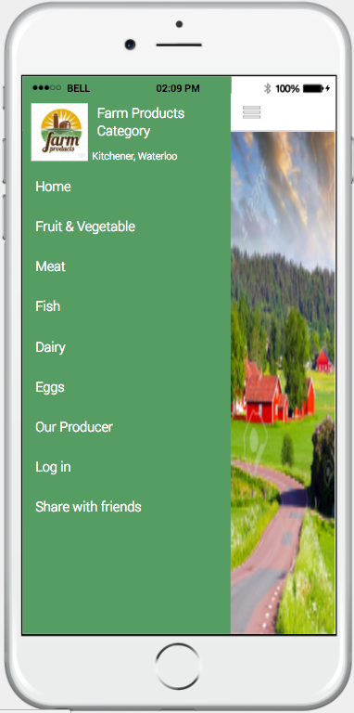
Home Page
Menu

Slide 10
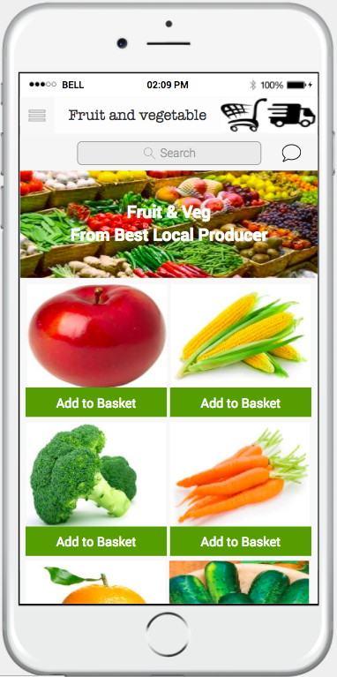
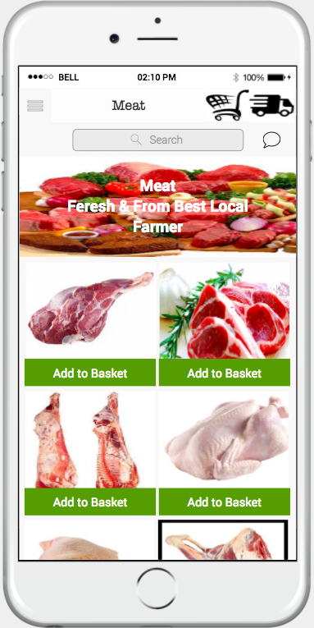
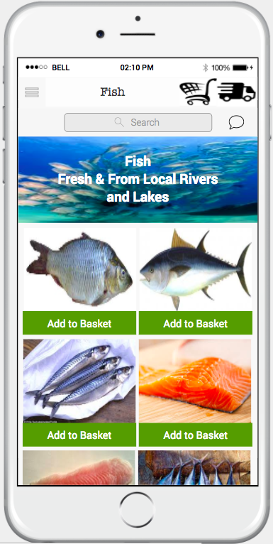
Fruit
Meat
Fish

Slide 11
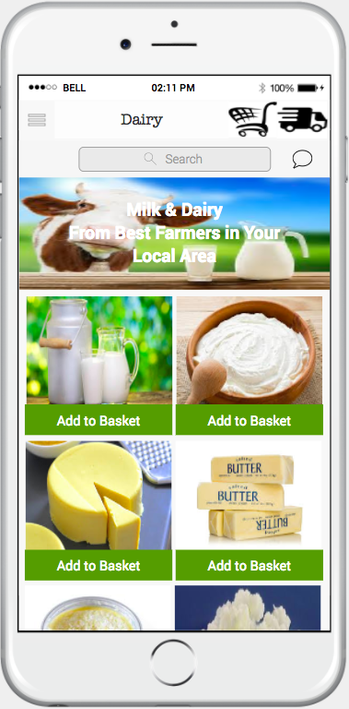
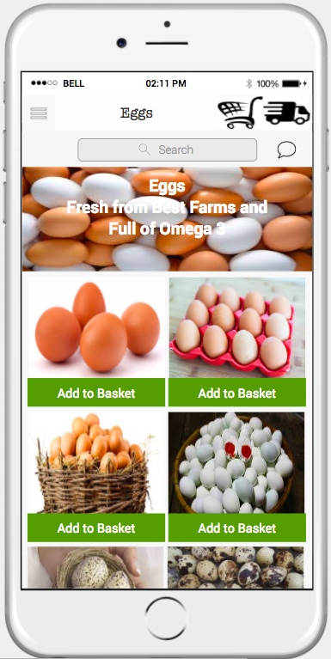
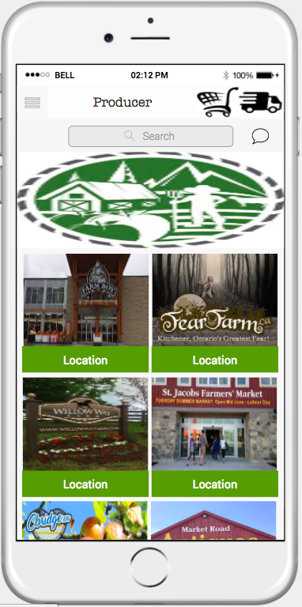
Dairy
Egg
Local Producers

Slide 12
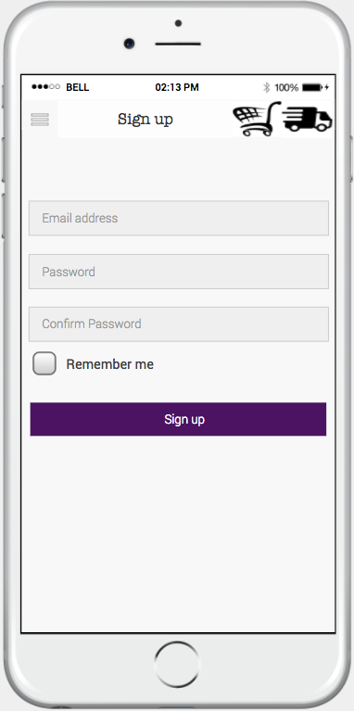
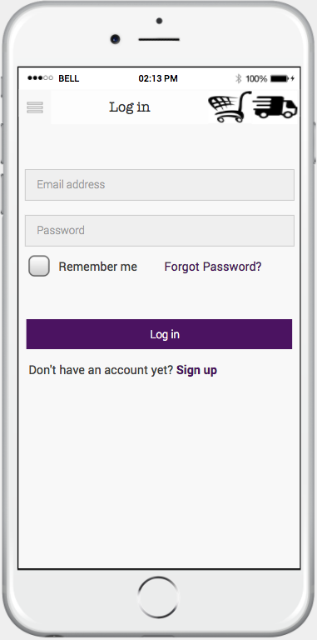
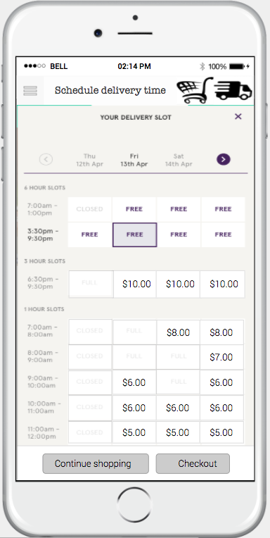
Sign Up
Log in
Schedule Delivery

Slide 13
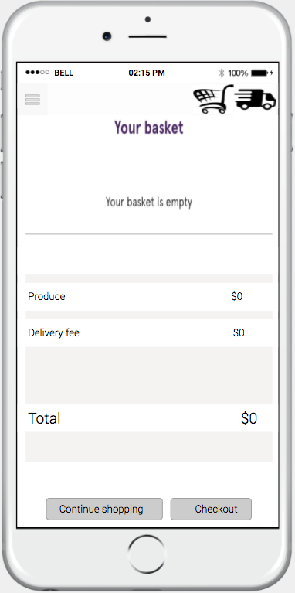
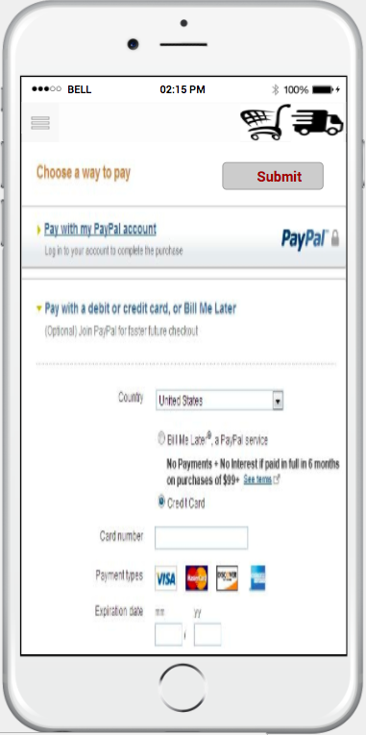
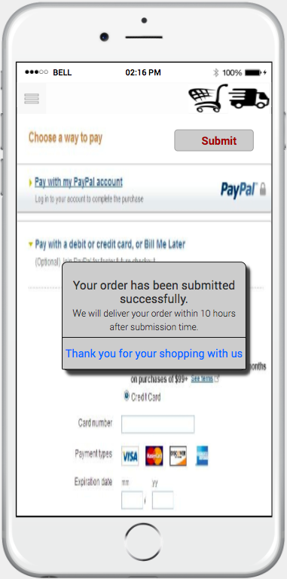
Payment process
Basket

Slide 14
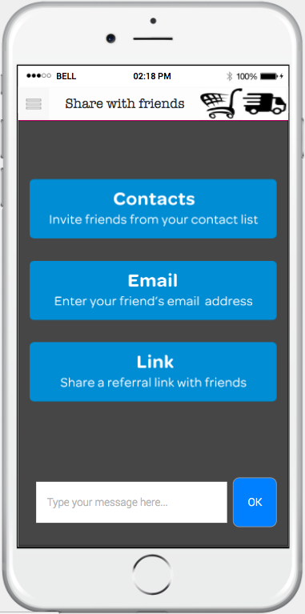
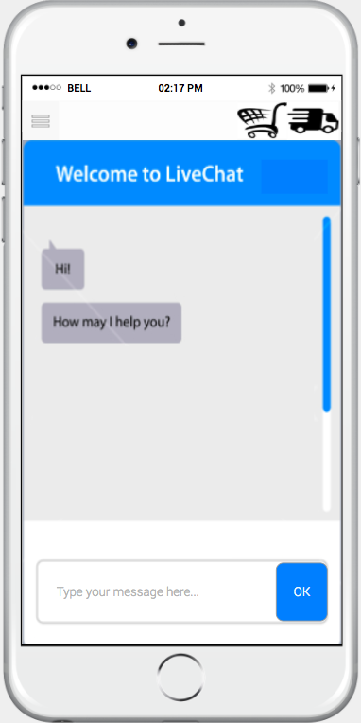
Share with friends
Live chat

Slide 15
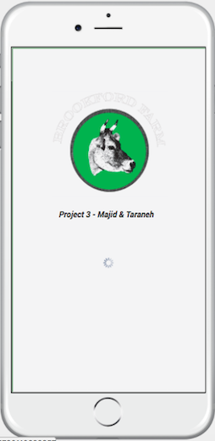
Thank
You

