Slide 1

Sentiment Analysis Using Machine Learning Classifiers
Presented by
Name: Soliha Mohi Ud Din Roll number: 2306708
Under the supervision of
Dr. Vandana & Ms. Suvidha
M.Tech – Computer Science & Engineering

Slide 2
Introduction
The digital age has brought an explosion of online textual content. From product reviews and social media posts to news comments and forum discussions, text data is generated at an astonishing rate every second [1].
This vast amount of user-generated content profoundly influences decisions in various sectors. What people say online can make or break a product, shape political discourse, or define a brand's reputation [2].
The sheer volume makes manual analysis impossible. Organizations and researchers face the challenge of extracting meaningful insights from this deluge of information.
Figure 1. Sentiment evaluation
Consequently, there is a critical need for automated sentiment detection systems that can efficiently process and interpret public opinion for better decision-making in marketing, governance, and customer service [1, 2].

Slide 3














Understanding Sentiment Analysis
NLP Subfield
A core area within Natural Language Processing, focusing on human language
interpretation.
Positive
Identifies expressions of approval, satisfaction, or favorable opinions.
Negative
Detects dissatisfaction, criticism, or unfavorable viewpoints.
Aspect Level
Focuses on sentiment towards specific features
or aspects of an entity.
Neutral
Recognizes objective statements lacking a clear positive or negative sentiment.
Sentence Level
Determines sentiment for individual sentences
within a text.
Document Level
Analyzes the sentiment of an entire text document.
Sentiment analysis is the process of converting unstructured human language into structured, quantifiable insights, allowing us to understand the emotional tone behind text.

Slide 4
Problem Statement
1
2
Sarcasm & Informal Language
Detecting subtle nuances like sarcasm or understanding highly informal language poses significant challenges for automated systems [3].
Mixed Emotions
Sentences often contain both positive and negative elements, making it difficult to assign a single sentiment label accurately.
3
4
Noisy Social Media
Social media data is rife with typos, abbreviations, emojis, and slang, which can hinder accurate analysis.
Unbalanced Classes
Datasets frequently have a disproportionate number of samples for certain sentiment classes (e.g., many more positive than negative), leading to biased models [4].
Our primary goal is to determine which machine learning classifier performs optimally for multi-class sentiment classification, effectively addressing these real-world textual complexities.

Slide 5

Key Objectives for Robust Sentiment Classification
Preprocess Raw Data
Clean and normalize textual data to ensure quality input for models.
Convert Text to Features
Transform linguistic data into numerical representations understandable by machine learning algorithms.
Implement Models
Apply and configure both Naive Bayes and Support Vector Machine classifiers.
Compare Performance
Evaluate models using standard metrics to assess their effectiveness.
Identify Best Model
Determine the most suitable classifier for the given multi-class sentiment task.

Slide 6
Literature Review Summary
S.no. | Author(s) | Year | Title | Summary
1 | H. Yang et al. [2] | 2024 | LLMs Meet Text-Centric Multimodal Sentiment Analysis | Surveys recent advancements in using LLMs.
2 | W. Zhang et al. [1] | 2023 | Evaluating Emotions in the Age of Big Language Models | Evaluates the effectiveness of LLMs like ChatGPT versus traditional models for sentiment analysis across multiple datasets.
3 | Y. Liu et al. [4] | 2023 | Modelling of Sentiment Motivated by Quantum Cognition | Explores quantum-, highlighting theoretical contextual modeling benefits.
4 | S. Rani and P. Kumar [8] | 2022 | Dependent Reading for Aspect-Based sentiment evaluation | Develops a dependency parsing method for languages.
5 | B. A. Januario et al. [9] | 2022 | Sentiment in Brazilian Stock Market News | Analyzes sentiment from financial news related to the Brazilian stock market to support investment decisions.
6 | X. Ouyang et al. [10] | 2015 | CNN for Sentiment Analysis | One of the first studies using machine learning for document-level sentiment classification.

Slide 7
Dataset Insights
The repository uses CSV files with three sentiment classes: positive, negative, and neutral.
Cleaning removes missing rows, normalized duplicates, conflicting-label groups, and train/test text overlap.
Raw rows: 27,481 train and 4,815 test.
Cleaned rows: 27,367 train and 3,529 test.
Test classes: 999 negative, 1,429 neutral, and 1,101 positive texts.
Dataset counts and class distribution come from artifacts/sentiment.json, generated by the current training pipeline.
Figure 2. Dataset Overview
Notes:
Dataset counts and class distribution: artifacts/sentiment.json.

Slide 8






Methodology
Data Collection
Preprocessing
Feature Extraction
Model Training
Testing & Evaluation
A stratified validation split ranks the models. Final models are retrained on all cleaned training texts and evaluated on the cleaned held-out test set.

Slide 9





Data Preprocessing
Unicode and case normalization
Normalizes Unicode, lowercases text, and trims whitespace.
URLs, mentions, and negation
Maps URLs and @mentions to tokens and expands negative contractions.
Duplicate and label checks
Removes empty rows, normalized duplicates, conflicting-label groups, and train/test overlap.
Feature preservation
Stopwords, punctuation, emoji, and negation cues remain available to TF-IDF.
Figure 3. Dataset processing
The final vectorizer uses word and character punctuation tokens with unigram and bigram TF-IDF features.

Slide 10
Feature Extraction
Term Frequency-Inverse Document Frequency
TF-IDF is a widely used numerical statistic that reflects how important a word is to a document in a collection or corpus.
Converts text to vectors: Transforms raw textual data into a numerical format that machine learning algorithms can process.
Weights important words: Assigns higher values to words that are more relevant within a document and less common across the entire dataset.
Reduces common word impact: Minimizes the influence of frequently occurring but semantically less significant words (like "a," "and," "the").
Figure 4. Feature Extraction
Suitable for ML algorithms: Provides a robust numerical representation, making it an ideal choice for various machine learning models [6].
By creating a powerful numerical representation of text, TF-IDF plays a crucial role in enabling classifiers to effectively understand and analyze sentiment.

Slide 11


Machine Learning Models for Sentiment Classification
Naive Bayes
Support Vector Machine (SVM)
Probabilistic Classifier: Based on Bayes' theorem, it calculates the probability of a text belonging to a certain sentiment class.
Finds Optimal Hyperplane: Constructs a hyperplane or set of hyperplanes in a high-dimensional space to separate data points into different classes with the largest margin.
Fast & Simple: Known for its computational efficiency and ease of implementation.
Works Well with High-Dimensional Text: Particularly effective in scenarios with a large number of features, as is common in text data [7].
Assumes Word Independence: A simplifying assumption that features (words) are independent of each other given the class, which often works well in practice for text classification.
Better Generalization: Often provides superior generalization performance, meaning it performs well on unseen data.
Both models use the same TF-IDF features and cleaned training texts. Linear SVM ranks first on validation macro-F1.

Slide 12
Evaluation Metrics
1
2
3
Accuracy
Measures the overall correctness of the model's predictions across all classes.
Precision
Indicates the proportion of true positive predictions among all positive predictions.
Recall
Represents the proportion of true positive predictions among all actual positive instances.
4
5
F1-Score
The harmonic mean of precision and recall, providing a balanced measure of performance.
Confusion Matrix
A table visualizing the performance of an algorithm, showing correct and incorrect classifications.
The report uses accuracy, precision, recall, macro-F1, and confusion matrices on the same cleaned test set. Test labels do not select the model or tie-breaking order.

Slide 13
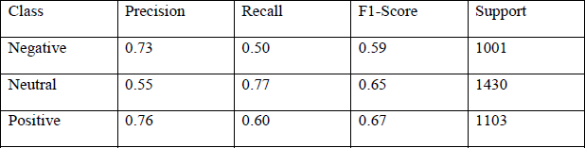
Naive Bayes
Overall accuracy: 67.07%
Macro-F1: 0.670
Multinomial Naive Bayes provides a fast baseline. Its negative precision is higher than SVM's, but its negative recall is lower.
Class | Precision | Recall | F1-score | Support
Negative | 0.75 | 0.56 | 0.64 | 999
Neutral | 0.59 | 0.77 | 0.67 | 1,429
Positive | 0.78 | 0.64 | 0.70 | 1,101
Key observation:
Naive Bayes reaches 67.07% accuracy on the shared 3,529-text test set. It identifies fewer negative texts than SVM, with 55.9% negative recall.
Notes:
Results: artifacts/sentiment.json. Metrics use 3,529 cleaned test texts.

Slide 14
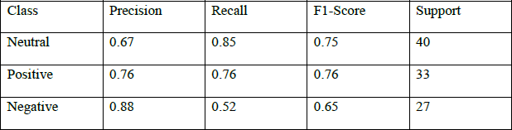
SVM
Overall accuracy: 68.35%
Macro-F1: 0.687
Linear SVM gives the stronger overall result on the shared test set and improves negative recall.
Class | Precision | Recall | F1-score | Support
Negative | 0.67 | 0.67 | 0.67 | 999
Neutral | 0.65 | 0.65 | 0.65 | 1,429
Positive | 0.75 | 0.74 | 0.75 | 1,101
Key observation:
SVM reaches 68.35% accuracy and 0.687 macro-F1. Negative recall rises to 66.8%, while negative precision is 66.7%.
Notes:
Results: artifacts/sentiment.json. Metrics use 3,529 cleaned test texts.

Slide 15
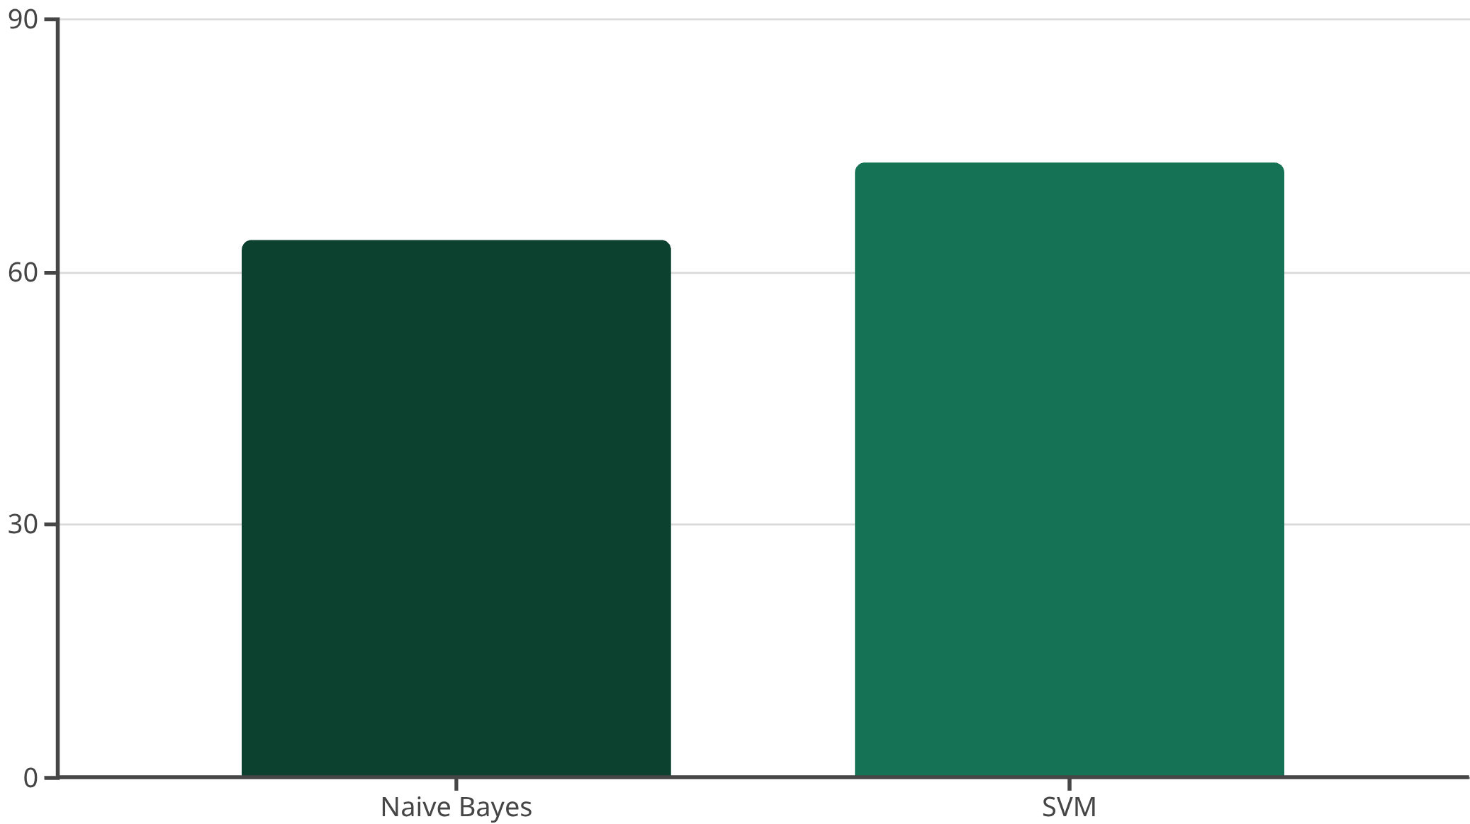
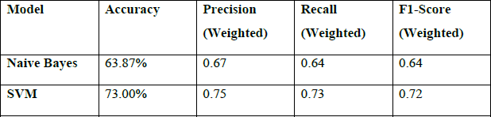
SVM Leads on the Shared Test Set
KEY FINDING
Table 3. Performance Summary
Model | Accuracy | Macro-F1 | Negative recall
Naive Bayes | 67.07% | 0.670 | 55.9%
Linear SVM | 68.35% | 0.687 | 66.8%
On the same 3,529 held-out texts, Linear SVM scores 68.35% accuracy and 0.687 macro-F1 versus 67.07% and 0.670 for Multinomial Naive Bayes. SVM ranks first on validation macro-F1 and decides split votes.
Notes:
Results and voting rule: artifacts/sentiment.json and sentiment.py.

Slide 16
Data and Model Behavior
Test-set distribution
The cleaned test set contains 1,429 neutral, 1,101 positive, and 999 negative texts.
Model comparison
SVM improves accuracy from 67.07% to 68.35% and macro-F1 from 0.670 to 0.687.
App voting
Agreement selects the shared label. A 1–1 split follows validation ranking; SVM ranks first.
App scope: model predictions, held-out metrics, and two-model voting.

Slide 17



Conclusion
Current result
Linear SVM leads on this shared test set with 68.35% accuracy and 0.687 macro-F1. The difference over Naive Bayes is modest, so both models remain useful for comparison.
System Applications:
Customer Feedback Analysis: Understand customer sentiment from reviews and comments to improve products and services.
Brand Monitoring: Track public perception of brands and campaigns across social media and news outlets.
TF-IDF
The same TF-IDF representation gives both classifiers a consistent feature space while preserving useful word and punctuation cues.
Social Analytics: Gain insights into public opinion, emerging trends, and overall sentiment from large social datasets.
Naive Bayes: Fast but Limited
Naive Bayes
Naive Bayes offers a fast baseline at 67.07% accuracy. The app keeps it alongside SVM and uses SVM to resolve split votes because SVM ranks higher on validation data.
Notes:
Conclusion follows the current repository evaluation report, artifacts/sentiment.json.

Slide 18




Future Scope
Deep Learning Integration
Explore advanced architectures like BERT and LSTM to capture more complex linguistic features and contextual nuances for improved accuracy.
Sarcasm Detection
Develop specialized modules for identifying sarcasm and irony, a major challenge in sentiment analysis, to enhance model intelligence.
Multilingual Sentiment
Expand model capabilities to analyze sentiment in multiple languages, opening doors to broader global applications and insights.
Real-time Deployment
Implement the sentiment analysis system for real-time data streams, enabling immediate insights and responsive actions for dynamic environments.

Slide 19
References
[1] W. Zhang et al., “Sentiment Analysis in the Era of Large Language Models: A Reality Check,” arXiv:2305.15005, 2023.
[2] H. Yang et al., “Large Language Models Meet Text-Centric Multimodal Sentiment Analysis: A Survey,” arXiv:2406.08068, 2024.
[3] P. N. Venkit et al., “The Sentiment Problem: A Critical Survey towards Deconstructing Sentiment Analysis,” arXiv:2310.12318, 2023.
[4] Y. Liu et al., “A Survey of Quantum-Cognitively Inspired Sentiment Analysis Models,” arXiv:2306.03608, 2023.
[5] B. Pang, L. Lee, and S. Vaithyanathan, “Thumbs up? Sentiment Classification using Machine Learning Techniques,” EMNLP, 79–86, 2002.
[6] S. Wang and C. Manning, “Baselines and Bigrams: Simple, Good Sentiment and Topic Classification,” ACL, 90–94, 2012.
[7] scikit-learn API documentation: TfidfVectorizer, MultinomialNB, and LinearSVC. scikit-learn.org/stable/api/sklearn.html
[8] Current project evaluation report: artifacts/sentiment.json, generated from the repository training pipeline.

Slide 20
Thank You
Questions?

