Slide 1
Employee Data Analysis using Excel
STUDENT NAME: MAJITHA PARVEEN N
REGISTER NO: 2213331042036 (82805F32C148136BCBD4B1A9F29C7E0A)
DEPARTMENT: B.COM
COLLEGE: BHARATHI WOMEN’S COLLEGE

Slide 2
PROJECT TITLE
Employee Performance Analysis Using Excel

Slide 3


AGENDA
Problem Statement
Project Overview
End Users
Our Solution and Proposition
Dataset Description
Modelling Approach
Results and Discussion
Conclusion
3/21/2024 Annual Review

Slide 4

PROBLEM STATEMENT
To Find out employee performance to conduct a meeting for their personal growth and identifying employees who need to be motivated to achieve inclusive growth.

Slide 5

PROJECT OVERVIEW
Project is all about defining how to identify employee performance level by scaling with different category like High, Med and Low to fill the gap and have inclusive growth of all employees.
In addition, added few slicers to drill through data by analyzing through gender , business unit, etc.

Slide 6
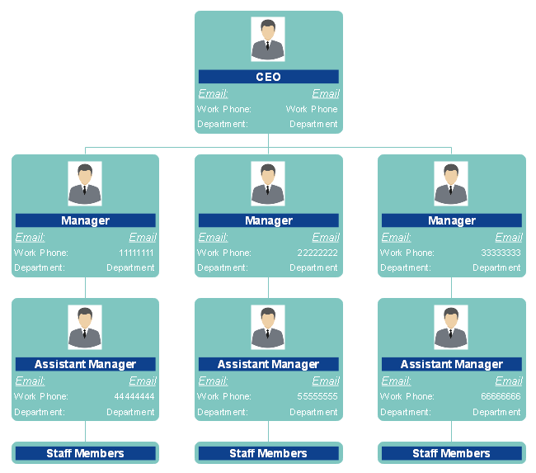

WHO ARE THE END USERS?
End user of this project is employees across business unit of organization.

Slide 7

OUR SOLUTION AND ITS VALUE PROPOSITION
Conditional Formatting – To mark blank items from list
Filter – Delete blank items
IFS – To identify Performance Level
Pivot Table - To Summarize Performance level through business unit
Graphs – To Visualize employee summary
Slicers – To filter visualization upon the selection.

Slide 8
Dataset Description
Employee Dataset = Downloaded from Kaggle
Total Items – 26
Used Items – 10

Slide 9
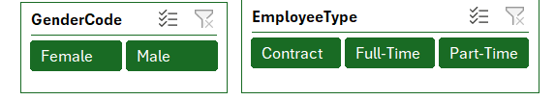

THE "WOW" IN OUR SOLUTION
IFS – To identify Performance Level
(=IFS(Z3>=5,"Very High",Z3>=4,"High",Z3>=3,"MED",TRUE,"Low")
Slicers – To filter visualization upon the selection.
Trendlines – To scale the performance
New Design enabled on Pivots
3/21/2024 Annual Review
9

Slide 10
MODELLING
Data Collection:
Login with Naan Mudalvan
Selected Menu and Downloaded Employee Dataset
Saved in Desktop to work.
Feature collection:
Open the Dataset
Made Source Copy
Selecting required items
Data Cleaning:
Using conditional Formatting
Filtered and deleted unwanted blanks items
Performance Level:
Added “Performance Level “ column
Put IFS logical function to get desired result by Current employee rating
Checked Formula and Created Pivot
Added data in Pivot and populated graphical visualization
Added trendline to show “MED” and “LOW” performance level to improvisation.
Inserted Slicers to filtered by Gender code and Business unit to see employee count.
10

Slide 11
RESULTS
By All
By Business Unit
11

Slide 12
Conclusion
Here I conclude the project with below results and actions:
First, Overall Female employees did Low and MED performance in employee data so organization can take step to motivate them.
Very High Performance performed by SVG Unit ( 16) and High Performed by PL (29).
Low Performance did in CCDR (47) , Improvement needed this unit for inclusive growth of organization.

