Slide 1
INTRODUCTION TO .NET

Slide 2
TOPICS
History
What is .NET Framework
Components of .NET Framework
Difference Between VB. NET and Visual Basic
Characteristics of .NET Framework

Slide 3

History
late 1990
The .NET Framework is a software development platform that was introduced by Microsoft in the late 1990 under the NGWS.
13 Feb. 2002
On 13 February 2002, Microsoft launched the first version of the .NET Framework, referred to as the .NET Framework 1.0.

Slide 4
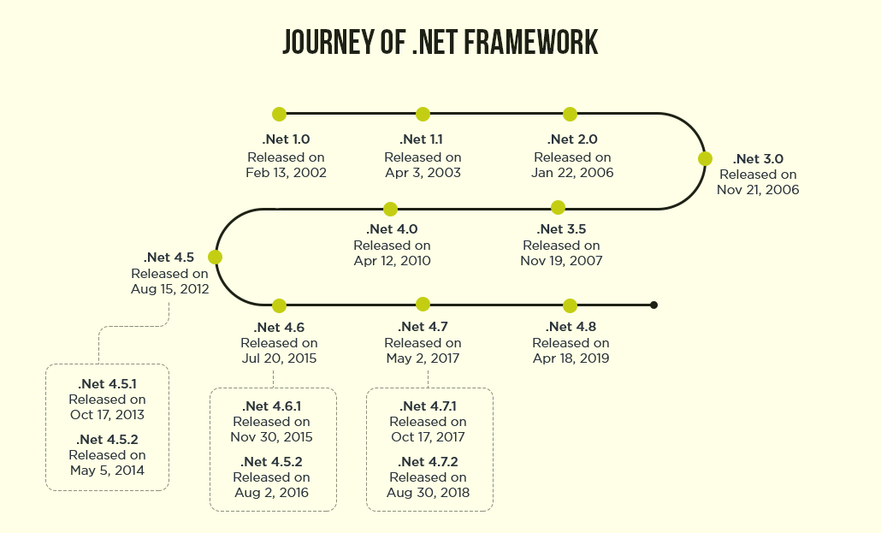

Slide 5
What is .NET Framework
It is a virtual machine that provide a common platform to run an application that was built using the different language such as C#, VB.NET, Visual Basic, etc. It is also used to create a form based, console-based, mobile and web-based application or services that are available in Microsoft environment.
Furthermore, the .NET frameworks a pure object oriented, that similar to the Java language. But it is not a platform independent as the Java. So, its application runs only to the windows platform.
The main objective of this framework is to develop an application that can run on the windows platform.
The current version of the .Net framework is 4.8.

Slide 6
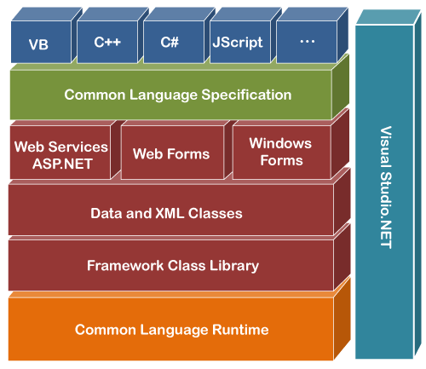
Components of .NET Framework
There are following components of .NET Framework:
CLR (Common Language Runtime)
CTS (Common Type System)
BCL (Base Class Library)
CLS (Common Language Specification)
FCL (Framework Class Library)
.NET Assemblies
XML Web Services
Window Services

Slide 7
CLR (common language runtime)
It is an important part of a .NET framework that works like a virtual component of the .NET Framework to executes the different languages program like c#
Visual Basic, etc. A CLR also helps to convert a source code into the byte code, and this byte code is known as CIL (Common Intermediate Language) or MSIL (Microsoft Intermediate Language). After converting into a byte code, a CLR uses a JIT compiler at run time that helps to convert a CIL or MSIL code into the machine or native code.

Slide 8
CTS (Common Type System)
It specifies a standard that represent what type of data and value can be defined and managed in computer memory at runtime. A CTS ensures that programming data defined in various languages should beinteract with each other to share information. For example, in C# we define data type as int, while in VB.NET we define integer as a data type.

Slide 9
BCL (Base Class Library)
The base class library has a rich collection of libraries features and functions that help to implement many programming languages in the .NET Framework, such as C #, F #, Visual C ++ and more. Furthermore, BCL divides into two parts:
User defined class library
Assemblies - It is the collection of small parts of deployment an application's part. It contains either the DLL (Dynamic Link Library) or exe (Executable) file.
Predefined class library
Namespace - It is the collection of predefined class and method that present in .Net. In other languages such as, C we used header files, in java we used package similarly we used "using system" in .NET, where using is a keyword and system is a namespace.

Slide 10
Microsoft .NET Assemblies
A .NET assembly is the main building block of the .NET Framework. It is a small unit of code that contains a logical compiled code in the Common Language infrastructure (CLI), which is used for deployment, security and versioning. It defines in two parts (process) DLL and library (exe) assemblies. When the .NET program is compiled, it generates a metadata with Microsoft Intermediate Language, which is stored in a file called Assembly.

Slide 11
FCL (Framework Class Library)
It provides the various system functionality in the .NET Framework, that includes classes, interfaces and data types, etc. to create multiple functions and different types of application such as desktop, web, mobile application, etc. In other words, it can be defined as, it provides a base on which various applications, controls and components are built in .NET Framework.

Slide 12
Characteristics of .NET Framework
CLR (Common Language Runtime)
Namespace - Predefined class and function
Metadata and Assemblies
Application domains
It helps to configure and deploy the .net application
It provides form and web-based services
NET and ASP.NET AJAX
Security and Portability
Interoperability
It provides multiple environments for developing an application

Slide 13
THANKYOU

