Slide 1
Spectral Separability of Forest Types
Across European Biomes
Airborne Hyperspectral Classification with Leave-One-Site-Out Cross-Validation
Manan Aggarwal | Multi-disciplinary Hyperspectral Project | June 2026
58
4
40
5
LOSO-CV
Forest stands
European sites
Spectral bands
Classifiers
Spatial blocking

Slide 2
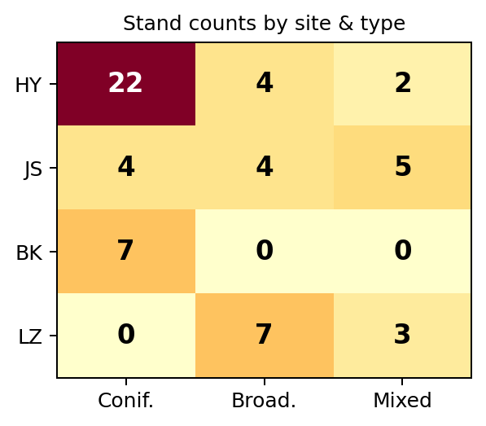
The Problem & Dataset
2
FREEDLES multi-site airborne hyperspectral survey
Research Questions
• Can CASI-1500 (382–1052 nm) tell coniferous from broadleaved forest?
• Does it work across biomes — not just within a single site?
• Does ALS structural data improve classification?
• Do findings transfer to field spectroradiometer (350–2500 nm)?
Site
Country
Biome
n
Species
Hyytiälä (HY)
Finland
Boreal
28
Pine, Spruce, Birch
Järvselja (JS)
Estonia
Hemiboreal
13
Pine, Spruce, Birch, Alder
Bílý Kríž (BK)
Czech R.
Temperate montane
7
Norway Spruce (plantation)
Lanzhot (LZ)
Czech R.
Temperate floodpl.
10
Oak, Ash, Hornbeam
Evaluation: Leave-One-Site-Out (LOSO) cross-validation Train on 3 sites → test on the 4th (strict spatial blocking) Primary metric: Balanced Accuracy (handles class imbalance)
57% coniferous | 26% broadleaved | 17% mixed

Slide 3
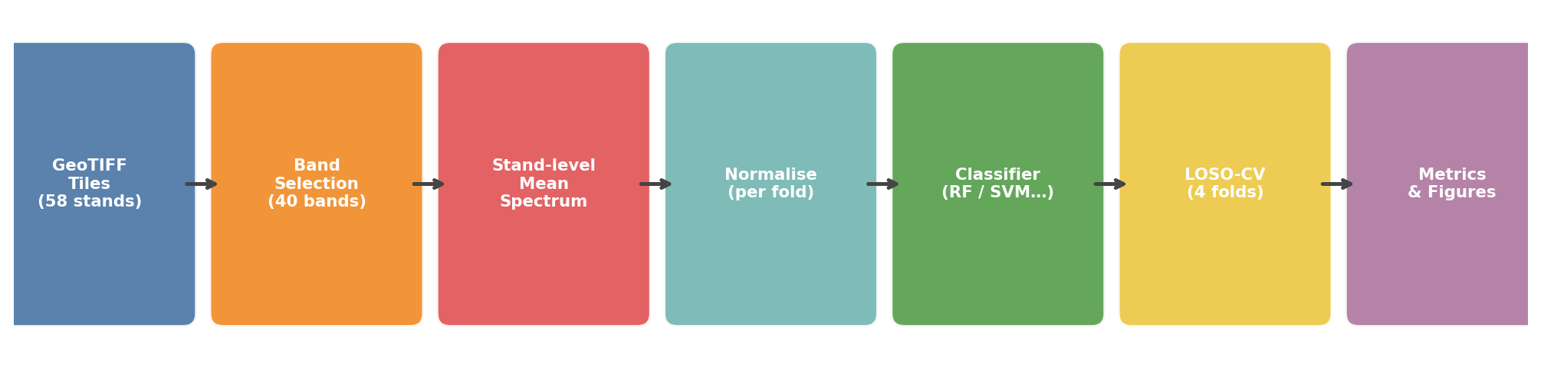
Classification Pipeline
3
From raw GeoTIFF tiles to evaluated metrics
Feature Extraction
• Stand-level MEAN reflectance per tile
• All valid pixels averaged band-wise
• Avoids overfitting (n=58 small sample)
Band Selection
• 48 CASI bands → 40 valid
• Remove 8 water-vapour bands
• (895-1003, 1092-1168, 1302-1528, 1737-2038 nm)
Normalisation
• z-score fit on TRAINING fold only
• Applied to test fold → no data leakage
• Refit fresh in each of 4 LOSO folds
Critical data fixes discovered during development
nodata=10000 (not 0) • scale factor /10000 • wavelengths from ENVI headers • ALS veg code=4 at BK/LZ

Slide 4
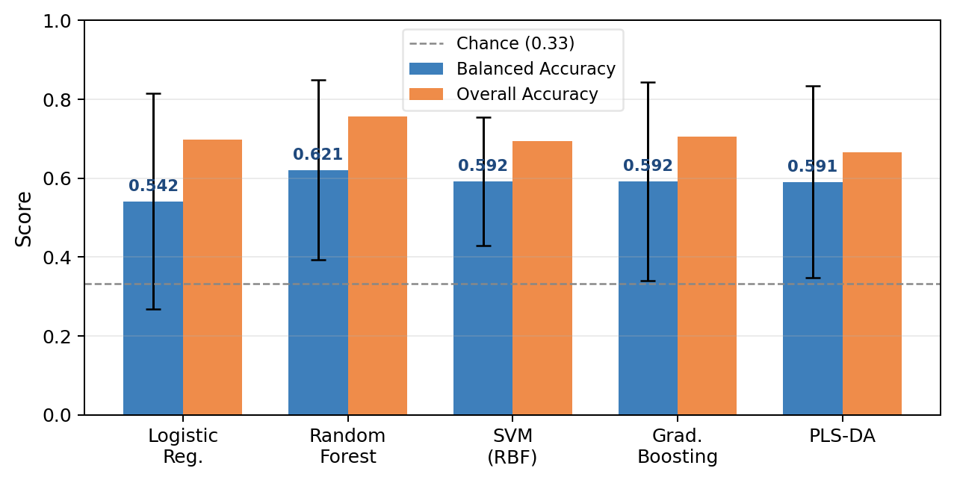
Classifier Comparison — 3-class LOSO-CV
4
58 stands, 4 folds, 3 forest types (coniferous / broadleaved / mixed)
Model
BA
OA
F1
Logistic Reg.
0.542
0.698
0.470
Random Forest
0.621
0.756
0.576
SVM (RBF)
0.592
0.694
0.438
Grad. Boosting
0.592
0.706
0.555
PLS-DA
0.591
—
—
★ Random Forest wins on BA and Macro-F1
• Broadleaved recall ≈ 0.94 → clear spectral signature
• Mixed recall ≈ 0.00 → completely undetected
• Site shortcut ratio 1.14× → model uses biology, not site offsets

Slide 5
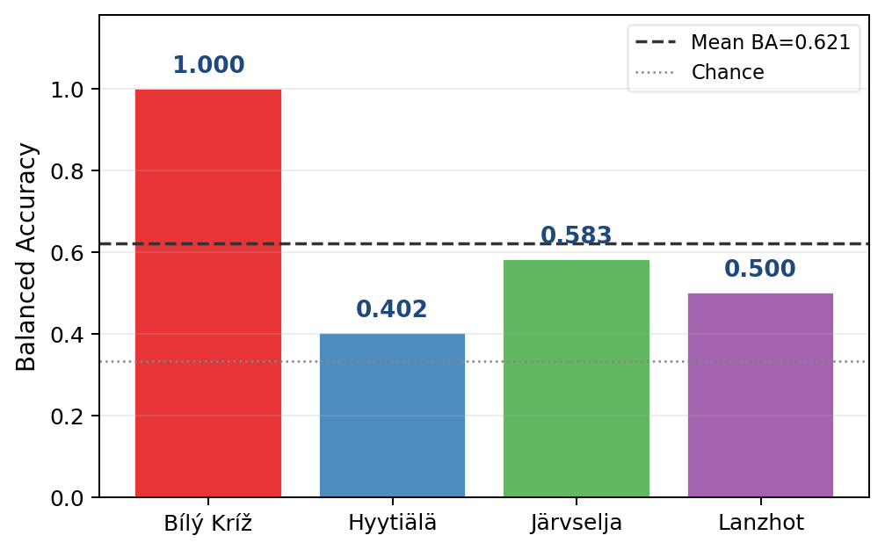
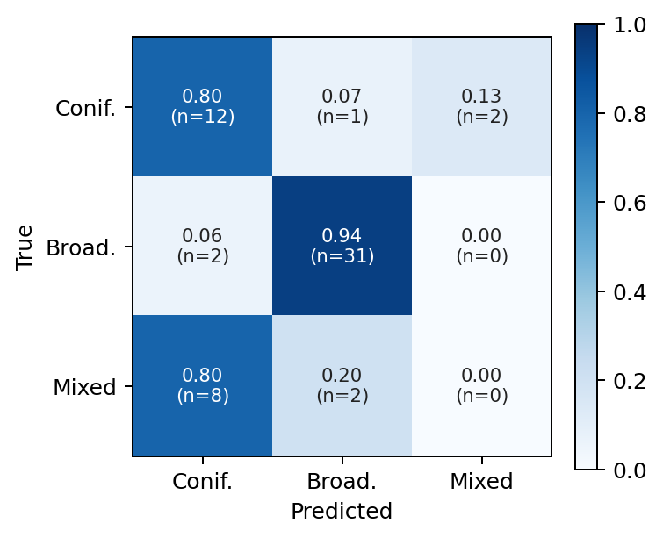
Per-Site Performance & Error Analysis
5
Where does the model succeed — and where does it fail?
Bílý Kríž BA=1.0 → trivial (100% coniferous test set). Remove it: mean BA over HY+JS+LZ = 0.495
Mixed class = 0/10 correct. All misclassified as CONIFEROUS. Stand-level mean spectra can't resolve spatial mixtures → needs crown-level analysis.
Hyytiälä (BA=0.402) is the hardest fold — all 3 classes present, 28 stands

Slide 6
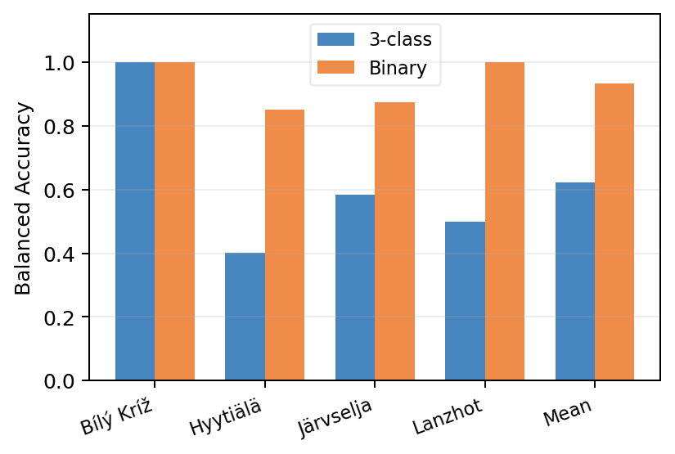
Key Finding: Binary Classification
6
Drop the mixed class — conifer vs. broadleaf is biome-stable
0.621
→
0.932
3-class BA
Binary BA
+31.1 percentage points
Per-fold gain from going binary
• Hyytiälä: 0.402 → 0.852 (+45 pp)
• Järvselja: 0.583 → 0.875 (+29 pp)
• Lanzhot: 0.500 → 1.000 (+50 pp)
• Bílý Kríž: 1.000 → 1.000 (±0 pp)
Interpretation: The biome-generalisation problem is SOLVED for conifer vs. broadleaf. The residual 3-class error is entirely the mixed label — not sensor limitations.

Slide 7
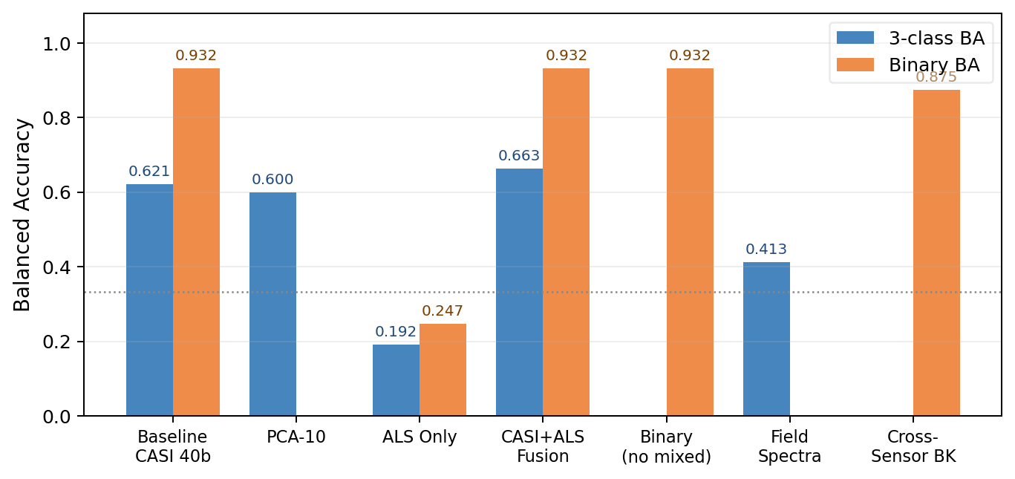
Ablation Study — What Helps and What Doesn't
7
Systematic isolation of each design decision
Ablation
3-cls BA
Δ
Interpretation
PCA-10
0.600
−0.021
PCA discards biologically relevant low-variance bands
ALS only
0.192
−0.429
Height/cover not diagnostic across biomes
CASI+ALS
0.663
+0.042
Modest 3-class gain; zero binary gain
Binary
0.932
+0.311
Largest gain — mixed class was the bottleneck
Field spectra
0.413
−0.208
BK fold collapses (training imbalance)
Cross-sensor
0.875
+—
7/8 BK stands correct via spectral resampling

Slide 8
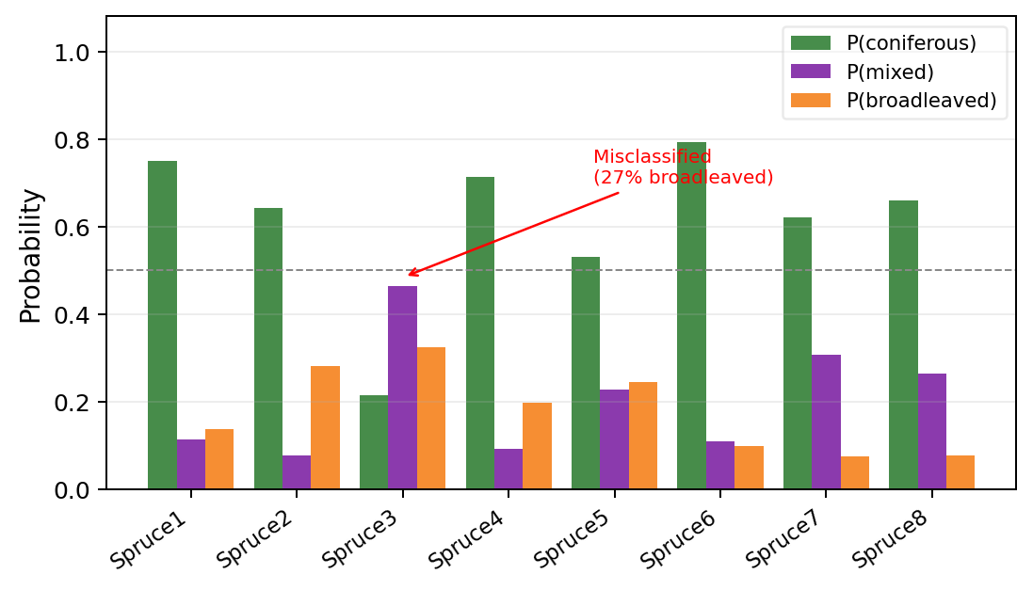
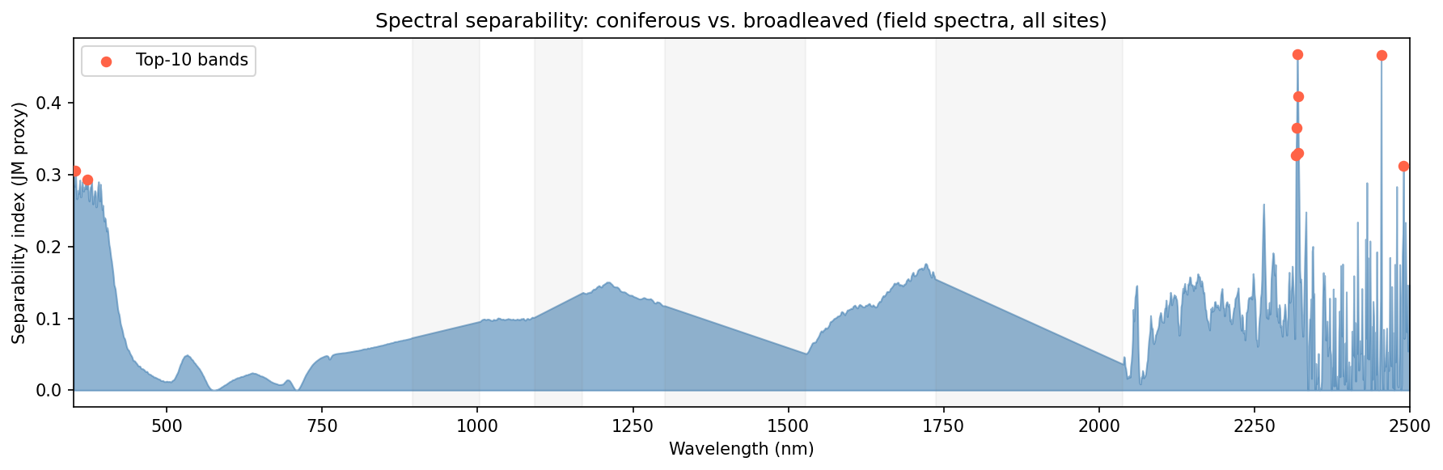
BilyKriz Field Spectra & Cross-Sensor Transfer
8
350–2500 nm spectroradiometer + CASI model applied to field data
Key findings — Field Spectroscopy
• Field LOSO-CV (31 stands, 3 sites): BA = 0.413
• BK fold collapses: 19 broadleaved vs 4 coniferous in training
• Top separable region: SWIR-2 (2317–2490 nm) — cellulose/lignin
• SWIR not in CASI range yet CASI binary BA = 0.932 → VIS-NIR sufficient
• Cross-sensor BK: 7/8 correct (BA = 0.875), misclassified Spruce3 has 27% broadleaved

Slide 9
Iteration Log — What We Fixed Along the Way
9
8 non-trivial bugs discovered and resolved during pipeline development
nodata = 10000, not 0
ALS veg code = 4 (not 1)
Pixel mask let 10000 DN through; post-scale = 1.0 reflectance corruption
BK/LZ used cls=4 for medium veg; cls==1 filter gave zero points
Reflectance scale /10000
Single-class fold crash
Raw DN range 0–2350; forgot to divide by 10000 — band importance was raw DN
BK fold = only coniferous; sklearn classification_report raised ValueError
Wavelengths from ENVI headers
SVM multi-class solver
GeoTIFFs have no spectral metadata; water-vapour exclusion silently skipped
liblinear incompatible with balanced multi-class; switched to lbfgs
Stand ID suffix stripping
f-string backslash Python 3.12
HY_PINE1_CASI.tif → stand_id=HY_PINE1_CASI; no metadata match
f'{f["ba"]}' is SyntaxError in 3.12; pre-computed variable needed

Slide 10
Conclusions & Next Steps
10
Conclusions
What's Next
✓
Binary conifer/broadleaf: BA = 0.932 Biome generalisation is SOLVED
1. Crown-level / patch-level features for mixed class
2. Species-level within coniferous type (Pine vs. Spruce)
△
3-class problem: BA = 0.621 Mixed class is entirely undetected
3. Multi-date imagery — phenological separability
4. Probability calibration for operational deployment
⊕
ALS gives +4.1 pp for 3-class Zero benefit for binary
Key Numbers at a Glance
0.621
0.932
0.663
★
SWIR-2 most separable (field data) But VIS-NIR already sufficient
3-class Balanced Acc.
Binary Balanced Acc.
CASI + ALS fusion
0.875
2317nm
7/8
↔
Cross-sensor transfer: 7/8 BK BA = 0.875 via spectral resampling
Cross-sensor BK
Most separable band
BK stands correct

