Slide 1

aecHive
Dublin 8-10 Nov 2019

Slide 2

Concept Overview

Slide 3
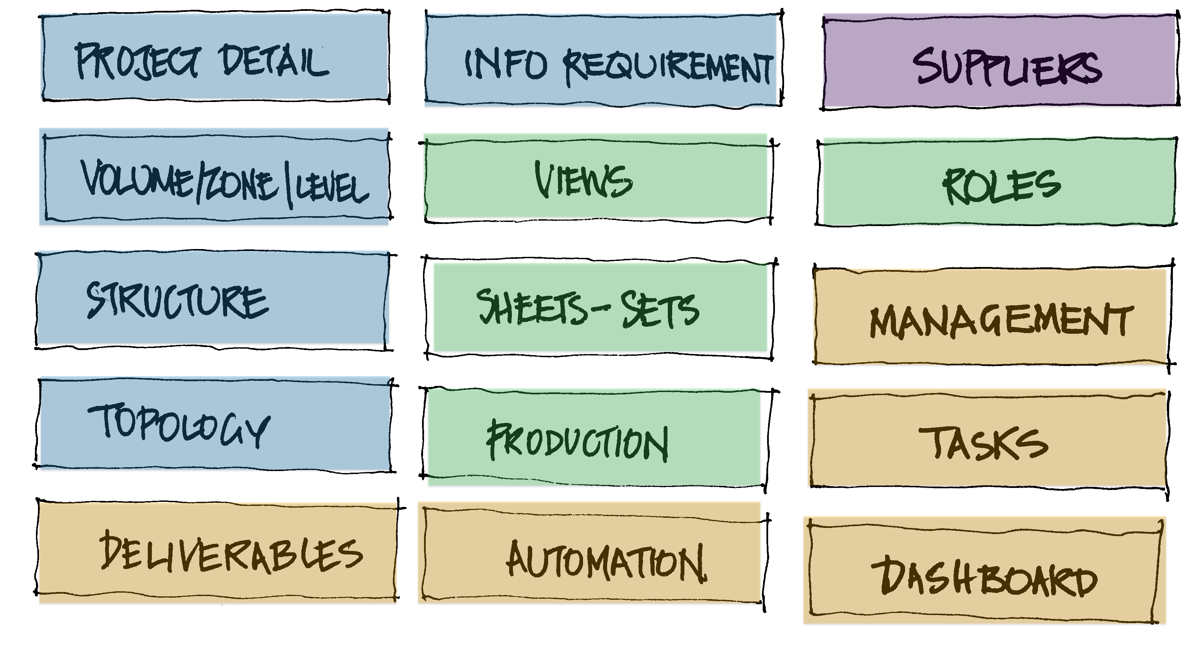
Introduction.
Should we have only one application that does everything?
How important is the Budget on Software& Hardware, on the implementation of BIM?
How much impact has technology on performance? Some Measures!
What do we do about Change Management?
Change Management?
BIM is democratic, follow me and we’ll be ok! LOL

Slide 4
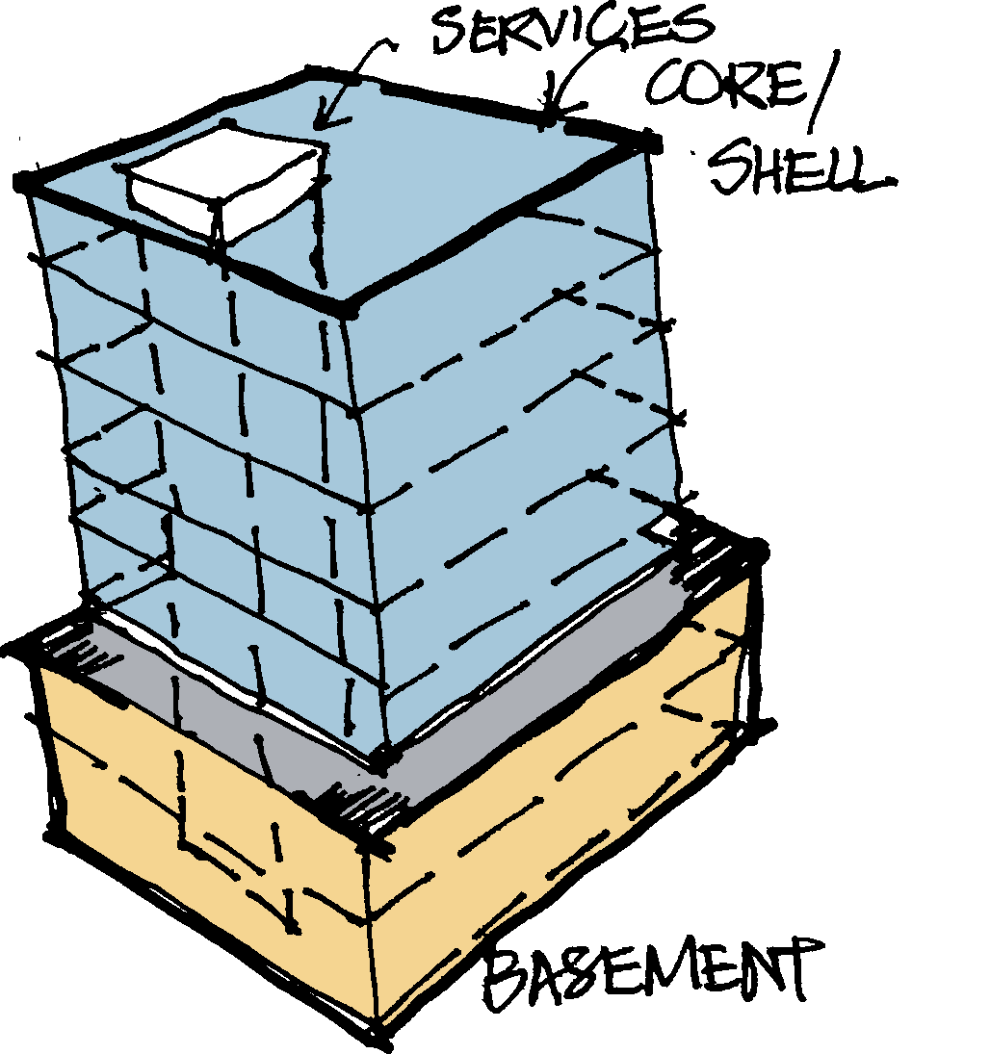
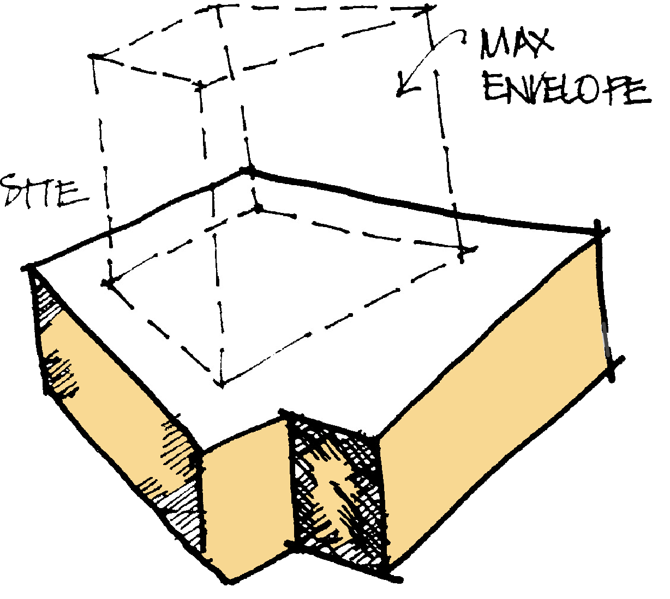
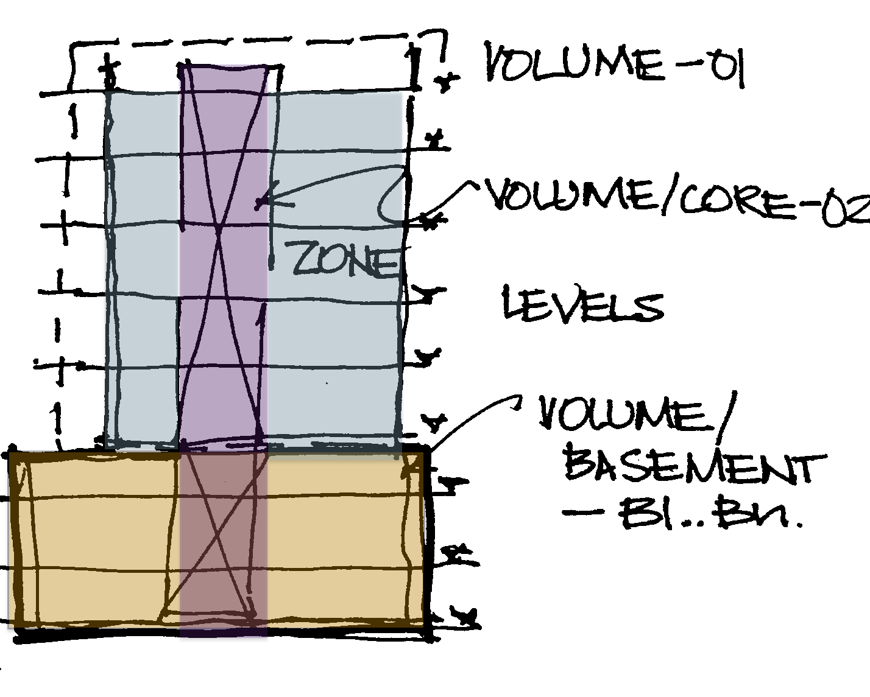
Step 1 – 3D Form + Levels

Slide 5


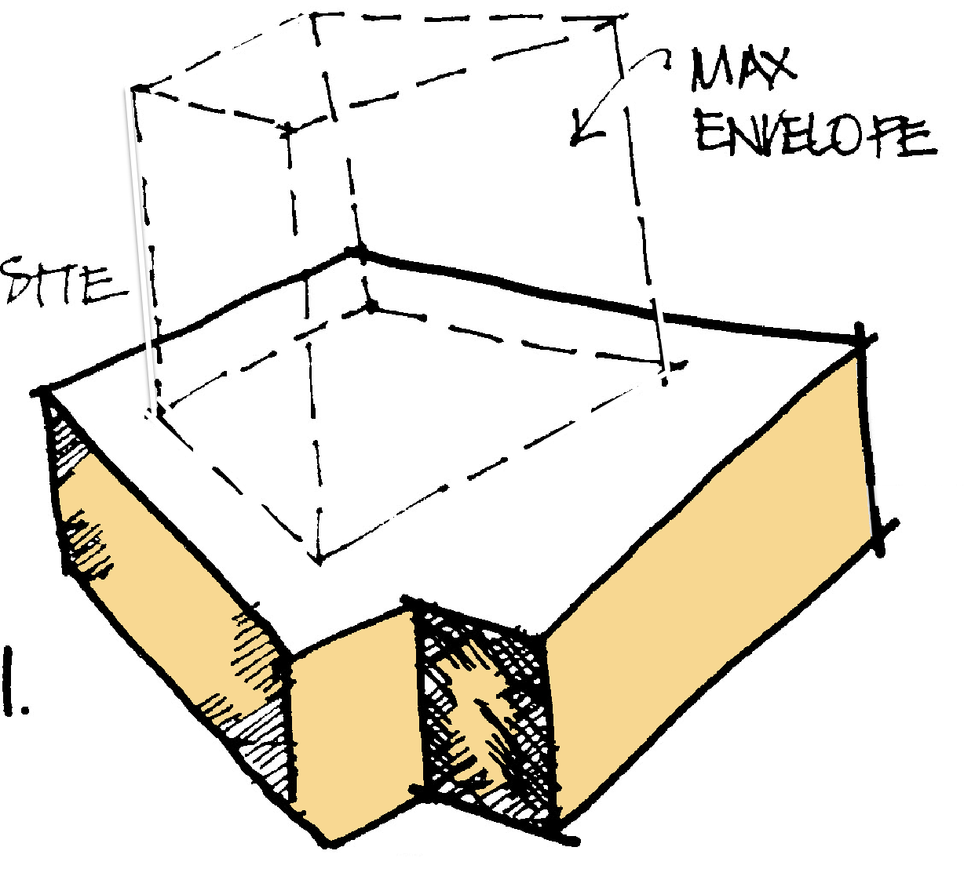
Dynamo Script
Step 1 – 3D Form + Levels
EvolveLab Script
Excel Data
Potential / Future

Slide 6
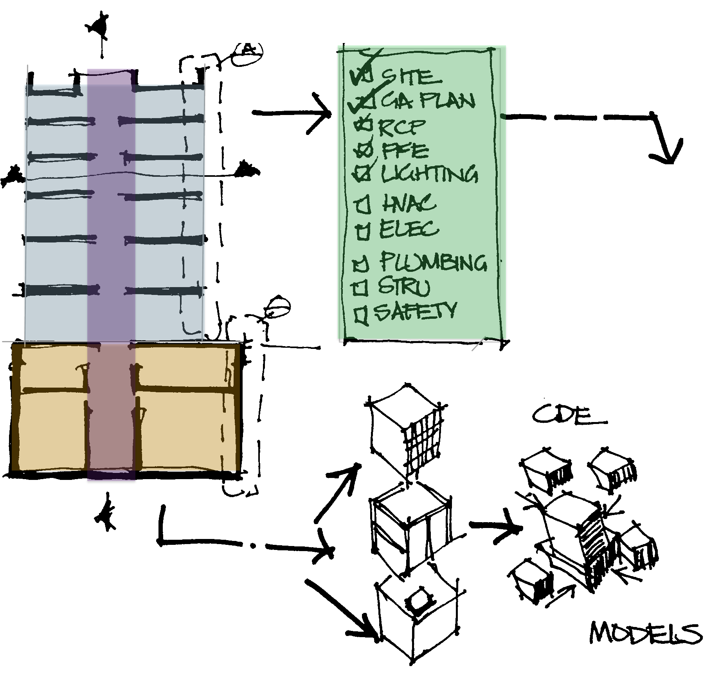
Step 2 – Generate Lists

Slide 7

Generate Levels from Model
Assign Disciplines, Groups, Roles
Naming Tools
Levels/Views List
Sheets / Sheet Sets
LOD/LOI content
Dynamo Scripts

Slide 8
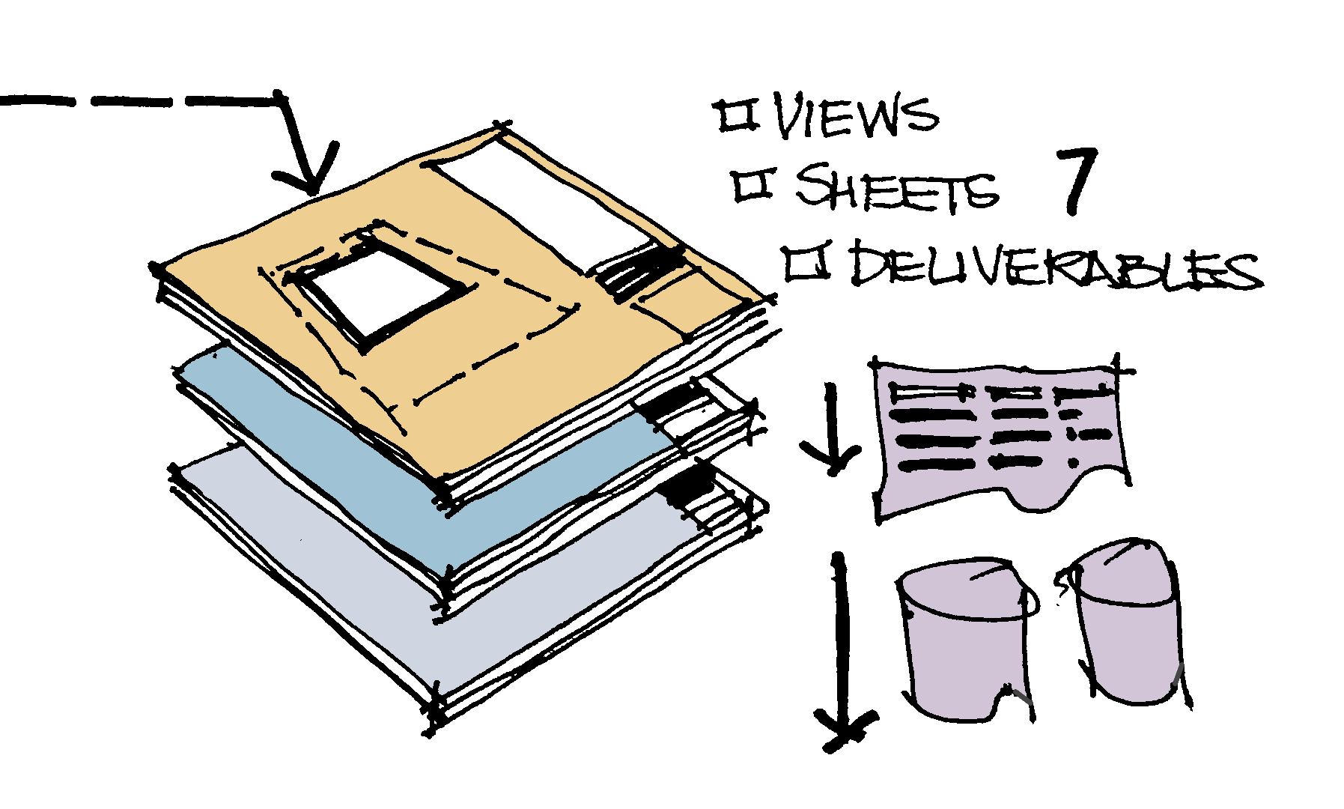
Step 2 – Generate Lists

Slide 10
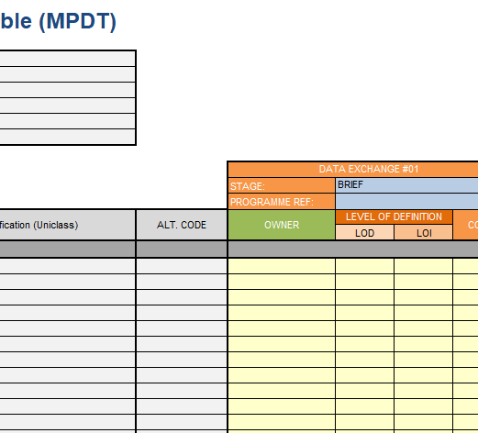
Step 3 – Generate the MPDT

Slide 12
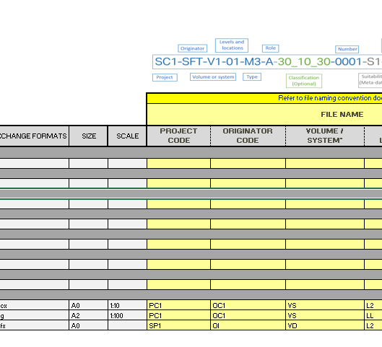
Step 4 – Task Lists + the Model

Slide 14
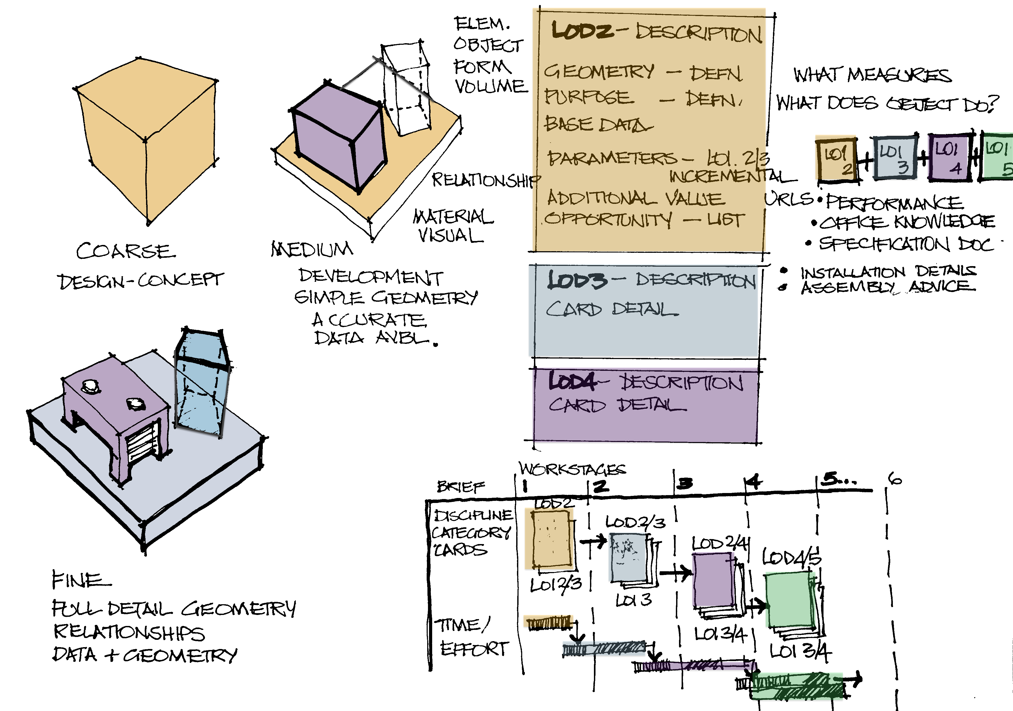
Step 5 – Tasks In/Out of the Model
Change Management

Slide 16
Step 5 – Process & Controls
Digital Plan of Work – Process/Workflow

Slide 18
Step 6 – Future Proposals

