Slide 1


Presentation
Dominik Major

Slide 2
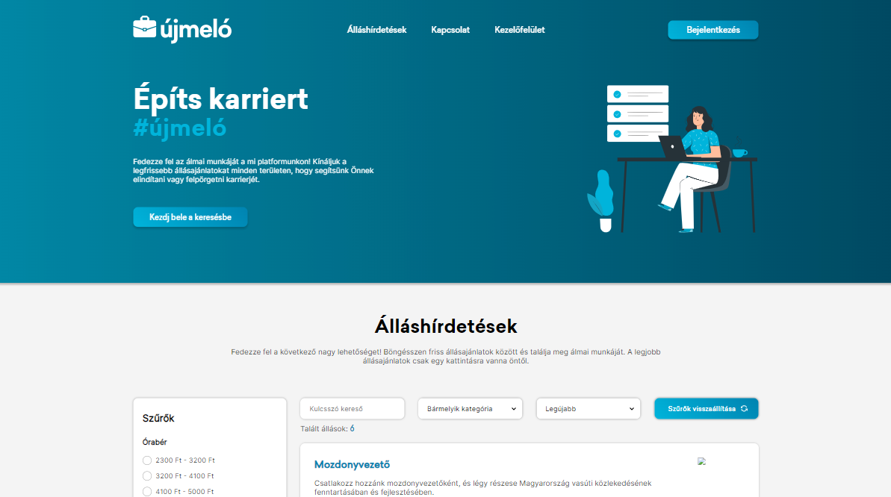
Homepage

Slide 3

Headers

Slide 4
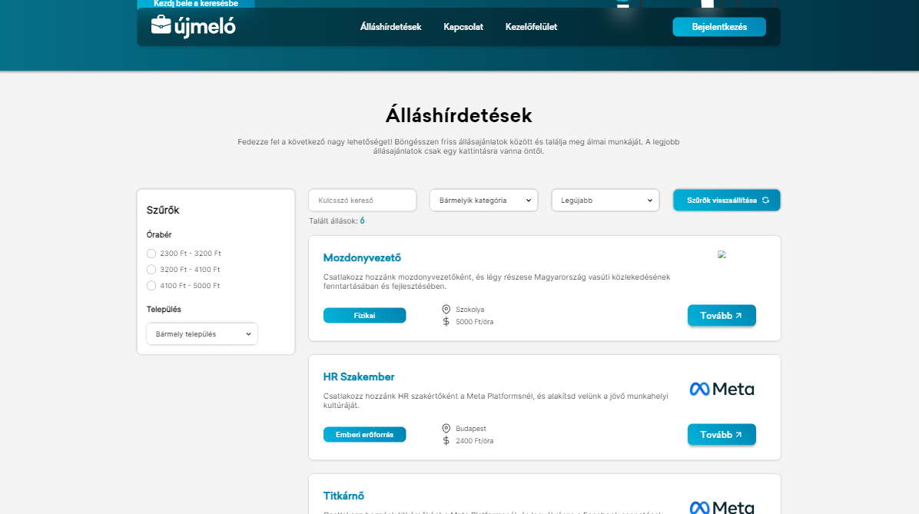

Advertisement

Slide 5
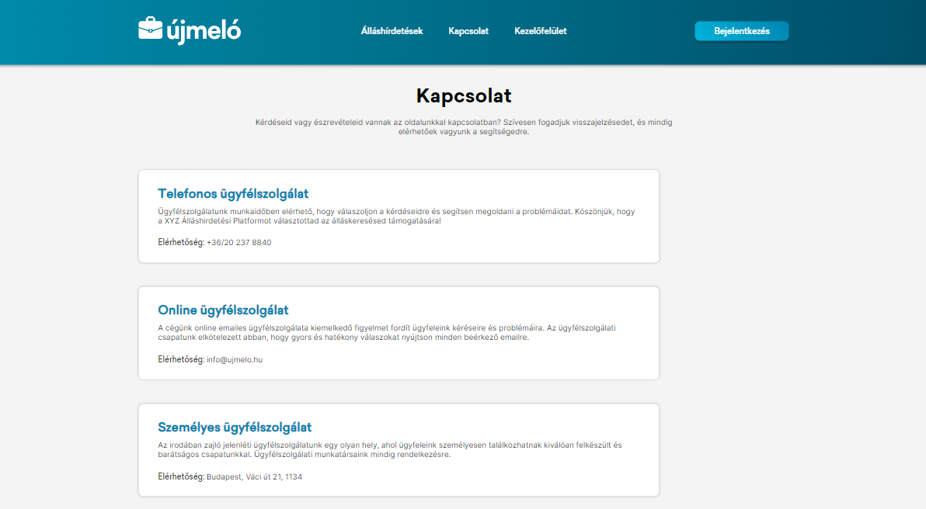
Contact page

Slide 6
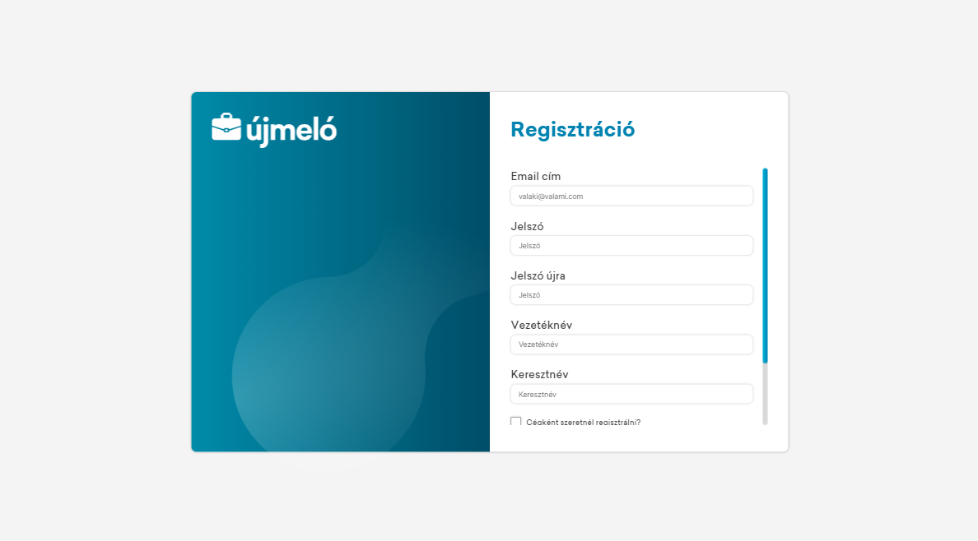
Register page

Slide 7
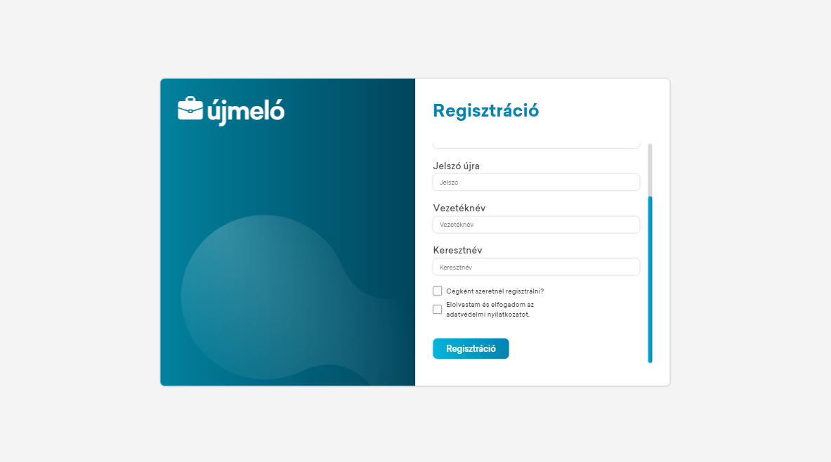
Register page

Slide 8
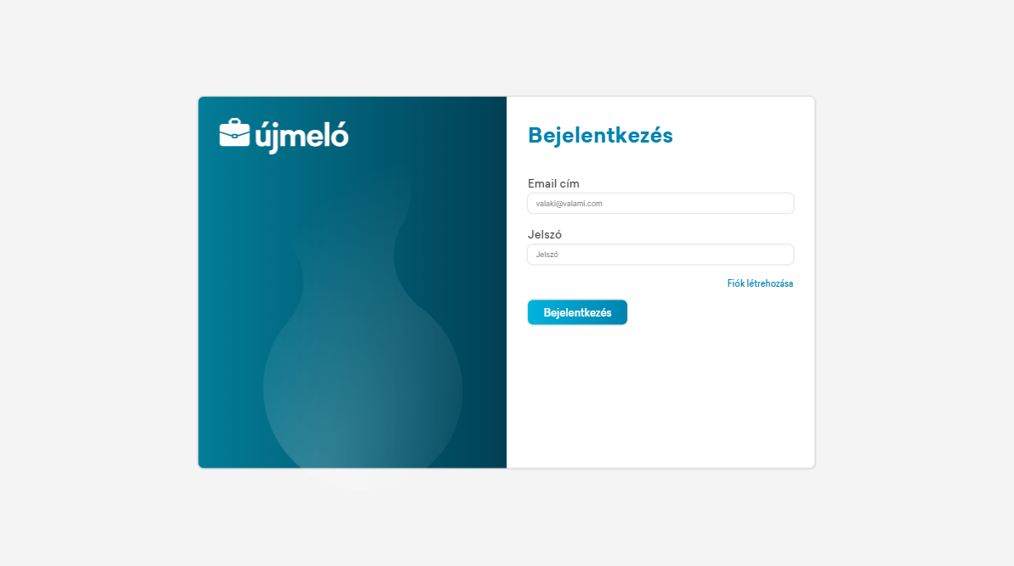
Login page

Slide 9
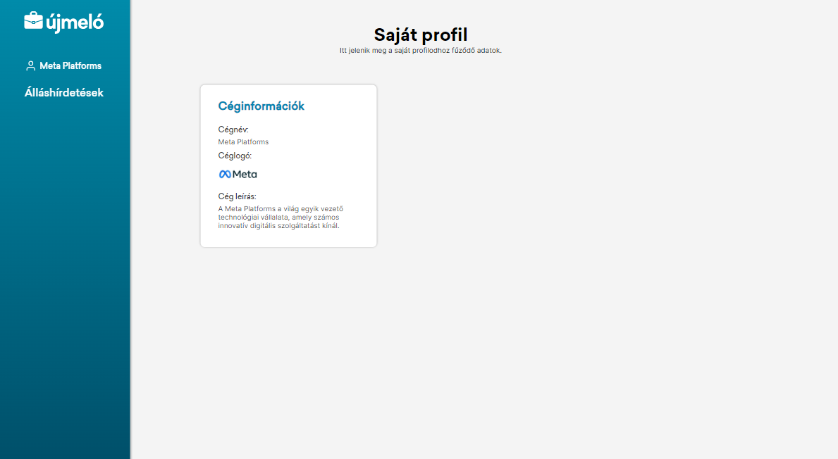
Controlpanel

Slide 10
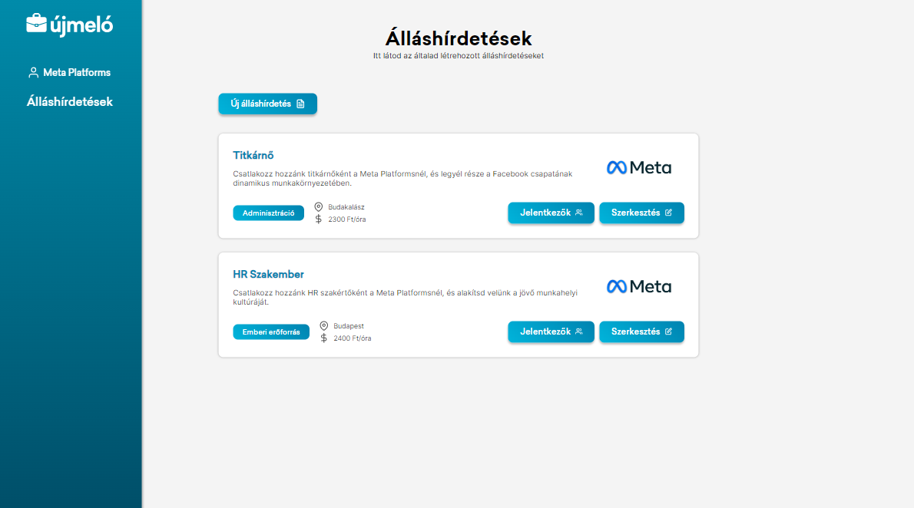
Advertisements

Slide 11
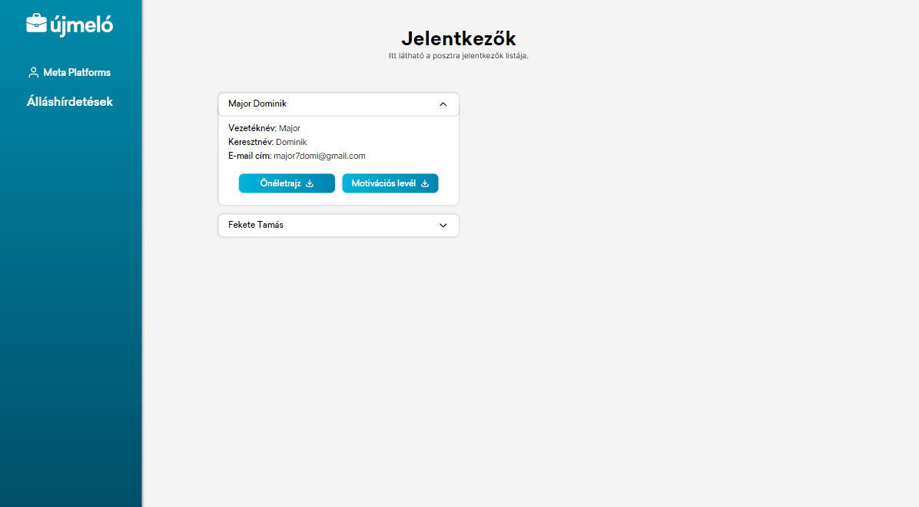
Applicants

Slide 12
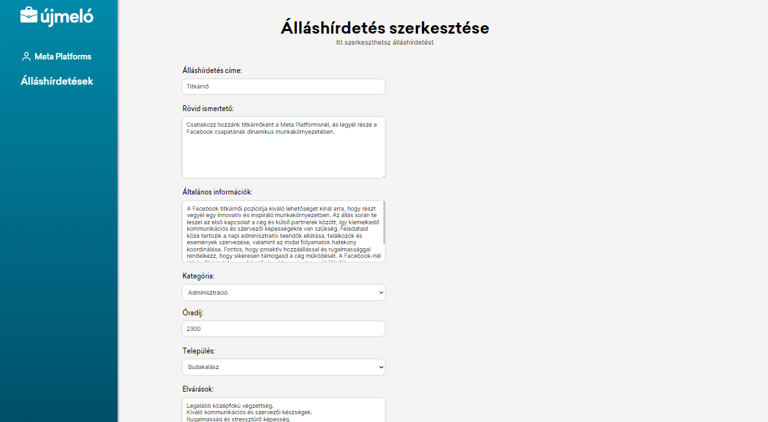
Edit advertisement

Slide 13
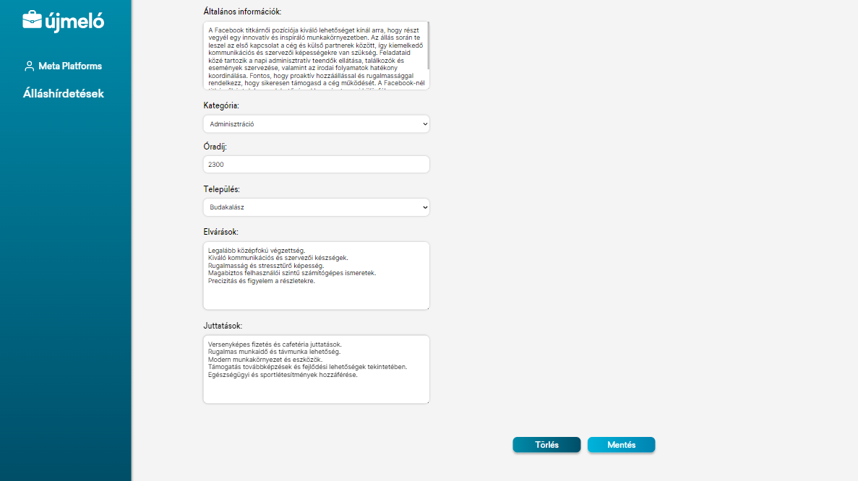
Edit advertisement

Slide 14
Advertisements

Slide 15
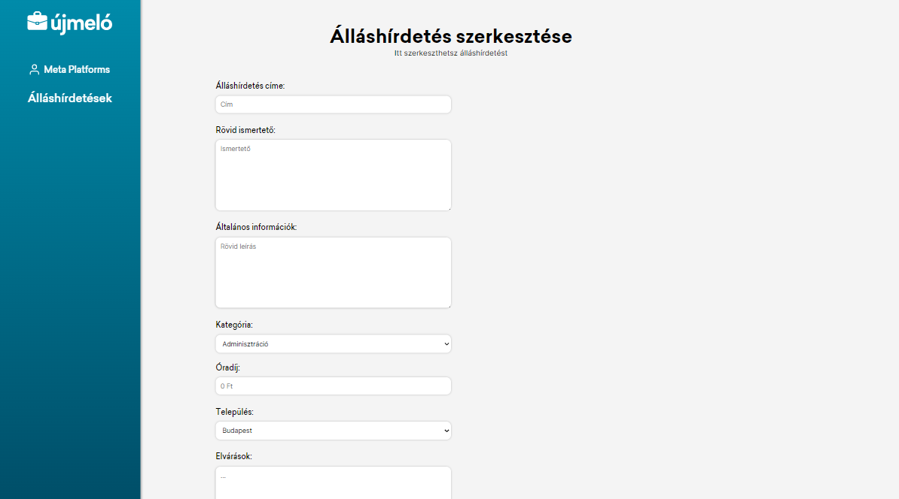
New advertisement

Slide 16
Thank you for watching!

