Slide 1
Automatic Plant Watering System
Course No: CSE 3104
Course Title: Peripherals and Interfacing Laboratory
Presentation On
Presented By:
Sourav Majumder (1807099)
Rifat Arefin (1807117)
Rafi Al Mahmud (1807119)

Slide 2
Overview
So what is this project? What does it do?
Basically this is a soil moisture monitoring system, which detects whether the moisture content in the soil is above or below a certain satisfactory threshold value.
If it goes below a certain satisfactory threshold value then it will check the humidity and water level.
If all of them are fair, then the water pump will pump the water to the plant. Relay Module controls the mini water pump.
Otherwise the buzzer will rises up to fill the water container.

Slide 3
Introduction
Automatic watering system is indispensable for households who want to grow plants but do not have time to water them. This system will provide the user with automatic action according to the sensor reaction. By using soil moisture sensor, the system will detect the dampness of the soil if it needs more water. Next, the water sensor start to detect the water level in the water tank. And another sensor is humidity sensor which will tell us the humidity of the environment. These sensors are the main component of this project.

Slide 4
Introduction (Cont.)
First of all, Arduino will check the humidity of the environment, if there is humidity then our sensor is working. Now, if there is moisture then the relay will be cut off. If there is no moisture then, it will check for the humidity. If the environment is not rainy, then it will check the water level of the tank. If there is enough water in the tank, then it will pump the water.

Slide 5
Apparatus Required
Arduino Uno
5 Volt Relay Module
Water Pump and tube/pipe
Soil Moisture Sensor
Breadboard
Jumper Wires
Water Sensor
Humidity Sensor
Battery
Piezo Buzzer

Slide 6
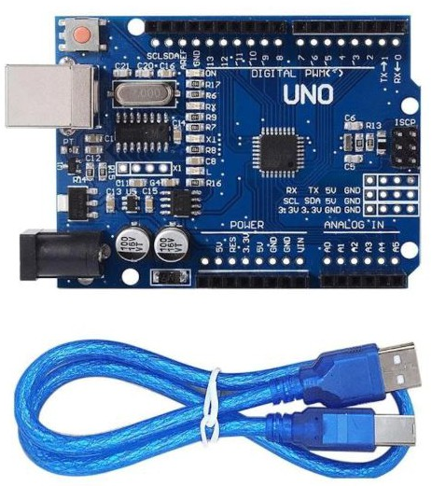
ARDUINO UNO
The Arduino Uno is an open-source microcontroller based kit for building digital devices and interactive objects that can sense and control objects in the physical world.
The Arduino based provides sets of digital and analog I/O pins that can be interfaced to various expansion boards and other circuits.
For programming the microcontrollers, the Arduino has a specific software associated with it which provides an integrated development environment (IDE) based on the processing project, which includes support for the C and C++ programming language.

Slide 7
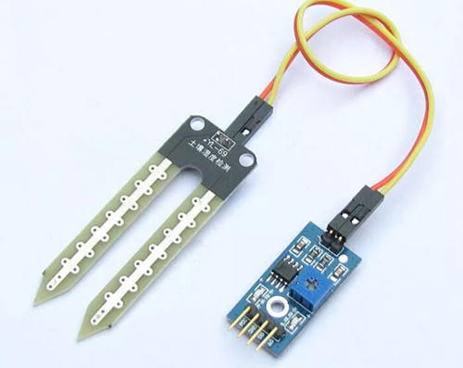
Soil Moisture Sensor
A soil moisture sensor measures the water content in soil by measuring the dielectric permittivity of the soil as a function of water content.
The volumetric water content is measured by the soil moisture sensor indirectly by properties like electrical resistance and dielectric constant.
Using this we can reduce manpower, save water to improve production and gravimetric method. VCC is 5V.

Slide 8
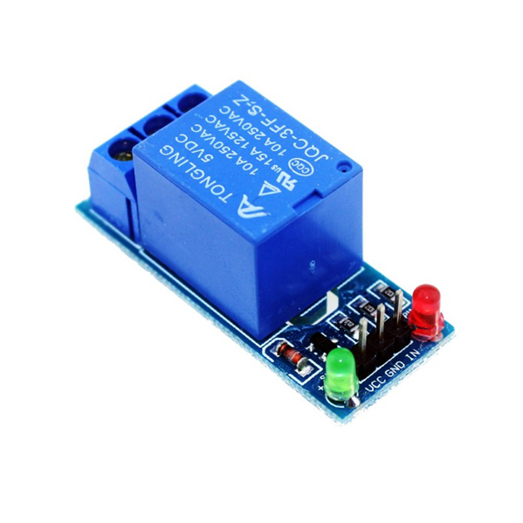
5v relay module
One-channel relay board which operates on 5-6V is used here.
The relay board consists of three pins which are normally open (NO), normally closed (NC) and common (C).
The common pin is connected to NC pin when the relay is off and to the NO pin when the relay is on.
The input pin receives logic high from Arduino Uno and in turn switches on the relay, thus common are connected to NO which turns the device on till the relay is on.
The “VCC” and “GND” pins of the relay are connected to 5V supply and ground respectively.

Slide 9
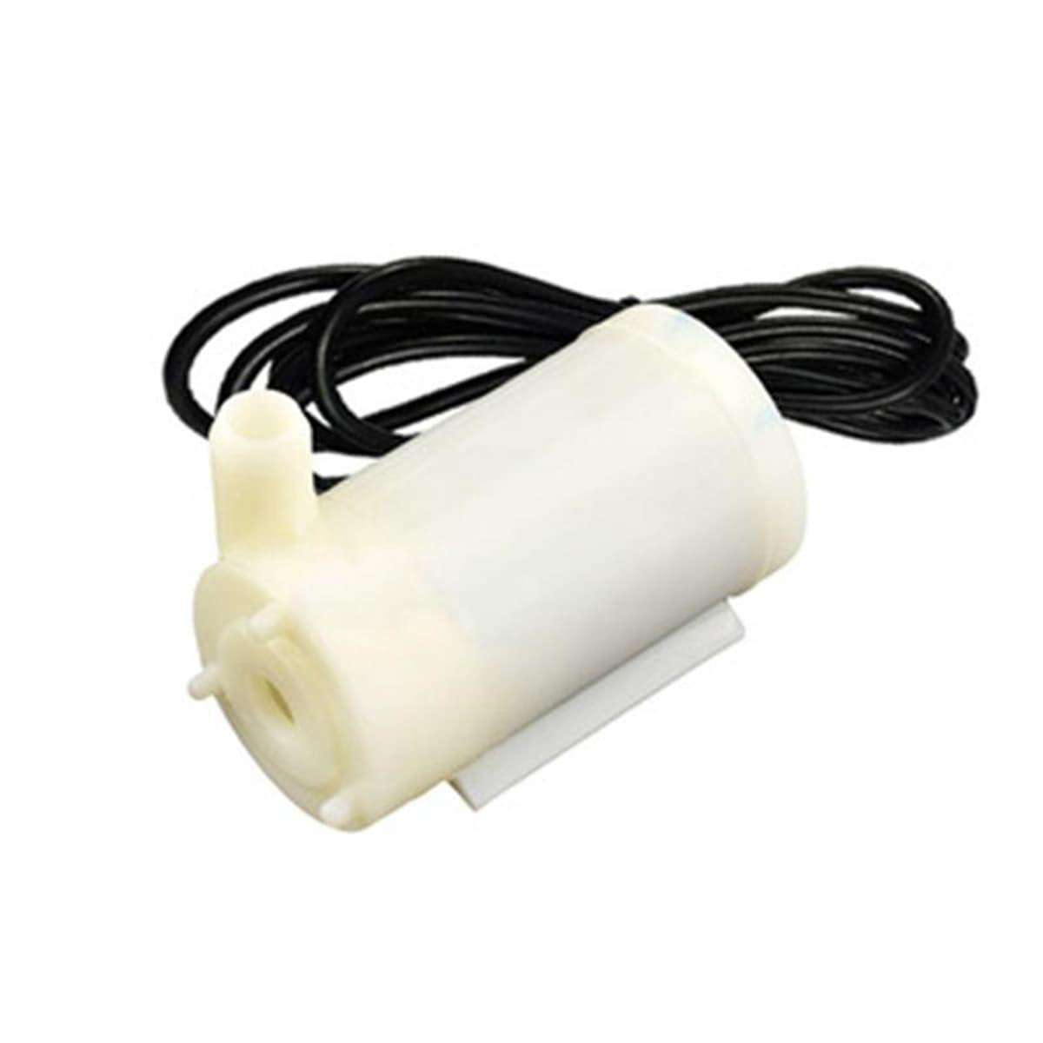
Mini water pump
The water pump is used to artificially supply water for a particular task.
It can be electronically controlled by interfacing it to a microcontroller.
It can be triggered ON/OFF by sending signals as required.
The process of artificially supplying water is known as pumping.
There are many varieties of water pumps used. This project employs the use of a submersible water pump which is connected to power supply through relay.

Slide 10
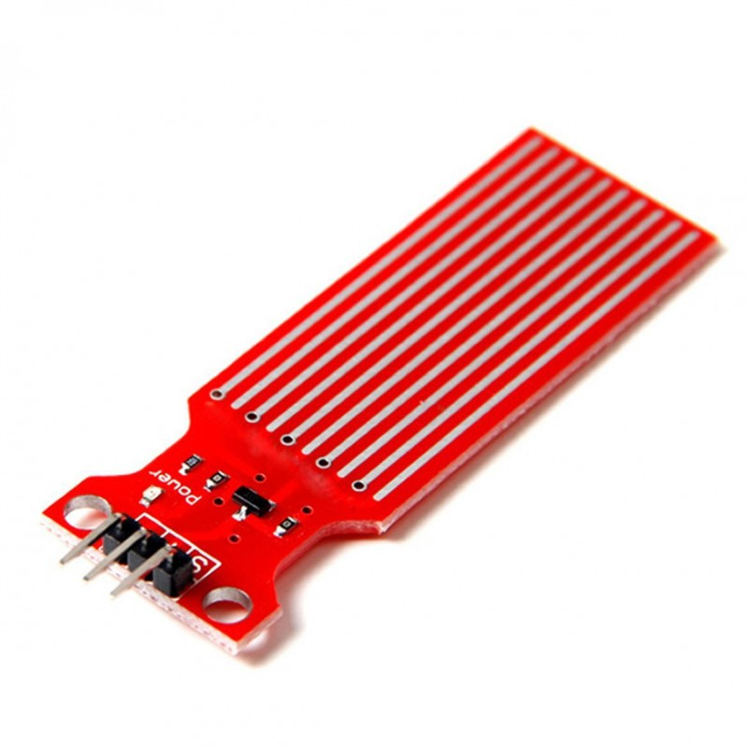
Water Sensor
The sensor has a series of ten exposed copper traces, five of which are power traces and five are sense traces.
These traces are interlaced so that there is one sense trace between every two power traces.
Usually these traces are not connected but are bridged by water when submerged.
There’s a Power LED on the board which will light up when the board is powered.

Slide 11
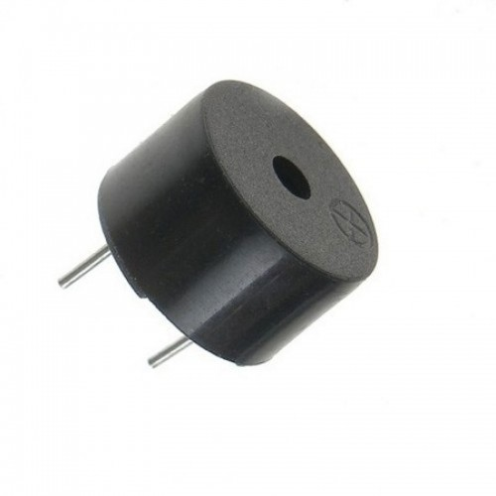
Piezo buzzer
In simplest terms, a piezo buzzer is a type of electronic device that’s used to produce a tone, alarm or sound.
It’s lightweight with a simple construction, and it’s typically a low-cost product.
Yet at the same time, depending on the piezo ceramic buzzer specifications, it’s also reliable and can be constructed in a wide range of sizes that work across varying frequencies to produce different sound outputs.

Slide 12
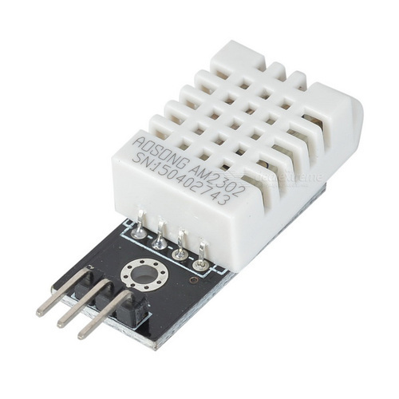
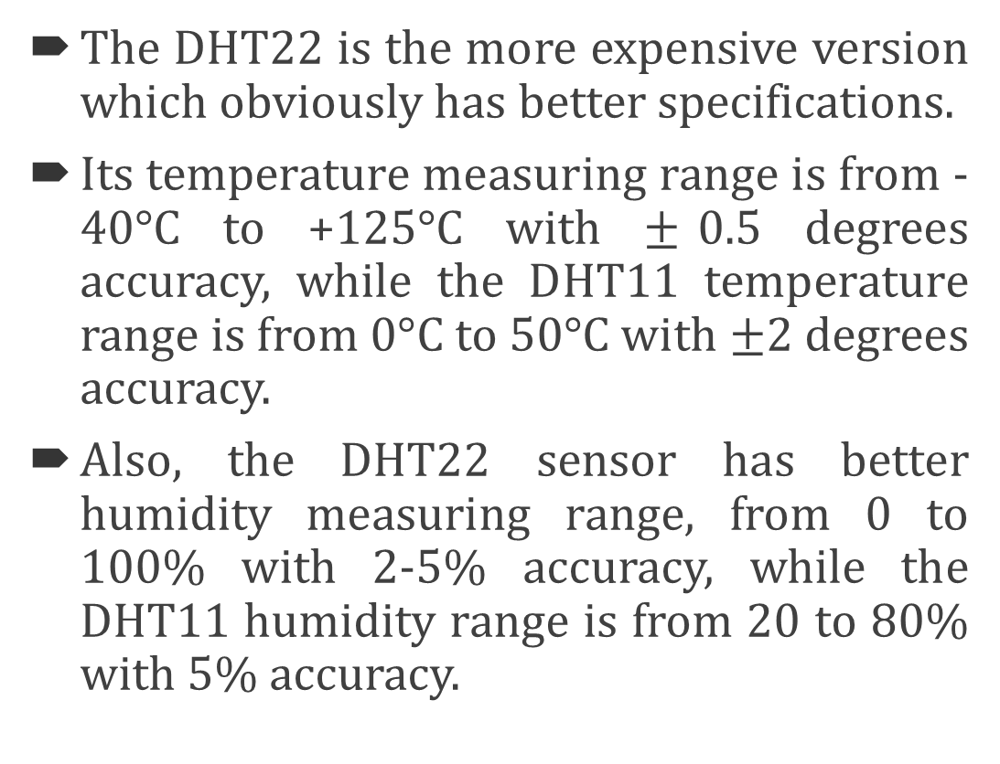
Humidity sensor
The DHT22 is the more expensive version which obviously has better specifications.
Its temperature measuring range is from -40°C to +125°C with $±$0.5 degrees accuracy, while the DHT11 temperature range is from 0°C to 50°C with $±$2 degrees accuracy.
Also, the DHT22 sensor has better humidity measuring range, from 0 to 100% with 2-5% accuracy, while the DHT11 humidity range is from 20 to 80% with 5% accuracy.

Slide 13
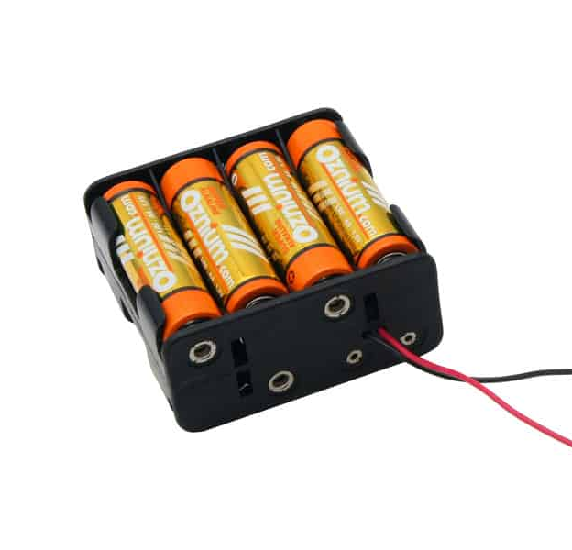
Battery and Battery Holder
A battery holder is one or more compartments or chambers for holding a battery.
It is giving power to the relay module and the water pump. Total voltage is 6V.

Slide 14
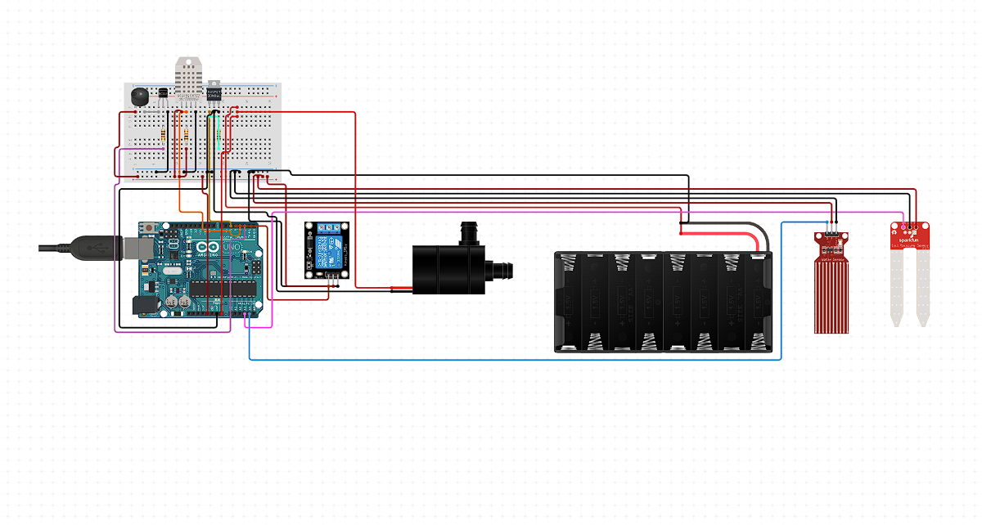
Circuit Diagram

Slide 15
Working Procedure
At first, Arduino will check the humidity sensor. If there is humidity, then the next step is to check the moisture of the soil. Otherwise it will show that the humidity sensor is not working.
The next step is, to calculate the moisture of the soil. It will give us a rating between 0% to 100%. The more the moisture, the more wet the plant is. If the moisture is more than or above 75%, then the relay will cut off. Otherwise, it will go to the next step.
Now, it will check the humidity. If the humidity is relatively 100% or above, the relay will cut off. Because there is a probability of rain.

Slide 16
Working Procedure(cont.)
Otherwise, it will go to the next step.
Now, it’s time to check the level of the water in the tank. Water sensor will do this task. If the water level is more than 450, then it means that there is enough water to pump.
If there is enough water, the relay will be switched on. The water pump will start to pump the water to the plant.
If there isn’t enough water, then the buzzer will make a beep sound continuously, until we pour enough water to the tank.

Slide 17
Advantages
Efficient Use Of Water.
Real time Data.
Low Operation Cost.
Increasing Productivity.
Reduce Soil Erosion And Nutrient Leaching.

Slide 18
Issues and risks
Sometimes the DHT22 Humidity sensor is giving wrong readings.
We are providing direct 5V to the VCC of the relay module. It might damage the relay module because of the direct connection.
We are also providing direct 5V to the VCC of the humidity sensor. It might damage the humidity sensor because of the direct connection.

Slide 19
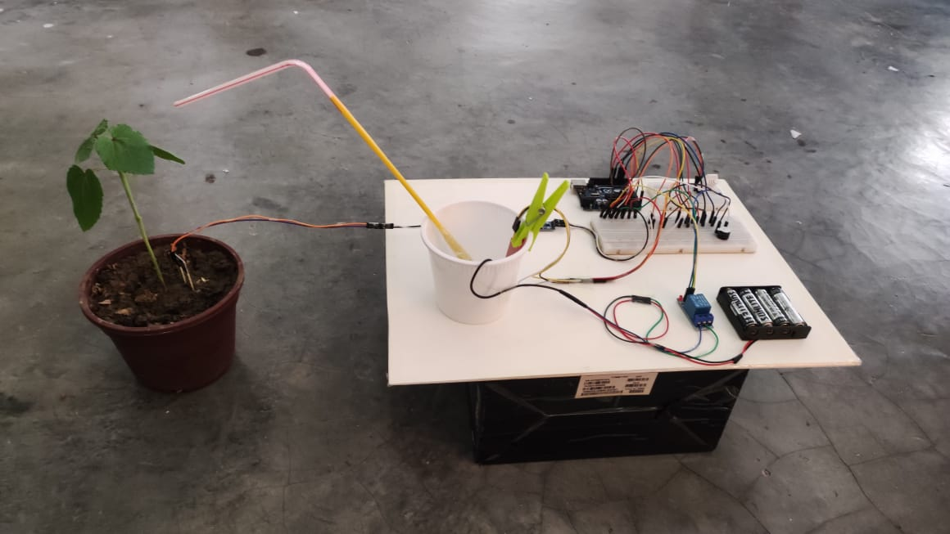
Final Project

Slide 20
References
https://create.arduino.cc/
https://lastminuteengineers.com/
https://www.tutorialspoint.com/
https://en.wikipedia.org/wiki/Battery_holder

Slide 21

Any Question?

