Slide 1
Mancala CSE-4110 : Artificial Intelligence Laboratory
Name: Sourav Majumder
Roll:1807099
Md. Amdadul Haque
Roll: 1807107

Slide 2
Outlines
Introduction
Rules of the Game
AI Opponent
Conclusion

Slide 3
Introduction
Mancala is a board game that has been played for thousands of years in various forms across the world.
The objective of the Mancala game is to capture more stones than the opponent.

Slide 4
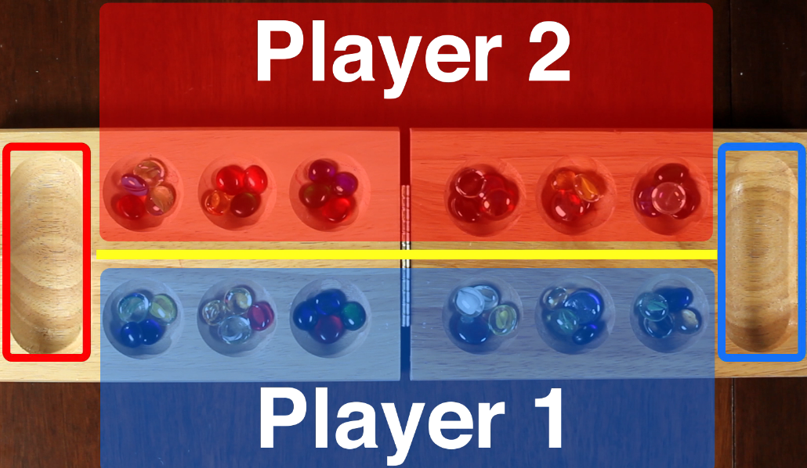
Rules of the Game
Mancala is played on a board with 2 rows of 6 holes(4 stones each hole) , called pits, and 2 larger pits, called stores.
Fig 1: Mancala Board

Slide 5
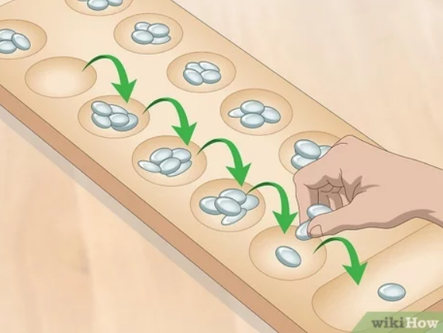
Rules of the Game (cont.)
Players take turns picking up all the stones in one of their pits and distributing them counterclockwise, one stone per pit.
If the last stone lands in the player's store, they get to take another turn.
Fig 2: Distributing stones

Slide 6
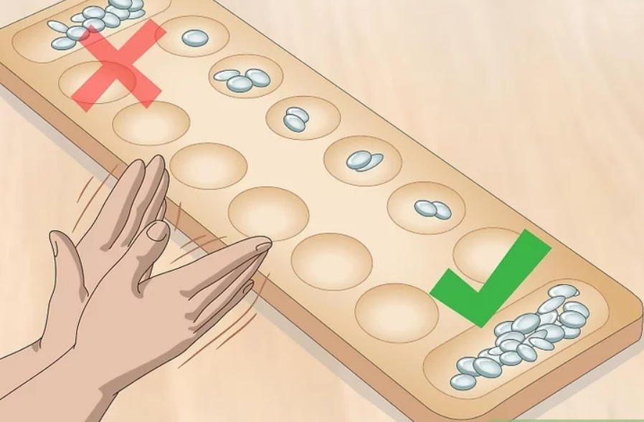
Rules of the Game (cont.)
If the last stone lands in an empty pit on their side of the board, they capture that stone and all the stones in the opposite pit, placing them in their store.
The game ends when one player has no stones left on their side of the board, and the other player takes all the remaining stones in their pits and places them in their store.
Fig 2: No stone left, opponent wins

Slide 7
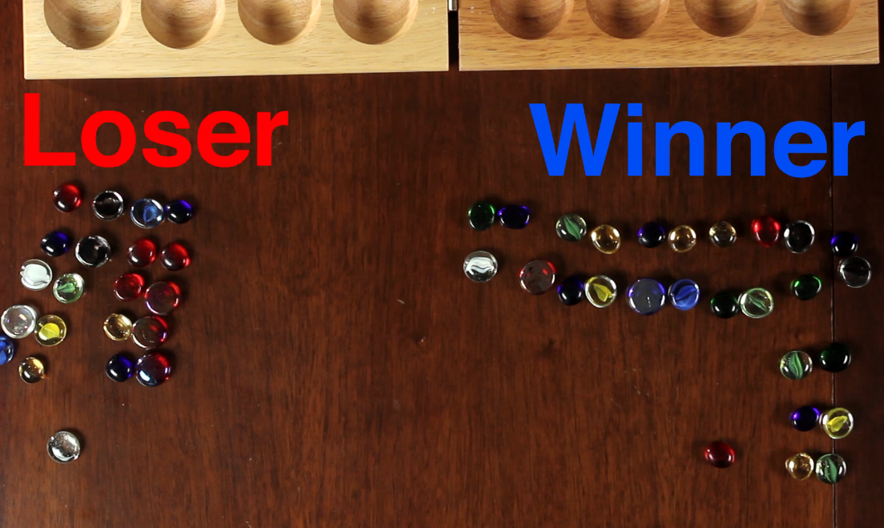
Rules of the Game (cont.)
The player with the most stones in their store at the end of the game wins.
Fig 4: Counting stones and result

Slide 8
AI Opponent
AI in our Mancala game will use the Minimax algorithm with alpha-beta pruning to determine the best move to make in each turn
The Minimax algorithm works by generating a game tree that represents all possible sequences of moves that can be made by both players.

Slide 9
AI Opponent (cont.)
At each level of the game tree, the algorithm will choose the move that maximizes the AI score
To improve the performance of the algorithm, we will implement alpha-beta pruning, which is a technique used to reduce the number of nodes that need to be evaluated by the algorithm.

Slide 10
Conclusion
Building a 2-player game of Mancala with the Minimax algorithm in Python is an exciting and challenging project.
By creating this game, we can learn more about the Minimax algorithm and how it can be applied to real-world problems.

Slide 11
THANK YOU

