Slide 1


Slide 2
Problem
I have a project, does someone want to collaborate?
I need a different opinion
I need support at a project
-Who can I ask
-did this question ever occur?

Slide 3
Solution
Collaborative Platform
-Schedule meetings
-ask and answer questions
-collaborate on ideas

Slide 4
Our concept for the platform
-Questions
-Communicating
-Searching/filtering
-Moderating

Slide 5
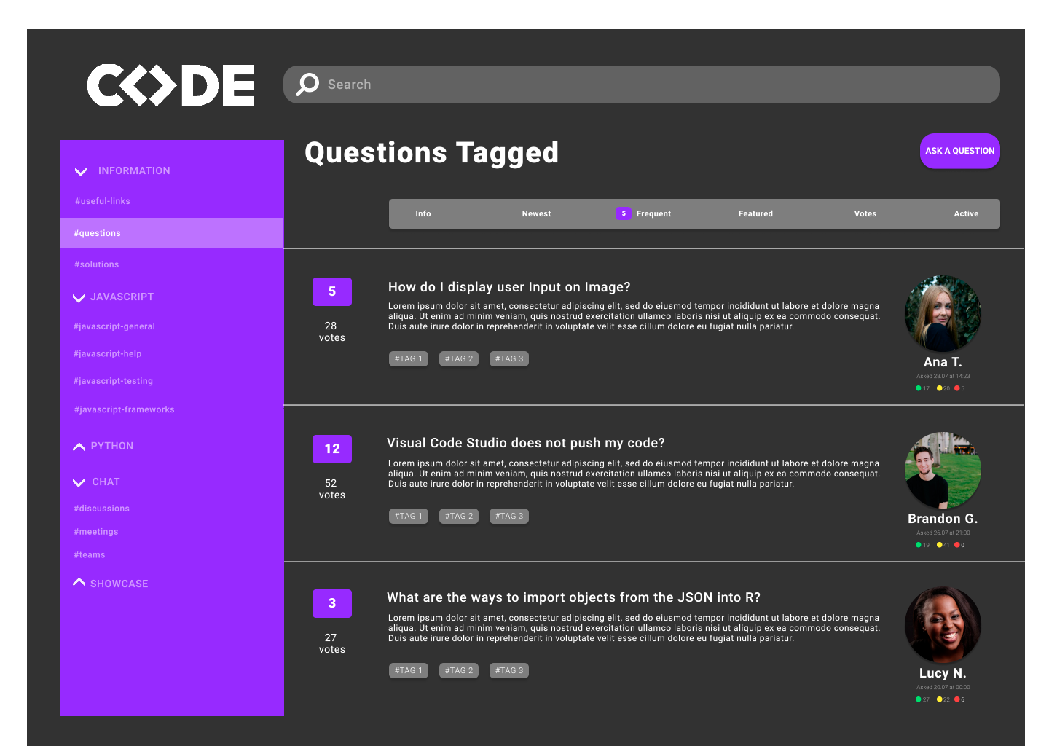

Slide 6
Link Figma
https://www.figma.com/proto/Pfxs3kat6EWZxYO22xJX17/Untitled?node-id=1%3A55&scaling=min-zoom

