Slide 1

Practical python for beginners
Novosibirsk, 2018

Slide 2

HTTP
Requests
API & URL
JSON data format
Working with requests in Python
Practical task: Create your own translator

Slide 3

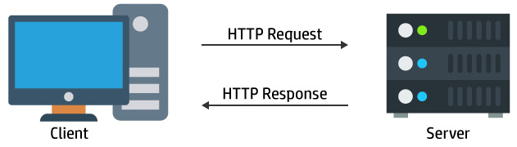
HTTP is a main protocol for data communication in the World Wide Web
Client-Server model:
  Client (usually web-browser) sends a request
  Server processes request and sends response

Slide 4

Client asks server through the request in the form of a URL
Request type indicates the desired action
  GET – request data from a specified resource
  POST – send data to create/update a resource
  PUT – upload data on a server
  DELETE, TRACE, OPTIONS …
Server specifies the request and required data in Application Programming Interface (API)

Slide 5
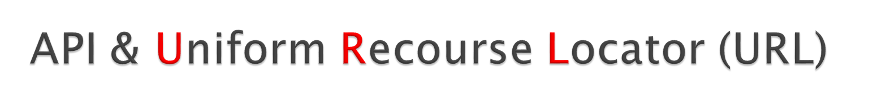
API is “an instruction” how to communicate with a specific server. Describes:
  Which requests can be made
  How to make them
  Required data, formats, conventions, …
URL (“web address”) is a reference to a web resource.
https://google.com/search?client=opera&q=teleportation
Protocol: secure HTTP
Server Domain Name: google.com
Path on server: /search
Query: {“client” : “opera”, “q” : “teleportation”}
Separators: ? (path-query), & (query fields)

Slide 6

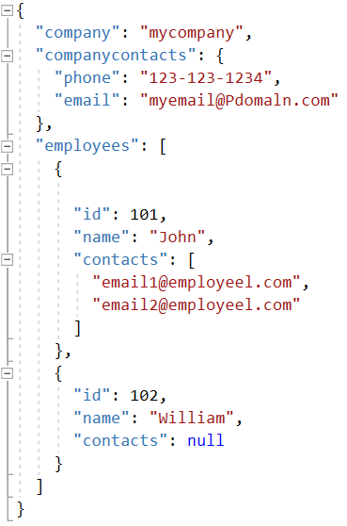
Common data interchange format
Very similar to Python dictionaries
JSON object
Object inside Object
JSON Array
Array inside array
String value
Number value
Null value

Slide 7


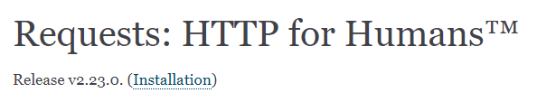
General program scheme
  Import necessary libraries (request, …)
  Create input (URLs, JSON) for requests (use API)
  Send request
  Receive response
  Process output data (use API)
High-level Python library
https://requests.readthedocs.io/en/master/

Slide 8

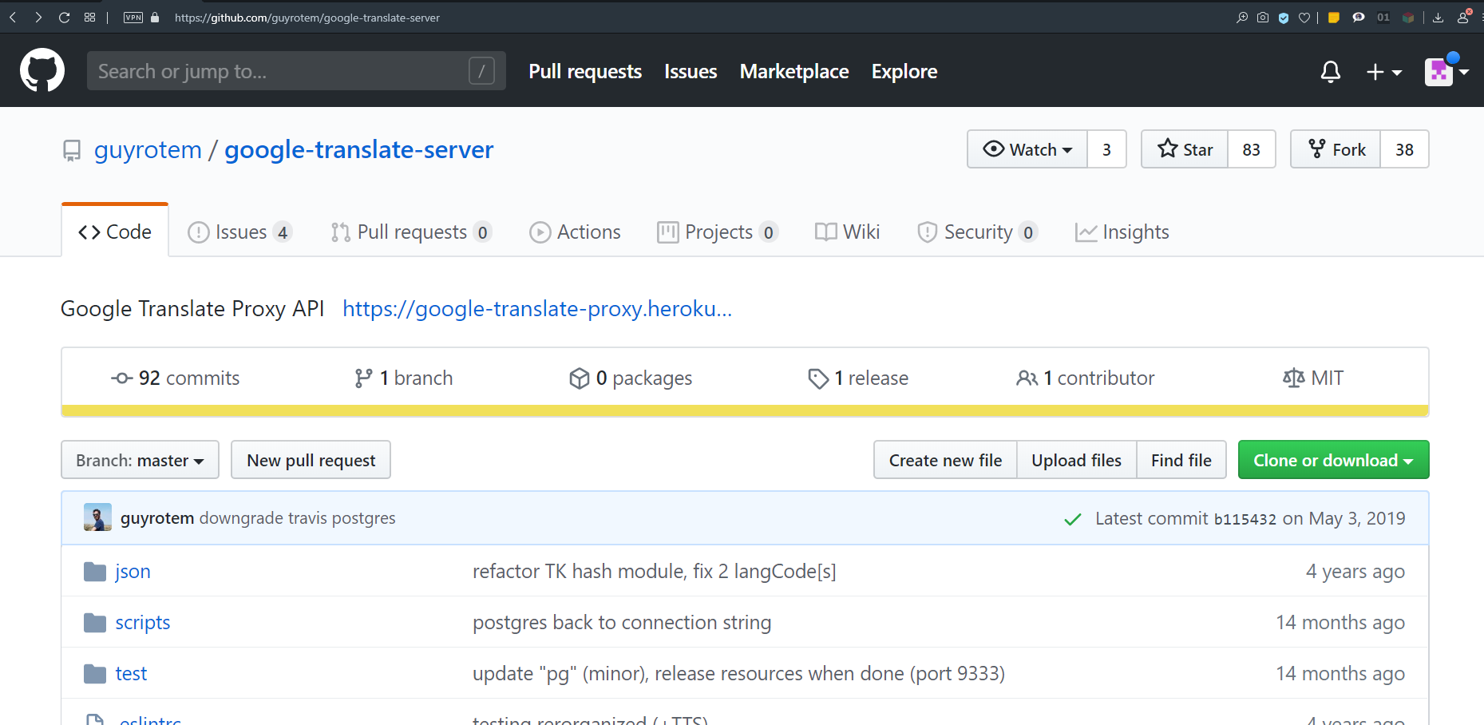
Wrapper for Google.Translate
https://github.com/guyrotem/google-translate-server

Slide 9

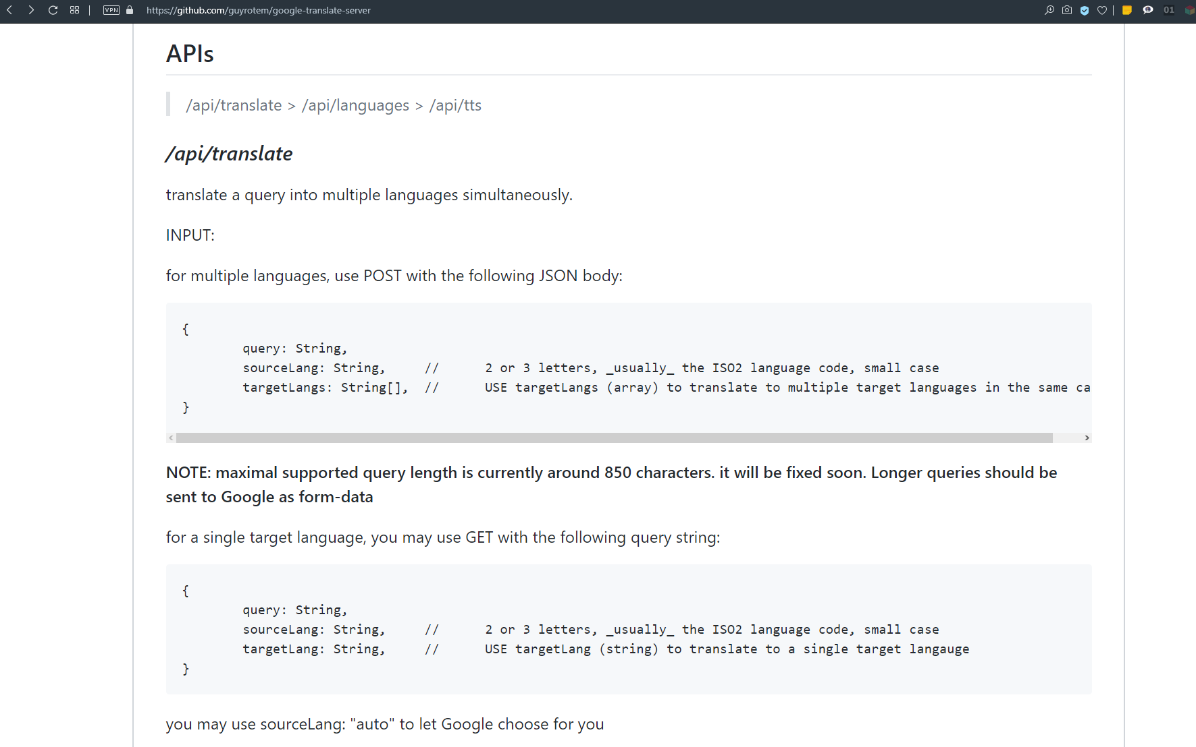

Slide 10

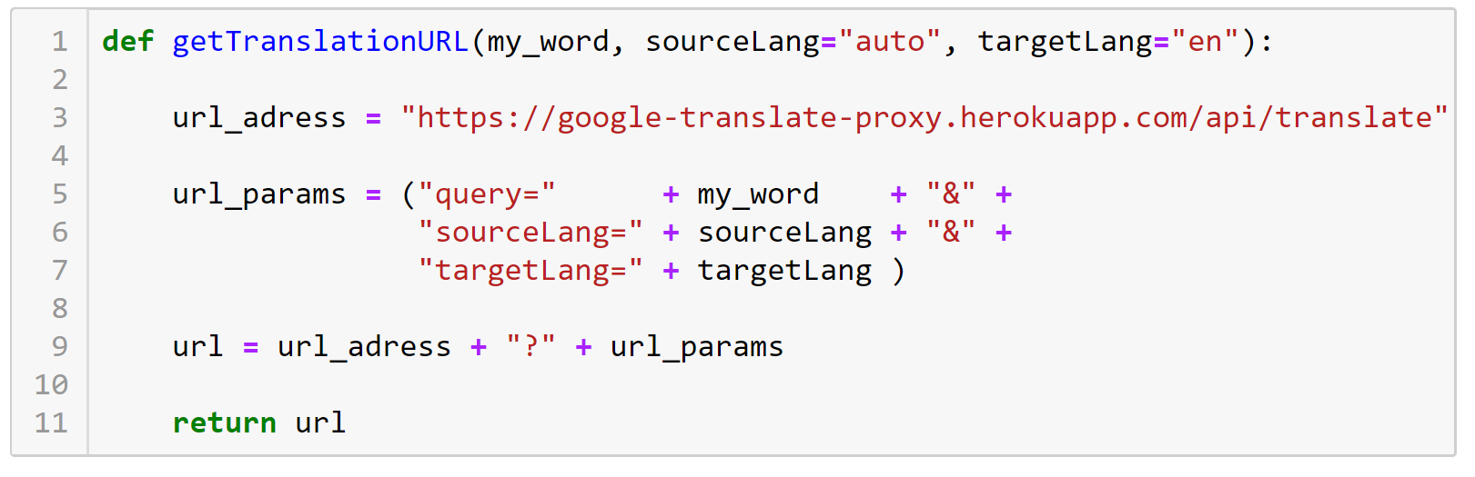
Create Request URL
Choose a word to translate

Slide 11

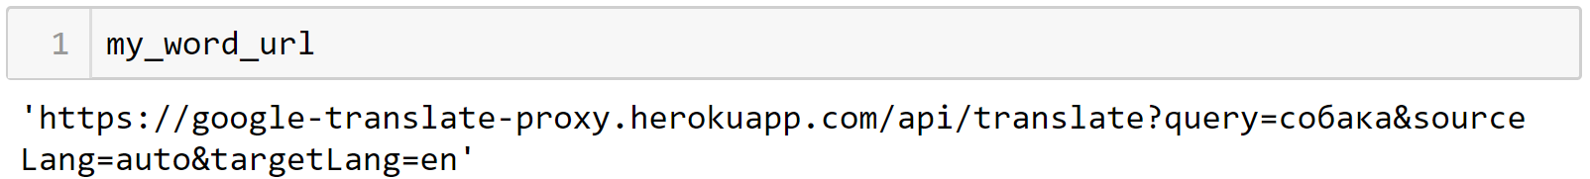
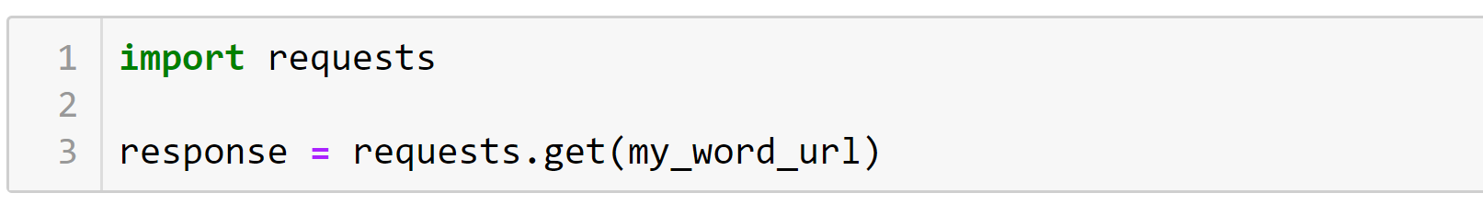
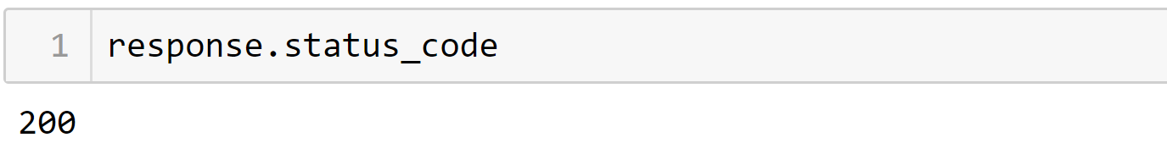
Check request URL
Send request
Check the status of request (2XX == Success)

Slide 12

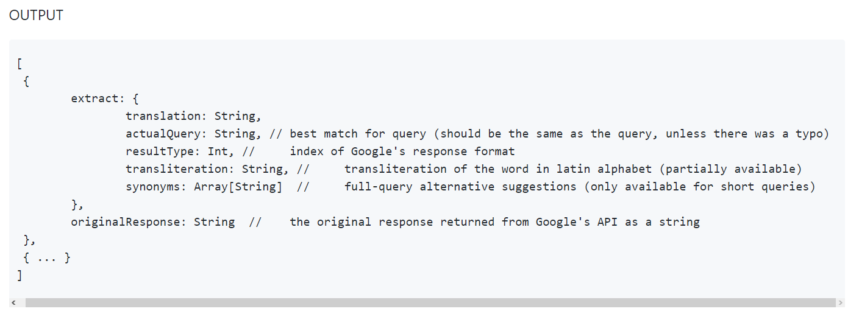
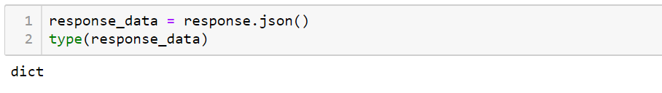
Format of output (API)
Extract data from response (JSON)

Slide 13

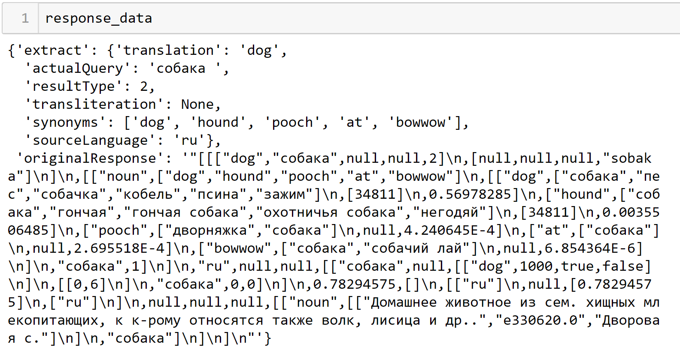
Let’s take a look on the data

Slide 14
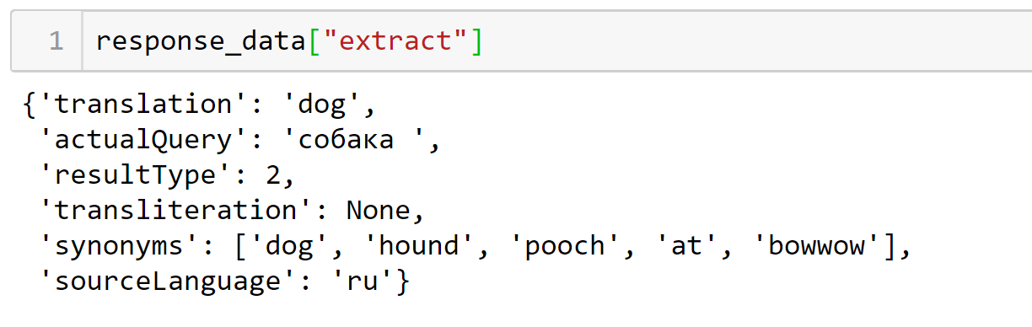
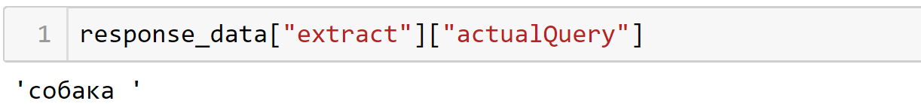
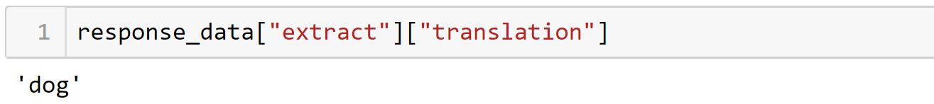
Get required data

Slide 15

