Slide 1
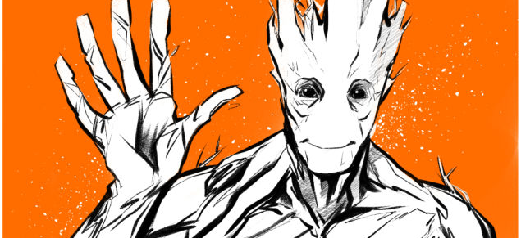
We are groot
Authors: M. Käser, F. Schwab, M. Tschanz

Slide 2
Presentation of groot
Introduction
Technologies used in the project
Architecture of our store
Live demonstration & features
Distribution among our team
Lessons learnt & review

Slide 3
Introduction
Standard project: Book shop called «groot» - apparently we sell books ^_^
Background & personal skills of the team members
Martin: ______________________
Fabian:
Never really used any technology covered in the course except for HTML and CSS in apprenticeship. Therefore the pace of the course was quite demanding.
Marcel:
2 Shops, 1 presentation

Slide 4
Technologies used in the project
… all the ones from the course:
HTML for static content
CSS for Styling
JavaScript for
PHP for
AJAX for
REST for
and in addition to them:

Slide 5
Live Demonstration & Features
Martin:
Aufbau Groot-Stack & allgemeines zur Architektur
Translation Files
TemplateRenderer
View-Controlle
Eventuell Standardablauf Such mit erstelltem Seq. Diagramm
-----> Präsentation eines Features nach Wahl

Slide 6
Live Demonstration & Features
Marcel: Wikipedia-REST API- Präsentation Shop- Model Beispiel anhand User Model (create / login)

Slide 7
Live Demonstration & Features
Fabian:
CSS
CSS3,
Shopping Cart
OOP PHP
Ordering Process

Slide 8
Distribution among the team
Martin
viu
Fabian
…
Shopping Cart & Ordering
Marcel
ou viu

Slide 9
Lessons learnt & Review
Distribution of work demands good planning – especially in teams where there’s a gap in skills & experience
Layouting consumed plenty of time. Especially if you’re not familiar with CSS
Handling of the repository tool with a suitable hierarchy and the possibility of versioning (unfortunately not available in GitHub)
What we liked
Despite of the given technologies to use there was enough space for individual implementation
What we didn’t like so much…
the effort to replace the implementation of a feature with another technology required too much time in some cases

Slide 10
Questions?

