Slide 1

We are groot
Martin Käser
Fabian Schwab
Marcel Tschanz
12.01.2015 | Web Programming BTI7054

Slide 2
Presentation of «groot»
Introduction
Technologies used in the project
Architecture of our store
Live demonstration & features
Distribution among our team
Lessons learnt & review

Slide 3
Introduction
Standard project without the support of a backend-framework:
Book shop called “groot”
2 shops, 1 presentation
Background & personal skills of the team members
Martin: Backend Web-Developer
Fabian:
Never really used any technology covered in the course except for HTML and CSS in apprenticeship. Therefore the pace of the course was quite demanding.
Marcel: Web-Developer (Webflow)

Slide 4
Technologies used in the project
… all the ones from the course:
HTML for static content and templates
CSS3 for styling and animation
JavaScript for the shopping cart cookie
PHP (OOP) for the server
AJAX for fetching Wikipedia data and autocomplete of the search
REST for fetching Wikipedia articles via REST client
and in addition to them:
MySQL for storing the data
Regex for form validation / template rendering and translation files
jQuery

Slide 5
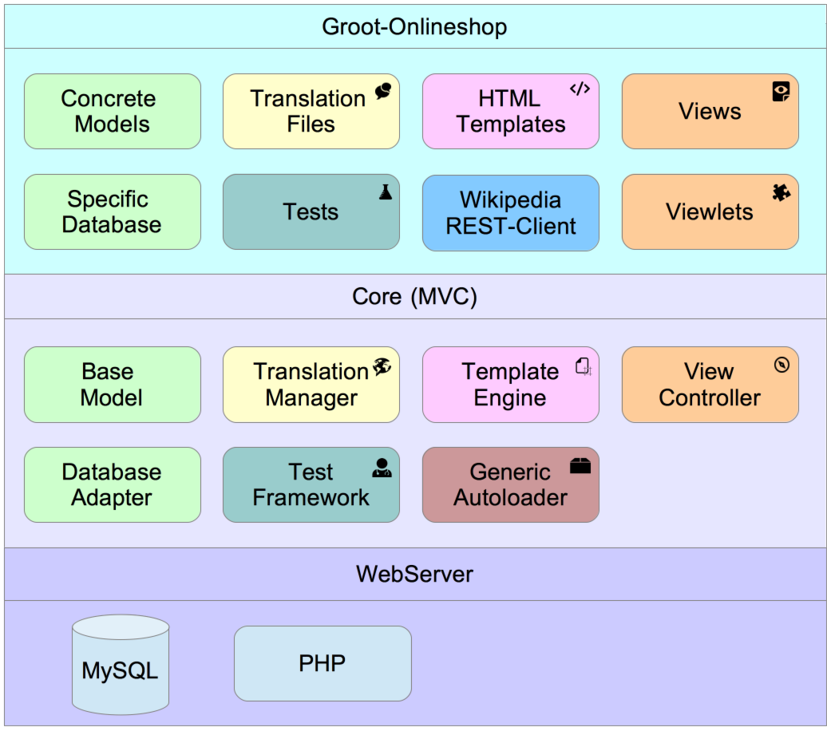
Live Demonstration & Features - Core
Template Engine
Variables / Ifs / Loops
Translation
Based on files
Variables possible
DB-Models
Dynamic
Simple to extend
View Controller
Fast development
AJAX-calls

Slide 6
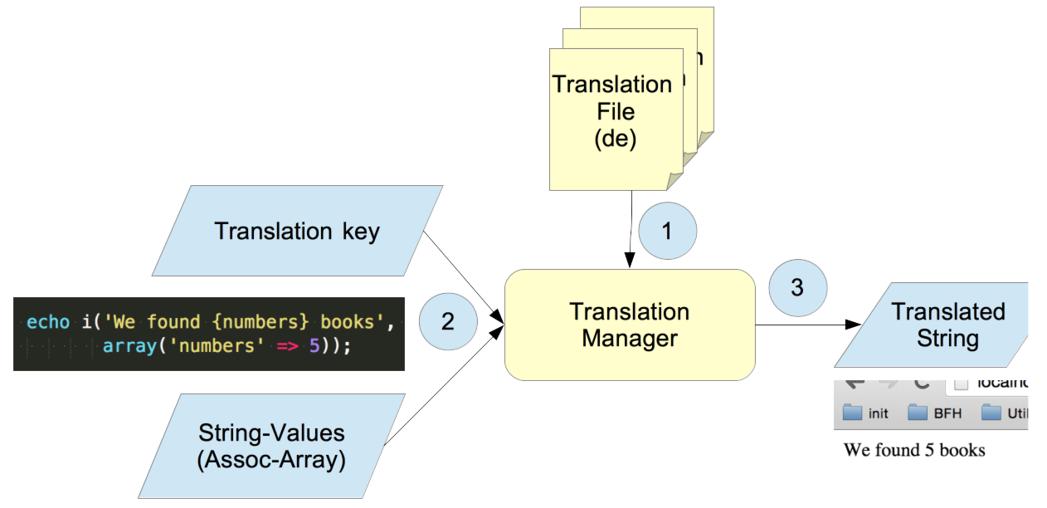
Live Demonstration & Features - Translation

Slide 7
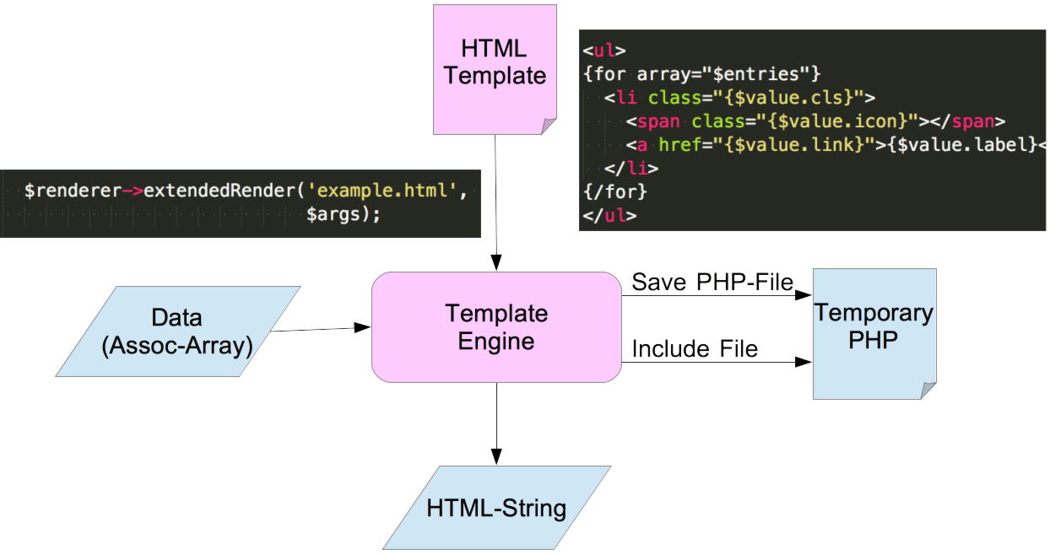
Live Demonstration & Features - Template Engine

Slide 8
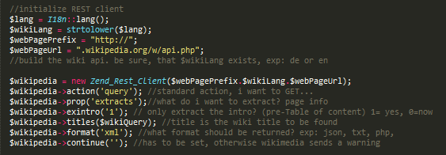

Live Demonstration & Features
Login
Translations
Genres & Searching
Wikipedia-REST
User Model

Slide 9
Live Demonstration & Features
Shopping with «groot»
Shopping cart
OOP element in PHP
Cart temporarily stored as a JSON encoded array in a Cookie
Creating of a shopping cart object by using the array in order to have access to functions like calculate price & display the cart
Ordering process

Slide 10
Distribution among the team
Martin
Core Applikation
Search view and genre view
AJAX Requests and CSS finalizing
(Emotional Support)
Fabian
Shopping cart & ordering
CSS
Marcel
REST API
Administration & Login
Main & Detail view
Payment-Flow
E-mail

Slide 11
Lessons learnt & Review
Distribution of work demands good planning – especially in teams where there’s a gap in skills & experience
As a beginner it’s a blessing to have skilled colleagues around you
CSS can be really tricky and might getting out of control without a proper hierarchy
If you do it, do it right (translations, encapsulation, commenting…)

Slide 12
Lessons learnt & Review
What we liked
Despite of the given technologies to use there was enough space for individual implementation
Separation of the workload depending on the skillset
What we didn’t like so much…
the effort to replace the implementation of a feature with another technology required too much time in some cases

Slide 13
Questions

