Slide 1
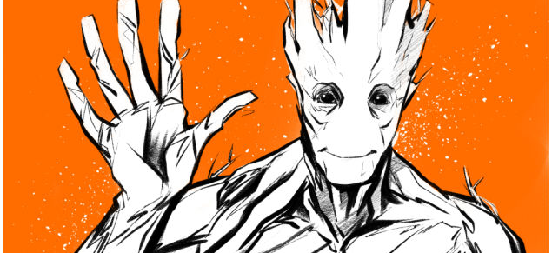
We are groot
Authors: M. Käser, F. Schwab, M. Tschanz

Slide 2
Presentation of groot
Introduction
Technologies used in the project
Architecture of our store
Llive demonstration & Features
Distribution among our team
Lessons learnt & review

Slide 3
▶ due to the limited time, focus your presentation on the demo plus maybe some highlights & distinct features of your project

Slide 4
Introduction
Book shop called «groot» - apparently we sell books
Background & personal skills of the team members
Martin:
Fabian:
Never really used any technology covered in the course except for HTML and CSS in apprenticeship
Marcel:
2 Shops, 1 presentation

Slide 5
Technologies used in the project
… all the ones from the course:
Was habt ihr noch verwendet?
HTML for static content
CSS for Styling
JavaScript for
PHP for
AJAX for
REST for
and in addition to them:

Slide 6
Live Demonstration & Features
Vorgängig Dinu:
Aufbau Groot-Stack
Translation Files
TemplateRenderer
View-Controlle
Eventuell Standardablauf Such mit erstelltem Seq. Diagramm
Märcu Wikipedia-REST API- Präsentation Shop- Model, beispiel anhand UserModel (create / login)

Slide 7
Features
Beschrieb des Features
PrintScreen

Slide 8
Features
Beschrieb des Features
PrintScreen

Slide 9
Features
Beschrieb des Features
PrintScreen

Slide 10
Distribution among the team
Martin
viu
Fabian
…
Shopping Cart & Ordering
Marcel
ou viu

Slide 11

Lessons learnt & Review
Distribution of work demands good planning – especially in teams where there’s a gap in skills & experience
Layouting consumes plenty of time – especially if you’re not familiar with CSS
What we liked
Despite of the given technologies to use there was enough space for individual implementation
What we didn’t like so much…
the effort to replace the implementation of a feature with another technology required too much time in some cases

Slide 12
Questions?

