Slide 1
Neural Network in SnarkyJS for Mina

Slide 2
Introduction and Goal
Proof of Concept for Implementing a Neural Network (NN) in SnarkyJS for zkApps
Benefit of zkApps allows for computational intensive calculations to be off-load onto the local computer and efficient usage of the protocol
Entirety of the Neural Network must be in the circuit
Implement MNIST Handwritten Digit Recognition Neural Network

Slide 3
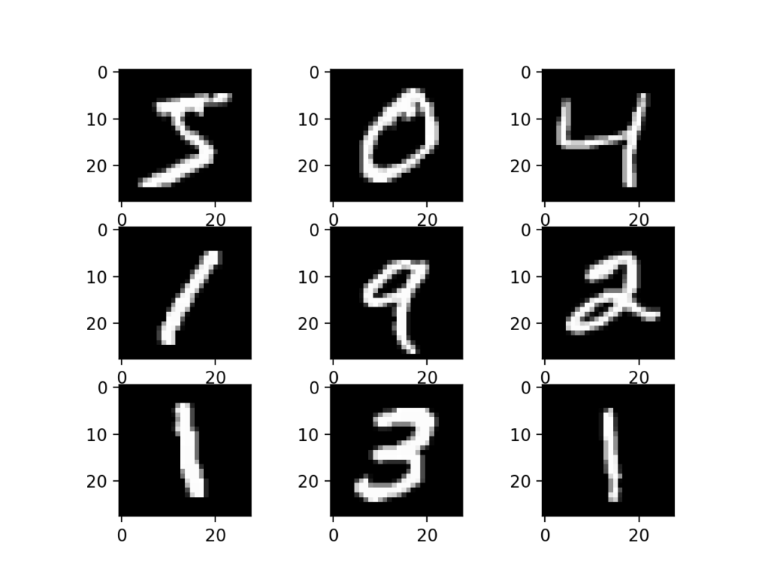
Background
Common application of Neural Networks include the multi-class classification of the MNIST Handwritten Digital images
Dataset of 60,000 28 x 28 grayscale images of digits 0 to 9
Reference: http://yann.lecun.com/exdb/mnist/

Slide 4
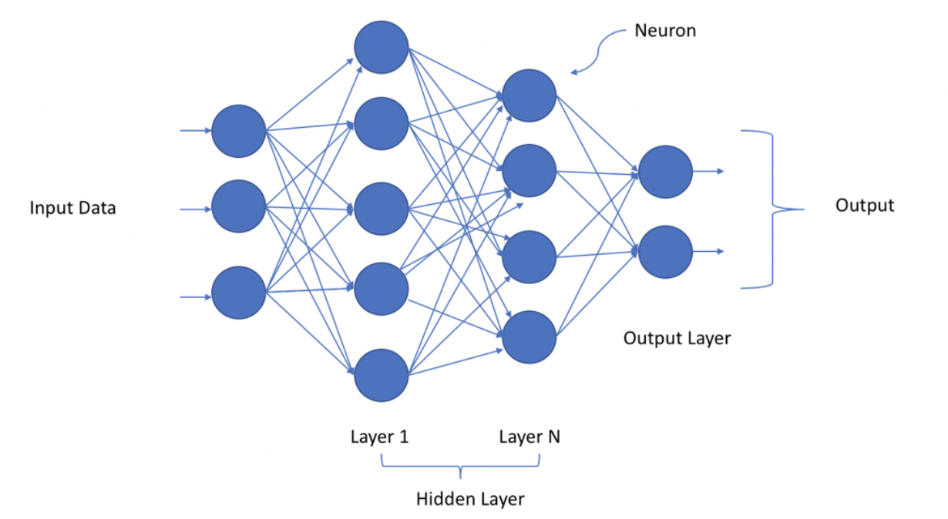
Approach
Develop and Train Neural Network in Python / Tensorflow
Subsequent weights for the layers will be imported into SnarkyJS

Slide 5
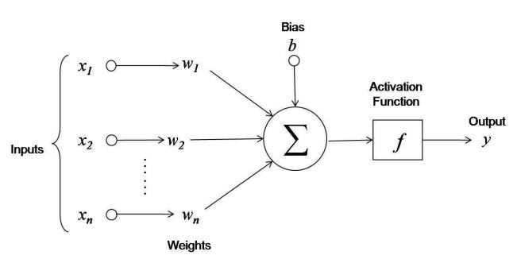
Approach - Neurons
At the fundamental level, a Neural Network is a series of dot products or linear functions with an activation function

Slide 6
Approach - SnarkyNet Classes
SnarkyTensor
Provides tensor manipulation, dot products, and activation functions
Implements decimal representation for Int65
SnarkyLayer (Extends SnarkyTensor)
Emulates Neural Network layer for handling the dot products and activation function
SnarkyNet (Extends SnarkyTensor)
Utilizes SnarkyLayers and performs prediction on the input image

Slide 7
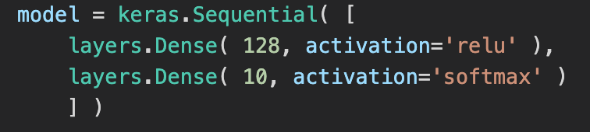
Approach - Neural Network
Neural Network Design:
Input layer of 784 x 1
Converted from the 28 x 28 image to a 784 x 1 vector
Hidden layer 1: 128 with RelU activation function
Classification layer: 10 with Softmax activation function
Train Model over 100 epochs in Python

Slide 8
Approach – Python to SnarkyJS
Translating the Python / Tensorflow model to the SnarkyJs
Python:
SnarkyJS:
Note: weights_l1 and weights_l2 are the weights from the Python / Tensorflow model

Slide 9
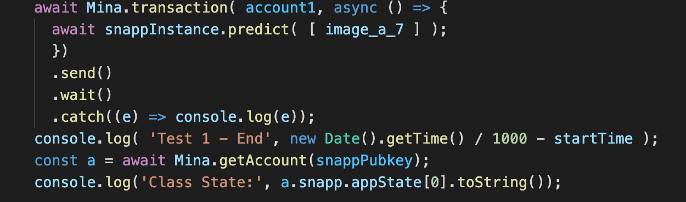
SnarkyNet for Prediction
Calling the SnarkyNet for Prediction on an Image

Slide 10
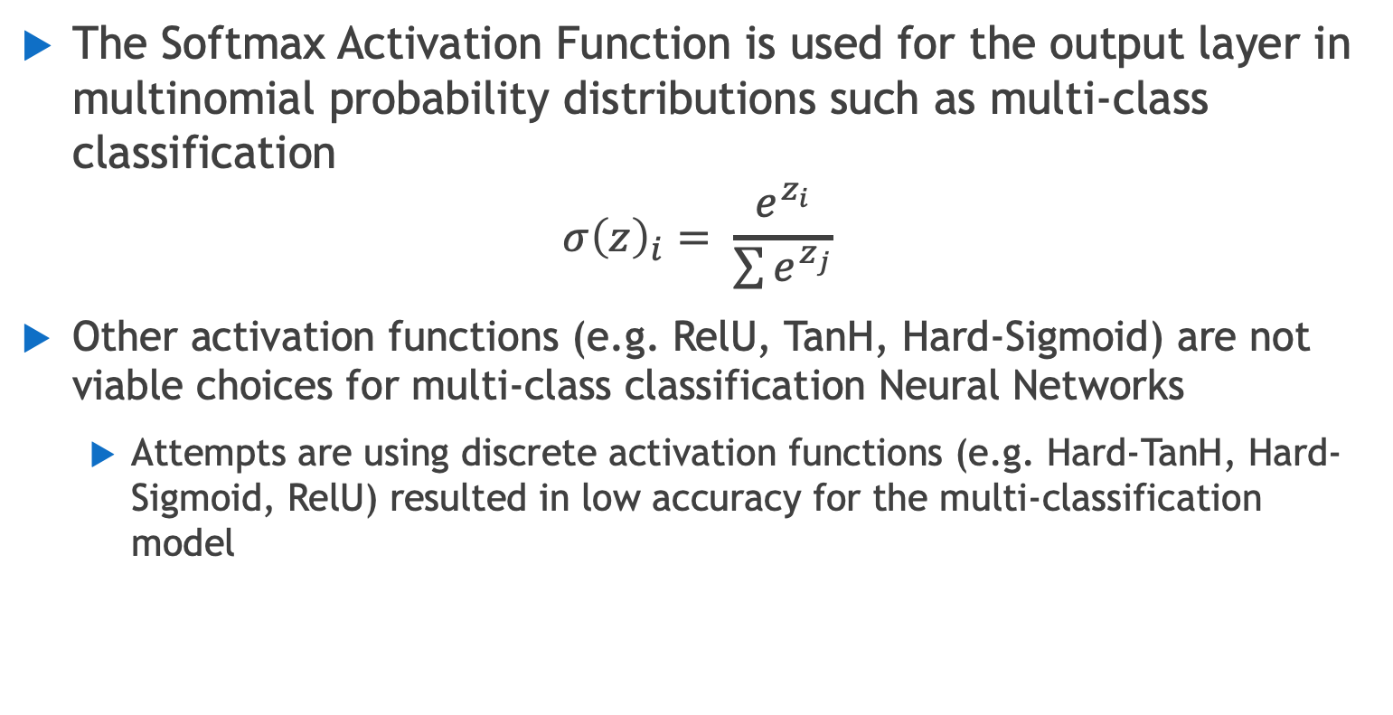
Design Decition – Softmax Activation Function
The Softmax Activation Function is used for the output layer in multinomial probability distributions such as multi-class classification
$$σ{\left(z\right)}_{i}= \frac{e^{z_{i}}}{\sum{e^{z_{j}}}}$$
Other activation functions (e.g. RelU, TanH, Hard-Sigmoid) are not viable choices for multi-class classification Neural Networks
Attempts are using discrete activation functions (e.g. Hard-TanH, Hard-Sigmoid, RelU) resulted in low accuracy for the multi-classification model

Slide 11
Results
A Neural Network in SnarkyJS is viable
A multi-class classification model is currently not viable due to difficulty implementing exponential function in the circuit
Initial results from the output of the model prior to the Softmax activation function matched the expected result from the Python / Tensorflow model Reference: https://discord.com/channels/484437221055922177/927630405555863573/941380883984842823

Slide 12
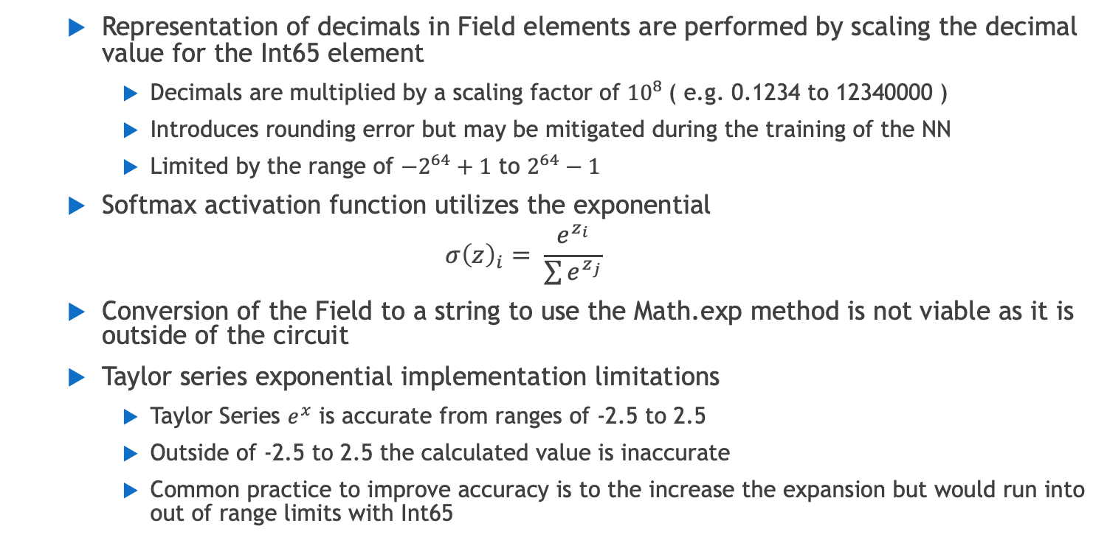
Challenges
Representation of decimals in Field elements are performed by scaling the decimal value for the Int65 element
Decimals are multiplied by a scaling factor of ${10}^{8}$( e.g. 0.1234 to 12340000 )
Introduces rounding error but may be mitigated during the training of the NN
Limited by the range of ${−2}^{64}+1$ to $2^{64}−1$
Softmax activation function utilizes the exponential
$$σ{\left(z\right)}_{i}= \frac{e^{z_{i}}}{\sum{e^{z_{j}}}}$$
Conversion of the Field to a string to use the Math.exp method is not viable as it is outside of the circuit
Taylor series exponential implementation limitations
Taylor Series $e^{x}$ is accurate from ranges of -2.5 to 2.5
Outside of -2.5 to 2.5 the calculated value is inaccurate
Common practice to improve accuracy is to the increase the expansion but would run into out of range limits with Int65

Slide 13
Lessons Learned
For a proof of concept Neural Network, implement a binary classification model rather than multi-classification model
Eliminates the need of the Softmax Activation Function
Implementing an IEEE Int64 Field element would have advantages over the scaled representation
Multiplication of two scaled elements could lead to a failure in the boundary checking of the Int65
Multiplication of two scaled elements required division by the scale factor and can compound rounding errors in large and complex operations

Slide 14
References
Github: https://github.com/Makalfo/SnarkyNet-MNIST-Digits
MNIST Handwritten Digits: http://yann.lecun.com/exdb/mnist/

Slide 15
Questions?

