Slide 1
Neural Network in SnarkyJS for Mina

Slide 2
Introduction and Goal
Proof of Concept for Implementing a Neural Network (NN) in SnarkyJS for zkApps
Benefit of zkApps allows for computational intensive calculations to be off-load onto the local computer and efficient usage of the protocol
Entirety of the Neural Network must be in the circuit
Implement MNIST Handwritten Digit Recognition Neural Network

Slide 3
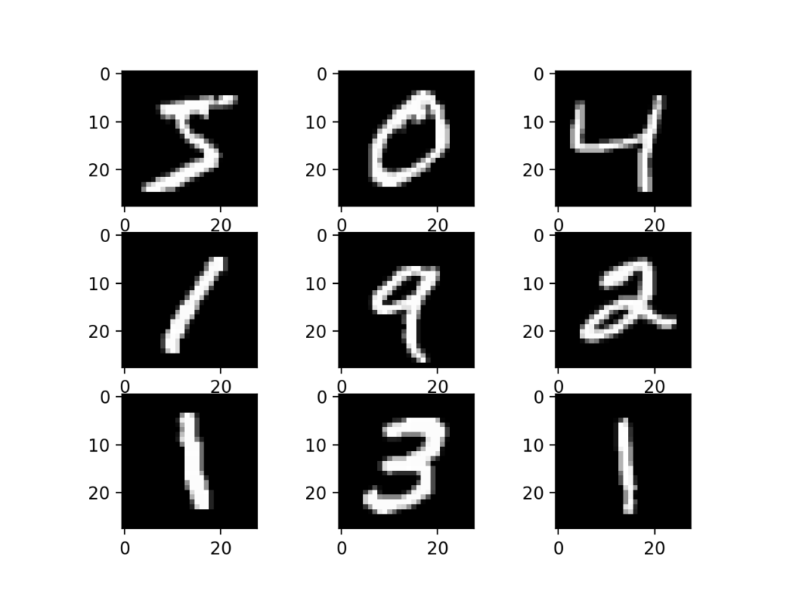
Introduction and Goal
MNIST Handwritten Digit Recognition Neural Network
Reference: MNIST Database of Handwritten Digits http://yann.lecun.com/exdb/mnist/

Slide 4
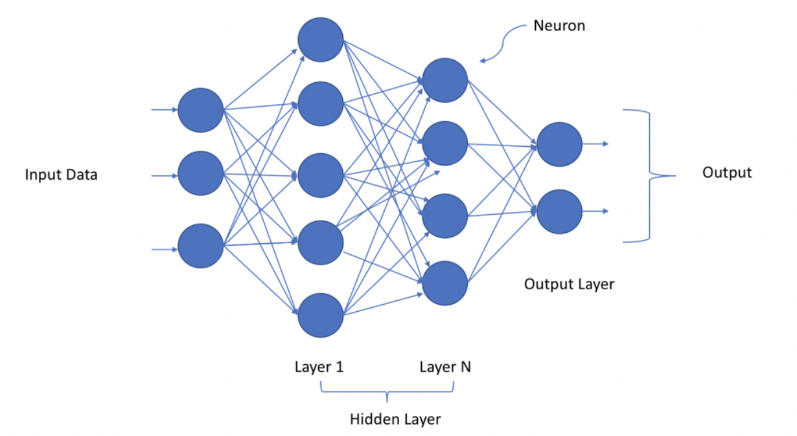
Approach
Develop and Train Neural Network in Python / Tensorflow
Subsequent weights for the layers will be imported into SnarkyJS

Slide 5
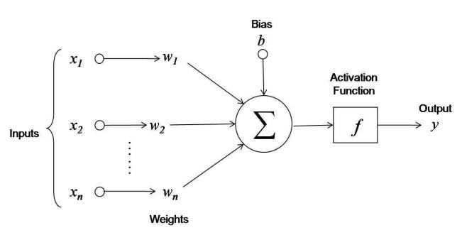
Approach - Neurons
At the fundamental level, a Neural Network is a series of dot products or linear functions with an activation function

Slide 6
Approach -

Slide 7
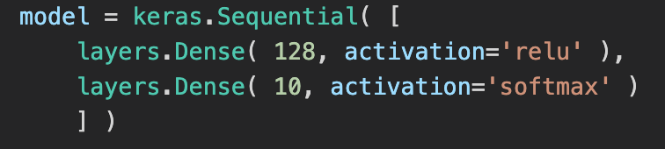
Approach – Python to SnarkyJS
Translating the Python / Tensorflow model to the SnarkyJs
Python:
SnarkyJS:
Note: weights_l1 and weights_l2 are the weights from the Python / Tensorflow model

Slide 8
Pros and Cons of the Blockchain
Advantages
Immutable
All transactions and history are publicly available
Large amounts of data
Transparent
Disadvantages
Successful attacks are very rare events and do not share common patterns
Data is unsupervised due to the lack of labeled data
Prone to seasonal, cyclic and trending fluctuations in the data
Pseudo-anonymous
Orphan blocks are not stored

Slide 9
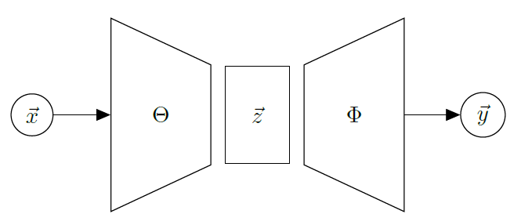
Technical Approach
Recurrent Autoencoder model to exploit the information collected by the activities within a blockchain
Highlight anomalies in the underlying network activity that can represent a potential symptom of a forthcoming or current attack on the system

Slide 10
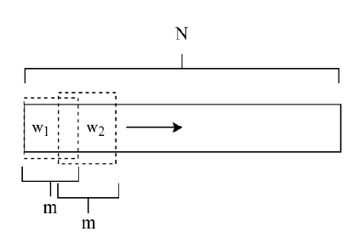
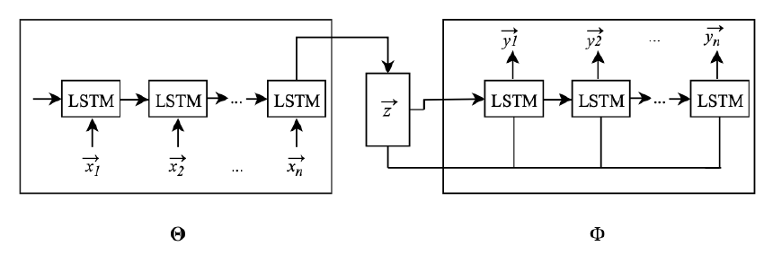
Technical Approach
Implemented the RNNs as Long short-term memory (LSTM) networks to save partial memory of each event
In the framework, the input and output of the autoencoder are temporally marked events in sliding window
Recurrent Autoencoder
Sliding Window Mechanism

Slide 11
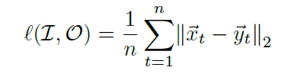
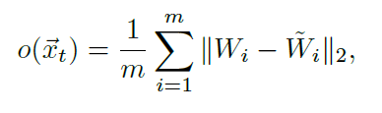
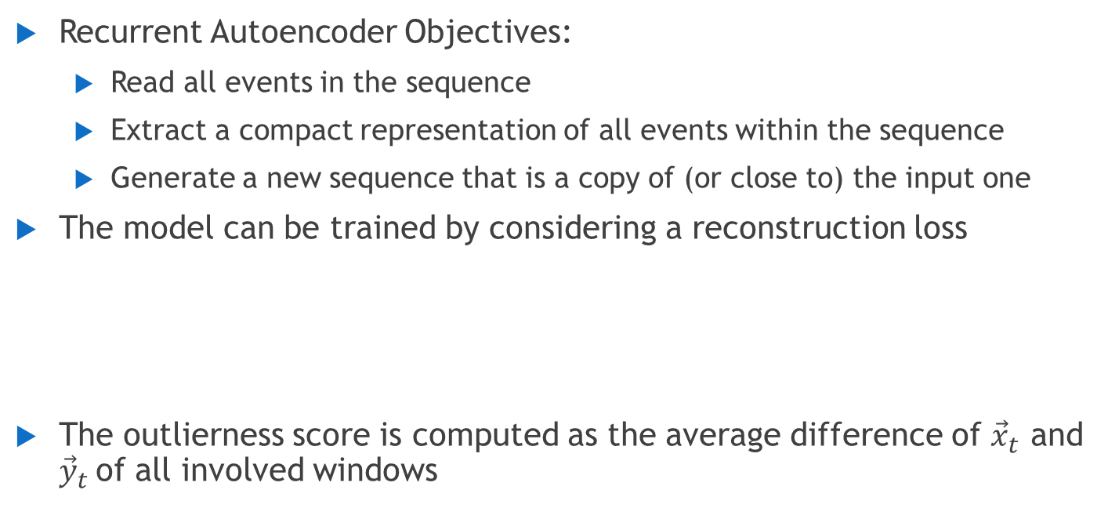
Technical Approach
Recurrent Autoencoder Objectives:
Read all events in the sequence
Extract a compact representation of all events within the sequence
Generate a new sequence that is a copy of (or close to) the input one
The model can be trained by considering a reconstruction loss
The outlierness score is computed as the average difference of ${\vec{x}}_{t}$ and ${\vec{y}}_{t}$of all involved windows

Slide 12
Feature Extraction and Normalization
Preprocess and normalize the data with feature selection of the more relevant attributes
Aggregate the data for the features on a daily basis:
Average size of a block (bytes)
Average provided gas (fee) to perform the transaction (wei)
Average difficult to validate a block
Average number of transactions contained in a block
Total amount of gas in all blocks
Total number of transactions in all blocks
Normalization allowed for the removal of seasonal, cyclic, and trending fluctuations in the data using a moving quantile ratio

Slide 13
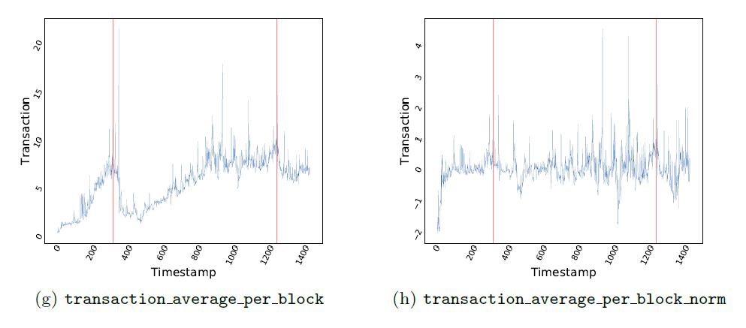
Visualization of Normalization
DAO Attack
51% Attack
DAO Attack
51% Attack

Slide 14
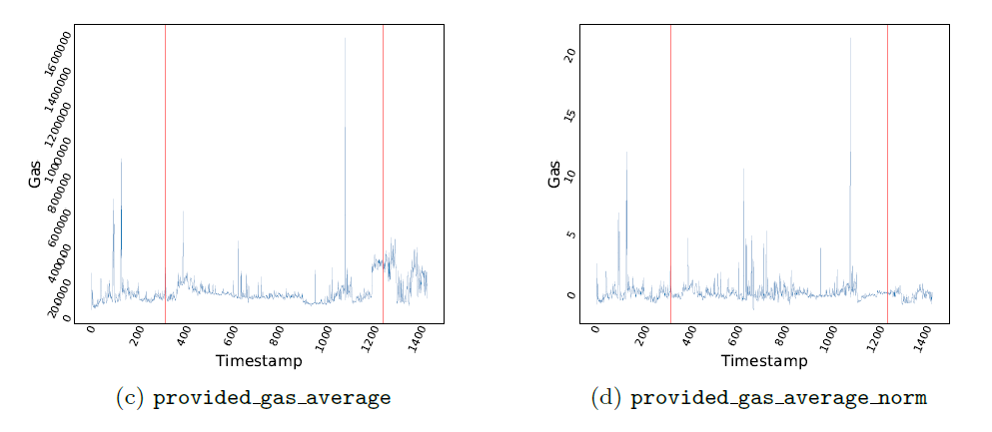
Visualization of Normalization
DAO Attack
51% Attack
DAO Attack
51% Attack

Slide 15
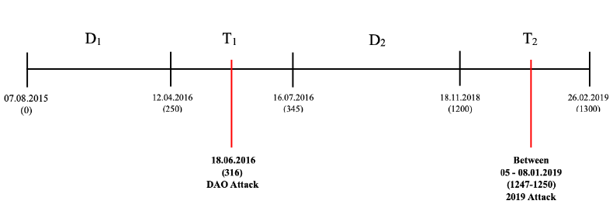
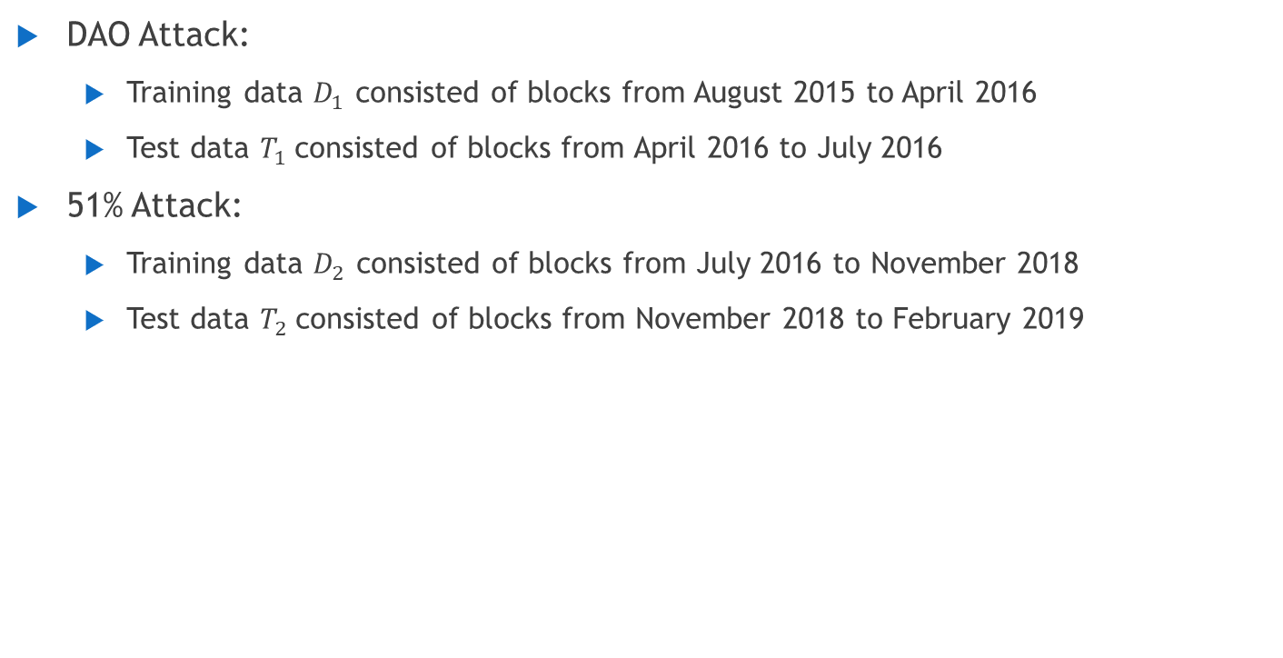
Training and Test Data
DAO Attack:
Training data $D_{1}$ consisted of blocks from August 2015 to April 2016
Test data $T_{1}$consisted of blocks from April 2016 to July 2016
51% Attack:
Training data $D_{2}$ consisted of blocks from July 2016 to November 2018
Test data $T_{2}$consisted of blocks from November 2018 to February 2019

Slide 16
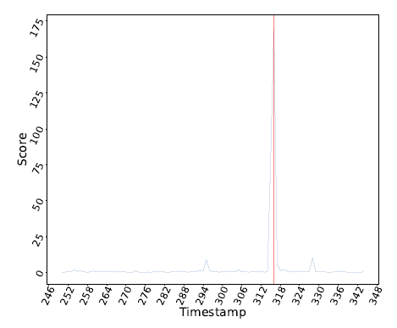
Experimental Results – DAO Attack
Small peak in the outlierness score on day 295
Large peak on day 316 of the DAO Attack
DAO Attack
Small Peak

Slide 17
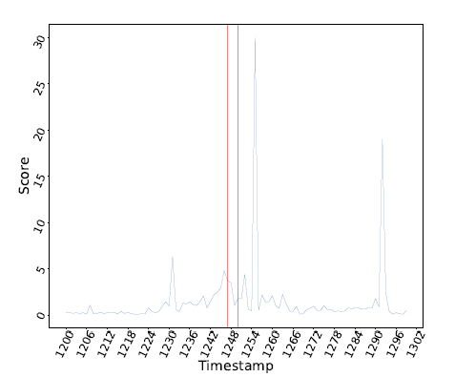
Experimental Results – 51% Attack
Strong anomaly on day 1255, a few days after the actual attack
A number of companies working on ETC detected the attack and decided to freeze their activities
Day 1255 appear to be when all the frozen activities were recorded on the network
Strong anomaly
51% Attack

Slide 18
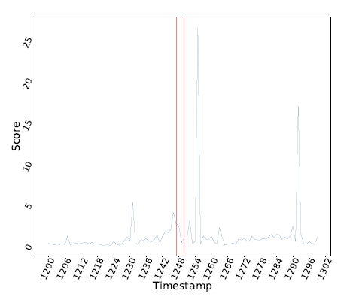

Experimental Results – 51% Attack
Results of the 51% Attack consistent when trained with a union of $D_{1}$ and $D_{2}$ when compared to $D_{2} alone$
Strong anomaly
51% Attack

Slide 19
Conclusion
DAO Attack:
Recurrent Autoencoder was able to successfully detect the DAO attack by recreating the input and calculating an outlierness score for the detection of the anomaly
51% Attack:
Recurrent Autoencoder was not able to show an anomaly associated with the 51% Attack until several days after the initial attack
Orphan Blocks are not stored in the protocol but could have provided valuable information
Main limitation of the work is that successful blockchain attacks are rare and therefore require an unsupervised solution

Slide 20
References
A Deep Learning Approach for Detecting Security Attacks on Blockchain Francesco Scicchitano, Angelica Liguori, Massimo Guarascio, Ettore Ritacco, Giuseppe Manco, CEUR, Italian Conference on Cyber Security, February, 2020.
Github: https://github.com/Makalfo/LSTM_Ethereum_Classic

Slide 21
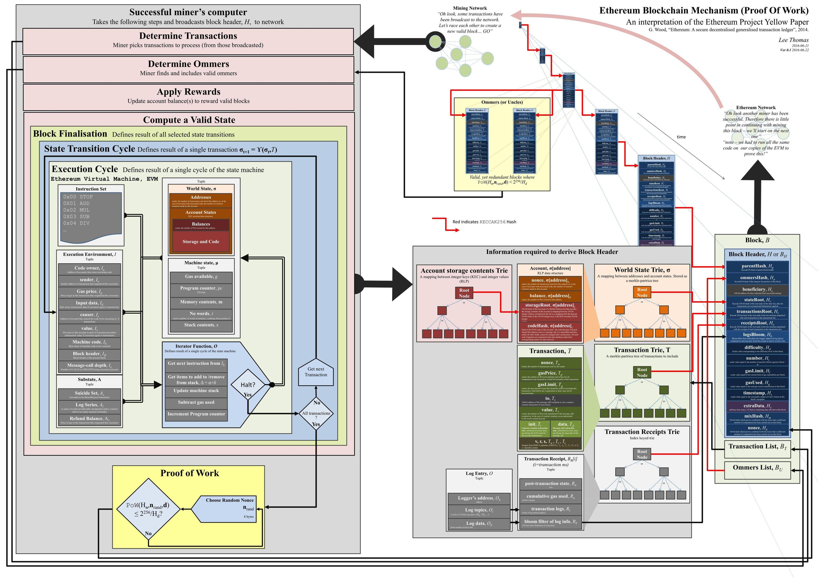
Ethereum

