Slide 1

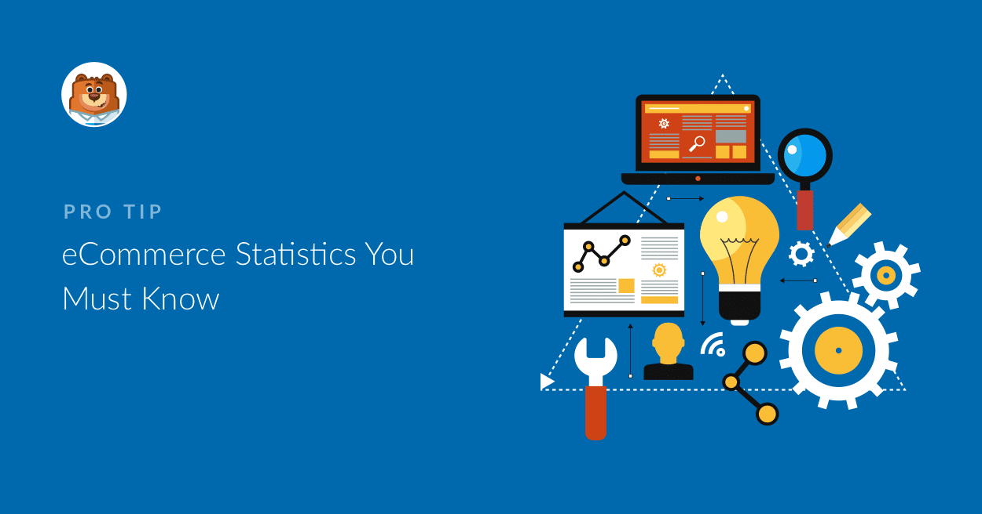
Analysing Region Wise E-Commerce Data Using IBM Cognos Dashboard

Slide 2
INTRODUCTION
With the increase in consumer demand , the E-commerce space has boomed.
Leads to an increase in fierce competition in today's online marketplace.
The ecommerce industry sells a diverse product line of grocery items and merchandise products, such as food, pharmaceuticals, apparel, games and toys, hobby items, furniture and appliances.
The analysis of such industry is of great importance as it gives insights for the sales and profits of various products.

Slide 3
OBJECTIVES
By the end of this project we will be able
Know fundamental concepts and can work on IBM Cognos Analytics.
Gain a broad understanding of plotting different graphs.
Able to create meaningful dashboards

Slide 4
PROJECT FLOW
Understand the Dataset
Build a Data Module in Cognos Analytics.
Create multiple analysis graphs/charts.
Using the analyzed chart creation of a Dashboard is done.
Saving and Visualizing the final dashboard in the IBM Cognos Analytics.

Slide 5
UNDERSTAND THE DATABASE
The data was sourced from the Kaggle, the data of file is US Superstore data.csv
The brief overview of what each feature represents or should represent
Row ID - Unique ID for each entry.
Order ID - Unique ID for each order.
Order Date - Date on which the order was placed.
Ship Date - Date on which the order was shipped.
Ship Mode - Mode of shipping the order.
Customer ID - Unique ID for each Customer.
Customer Name - Name of the Customer.
Segment - Segment to which the Customer belongs.
Country - Country to which the Customer belongs.
City - City to which the Customer belongs.
State - State to which the Customer belongs.
Postal Code - Postal Code of the Customer.
Region – Region to which the Customer belongs.
Product ID - Unique ID for each Product.
Category – Category to which the product belongs.
Sub-Category - Sub-Category to which the product belongs.
Product Name – Name of the product.
Sales – Sales fetched.
Quantity – Quantity of the product sold.
Discount – Discount Given.
Profit – Profit fetched.

Slide 6
BUILD A DATA MODULE IN COGNOS ANALYTICS
In Cognos Analytics, a Data Module serves as a data repository. It can be used to import external data from files on-premise, data sources, and cloud data sources. Multiple data sources can be shaped, blended, cleansed, and joined together to create a custom, reusable and shareable data module for use in dashboards and reports.
Upload files into Cognos Analytics (US Superstore data.csv )
From the Cognos Analytics main dashboard, select the menu icon in the upper-left corner. Select Upload files

Slide 7
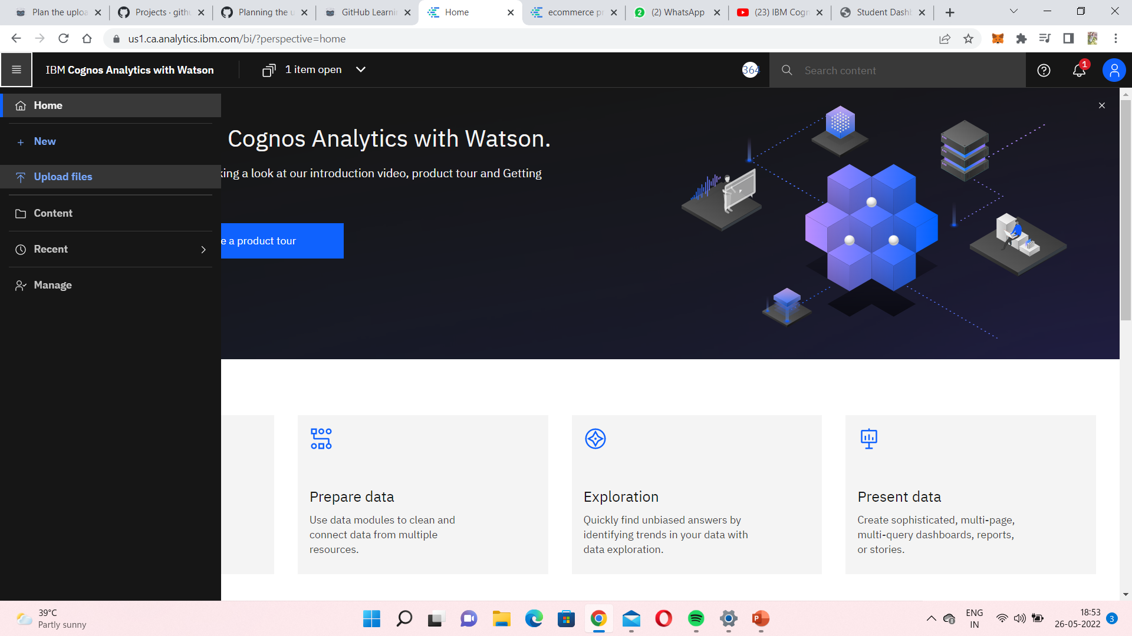

Slide 8
VISUALIZATION OF DATASET
In cognos we can create different numbers of visualization and in the data exploration part we will be going to plot multiple data visualization graphs for getting the insights from our data and once the explorations are done we will build our dashboard.
Once you’ve loaded all the CSV files on the data module for creating different explorations.

Slide 9
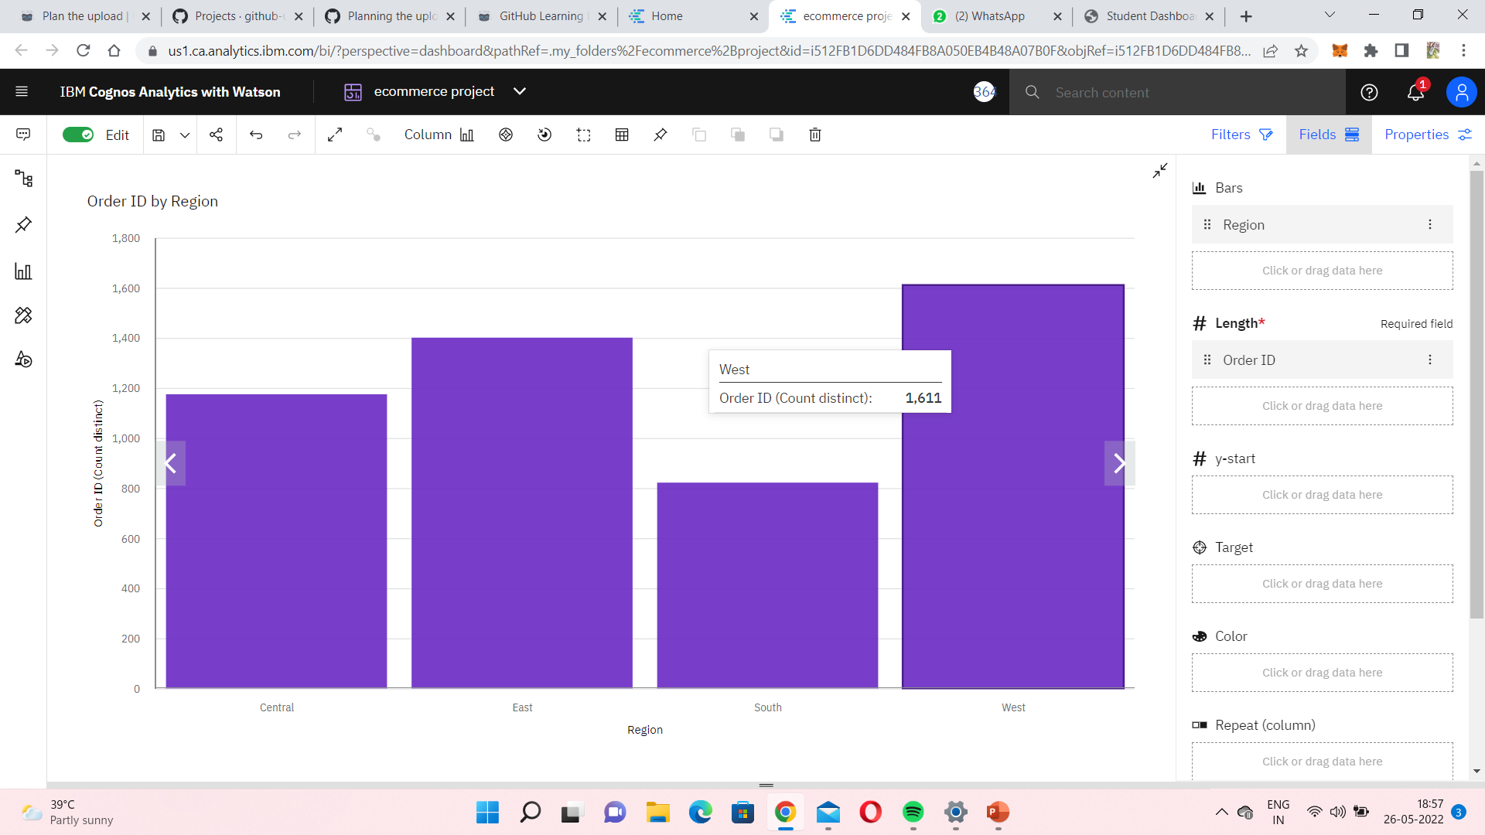
Region That Accounts For Greater Number Of Orders

Slide 10
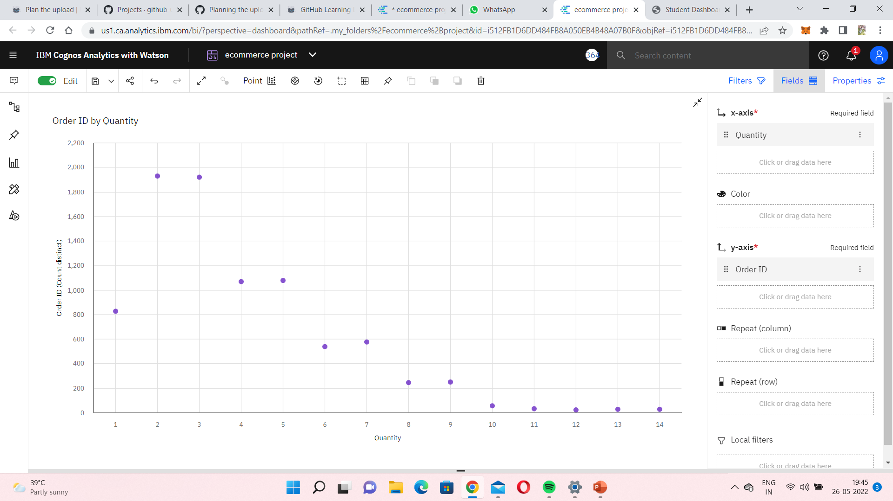
Frequency Distribution Of Quantity Ordered

Slide 11
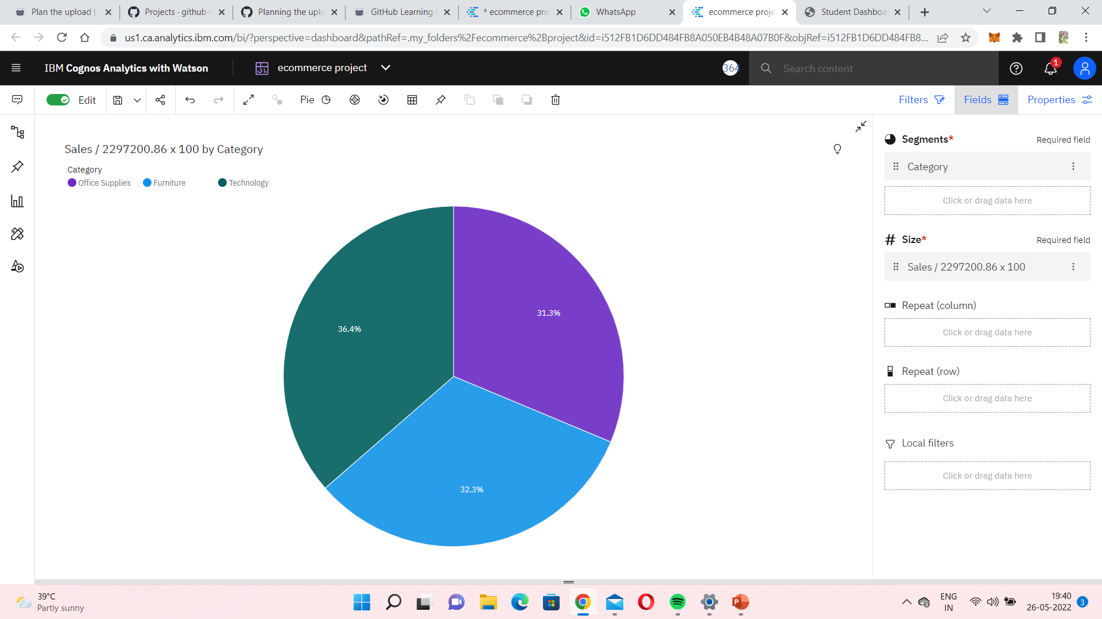
Percentage Sales By Different Product Categories

Slide 12
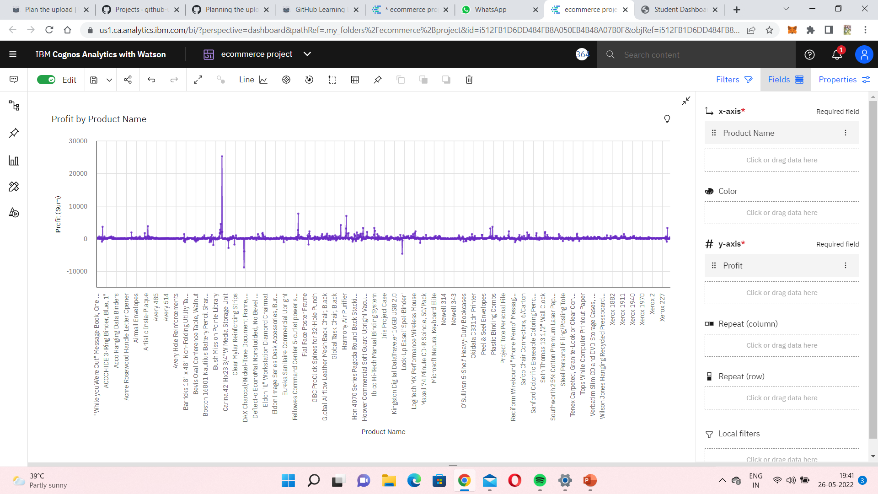
Profitable Products Or Their Sub Products In Last Few Years

Slide 13
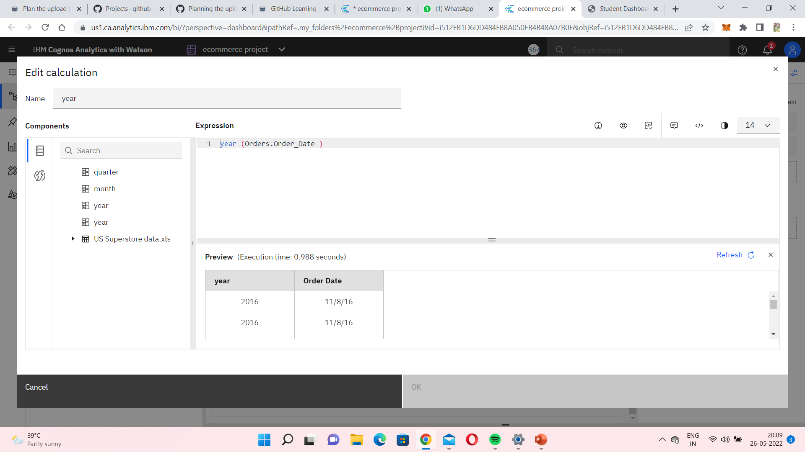
Year Calculation

Slide 14
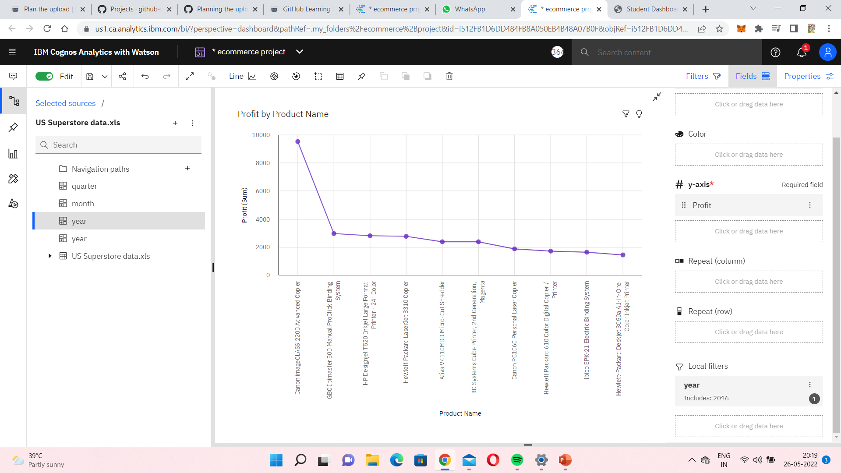
According to the year 2016

Slide 15
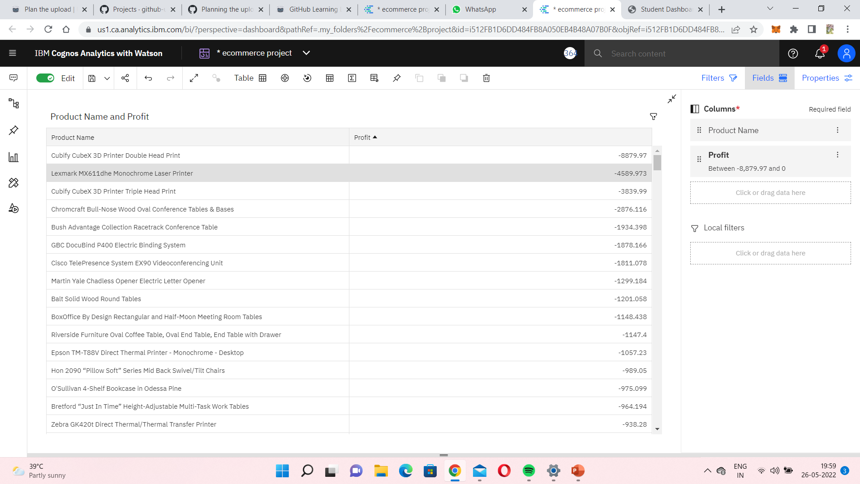
Products That Incurred Losses

Slide 16
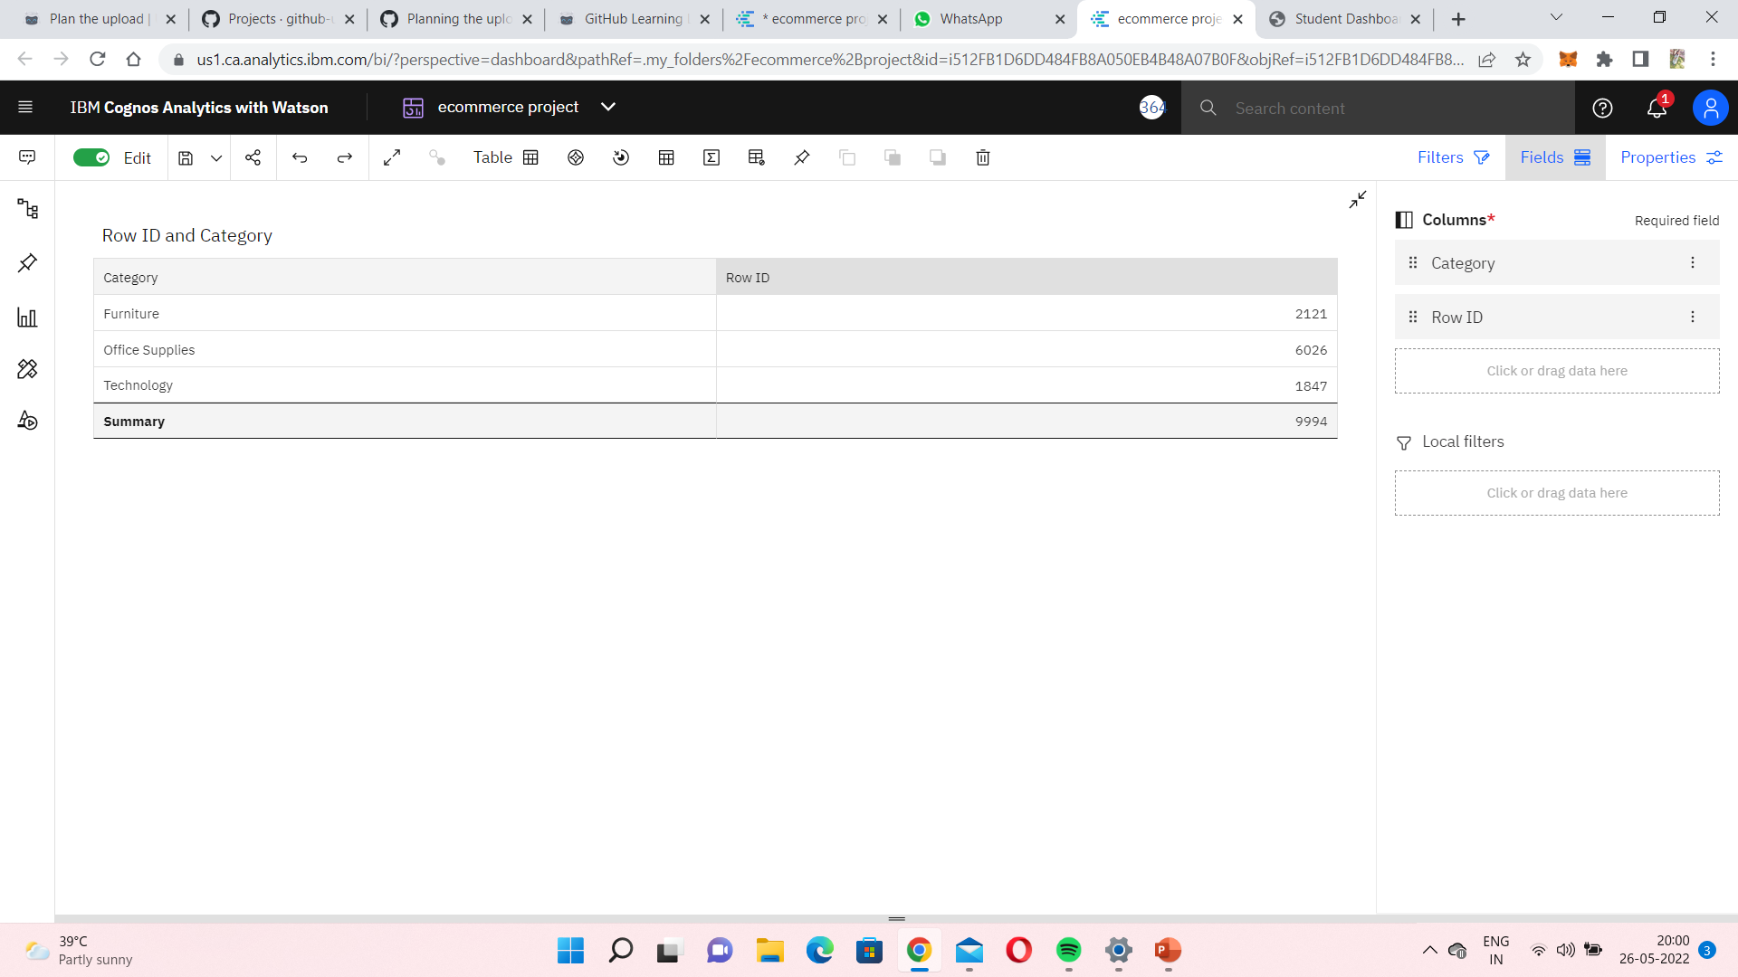
Product That Was Ordered Greater Times

Slide 17
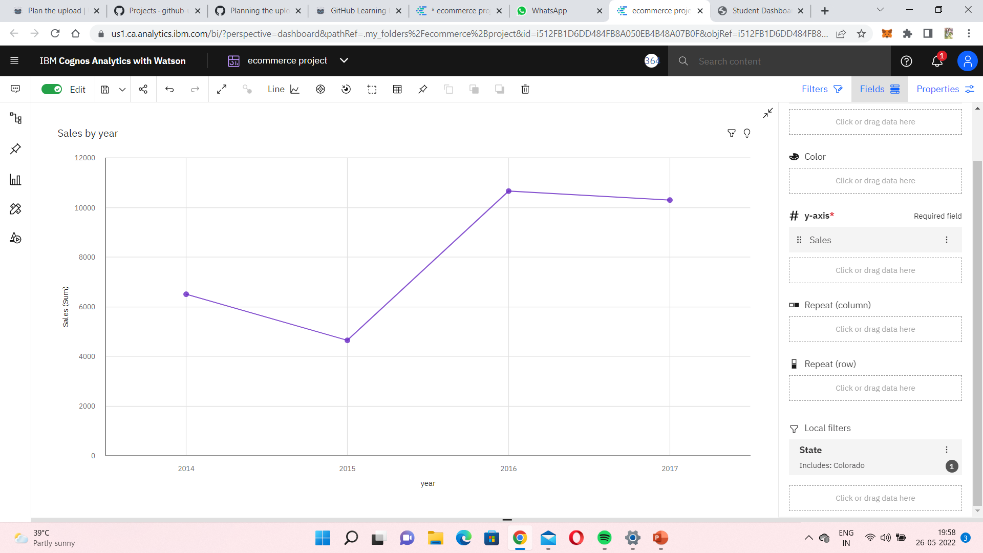
Yearly Sales For Various States

Slide 18

Trend In Profit/Sales Over Time (Years/Months/Quarters)

Slide 19


Slide 20
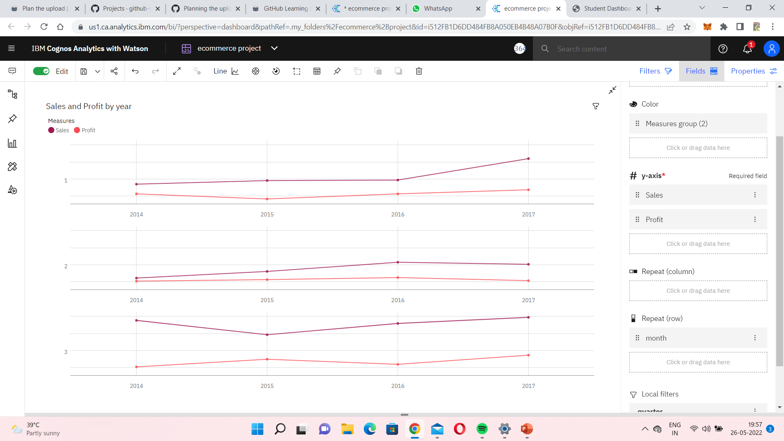
Sales and profit for first 3 months

Slide 21
BUILD COGNOS ANALYTICS DASHBOARD
In Cognos Analytics, a Dashboard provides a way to communicate insights and analysis of their data.
A dashboard view contains visualizations such as graphs, charts, plots, tables, maps, or any other visual representation of data.
CREATE A DASHBOARD
From the Cognos Analytics home page goto menu bar, select the + new option and Select Dashboard. Then use the default template and click OK.
Click Select a source to bring up the selection dialog, and click OK

Slide 22
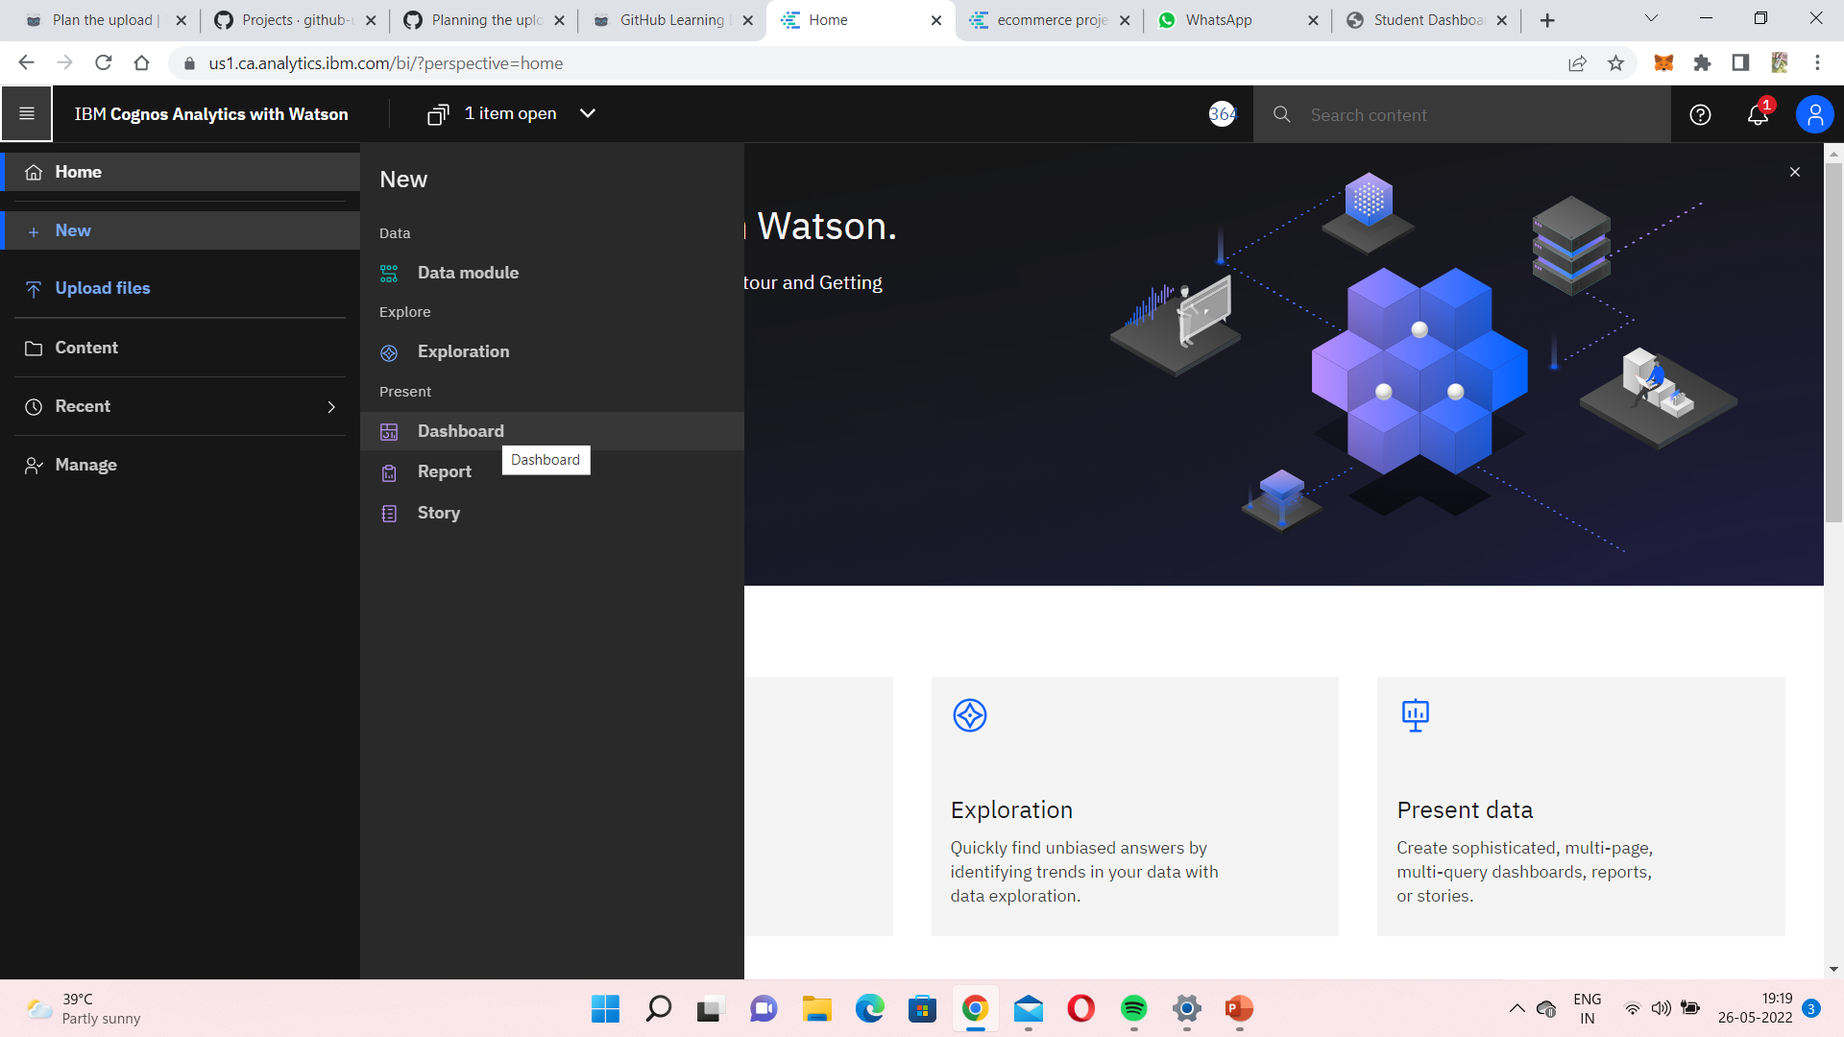

Slide 23
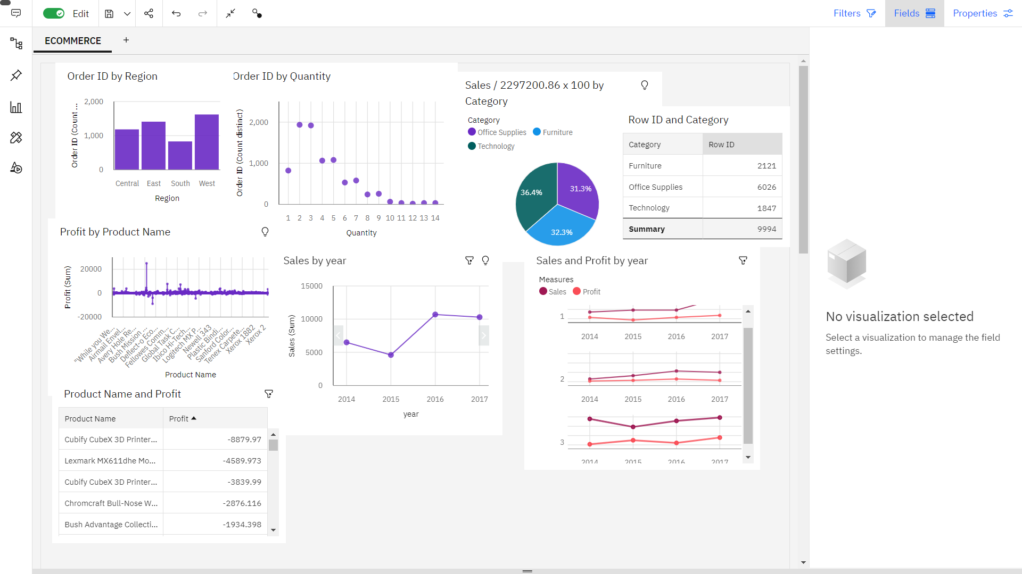

Slide 24
THANK YOU

