Slide 1
RFPerfusion · re:AGENT Hackathon · Track C
We asked AI to design
an impossible protein.
It tried anyway.
A scientist-controlled agent that turns impossible biological questions into evidence, models, and candidate designs.
01
Notes:
Keep the hook exactly as written. Then broaden the reveal: RFPerfusion is not one verifier. It is a scientist-facing co-pilot that can formulate the question, mine the literature, and run biological models.
[Sources]
- /Users/andrii/.codex/attachments/01cdc36c-dc20-482e-ac30-c04843db1a66/pasted-text.txt
- /Users/andrii/RFPerfusion/README.md

Slide 2
THE AGENT
One scientist. Three coordinated scientific agents.
01
02
03
04
ASK
FORMULATE
MINE
MODEL
→
→
→
A biological design goal
Rank testable directions
Extract evidence + artifacts
Run biological AI tools
Inspect, redirect, or stop at every transition.
Formulation frames it. Literature grounds it. Proto-tools computes it.
02
Notes:
This is the entire product in one slide. The scientist supplies a goal. The formulation agent proposes and ranks directions. The literature agent turns papers into evidence and usable artifacts. Proto-tools selects and runs computational biology models. The scientist controls every handoff.
[Sources]
- /Users/andrii/.codex/attachments/01cdc36c-dc20-482e-ac30-c04843db1a66/pasted-text.txt
- /Users/andrii/RFPerfusion/.claude/skills/formulate-grounded-directions/SKILL.md
- /Users/andrii/RFPerfusion/.claude/skills/mine-literature-from-concept/SKILL.md
- /Users/andrii/RFPerfusion/.claude/skills/proto-tools/SKILL.md

Slide 3
FORMULATION AGENT
The formulation agent turns goals into testable routes.
SCIENTIST STARTS WITH
Design an RF-responsive biological system
OPEN-ENDED
RANKED
→
A vague biological goal
Ranked, falsifiable research routes
Mechanism and evaluator still unknown
Drop, follow up, or refine
Inject priors. Redirect at any time.
03
Notes:
The formulation agent does not force a preferred mechanism. It expands the hypothesis space, decomposes directions into checkable claims, grounds them against full text, and ranks them. The scientist can drop a route, request a focused follow-up, supply priors, or ask for another iteration.
[Sources]
- /Users/andrii/RFPerfusion/formulation_agent/README.md
- /Users/andrii/RFPerfusion/.claude/skills/formulate-grounded-directions/SKILL.md
- /Users/andrii/RFPerfusion/formulation_agent/src/formulation_agent/agent.py
- /Users/andrii/RFPerfusion/formulation_agent/src/formulation_agent/followup.py

Slide 4
LITERATURE AGENT
The literature agent turns papers into usable artifacts.
01
02
03
04
DISCOVER
ZOOM
EXTRACT
LOOP
→
→
→
Broad document search
Full-text sentence search
Sequences + parameters
Re-query gaps and bias
Output: traceable mechanisms, sequences, and quantitative constraints.
REVIEWED PLAN · MANIFEST · KNOWLEDGE BASE
04
Notes:
The literature agent first discovers documents, then searches exact full-text phrases, then extracts model-ready artifacts: sequences, accessions, mutations, and quantitative measurements. If the corpus is thin, biased, or missing sequences, the scientist can inspect the manifest and send the agent through another query loop. Discovery leads are not silently promoted to verified evidence.
[Sources]
- /Users/andrii/RFPerfusion/.claude/skills/mine-literature-from-concept/SKILL.md
- /Users/andrii/RFPerfusion/litterature_search_from_concept/paperclip_kb.py
- /Users/andrii/.codex/attachments/01cdc36c-dc20-482e-ac30-c04843db1a66/pasted-text.txt

Slide 5
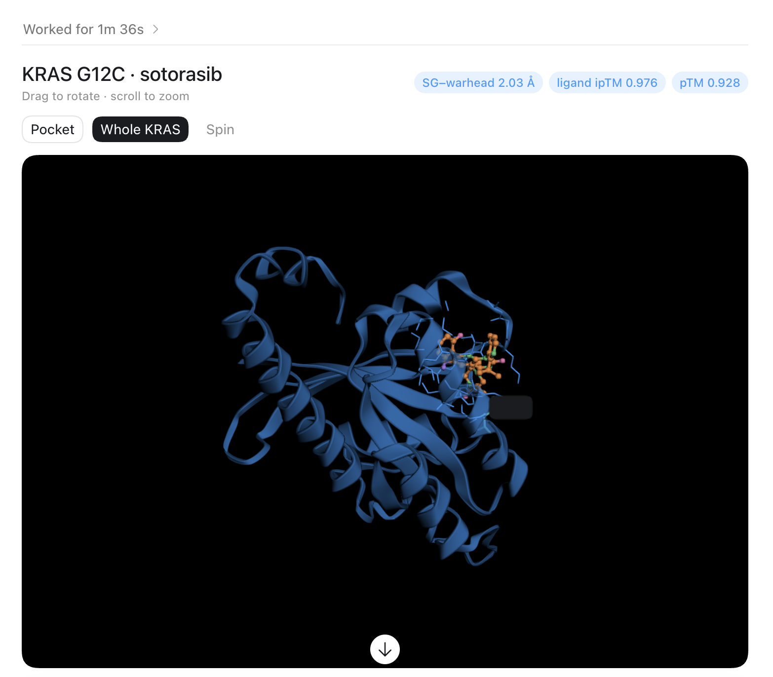
PROTO-TOOLS AGENT
Proto-tools can co-fold a protein with its ligand.
CO-FOLDING DEMO
1
Select the right structure model
2
Run KRAS G12C + sotorasib
3
Return structure + confidence
ligand ipTM 0.976 · pTM 0.928
05
Notes:
This is a real result supplied by the team: the agent co-folded KRAS G12C with the ligand sotorasib. Proto-tools gives the LLM a unified interface to discover and launch computational biology models, return structured results, and preserve method attribution. This screenshot shows ligand ipTM 0.976 and pTM 0.928; those are model confidence outputs, not experimental validation.
[Sources]
- /var/folders/yx/xfm2flr17rq_5l34_ckcgrjm0000gp/T/codex-clipboard-4c002890-1964-4ef9-bd59-bca386f85430.png
- /Users/andrii/RFPerfusion/.claude/skills/proto-tools/SKILL.md
- /Users/andrii/.codex/attachments/01cdc36c-dc20-482e-ac30-c04843db1a66/pasted-text.txt

Slide 6
SCIENTIST CONTROL
The scientist stays in control at every handoff.
01
02
03
shape the objective
inspect the evidence
approve computation
Add priors + constraints
Open papers + artifacts
Choose models + review outputs
AUDIT TRAIL
Question · queries · papers · artifacts · model jobs · results
Every handoff remains inspectable, reproducible, and reversible.
06
Notes:
The scientist is never reduced to a prompt. They shape the objective, inspect evidence and extracted artifacts, approve or redirect computational work, and review every returned structure or score. The full path—from question to query to paper to model job to result—remains visible and reproducible.
[Sources]
- /Users/andrii/.codex/attachments/01cdc36c-dc20-482e-ac30-c04843db1a66/pasted-text.txt
- /Users/andrii/RFPerfusion/.claude/skills/formulate-grounded-directions/SKILL.md
- /Users/andrii/RFPerfusion/.claude/skills/mine-literature-from-concept/SKILL.md
- /Users/andrii/RFPerfusion/.claude/skills/proto-tools/SKILL.md

Slide 7
RFPerfusion
Make the impossible.
Scientifically actionable.
Search, reason, and compute—with the scientist in control.
Ask. Inspect. Redirect. Design.
re:AGENT Hackathon · Track C
07
Notes:
Close on the combined capability. RFPerfusion helps a scientist move from an underspecified biological goal to evidence-backed routes, reusable literature artifacts, and computational model outputs—without surrendering scientific judgment.
[Sources]
- /Users/andrii/.codex/attachments/01cdc36c-dc20-482e-ac30-c04843db1a66/pasted-text.txt
- /Users/andrii/RFPerfusion/README.md

